Slide 1
A Portable Overhead Document Camera
Presented by David Walker
To The Ottawa TMG Users Group
9 September 2017

Slide 2
Introduction
This presentation will detail my use of a new tool for the travelling genealogist.
There are several manufacturers of overhead document cameras
I will focus on Model H1000 from Riiai

Slide 3
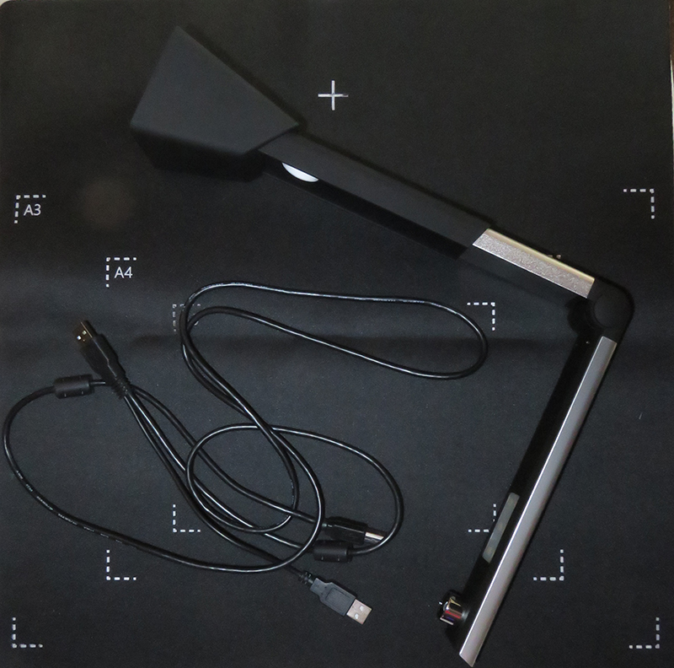
Introduction
Camera, USB cable & mat, folded for travel.
Camera, USB cable & mat

Slide 4
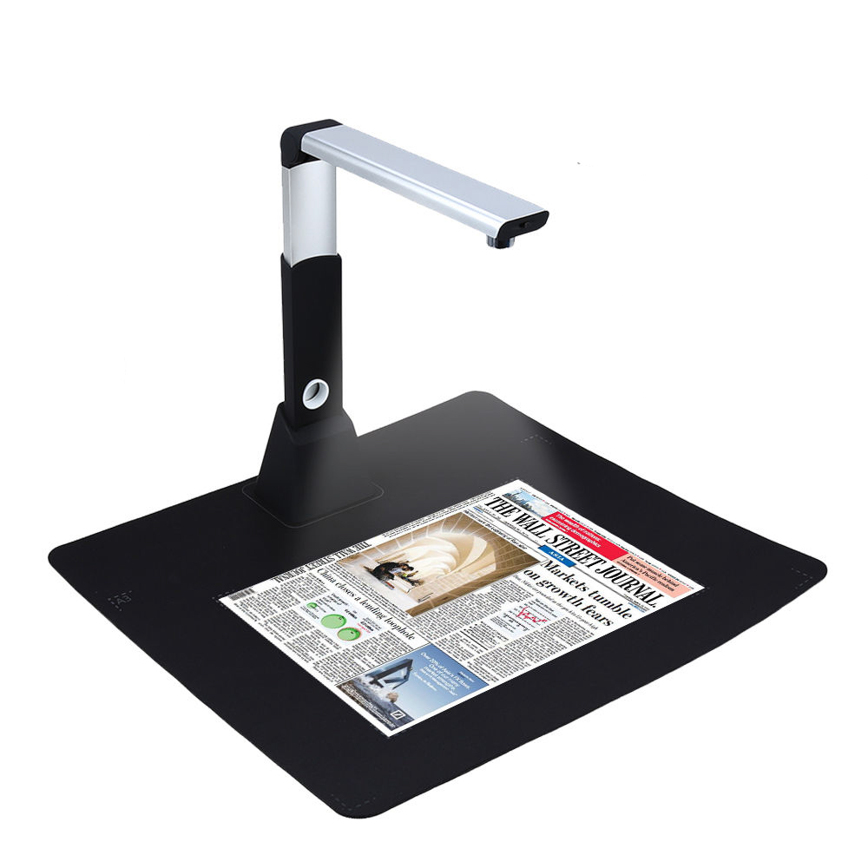
Introduction
Assembled for use.

Slide 5
Specifications
10 MP camera
Resolution: 3672x2856
Scans documents and 3-dimensional objects
Scan size: A3, A4, A5, A6, A7 (Mat has markings for A3, A4, A5 sizes)
Picture format: JPEG, GIF, BMP, TIF, PDF
Colour Type: B&W, Colour, Grey-scale
Capture speed: <1 second
Colour depth: 24 Bit
Light: Natural or LED supplement lighting
Interface: USB 2.0
Image control: Intensity, Saturation, Exposure, Sharpness, Colour, Gain
Image Editing: Crop, Rotate, Contrast
Other functions: OCR, Video recording & output to projector

Slide 6
Document Sizes
In addition to the range of A3 - A7 document sizes, one can capture much larger images
With the camera standing on a standard 30” table, and arm extended, the maximum source size is 36”x50”, ideal for maps and charts. Distance from camera lens to floor is 42.5”
The closest focussing distance is 7”, with a field of view 5½”x7¾”

Slide 7
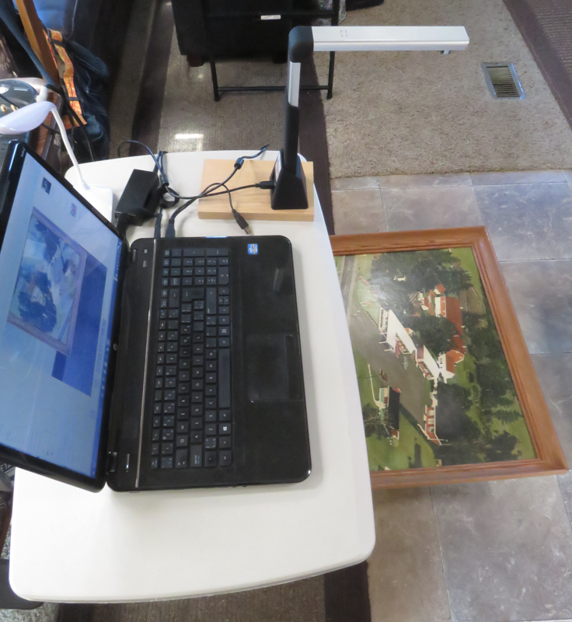
Examples
A typical setup for large format objects. This aerial photograph is 16”x23”.

Slide 8
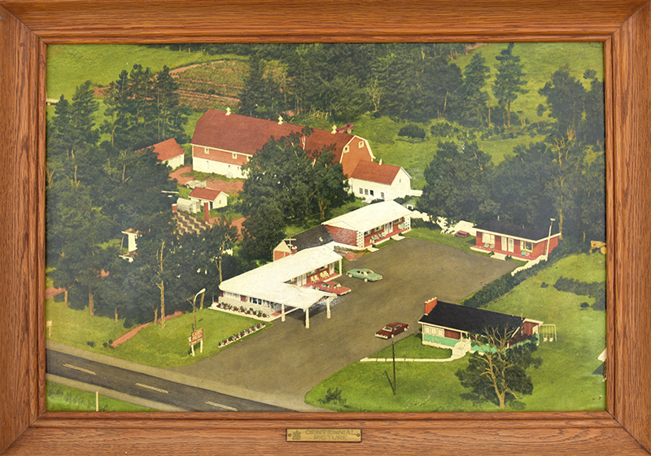
Examples
Aerial photograph, 16”x23”

Slide 9
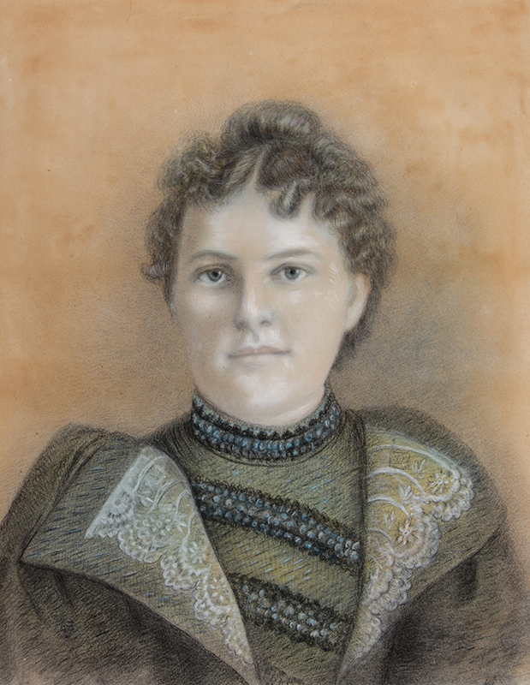
Examples
Pastel portrait, 1896, 18”x24”

Slide 10
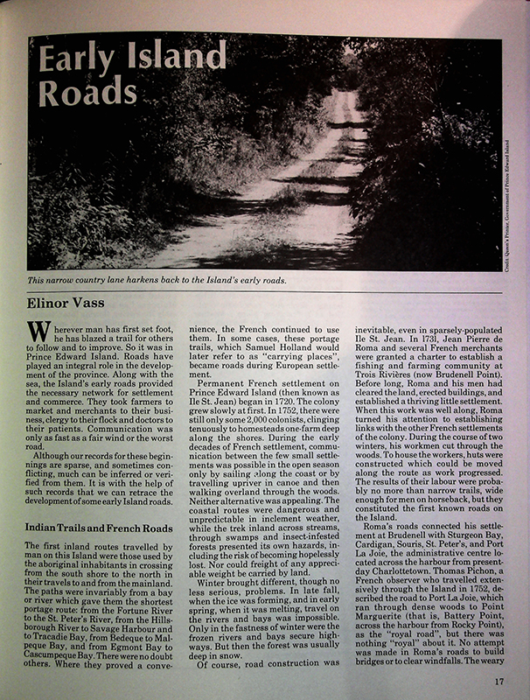
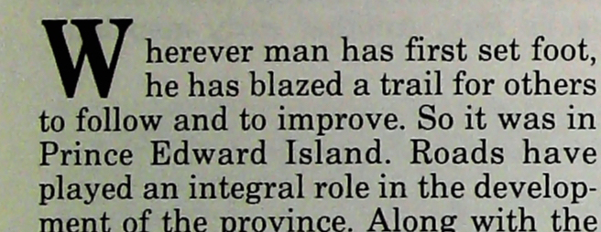
Examples
Zoomed view to show high quality of image.
Page from The Island Magazine.

Slide 11
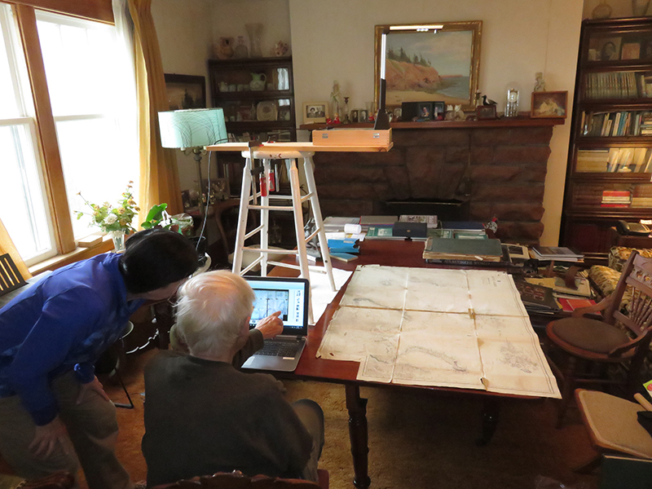
Examples
Camera perched high above the chart
Nautical chart, published 1872, 35”x49”

Slide 12
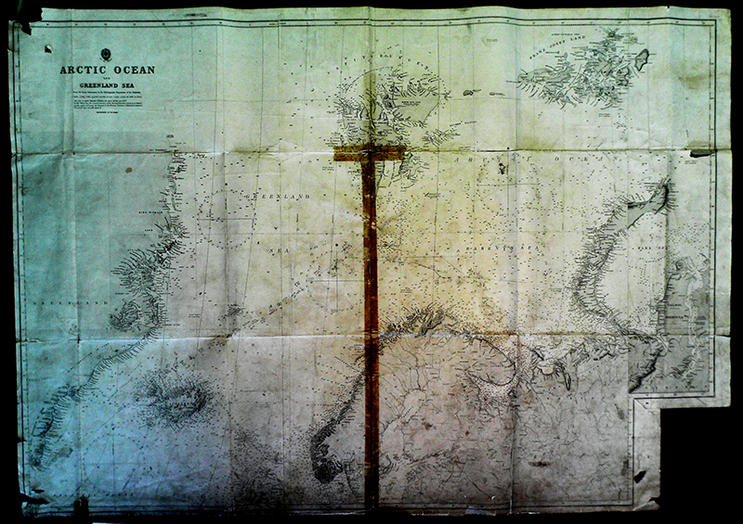
Examples
Nautical chart, featuring a journey of six weeks from Nova Scotia to Russia, 1916.

Slide 13
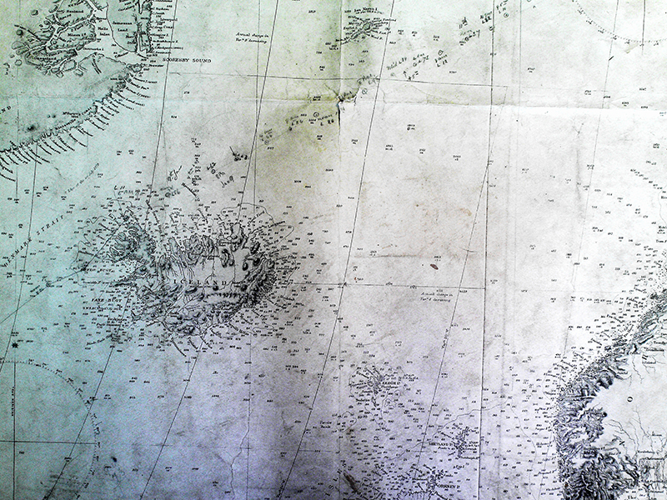
Examples
Handwritten points along the journey
Iceland
Detail of nautical chart, showing handwritten points along the way.

Slide 14
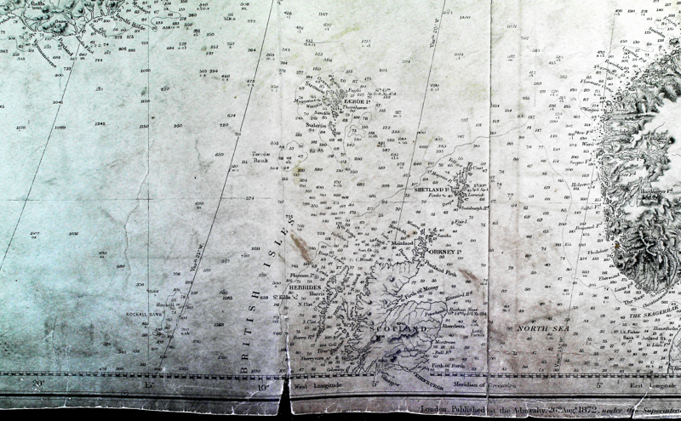
Examples
Nautical chart, featuring northern Scotland & publication date, 26 August 1872.

Slide 15
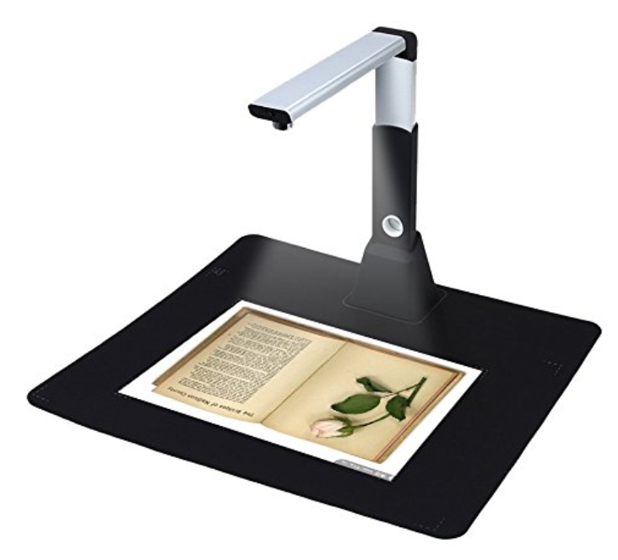
The Riiai H1000 can be purchased from:
amazon.ca for $160.00 (free shipping)
eBay.ca for $103.00 (free shipping)

Slide 16
The End
You can download this presentation from
www.ottawa-tmg-ug.ca

