Slide 1
Adobe Lightroom
An Image Editor & Database Manager for Genealogy
David A. Walker
Ottawa TMG Users Group
4 March 2017

Slide 2
Introduction
Traditionally, Adobe Lightroom and Photoshop were used as standalone software products.
They are becoming more commonly used as a combined product of the Adobe Creative Cloud, considerably less expensive as a monthly subscription.
Such a subscription entitles the user to a free third program entitled Bridge, which is a folder based image viewer, aka “digital asset manager”.

Slide 3
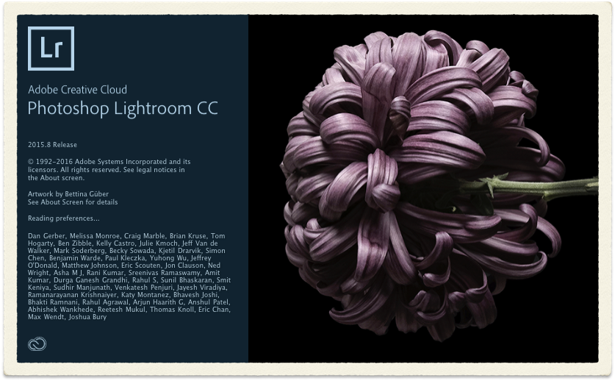
Introduction
Lightroom CC

Slide 4
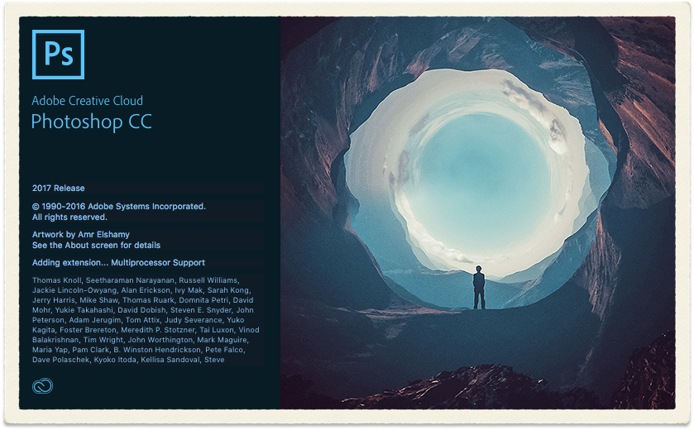
Introduction
Photoshop CC

Slide 5
Introduction
To properly describe all features of Lightroom CC would take a week of seminars.
To view comprehensive seminars on Adobe Lightroom I suggest visiting the Creative Live web site (creativelive.com) and search for Lightroom. Seminars by Ben Willmore or Jared Platt are recommended.
This presentation will be restricted to describing my workflow when using Lightroom CC as a photo editor for TMG exhibits.

Slide 6
Introduction
TIP: Before you start using Lightroom decide on the location for your photo library.
I use an external 5TB hard drive, which can be used between desktop and notebook computers.
This hard drive is also backed up daily.

Slide 7
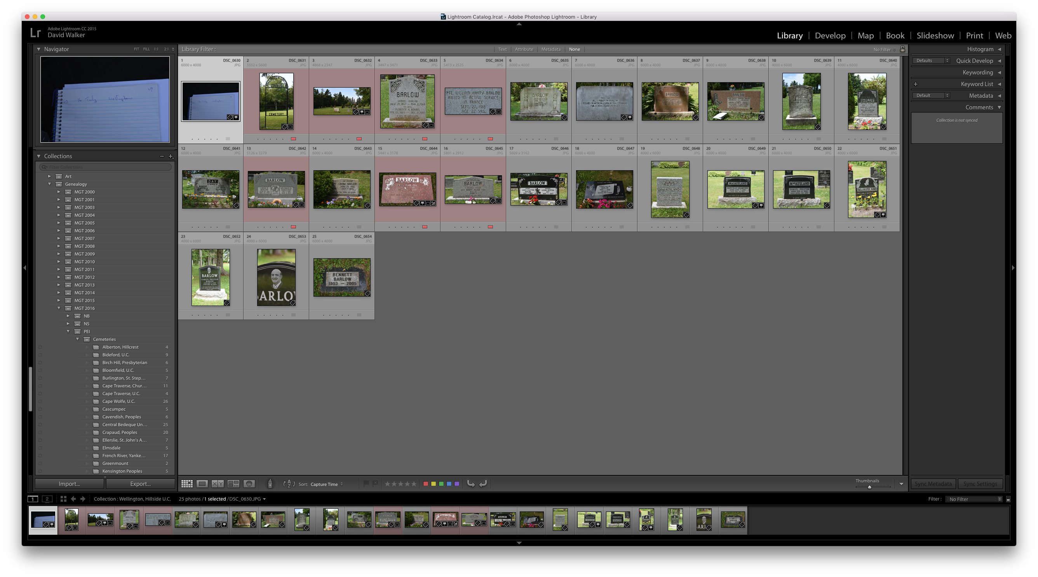
Navigating the LR Display
Library Module
Right panel contains the Histogram panel, and any combination of the Quick Develop, Keywording, Keyword List, Metadata and Comments panels.
Left panel consists of the Navigator panel and any combination of the Catalog, Folder, Collections & Publish Service panels.

Slide 8
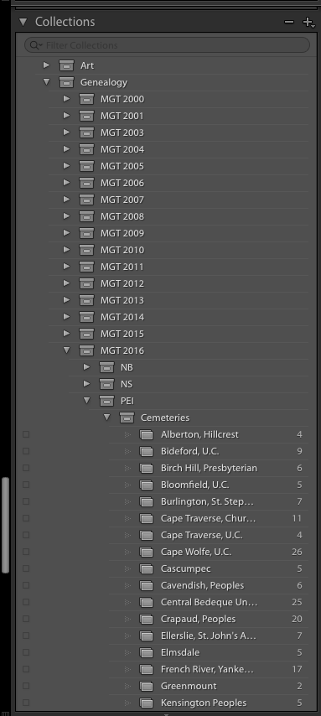
Library Module

Slide 9
Navigating the LR Display
Library Module
Grid View

Slide 10
Navigating the LR Display
Library Module
My photographic workflow in a cemetery:
First page of notes showing date & location

Slide 11
Navigating the LR Display
Library Module
My photographic workflow in a cemetery:
Photo of cemetery sign

Slide 12
Navigating the LR Display
Library Module
My photographic workflow:
Overview of cemetery

Slide 13
Navigating the LR Display
Library Module
My photographic workflow:
Front of marker

Slide 14
Navigating the LR Display
Library Module
My photographic workflow:
Front, left, right & back detail, as needed

Slide 15
Navigating the LR Display
Library Module
My photographic workflow:
Move on to next marker

Slide 16
Navigating the LR Display
Library Module
My photographic workflow:
Edit the colour tag to indicate images have been exported to TMG

Slide 17
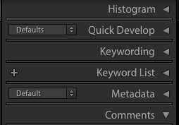
Navigating the LR Display
Library Module
Right Panel

Slide 18
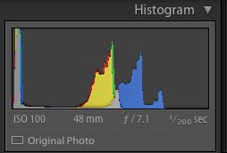
Navigating the LR Display
Library Module

Slide 19
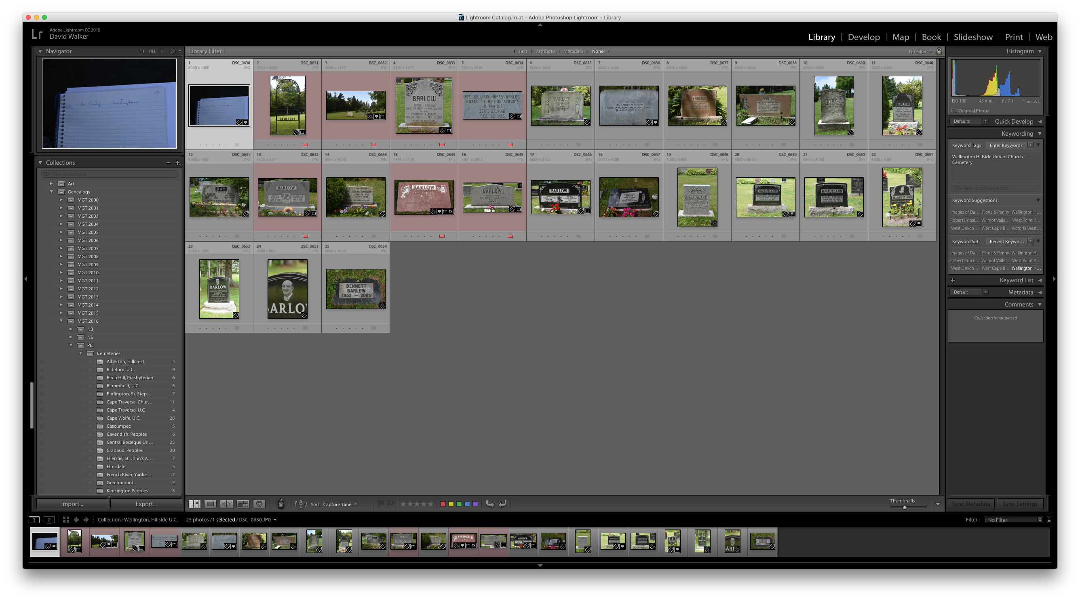
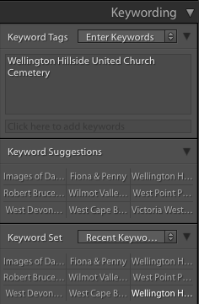
Navigating the LR Display
Library Module

Slide 20
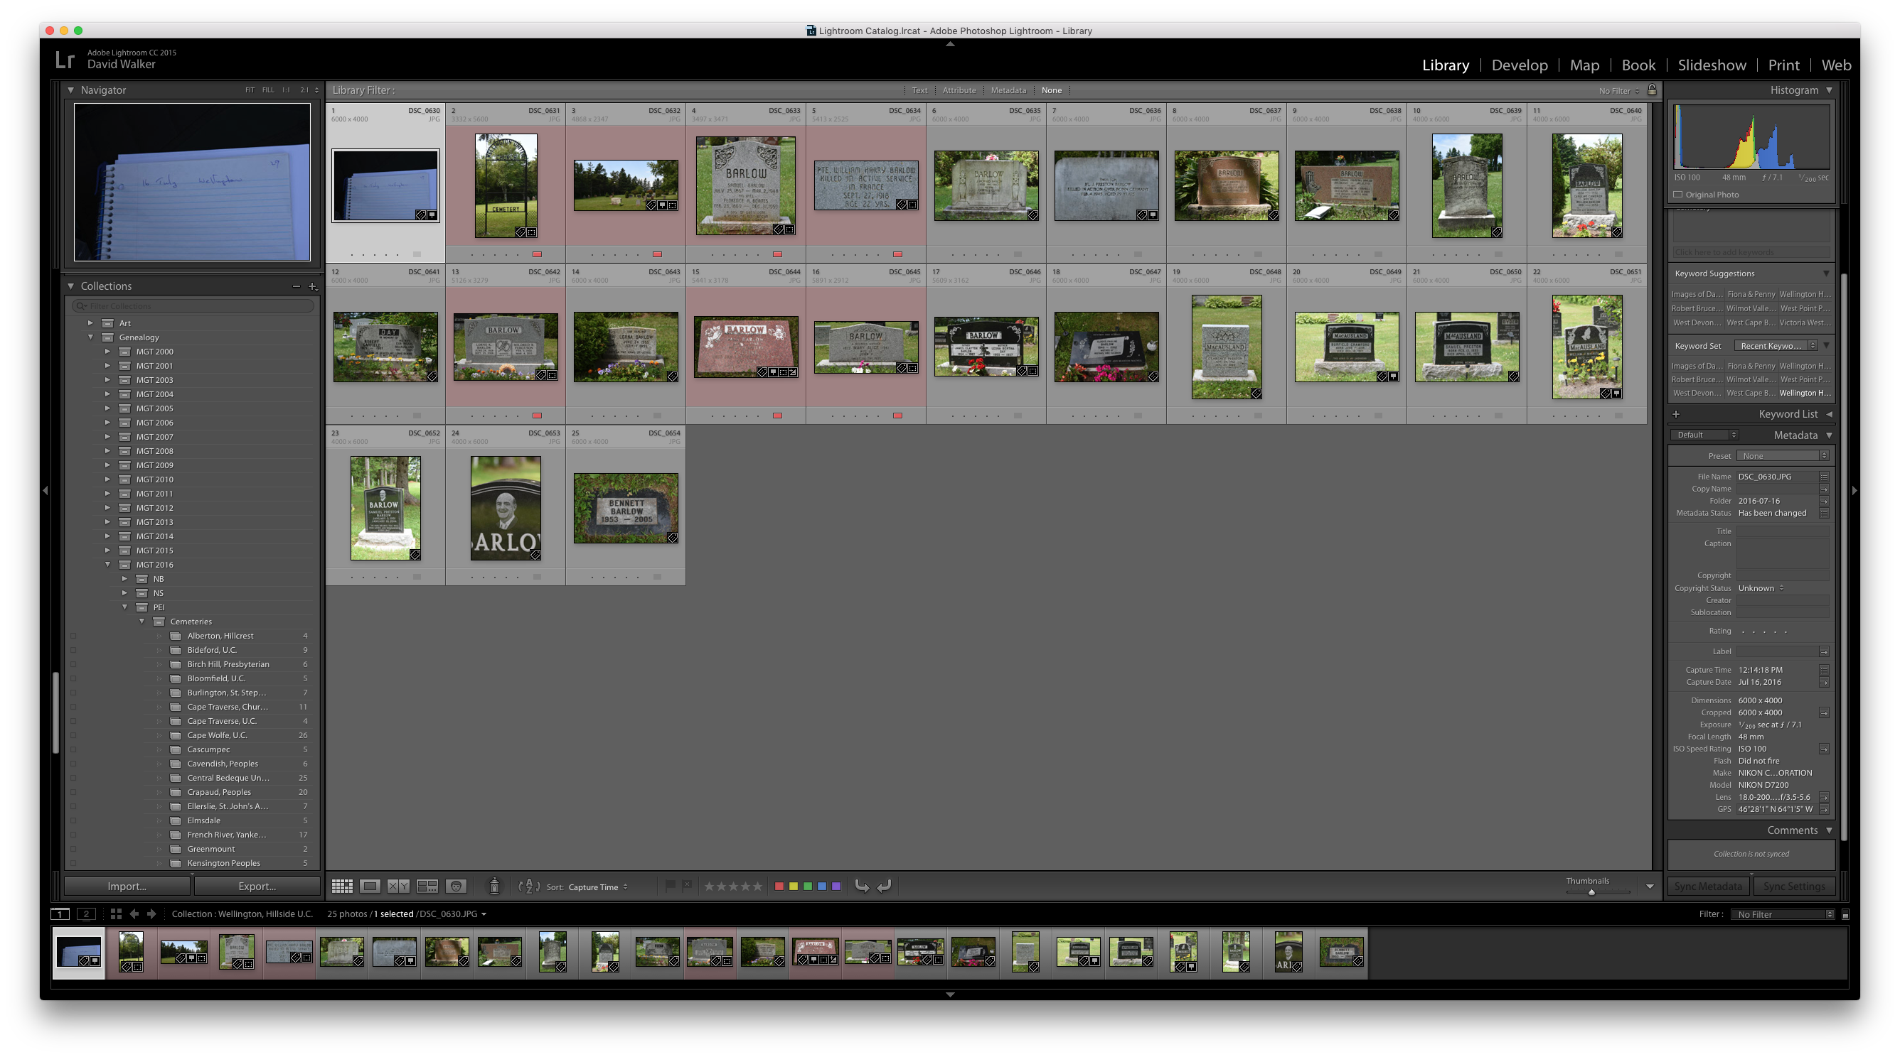
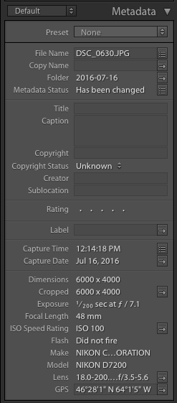
Navigating the LR Display
Library Module

Slide 21
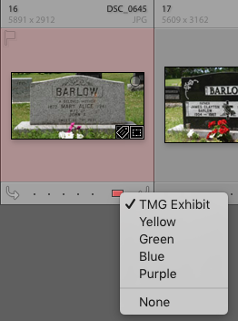
Navigating the LR Display
Library Module
Colour code each image to indicate they have been entered as a TMG exhibit

Slide 22
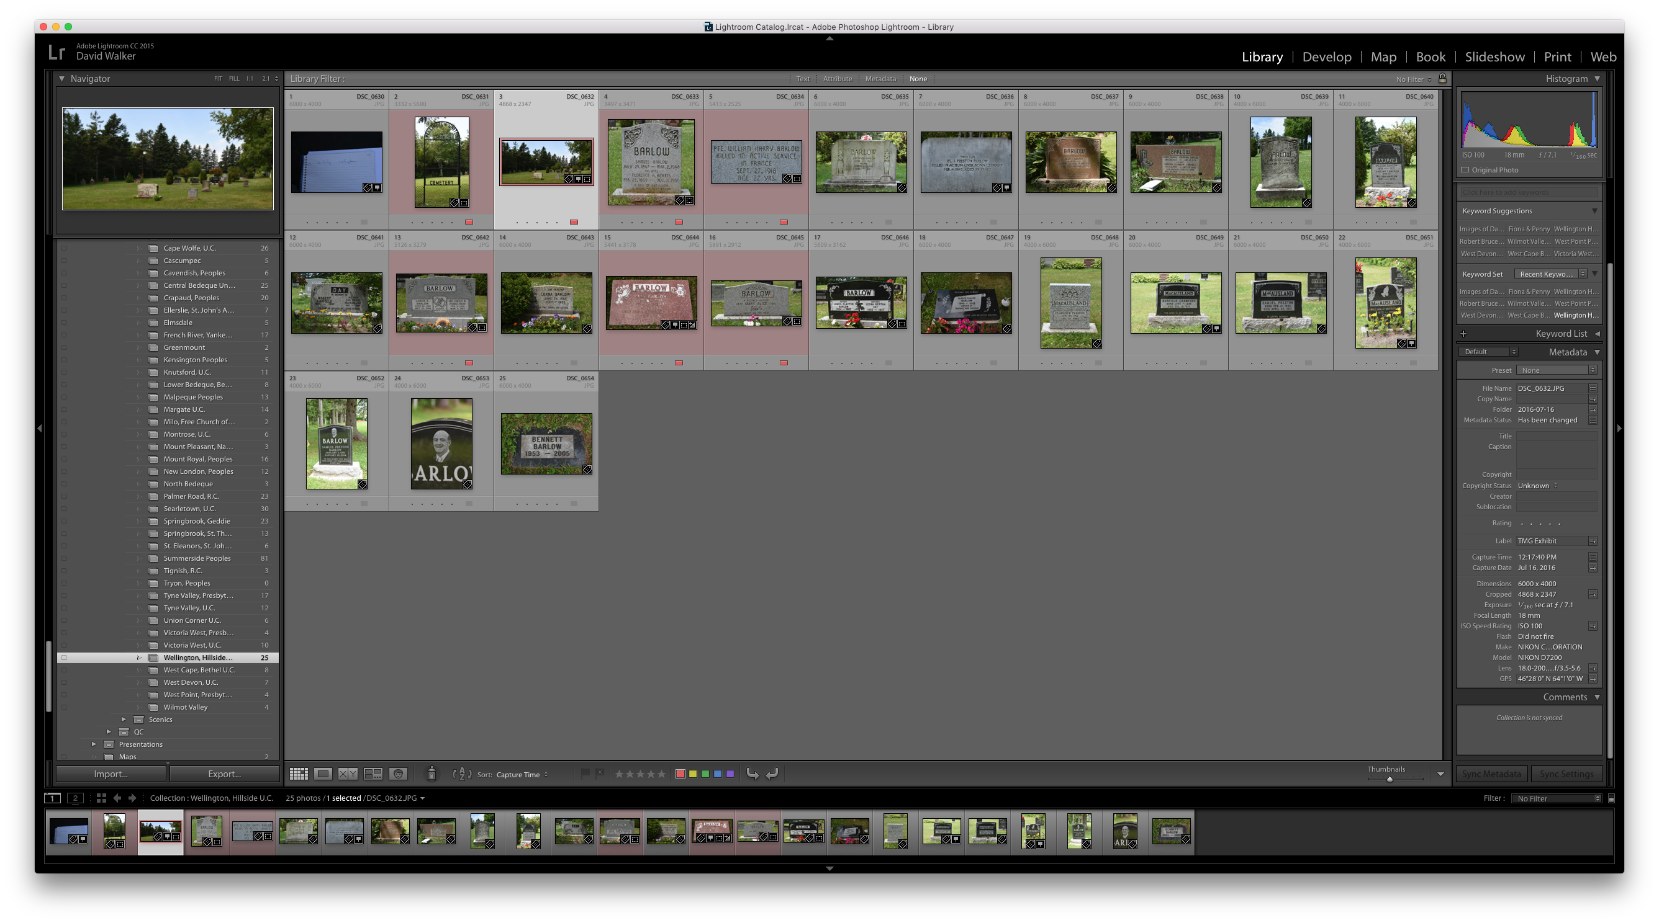
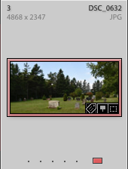
Navigating the LR Display
Library Module
Map Module

Slide 23
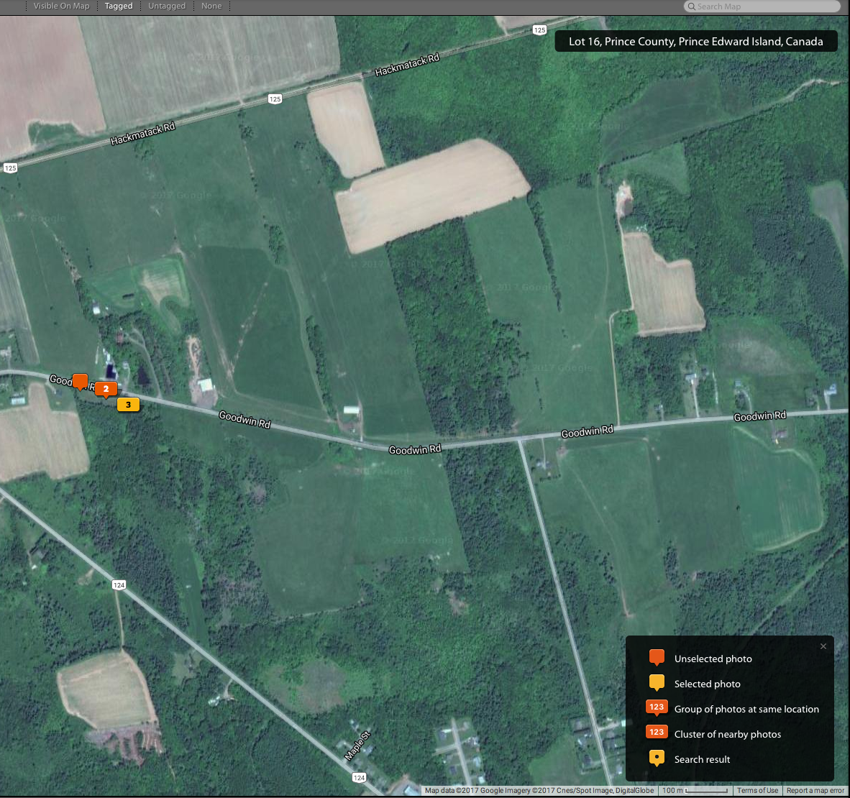
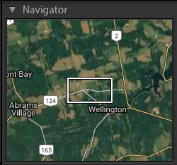
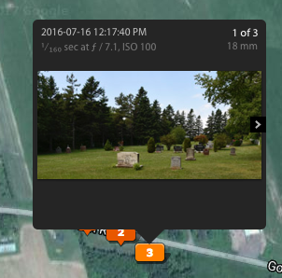

Slide 24
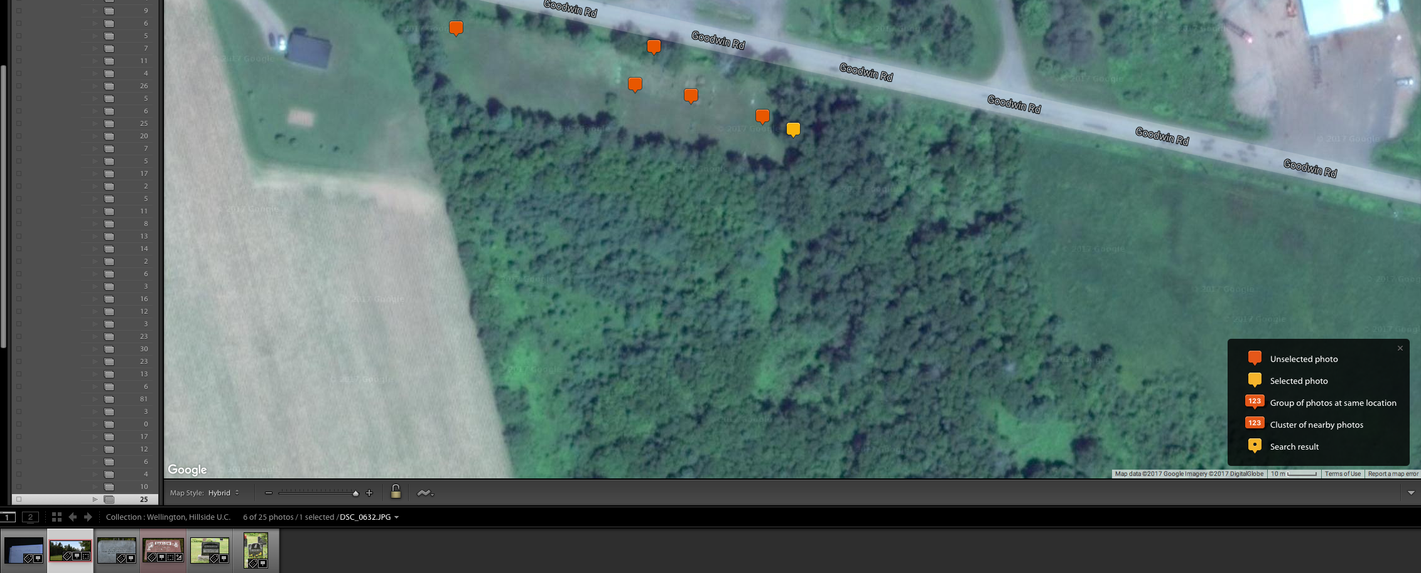
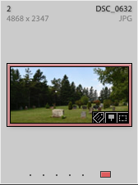
Enlarged View
Selected photo location

Slide 25
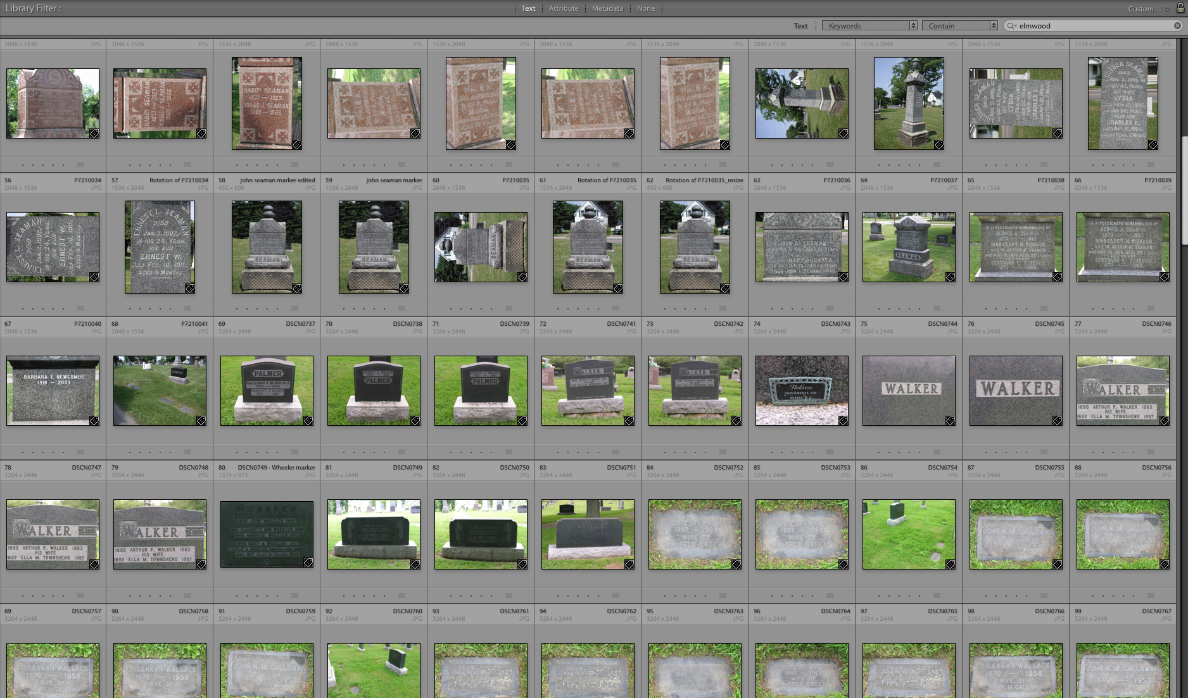
Navigating the LR Display
Library Module ~ Search using keyword ‘elmwood’
Images from Elmwood Cemetery found, from 2000 to 2016

Slide 26
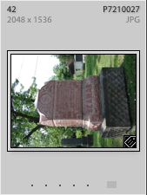
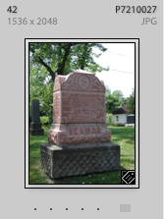
Navigating the LR Display
Library Module ~ Quick Rotation
For those cameras lacking auto rotate functionality, images can be rotated in the Library Module using arrows in the lower left & right corners (not shown here).

Slide 27
Collections
Collections are a means of organizing your photo library
I chose to use a hierarchy that displays my genealogy images by year & province. Within each province I have cemeteries, various archives, visits with relations etc.
I recommend establishing Collections before importing images for an efficient workflow
Prior to creating a Collection I will have transferred images from camera to folders on my external hard drive.

Slide 28
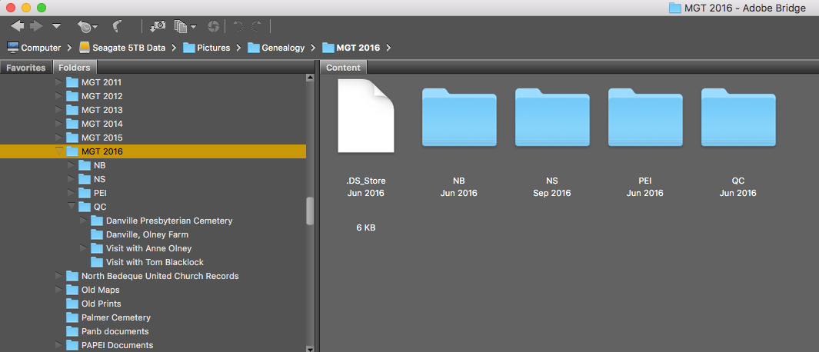
Organizing the Photo Library
As a case study I will demonstrate importing a new folder into Lightroom. The above screenshot is from Adobe Bridge.

Slide 29
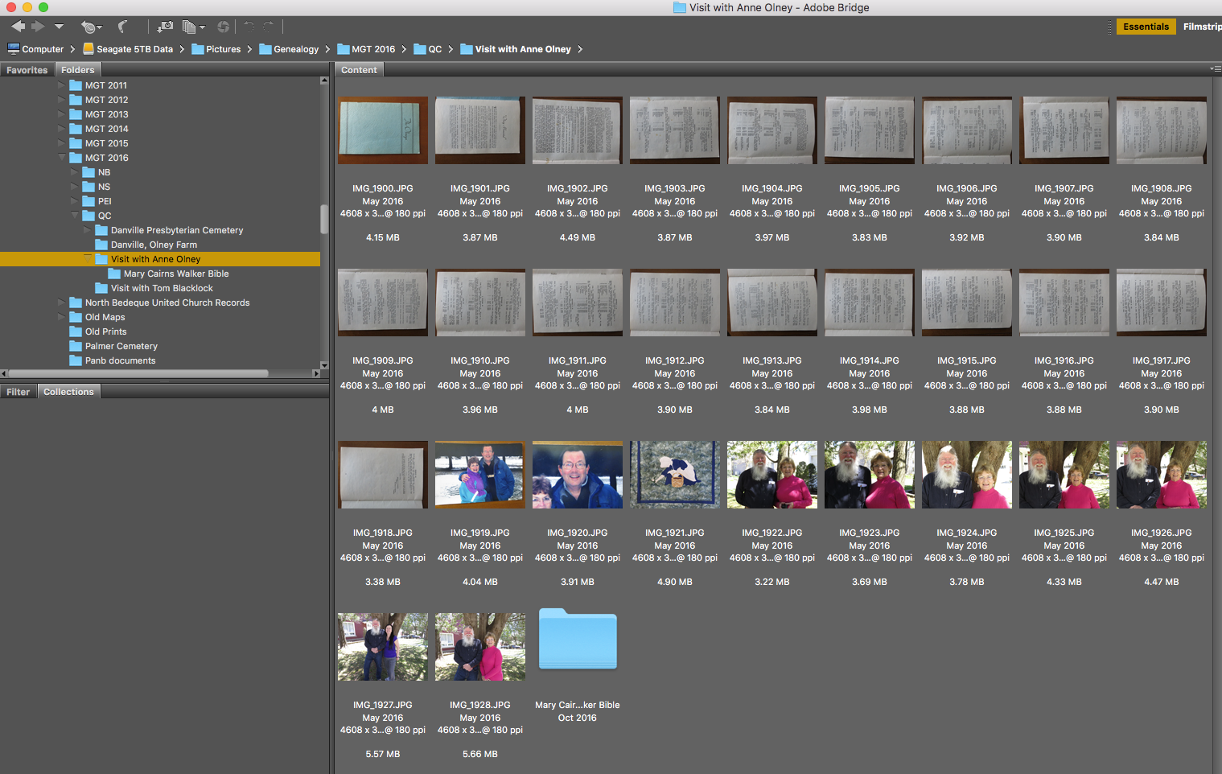
Organizing the Photo Library
Adding visits in Québec during the Maritime Genealogy Tour 2016 I will add a new Lightroom Collection for a visit with a new cousin in Sherbrooke.

Slide 30
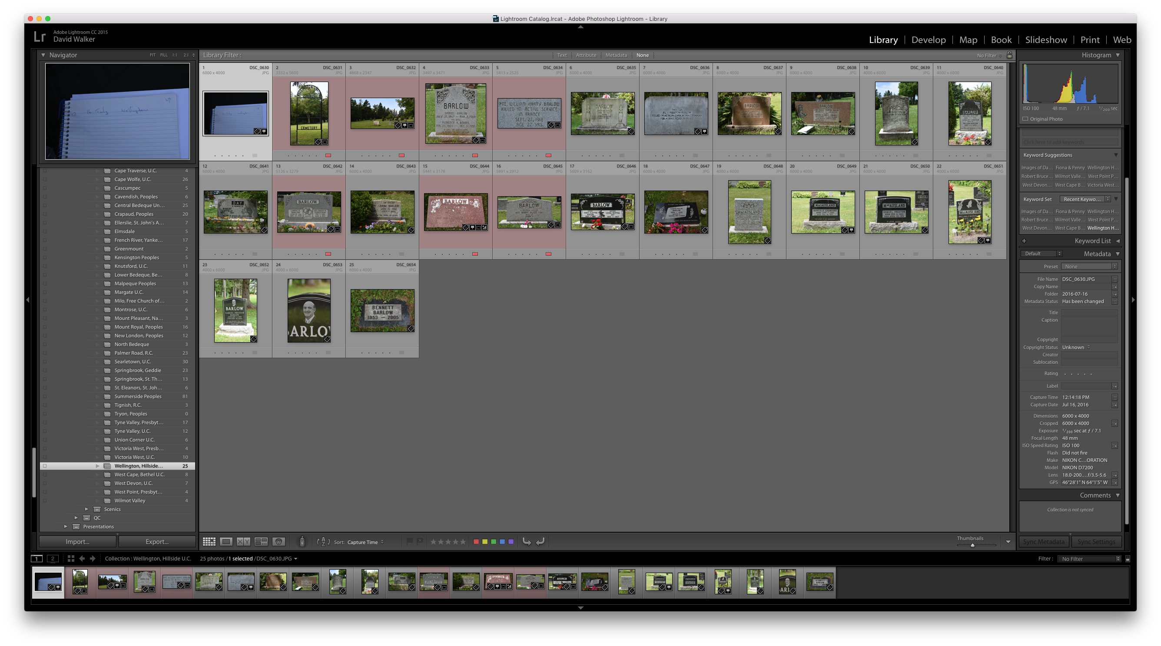
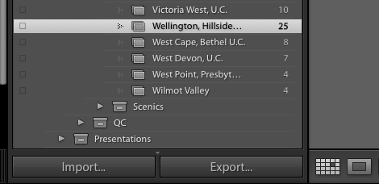
Importing Images
Library Module
The first step in the image editing workflow is to import images.
Select ‘Import’

Slide 31
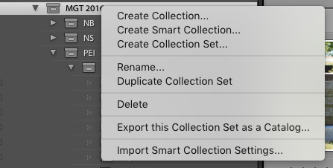
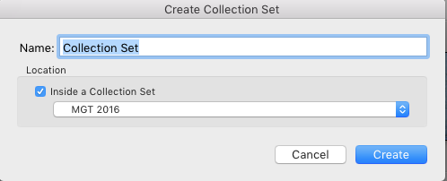
Importing Images
Library Module
QC folder was created as a Collection Set, under which there will be a series of Collection folders
Replace default ‘Collection Set’ with QC

Slide 32
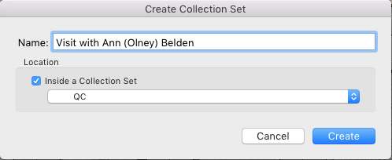
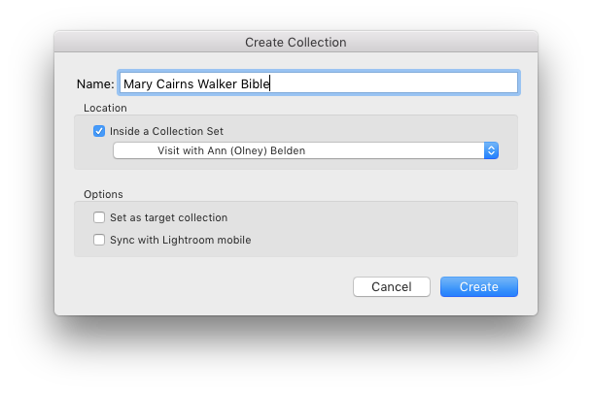
Importing Images
Library Module
A new Collection Set was created within the QC Collection Set, to accommodate several Collections.
Within the above new Collection Set a new Collection was created.

Slide 33
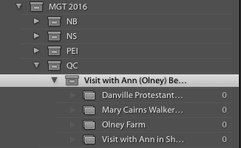
Importing Images
Library Module
Four new Collections were created within a Collection Set, each indicating ‘0’ photos imported.

Slide 34
Importing Images
Library Module
In the lower left corner select ‘Import’

Slide 35
Importing Images
Library Module
A panel displaying all available sources
Select the location of the photos to be imported.

Slide 36
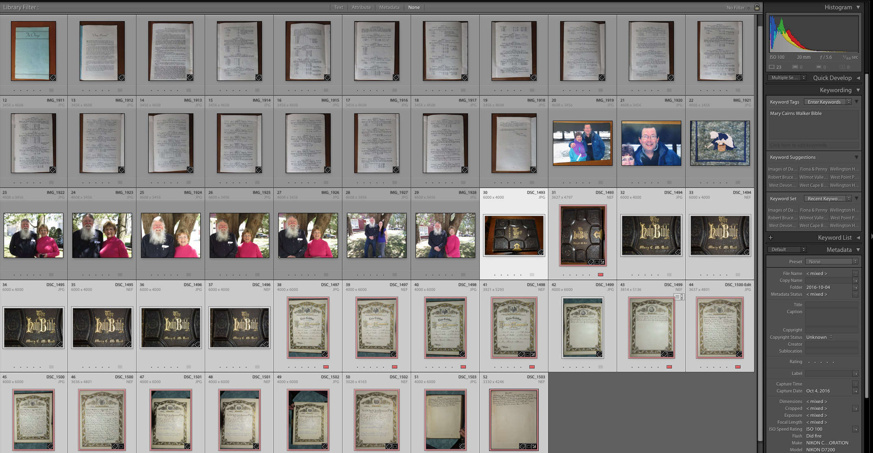
Importing Images
Library Module
Select all or some images.
Add keywords

Slide 37
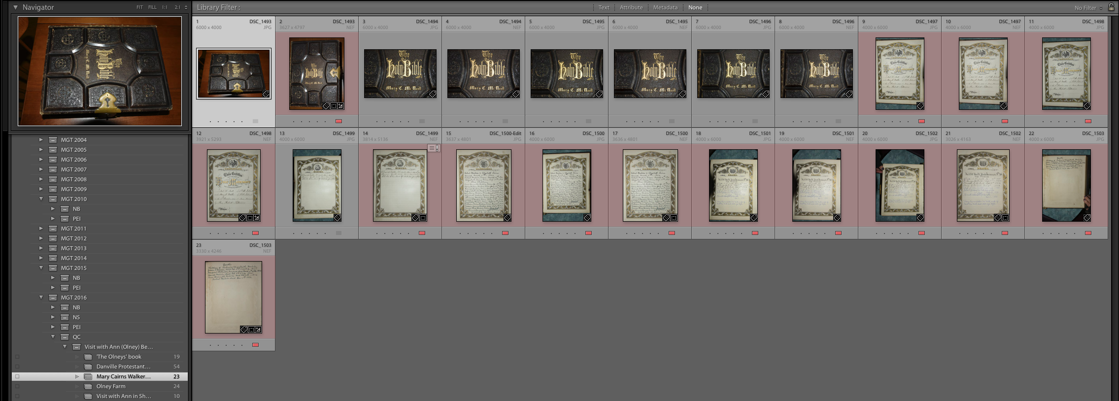
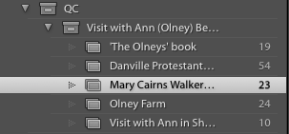
Importing Images
Library Module
New Collections with imported photos

Slide 38
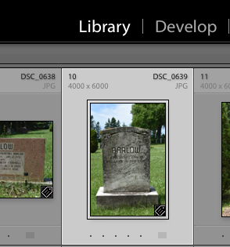
Editing Images
Develop Module
Select a photo to edit, click ‘Develop’

Slide 39
Editing Images
TIP: The editing process in Lightroom is nondestructive. Instead of editing the original image, never to return to its original state once saved, or having software create an ‘Originals’ folder, then editing a copy, Lightroom creates a small text file linked to the image. One can always go back to any point in the editing process, even all the way back to the original.

Slide 40
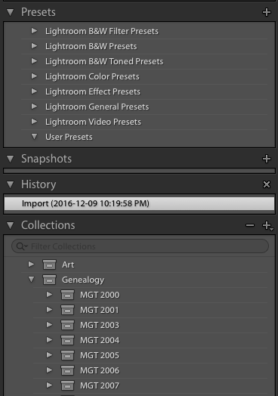
Editing Images
The left panel displays Presets, History & Collections

Slide 41
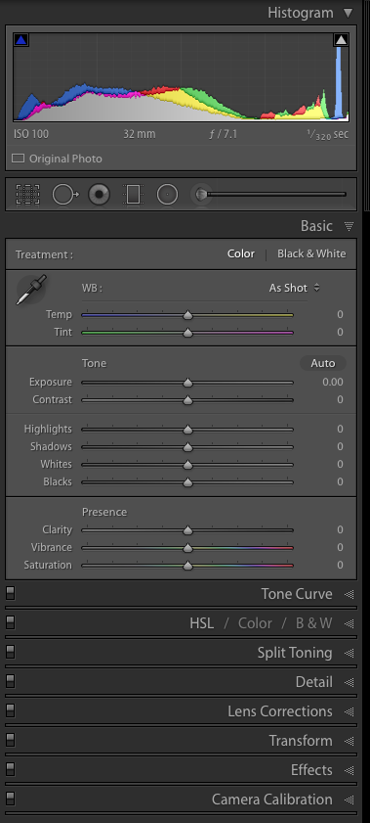
Editing Images
The Develop module offers many more editing options than Quick Edit in the Library module.
The work area offers two viewing modes: Loupe view, which allows viewing the image at different magnifications, and the Before/After view, which compares original and edits side by side.
The right panel contains the Histogram panel, and a wide selection of editing tools, including Crop Overlay, Spot Removal, Remove Red Eye, Basic, Detail, Lens Correction, Transform, Effects and Camera Calibration.

Slide 42
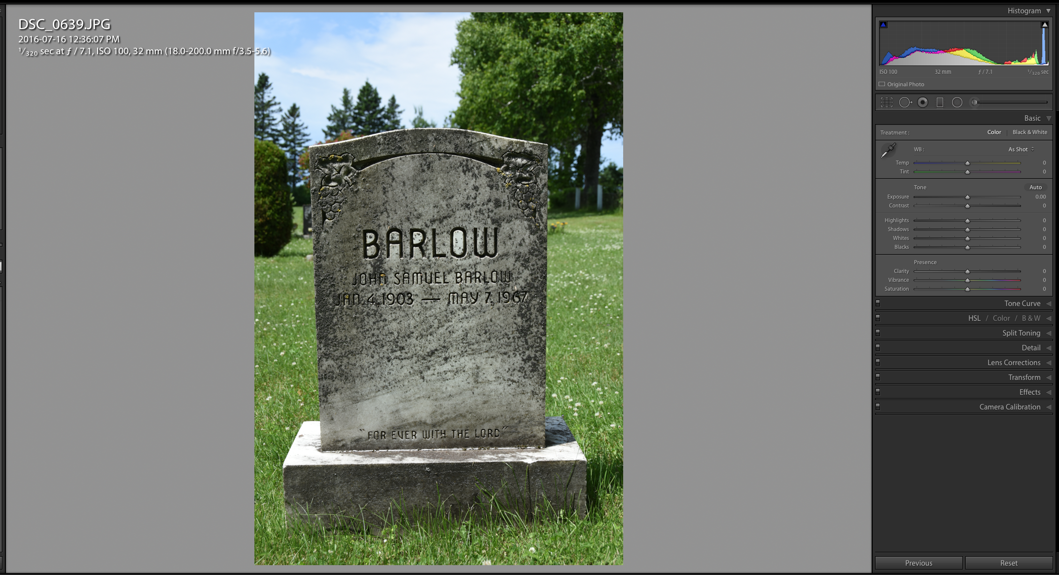
Editing Images
Develop Module
Image is full screen.
Right pane changes with Develop options

Slide 43
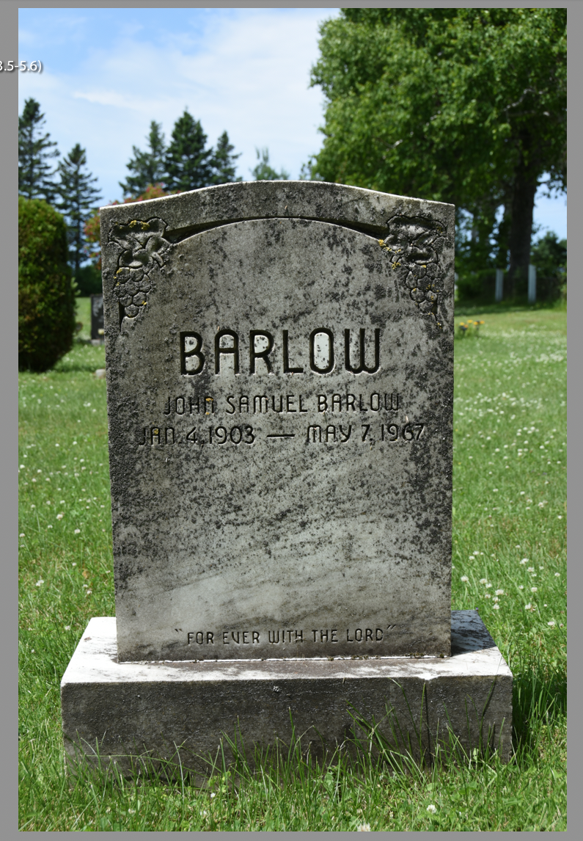
Editing Images
Develop Module
In this example I will show how to make corrections for tilt, vertical perspective, cropping, brightness & contrast.

Slide 44
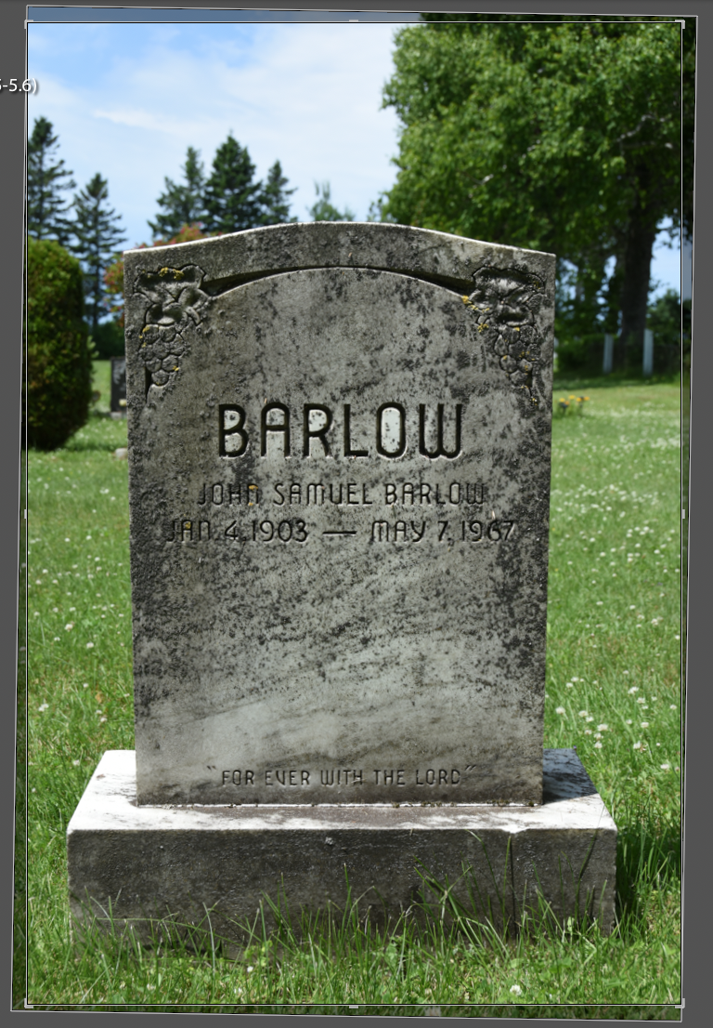
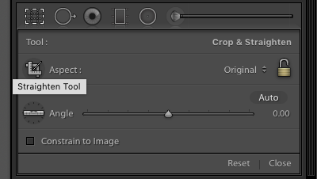
Editing Images
Develop Module
Having selected the level icon, a line was drawn along the edge of the stone block supporting the tombstone. The image is now ready for cropping.

Slide 45
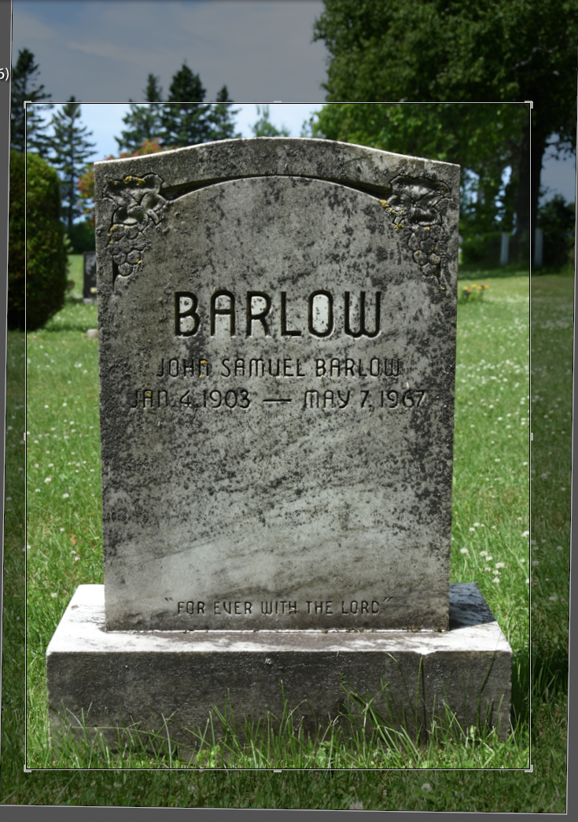
Editing Images
Develop Module
All four edges were brought in to crop the tombstone.
Once done, double click inside the cropped area to save, or click Done.

Slide 46
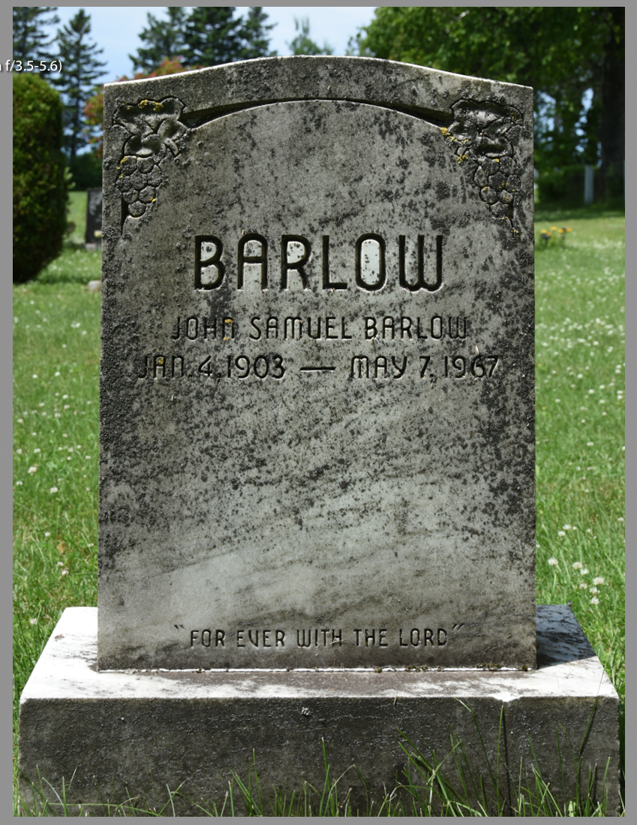
Editing Images
Develop Module
Tilt correction and cropping completed.

Slide 47
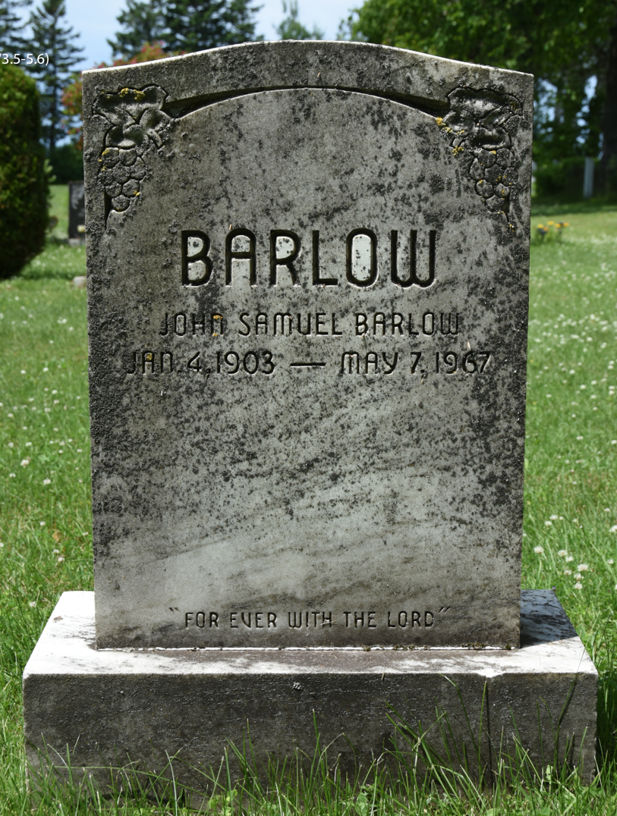
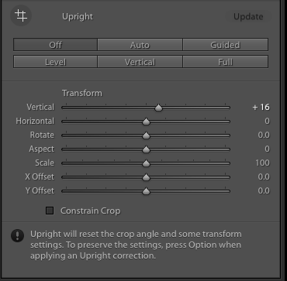
Editing Images
Develop Module
A slight amount of vertical perspective correction was necessary.

Slide 48
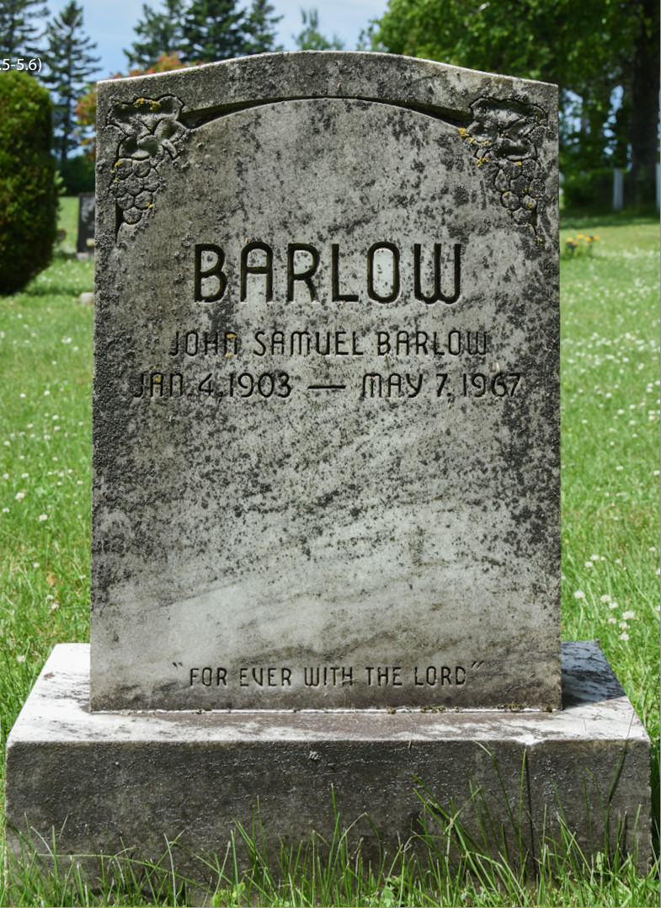
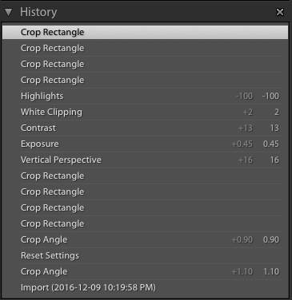
Editing Images
Develop Module
The above list shows the History of all edits.

Slide 49
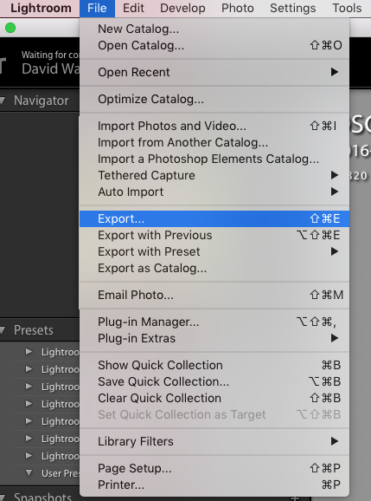
Exporting to TMG
From the File dropdown menu select Export

Slide 50
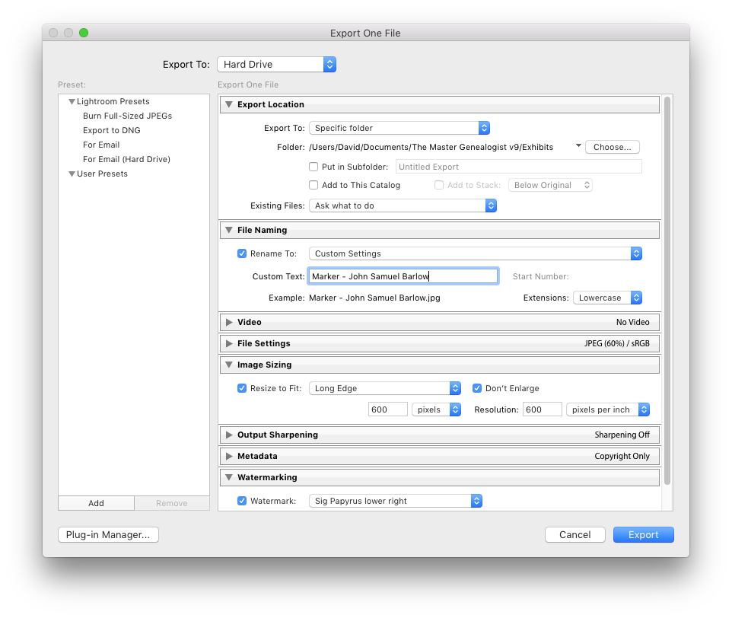
Exporting to TMG
Select Export Location > Specific Folder > TMG Exhibits
Name the file
Resize the image
(refer to my article “Suggested Sizing of TMG Exhibits”)
Add your name as a watermark
Click Export

Slide 51
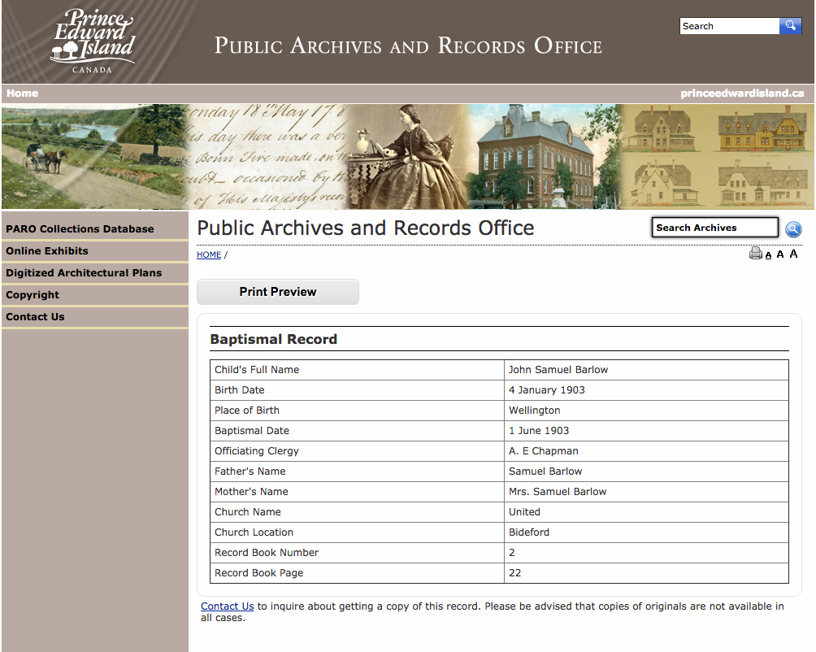
Importing into TMG
I documented the tombstone for John Samuel Barlow, because I have several Barlow relations from the same area, even though I didn’t know how he might fit in my records. A match of his birth date on the tombstone & a search at the PEI archives, confirmed his connection.

Slide 52
Importing into TMG
Having entered this new person in my TMG dataset,
the next step was to enter his death and burial information.

Slide 53
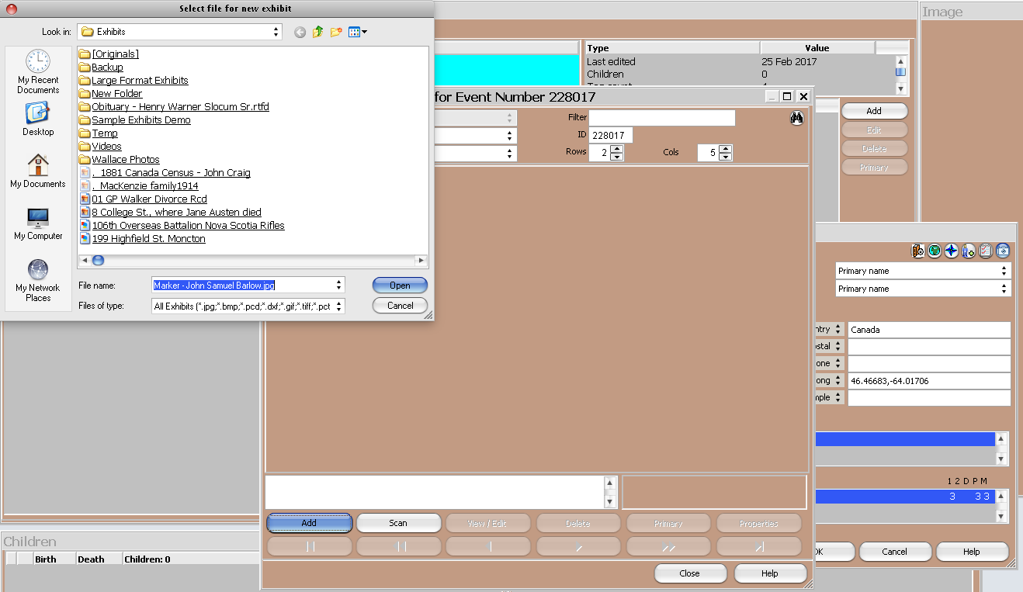
Importing into TMG
Having exported the marker photo from LR to TMG I was ready to ready to add it as an exhibit.

Slide 54
Importing into TMG
Marker exhibit and caption now entered.

Slide 55
Importing into TMG
Burial data and marker exhibit have been entered.

Slide 56
Importing into TMG
The final stage in completing entry of death and burial information.

Slide 57
Importing into TMG
Having entered this new person in my TMG dataset, his death and burial information were subsequently added.

Slide 58
Editing Images
Spot Removal
Before we carry out spot removal procedures, there will be corrections for rotation and cropping.

Slide 59
Editing Images
Spot Removal
At the top of the right pane, select Spot Removal

Slide 60
Editing Images
Spot Removal
Enlarging the image makes editing more efficient. Move the rectangle as required.

Slide 61
Editing Images
Spot Removal
Spot remover tool selection
Choose Clone or Heal
Adjust the size of the area to be corrected, feathering (soften edges) & opacity
Clone will create a duplicate of the source area, Heal will produce a softer effect

Slide 62
Editing Images
Spot Removal
Corrected area
Source of correction
(can be moved)
Spot removal within the rectangle is nearly complete. Click ‘Done’ to view progress.

Slide 63
Editing Images
Spot Removal
Ready to move on to the next area.

Slide 64
Editing Images
Spot Removal
In the left panel one can review the history of the editing process. Highlighting any one stage in the editing will display the process up to that point.
When the editing is complete, choose File > Export.

Slide 65
A Bit of Fun with Lightroom
Select ‘Enable Profile Corrections’ for immediate result.
This lens is part of the LR database.

Slide 66
A Bit of Fun with Lightroom
Original shoreline photo using Nikon 10.5mm fisheye lens.

Slide 67
A Bit of Fun with Lightroom
Lens correction with a single click.

Slide 68
Conclusion
Visit Adobe Creative Cloud
Download a 30 day Trial

Slide 69
Conclusion
Excellent reference books by Scott Kelby on amazon.ca
1. The Adobe Photoshop Lightroom CC Book for Digital Photographers
2. The Adobe Photoshop CC Book for Digital Photographers

Slide 70
Conclusion
Visit our web site to download this presentation.
http://ottawa-tmg-ug.ca/

