Slide 1
Creating a Pseudo-person in TMG to record Repositories
David Walker
Ottawa TMG Users Group
4 February 2023

Slide 2
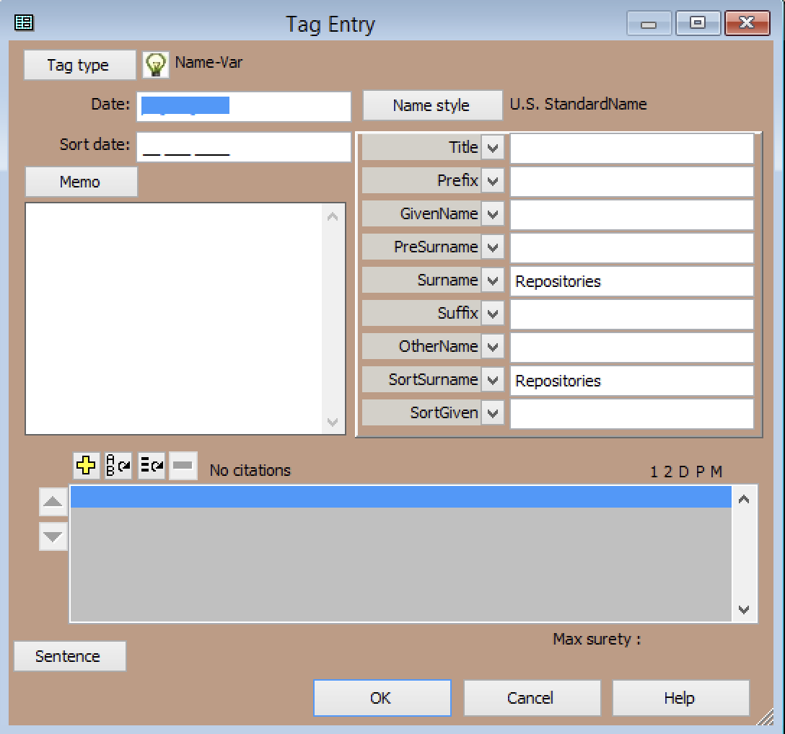
Goal: I wanted to create a Second Site page with images of repositories, such as churches, cemeteries, museums, archives, homesteads etc.
To achieve this goal, I created a pseudo-person in TMG. I named this pseudo-person “Repositories”.

Slide 3
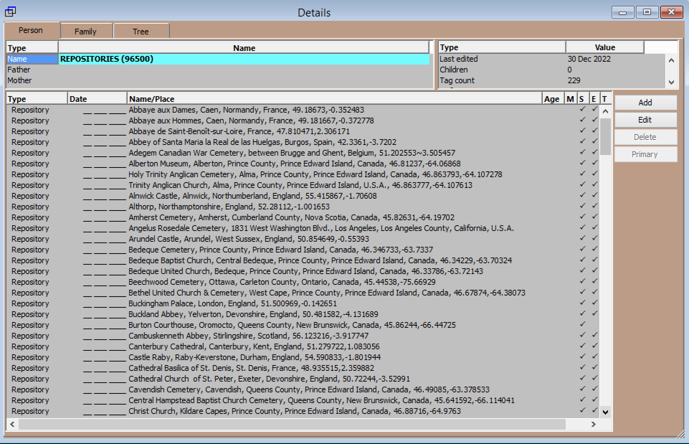
The next step was to create Tags that would represent each of the repositories.

Slide 4
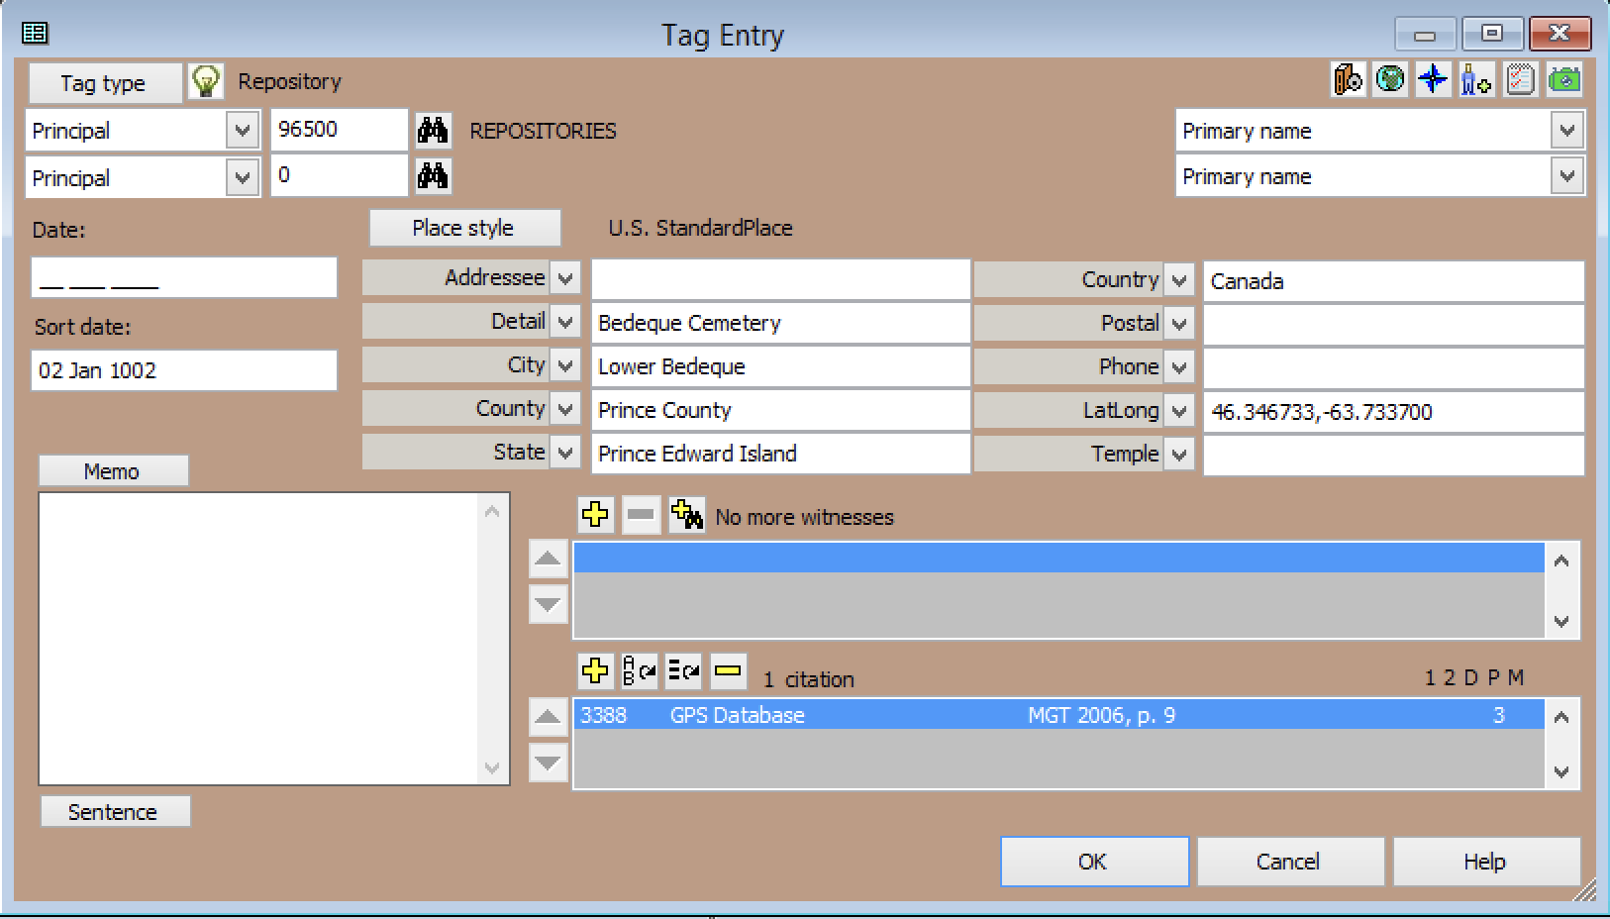
To sort these tags alphabetically, I used TMG’s sort date feature.

Slide 5
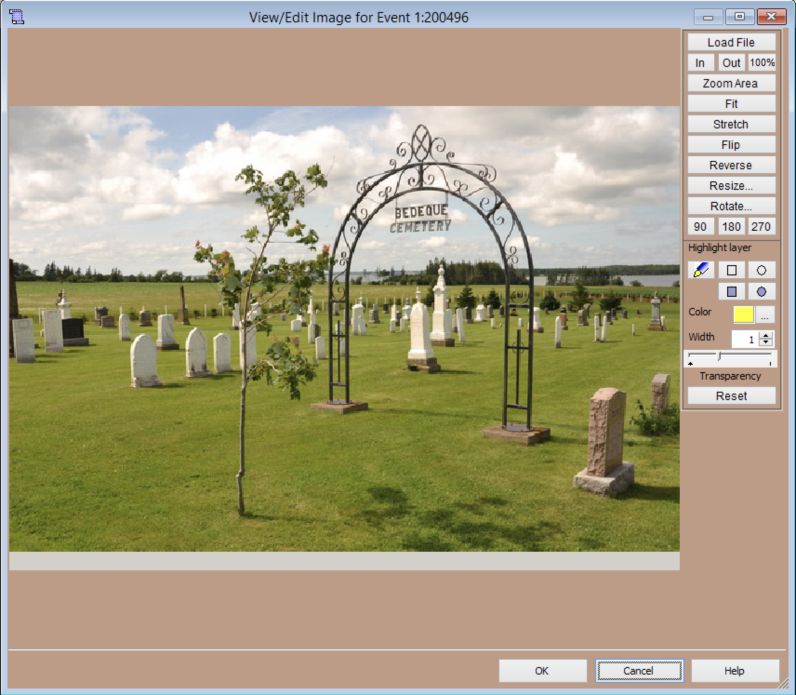
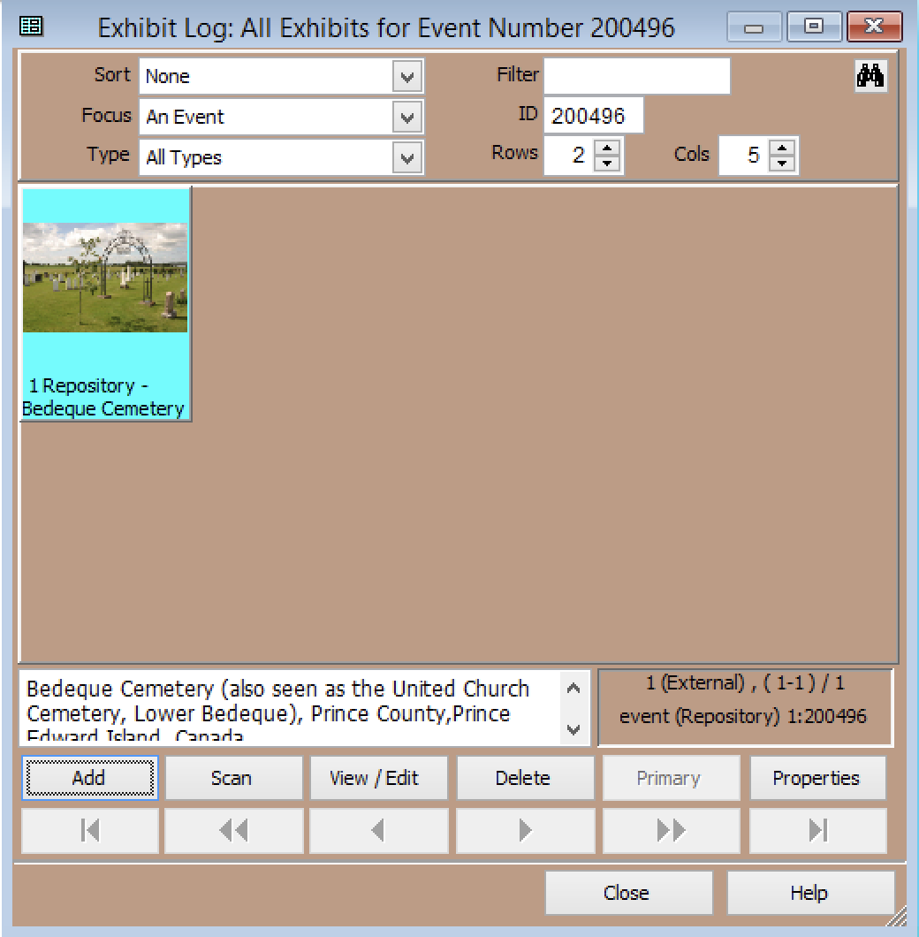
The next step was to add exhibits.

Slide 6
The final step was to run Second Site
A link for displaying the list of repositories was created.

Slide 7
A link for displaying the list of repositories was created.

Slide 8
Completely Different Topic
Free Webinar: Elizabeth Shown Mills reveals her secret to success in genealogy
https://familytreewebinars.com/webinar/elizabeth-shown-mills-reveals-her-secret-to-success-in-genealogy/
Scottish Research Tour
https://www.americanancestors.org/events/scottish-research-tour

