Slide 1
Customizing the Toolbar
Ottawa TMGUG
7 Oct 2017

Slide 2
Using the Toolbars
TMG comes supplied with eight handy toolbars to allow specific operations with just the click of a button. Only three of them, "Standard," "Layout," and "Tag Editing" are displayed in the standard Layout.
You can see the others listed, and turn them on or off, by either right-clicking on any toolbar, or using the View > Toolbars menu.
In addition, you can create custom toolbars that provide functions not available on the standard toolbar.
Toolbars can be turned on or off, they can be located in any desired position on the main TMG window, and the size of their buttons changed.

Slide 4
Supplied Toolbars
Standard – open project, navigation between people, add person, web search, and access to the research, exhibit, and DNA logs
Layout – open or close the various windows within the main TMG window, and managing Layouts
Easy Search – navigate to the first person with surname starting with the selected letter
Bookmark – manage bookmarks
Reporting – create selected reports
Tag Box – add or delete Tags or make them Primary, set or delete Tag Box filters, and turn Timelines on or off
Text Editing – various functions for editing Tags

Slide 5
Standard Tag Box Bookmark Custom Reporting

Slide 6
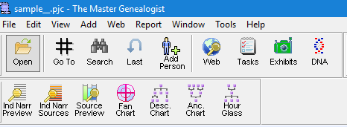
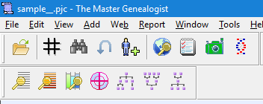
Toolbar Size
Toolbar buttons come in three sizes: Large with text (the default), Large, and Small. You can choose the size you prefer by right-clicking on any toolbar, or using the View > Toolbars menu.

Slide 7
Toolbar Layout
If you drag it near the top or a side, it automatically "docks" - that is attaches itself to that edge. If you leave in elsewhere in the screen it's appearance becomes more like a normal window, with a small title bar at the top.
Whether toolbars are on or off, their positions in the main TMG window, and the selected button size are all part of the Layout. If you want changes to the toolbars you have selected to be displayed the next time you open TMG, save the Layout before closing the program.

Slide 8
Custom Toolbars
In addition to the standard toolbars, you can create your own custom toolbars, including any buttons you find useful.
If you find you use only a few buttons on one or more of the standard toolbars, you can include only those buttons on a custom toolbar and turn off the standard one to save space. Most, but not all, buttons on the standard toolbars can be added to a custom toolbar.
Most of the functions available in menu commands can also be accessed by toolbar buttons, many of which are not included in the standard toolbars. In addition, there are special functions, such as opening a specific Project, turning on a specific Accent, or running a specific report, that require several steps with menu commands or standard toolbars, but can be done with a single mouse click using buttons on a custom toolbar.
You can create and name any number of custom toolbars, but only one can be displayed at any one time. If you create more than one custom toolbar, you can display a different one by accessing the Customize command on the View > Toolbars menu or the right-click menu on any toolbar, and choosing the desired toolbar from the drop-down list at the top of the Custom Toolbar Manager. For easier access, you can save separate Layouts with different custom toolbars, and then choose the Layout that includes the desired custom toolbar.

Slide 9
Custom Toolbars
Add a Census Tag
Add a Religion Tag
Automated Genealogy website
Copy Person
LDS
FamilySearch
NEHGS
Ancestry
Backup

Slide 10
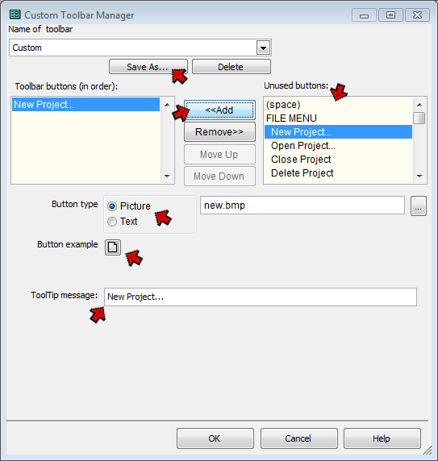
Adding Buttons
Adding buttons to a custom toolbar is relatively straightforward. First, you open the Custom Toolbar Manager, using the View > Toolbars > Customize... menu command, or by right-clicking on any toolbar and choosing Customize... from the right-click menu.

Slide 11
If you are creating more than one custom toolbar, use the Save As button at the top of the screen to give each custom toolbar a unique name. Otherwise, ignore this button and your toolbar will be saved with the default name "Custom."
Select the buttons you want to add from the list on the right – "Unused buttons." Note that most of the buttons are listed in the order of the menu commands they replicate. But after the menu commands there is a section called "Special Functions" which do not have corresponding menu commands.
Notes:
More on Special Functions later.

Slide 12
After selecting a button from the list, click the "<<Add" button in the center of the screen to add it to the list on the left – "Toolbar buttons." They will appear on the toolbar in the order listed, which can be changed with the "Move Up" and "Move Down" buttons. You can add as many buttons as you like, limited only by the amount of room the resulting toolbar will take up on your screen.
Notes:
More on Special Functions later.

Slide 13
You can set the button to display as an image or as text, and set the "ToolTip" – the message that appears when you hover the mouse cursor over the button. To do that, select the button you want to work with in the list on the left, "Toolbar buttons" and use the controls in the lower half of the Custom Toolbar Manager screen.
Toolbar buttons may display images or text labels. Some buttons have default images associated with them, while others do not. If there is a default image, as for the New Project button shown in the screenshot above, the default choice for "Button Type" well be "Picture," and the default image will appear as the "Button Example." If not the default text will appear there.

Slide 14
If you want your button to contain text instead of an image, select the Text as the "Button Type" and enter the desired text in the box to the right. The button will expand to accommodate the text, so a brief label is generally best. The button with its text will appear below as the "Button Example." (The Large Buttons with Text actually contain the text as part of the image, so it cannot be changed except by editing the image.)
If your button doesn't have a default image, or you prefer a different image, select Picture as the "Button Type" and click the "Button Example" button to open the Select Icon screen.

Slide 15
When you are done, click OK to close the Custom Toolbar Manager. If you don't already have the custom toolbar displayed you will be prompted to display it – click Yes.
The default "ToolTip" appears below the "Button Example." You can change that to any text you like.
If the custom Toolbar is not already part of your custom Layout, it will not be displayed when you close and then restart TMG. To have it display each time, you need to arrange it where you want it to appear, than save the layout that includes it.

Slide 16
Special Functions
There are special functions, such as opening a specific Project, turning on a specific Accent, or running a specific report, that require several steps with menu commands or standard toolbars, but can be done with a single mouse click using buttons on a custom toolbar.
Buttons that do not correspond to menu commands, those listed in the Special Functions section of the "Unused buttons" list, generally require a few more steps to set up.

Slide 17
Special Functions

Slide 18
Add a Tag of a Specific Type
When you add this button, you get another field to select. Click on the button with the three dots and a box opens with all the available Tag Types for you to select.

Slide 19
Access a Web Page
Similarly, this customization requires you to enter the appropriate url.
I’ve used Text buttons with the website initials to save space

Slide 20
Other Special Function Buttons
For other Special Function buttons, see Terry Reigel’s instructions
Buttons to Run a Specific Report
Buttons to Specify a Specific Accent Condition
at http://tmg.reigelridge.com/toolbars.htm

