Slide 1
Upcoming Genealogy Events in Ottawa and area 20 Sep 2020

Slide 2
Celebrating 50 Years: 1970 - 2020

Slide 3
Upcoming Presentations
Saturday 24 Oct
Ottawa Public Library Genealogy Services
Krista Woltman
1:30pm online via Ontario Ancestors
Saturday 28 Nov
Canadiana.ca
Émilie Lavallée-Funston & Francesca Brzezicki
1:00pm online via Ontario Ancestors

Slide 4
SIG Meetings
DNA Tools Workshop: Cancelled until further notice
Irish Research Group: Cancelled until further notice
Ottawa TMG Users Group (webcast on Google Hangouts)
10 Oct 2:00PM, online - https://meet.google.com/nvz-kftj-dax
British Colonial America SIG
23 Sep 7:00PM - online (contact treasurer@bifhsgo.ca)
DNA Interest Group:
3 Oct 9:30 to 11:30AM online (see https://bifhsgo.ca/cpage.php?pt=21)
Scottish Genealogy Group
24 Oct 10:00AM, online via Zoom (details tba)

Slide 5
Virtual Genealogy Drop-In – Tuesday 2pm-3pm In partnership with the Ottawa Public Library
Drop in to share research strategies, & discover what resources are available for your research. Volunteers from The Ontario Genealogical Society will be here to answer questions & help you get the most from on-line resources.
Join the meeting with this link: https://meet.google.com/nvz-kftj-dax
You do NOT need a Google account but will be asked for a name. To listen only, you do not need a microphone or a camera. In fact, you are encouraged to turn your camera off, and also leave your microphone muted until you are called upon. Google Meet has been successfully tested with Firefox, Chrome and the newest Edge browsers in Windows 10. There are also apps for Android, iPad and iPhone. If you need help joining, send an e-mail to ottawawebmaster@ogs.on.ca.

Slide 6
Ontario Ancestors’ Virtual Events
Many branches of Ontario Ancestors are offering online presentations as we battle through the pandemic.
Most are open to everyone, so please encourage friends who may be interested to register too!
Check out the calendar at
https://ogs.on.ca/events-calendar/

Slide 7
This Week's Online Genealogy Events
Check out John Reid’s blog, Canada's Anglo-Celtic Connections, for a list of the current week’s online genealogy events, published on Tuesdays
https://anglo-celtic-connections.blogspot.com/

Slide 8
BIFHSGO
Saturday, October 10
Soldier, Settler, Sinner: The Remarkable Journey of Charles MacDonald (Feature Talk)
10:00 am to 11:30 am
Online - registration required
Jane Simpson will tell the story of her ancestor Charles MacDonald, an officer in the British Army, on his journey of chance, spanning three continents and experiencing a number of precarious circumstances. Born into a life of relative ease in the North of England, tragedy struck and he found himself in the service of the King during the Napoleonic Wars. Not always a saint and sometimes very much a sinner, he fathered seventeen children and swept them along in his journey from England to the West Indies and finally to the quiet shores of the Bay of Quinte on Lake Ontario. Jane one day stunned her grandmother by asking an inconvenient question and the answer was not altogether convincing. Fifty years later, she had her answer, finding many surprises and shocks for her MacDonald relatives. Jane will relate her research leading to her book, Soldier, Settler and Sinner: The Remarkable Journey of Charles MacDonald.
(http://www.bifhsgo.ca)

Slide 9
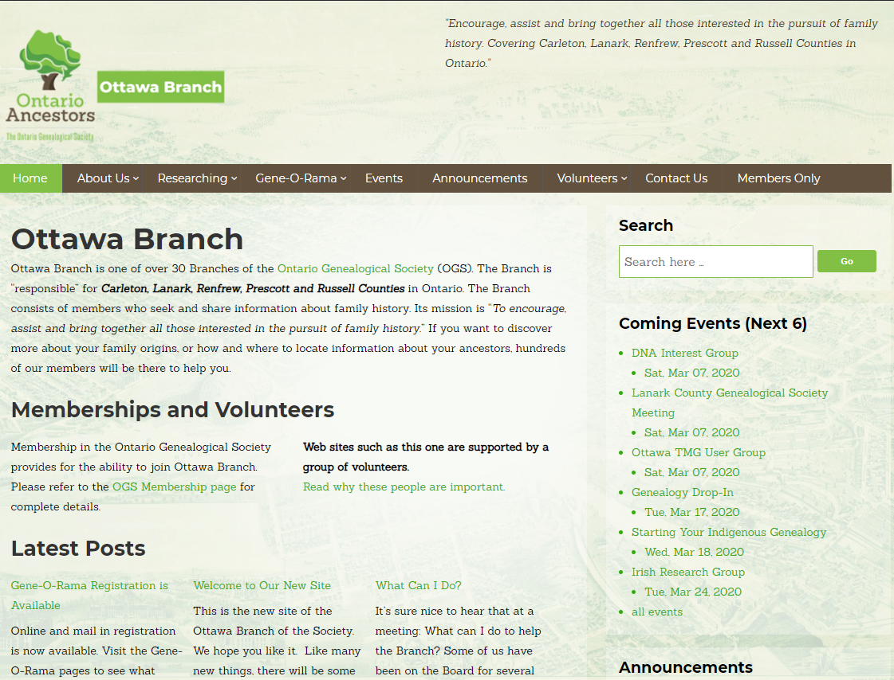
New Branch Website https://ottawa.ogs.on.ca/

Slide 10
Local Events
26 Sep: BIFHSGO Half-day Webinar with Dr. Penny Walters 9:00 am to 12:00 pm
Online - registration required
BIFHSGO is pleased to offer a half-day webinar with Dr. Penny Walters. Two sessions will be offered during this morning session – ethical dilemmas in family history research and the psychology of searching.. Registration is required; cost for the half-day is $20. Registrants will receive a detailed handout for each session,
Please register by purchasing a "ticket" on Eventbrite. You will be asked to log in or create an Eventbrite account before you purchase your ticket. There is a “pay by cheque” option, if you do not wish to make an electronic payment via Eventbrite. Once you have registered, you should almost immediately receive a confirmation email from Eventbrite. Please contact Kathy Wallace at bifhsgo.kw@gmail.com if you have registration issues.

