Slide 1
Hurricane Dorian:
Destruction on Prince Edward Island 7 September 2019
Presented by David Walker
To Ottawa TMG Users Group
2 November 2019

Slide 2
Introduction
Sunday, 1 September 2019
Hurricane Dorian arrived at the Abaco Islands in the Bahamas
It made landfall as a Category 5 hurricane, becoming the strongest hurricane in modern records to strike this part of the islands, and the worst natural disaster in the country’s history
It had maximum sustained wind speeds of 185 mph (295 km/h)
Most buildings were either flattened or swept to sea
At least 70,000 people were left homeless
70 known dead
It proceeded along the coasts of the southeastern United States and Atlantic Canada

Slide 3
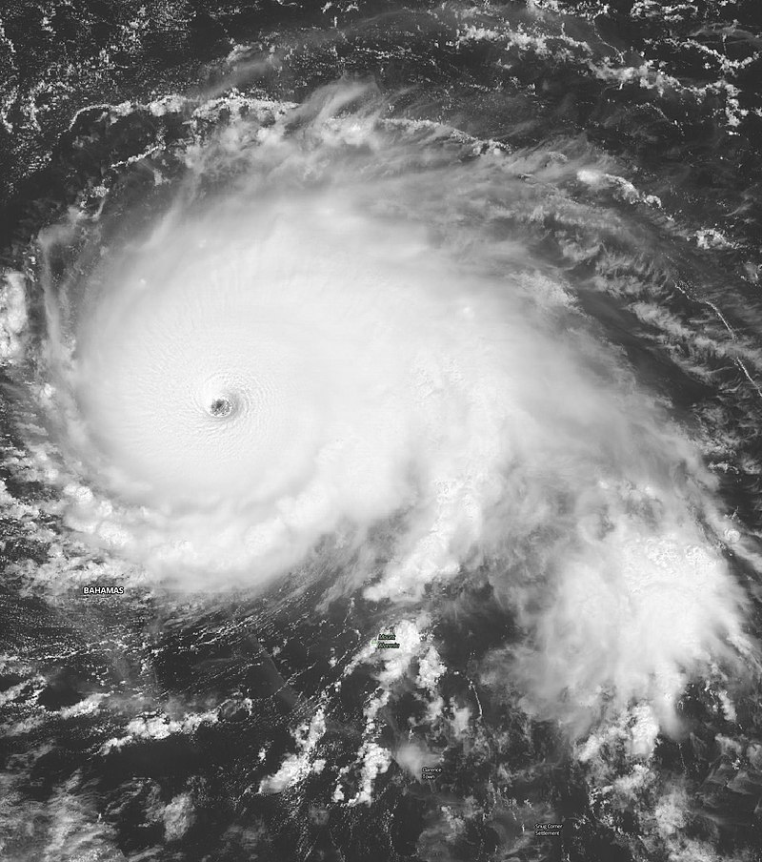
Introduction
Dorian over the Abaco Islands.
By National Aeronautics and Space Administration

Slide 4
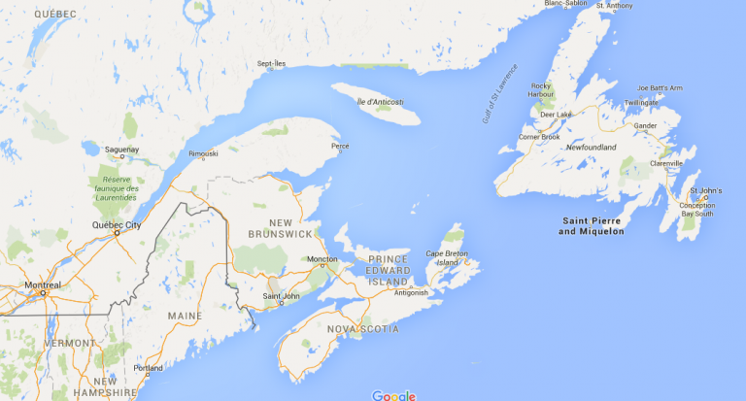
Introduction
Atlantic Canada

Slide 5
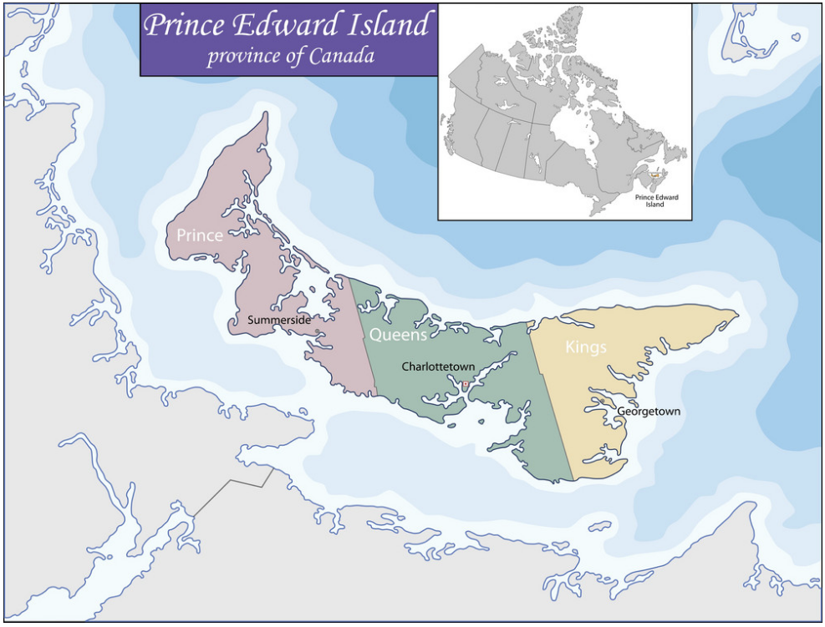
Introduction
Red dot is location of campground in New Annan
Prince Edward Island

Slide 6
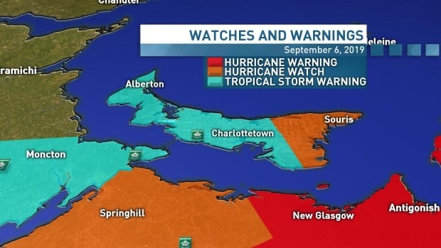
Introduction
Red dot is location of campground in New Annan

Slide 7
Introduction
Friday, 6 September 2019
I spent the day documenting tombstones in the Peoples Cemetery, Malpeque, Prince County, Prince Edward Island
By this time Dorian had weakened to the status of a tropical storm.
It was expected to strike Kings County in the eastern part of Prince Edward Island the next day, likely avoiding the central & western parts
The feeling amongst the Islanders was that this was not a storm to worry about
Everyone I talked to at our campground, near Summerside in Prince County, said they were going to stay in their trailers. That was to change.

Slide 8
Waiting for the Storm
Saturday, 7 September 2019
Morning was overcast with slight wind
Afternoon was more windy, with gusts
Late afternoon brought rain and higher winds

Slide 9
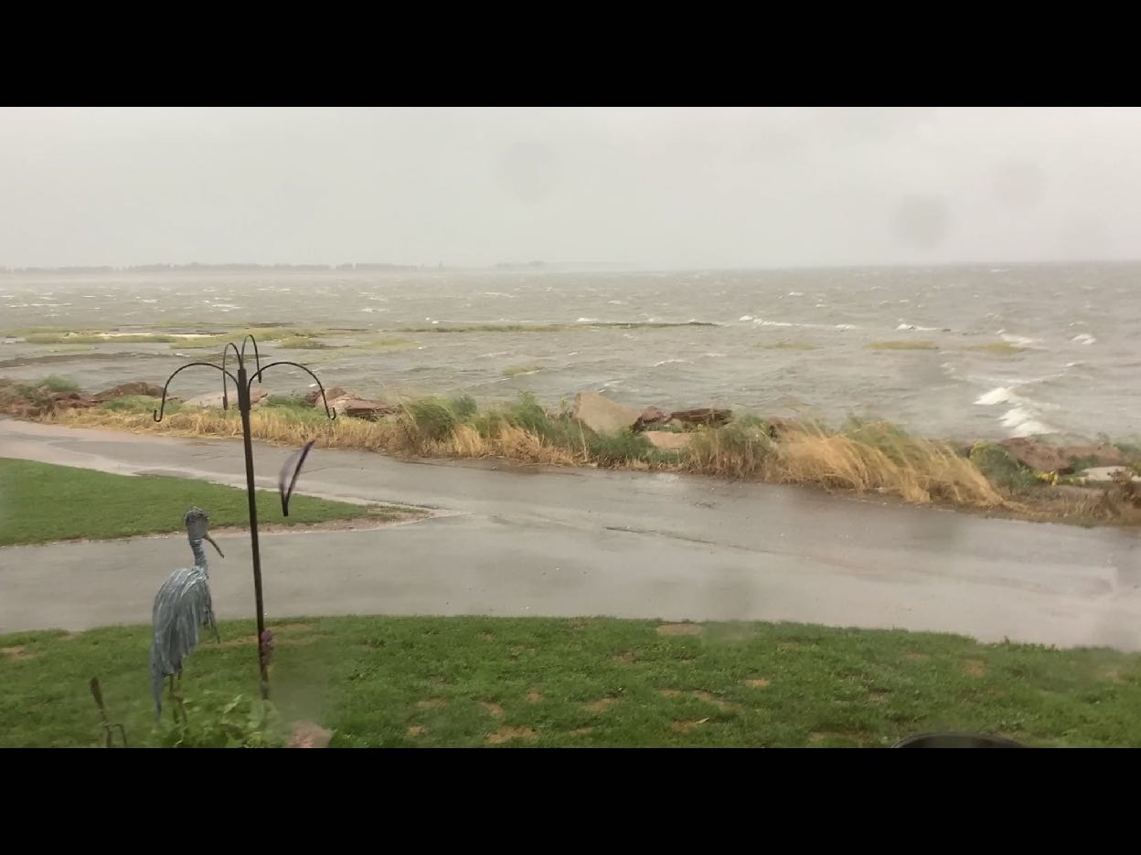
Waiting for the Storm
Afternoon view from our campsite.

Slide 10
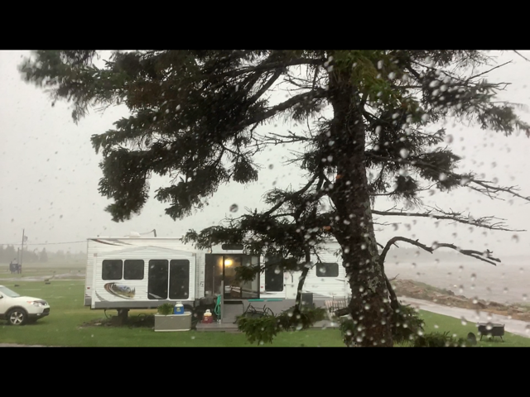
Waiting for the Storm
Our neighbour’s identical trailer, viewed from our trailer

Slide 11
Waiting for the Storm
Saturday, 7 September 2019, late afternoon
Dorian was upgraded from a Tropical Storm to Category 2 Hurricane
We started packing essentials, including computers, photographic equipment, clothing
Our trailer started to rock
By 6:30 pm hydro was cut across the Island
Wind speed had increased to 90 kph, gusting to 130 kph
It was time to leave for a cousin's home in Borden-Carleton

Slide 12
The Aftermath
Sunday, 8 September 2019
The trip up to Summerside was not a pretty site
Many uprooted trees, some having collapsed over hydro lines

Slide 13
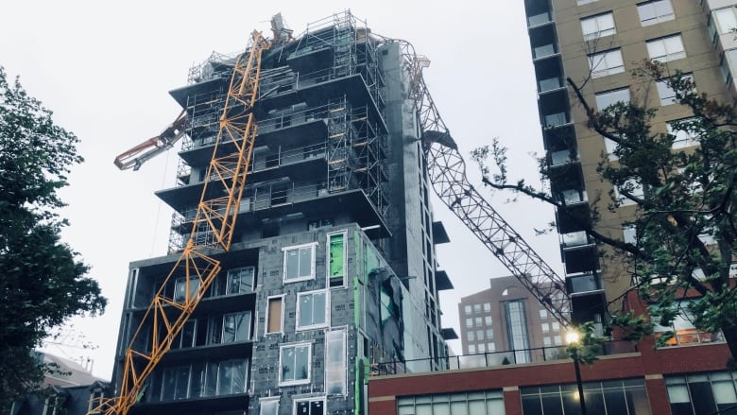
The Aftermath
Crane collapsed onto apartment building under construction in Halifax.

Slide 14
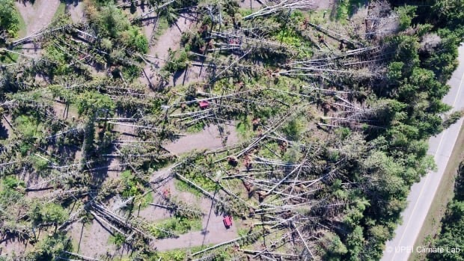
The Aftermath
The Cavendish area on the north shore was hard hit. The National Park lost over 80% of its trees, strewn everywhere like sticks.

Slide 15
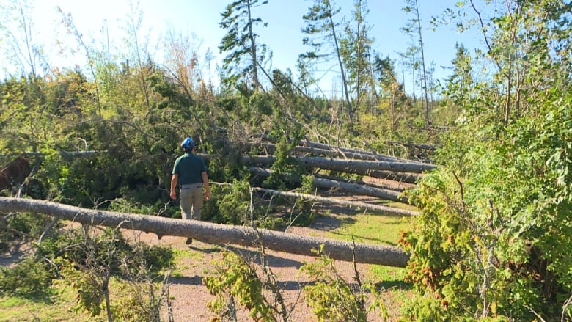
The Aftermath
Rebuilding begins.

Slide 16
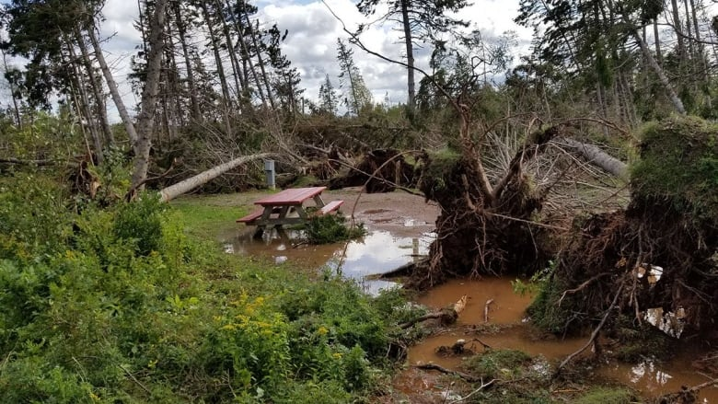
The Aftermath
Cavendish National Park Campground closed until further notice.

Slide 17
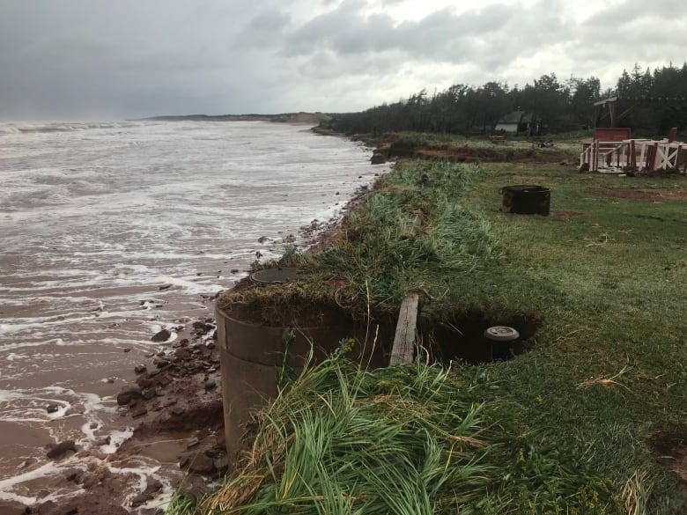
The Aftermath
Substantial coastal erosion everywhere.

Slide 18
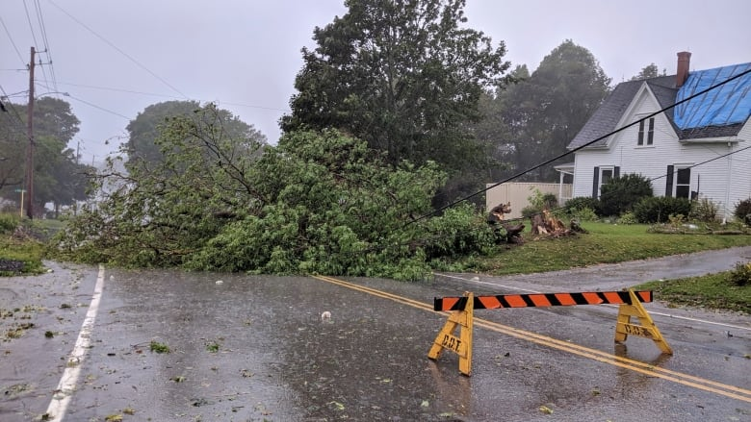
The Aftermath
Damage in a community on the south shore.

Slide 19
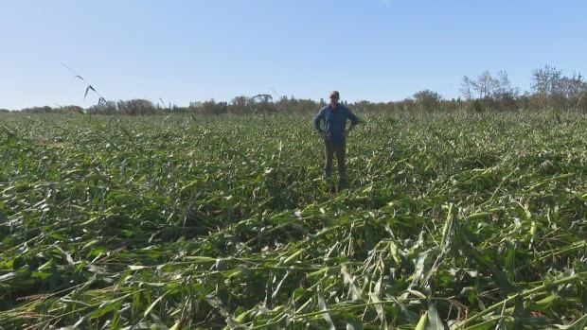
The Aftermath
Extensive crop damage.

Slide 20
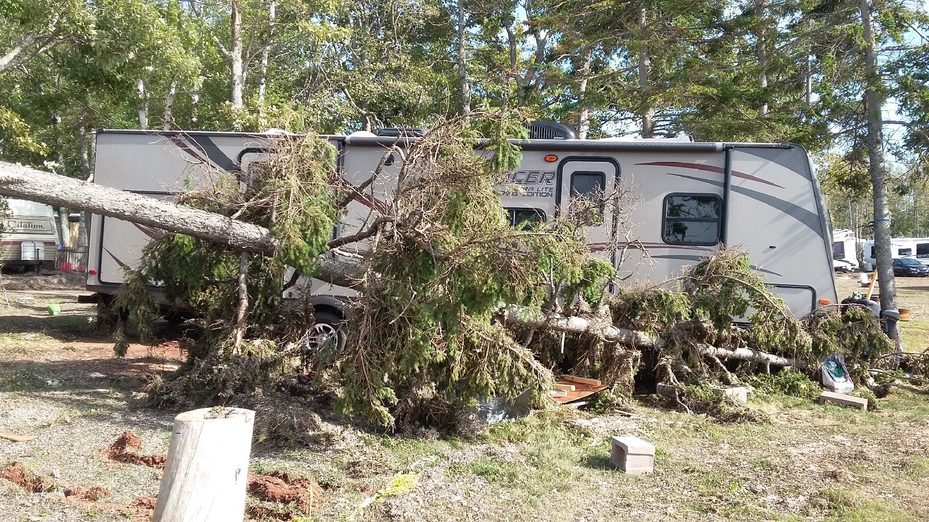
The Aftermath
Crystal Beach Campground, New Annan

Slide 21
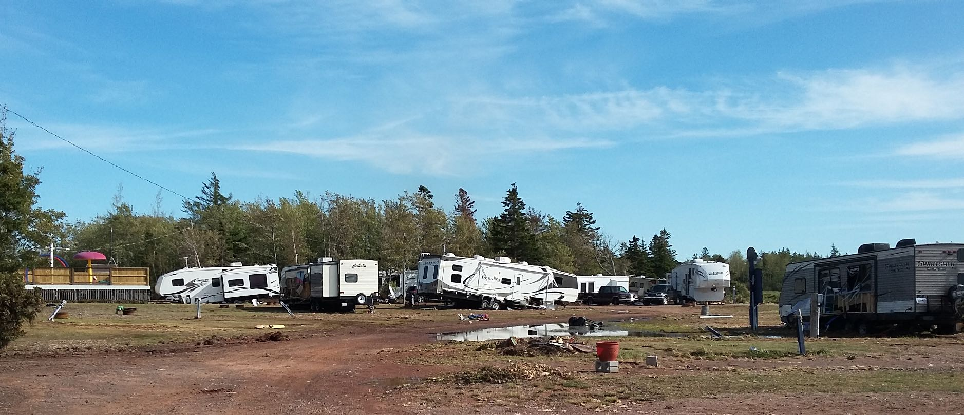
The Aftermath
Crystal Beach Campground, New Annan

Slide 22
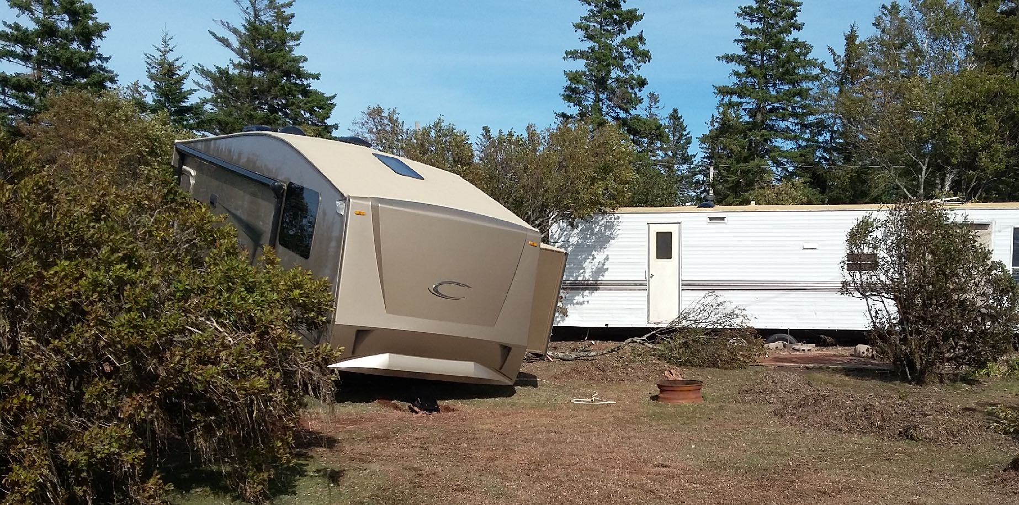
The Aftermath
Crystal Beach Campground, New Annan

Slide 23
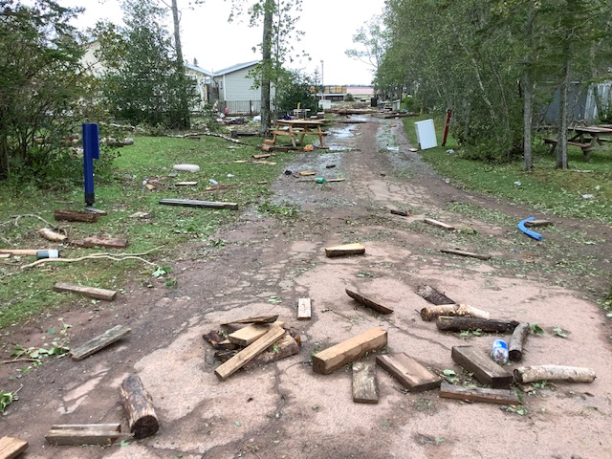
The Aftermath
Roadway littered with firewood.

Slide 24
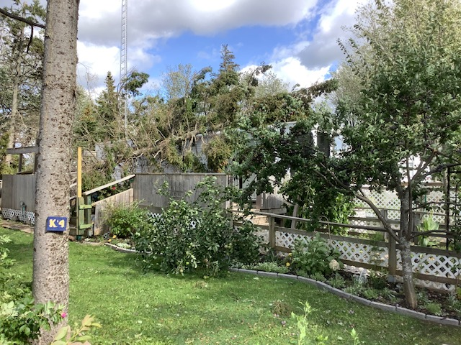
The Aftermath
A tree fell on a friend’s trailer.

Slide 25
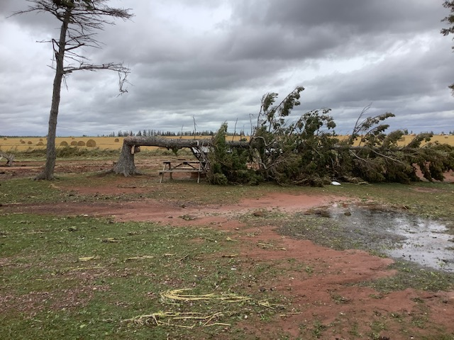
The Aftermath
Toppled trees everywhere, most uprooted.

Slide 26
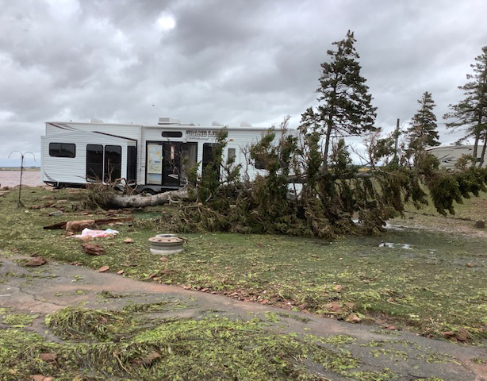
The Aftermath
Our campsite, Crystal Beach Campground, New Annan

Slide 27
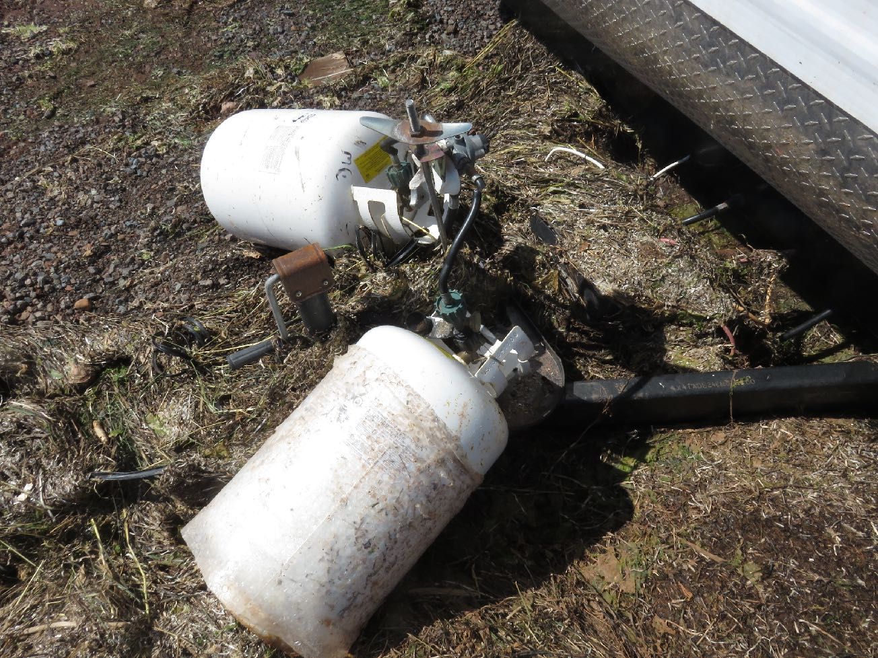
The Aftermath
Our campsite, Crystal Beach Campground, New Annan

Slide 28
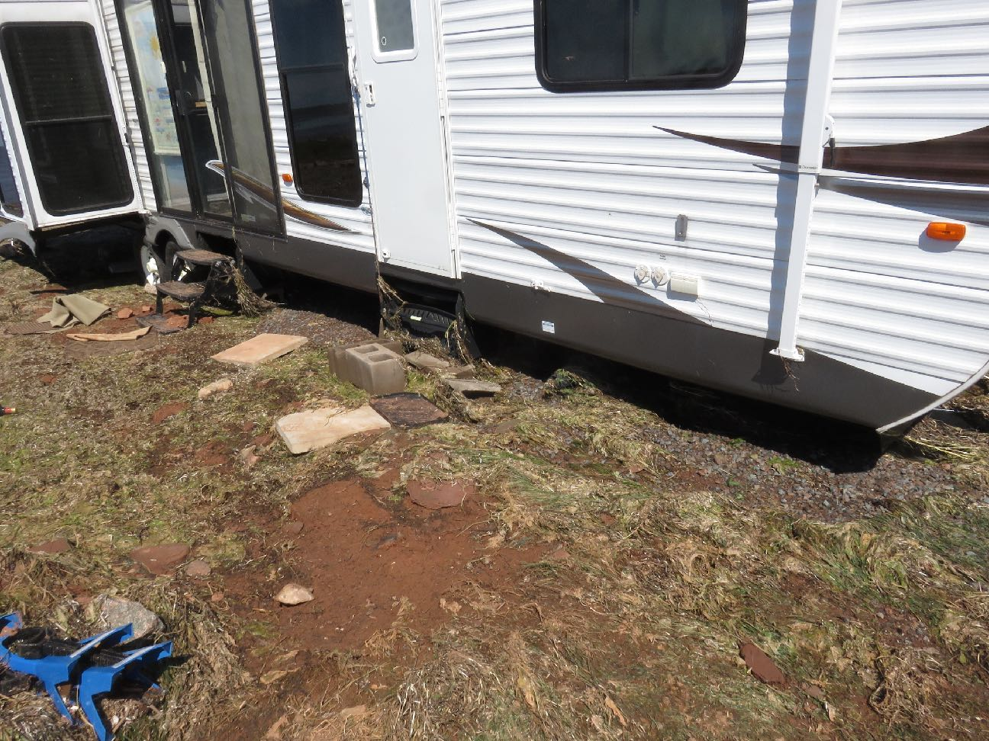
The Aftermath
Everything outside is now gone, including the deck.

Slide 29
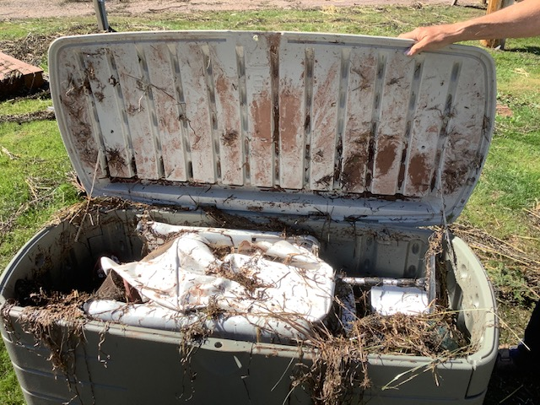
The Aftermath
Our storage bin floated away 400 feet, filled with sand and seaweed.

Slide 30
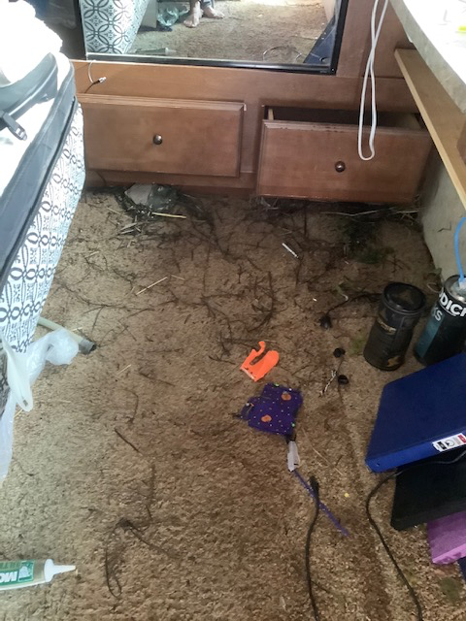
The Aftermath
Our 40’ trailer filled a foot deep with seawater and seaweed.

Slide 31
The Aftermath
Our neighbour’s identical trailer, viewed from our trailer

Slide 32
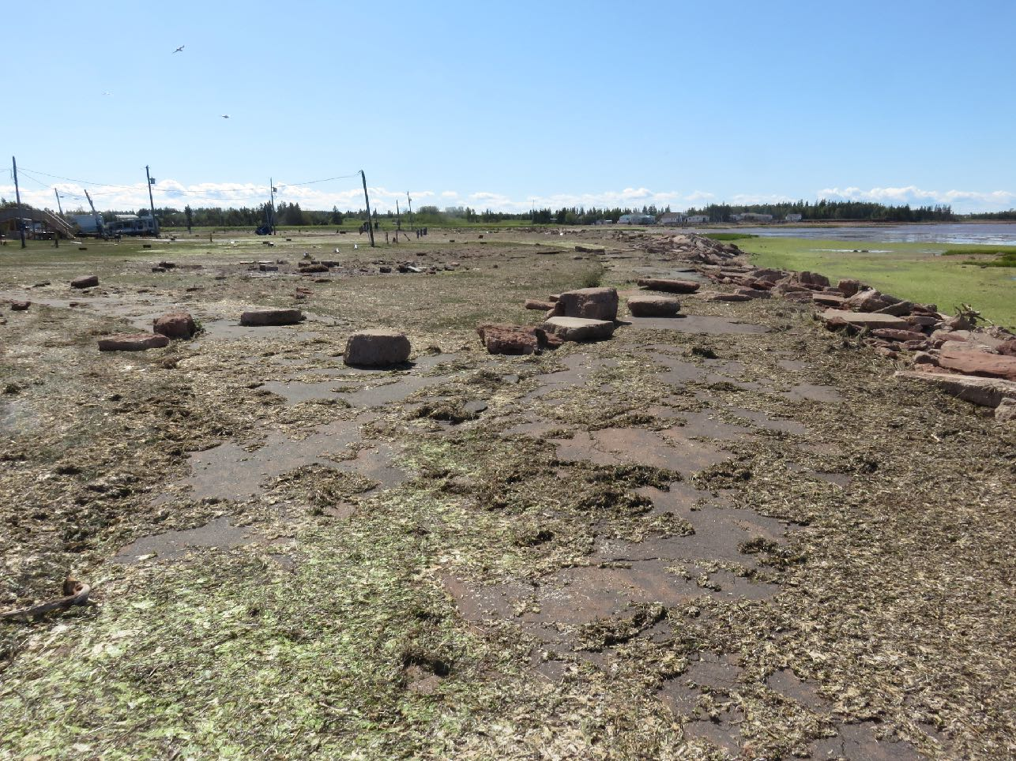
The Aftermath
Rocks thrown up from shore
Our neighbour’s trailer is gone.
Paved road along shore
Roadway along shore was eroded, boulders tossed up from the breakwater.

Slide 33
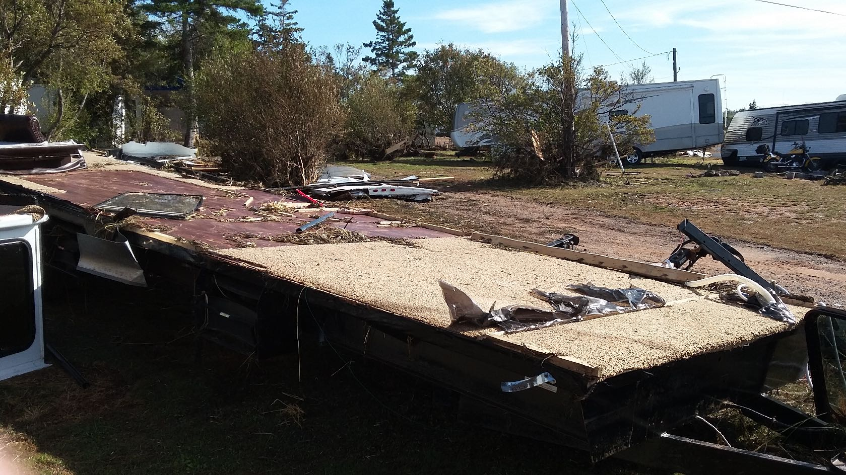
The Aftermath
This is all that remains of our neighbour’s trailer.

Slide 34
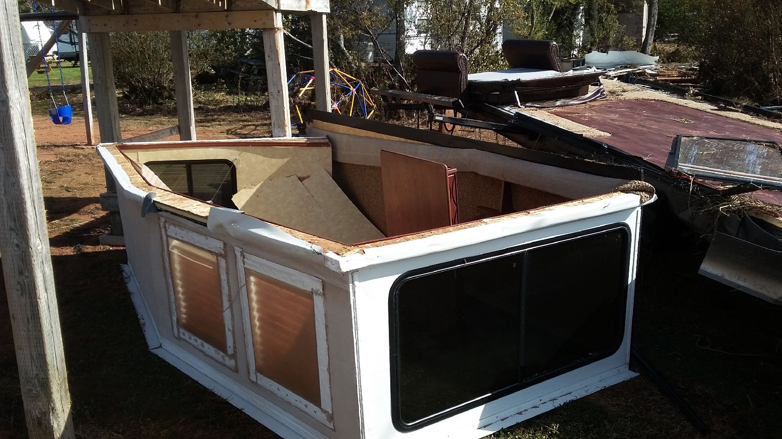
The Aftermath
This is what remains of the dining area walls.

Slide 35
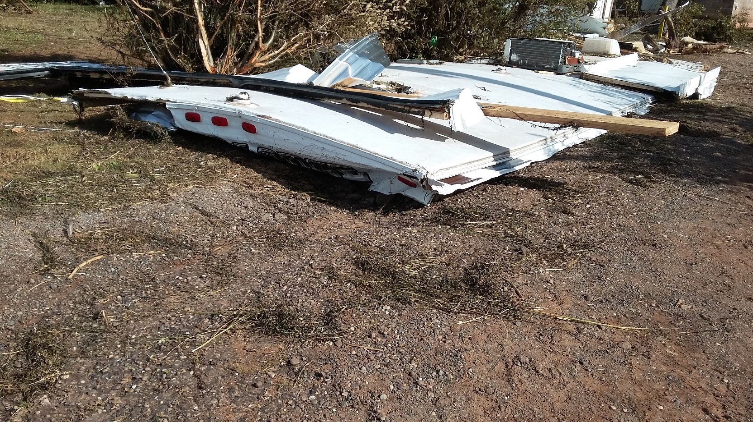
The Aftermath
Remains of part of the roof.
Lucky for them having left in time for their home in Summerside.

Slide 36
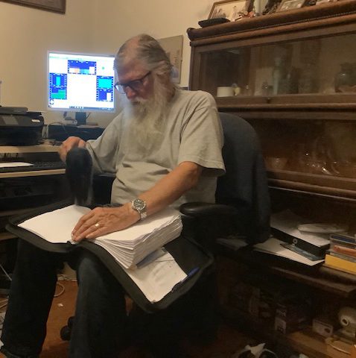
The Aftermath
Some books & binders could be salvaged using a hair dryer.

Slide 37
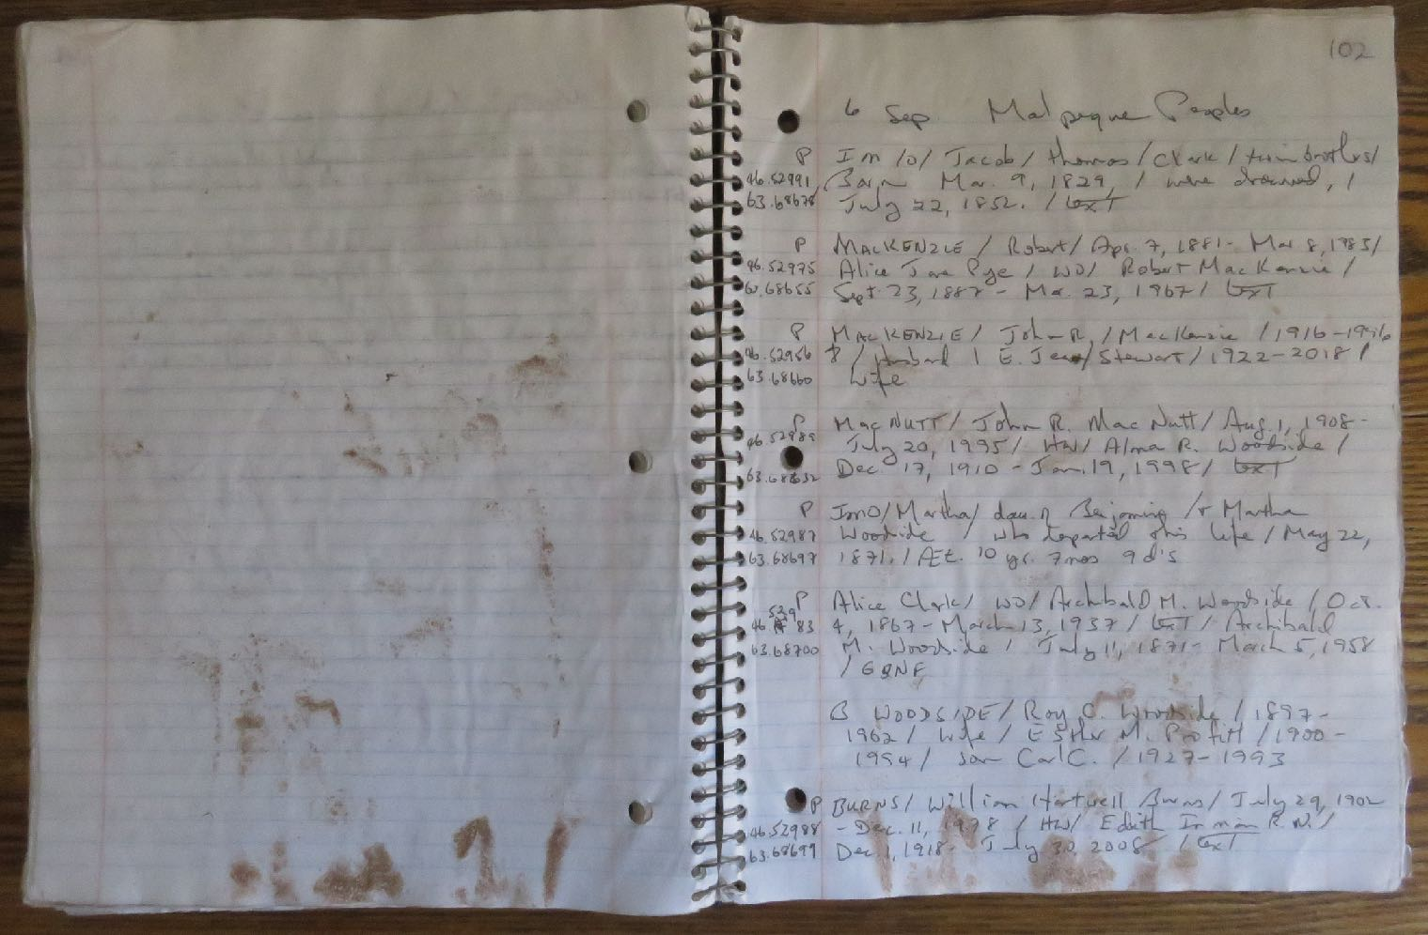
The Aftermath
My cemetery notebook saved with a hairdryer, stained with sand.

Slide 38
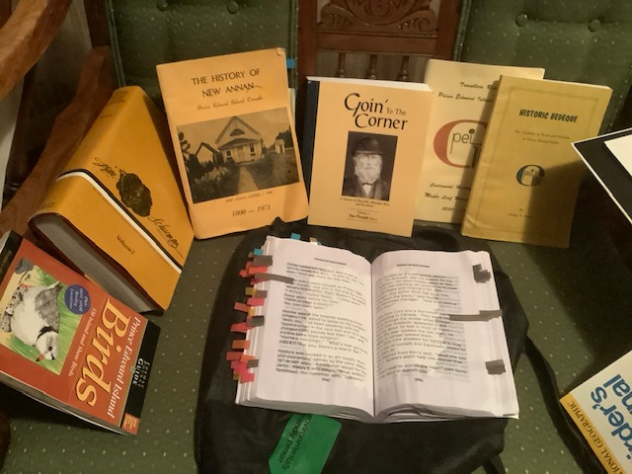
The Aftermath
Many rare books were soaked beyond repair.

Slide 39
The Aftermath
We lived with my cousin in Borden for a month while we recovered as much of our personal items as possible, packed & stored them in totes.
We had two trailers, one for commuting between Ontario and Prince Edward Island, and our home away from home trailer in which we lived for 5 months each year. Both were write-offs. The commuting trailer has since been replaced, during the time that we were cleaning up. We are negotiating with the RV dealer for replacement of the vacation trailer.
Miraculously, no one was killed or even injured, unlike the tragedy in the Bahamas.

