Slide 1
Some Photography Tips When Documenting Cemeteries
David Walker
Ottawa TMG Users Group
15 November 2014

Slide 2
This presentation will feature two photographic aspects of tombstone documentation that I use routinely.
Choice of lenses
Use of a polarizing filter to remove reflections

Slide 3
TIP: When out for a day trip to cemeteries, begin the recording session with a photograph of the cemetery sign. If this is the first visit, take an overview of the cemetery. When you import your photos into a computer, they are then easily separated into groups by cemetery.

Slide 4
Choice of Lenses
I have two lenses that I routinely use for cemetery documentation
Sigma 10-20mm zoom lens to record panoramic view of cemeteries (also for tall buildings)
Nikon 18-200mm zoom lens to record complete tombstone, then close-up of front, left, right and rear

Slide 5
Choice of Lenses
The Sigma 10-20mm zoom lens is an excellent choice for panoramic photographs
If you are in a particularly large cemetery a single frame, even at 10mm, may not be sufficient to capture a representative view of the cemetery
Microsoft ICE (Image Composite Editor) is an excellent, and free, application to stitch images
Hugin, also free, is an excellent choice for Mac & Windows

Slide 6
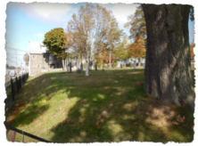
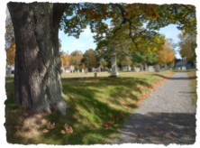
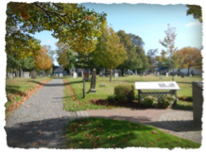
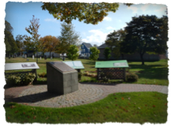
Composite Image
Note the centre road in each photo is not straight
These are 4 images from the Old Protestant Burying Ground in Charlottetown. When creating a set of such photos I advise a 10-15% overlap to ensure an adequate number of common data points between photos

Slide 7
Composite Image
This is a composite image of the Old Protestant Burying Ground in Charlottetown, created from 4 images using Hugin for Mac.

Slide 8
TIP: Set the exposure mode on your camera to Manual. Base your exposure on the brightest element (e.g. clouds, sky, sun). This is vital to maintain the same exposure for all common features, such as sky.

Slide 9
TIP: The technique of creating a composite image can also be used for scenery panoramic images. In this case I suggest taking the series of photographs in portrait format, thus allowing for larger images in the vertical dimension.

Slide 10
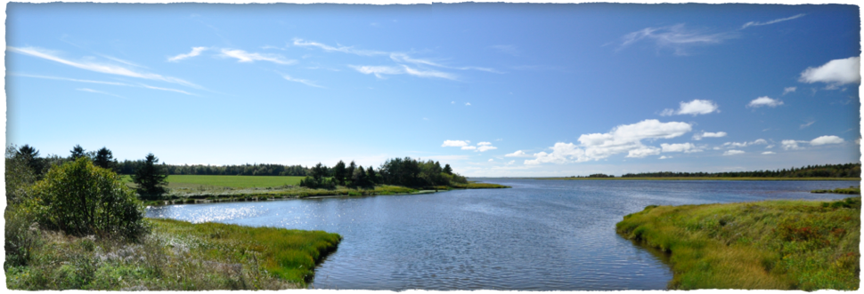
Indian River, Prince Edward Island.
This image is the result of stitching 5 images together using Microsoft ICE.

Slide 11
Malpeque Bay, Prince Edward Island.
This image is the result of stitching 5 images together using Hugin for PC.

Slide 12
Use of Polarizing Filters
One of the most difficult types of tombstones are polished granite, especially black, because of reflections.
The source of annoying reflections can be grass, fallen leaves, other tombstones and you as the photographer.
Without the use of a polarizing filter your only recourse is to position yourself to the left or right of the marker to eliminate your reflection.
The downside to this method is the introduction of perspective distortion, which can be corrected somewhat with image editing software.

Slide 13
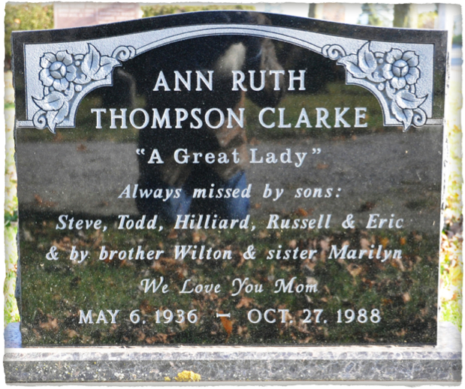
Use of Polarizing Filters
A Good Example of a Bad Example
Marker
Pathway
People
Grass &
leaves

Slide 14
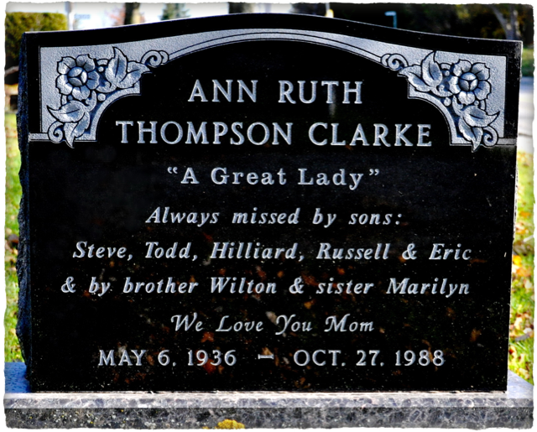
Use of Polarizing Filters
Corrections Using Filter & Image Editor
Start of removal of blemishes with Clone tool in ACDSee

Slide 15
This presentation is available to download from our web site, on the Articles & Presentations page.
http://ottawa-tmg-ug.ca/

