Slide 1
Using TMG v.9.05 Flags to Create Custom Pages in Second Site v.6.4.0
Presented by ~ David Walker
To ~ Ottawa TMG Users Group
3 March, 2018

Slide 2
Introduction
TMG Flags, whether standard or custom, are useful tools as filters in the Project Explorer.
They can also be useful in creating a Custom Page in Second Site.
This presentation will illustrate steps to create a web page with a table all known Loyalists in your TMG data.
Current software versions used for this demonstration are TMG v.9.05 and Second Site v.6.4.0

Slide 3
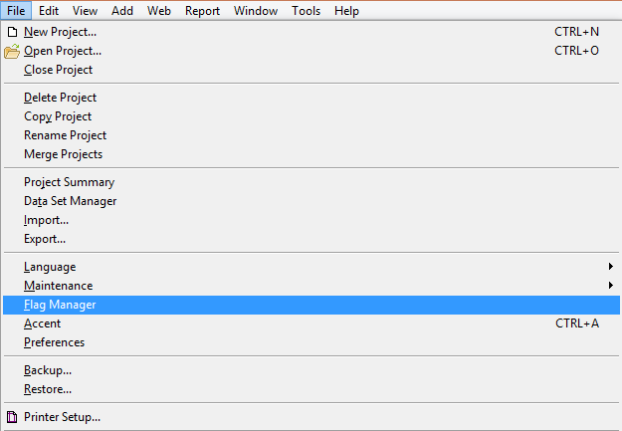
Procedure - TMG
TMG - File > Flag Manager

Slide 4
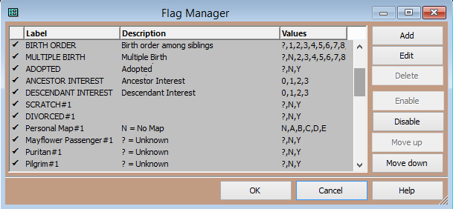
Procedure - TMG
TMG - File > Flag Manager > Add

Slide 5
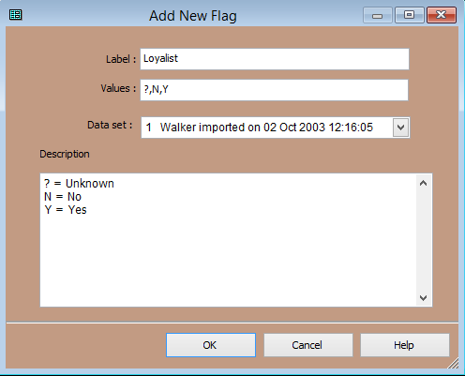
Procedure - TMG
Leave default Values, or change to whatever you wish to use.
TMG - File > Flag Manager > Add > Enter name of flag

Slide 6
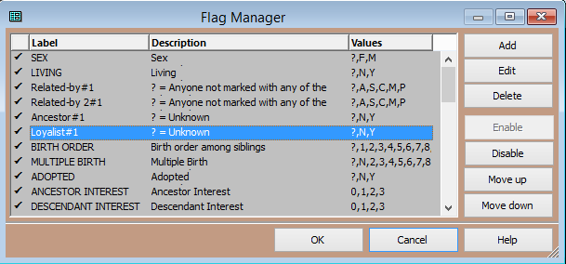
Procedure - TMG
The position of the flag can be moved within the list
A new Loyalist flag is now part of the list

Slide 7
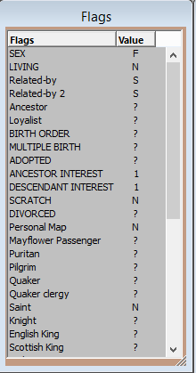
Procedure - TMG
This is the Flag window with the newly created Loyalist flag, with ‘?’ (Unknown) set to default

Slide 8
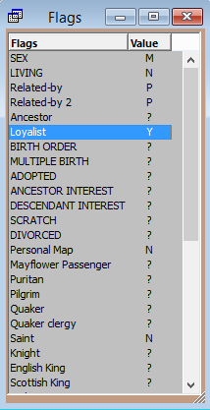
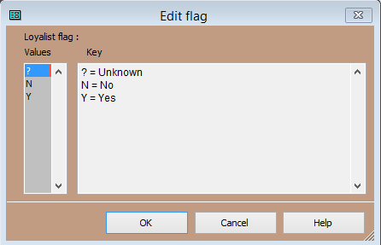
Procedure - TMG
Click OK
Click the flag to open the Edit Flag window, and change its value for the current person
Loyalist flag is now defined as Yes

Slide 9
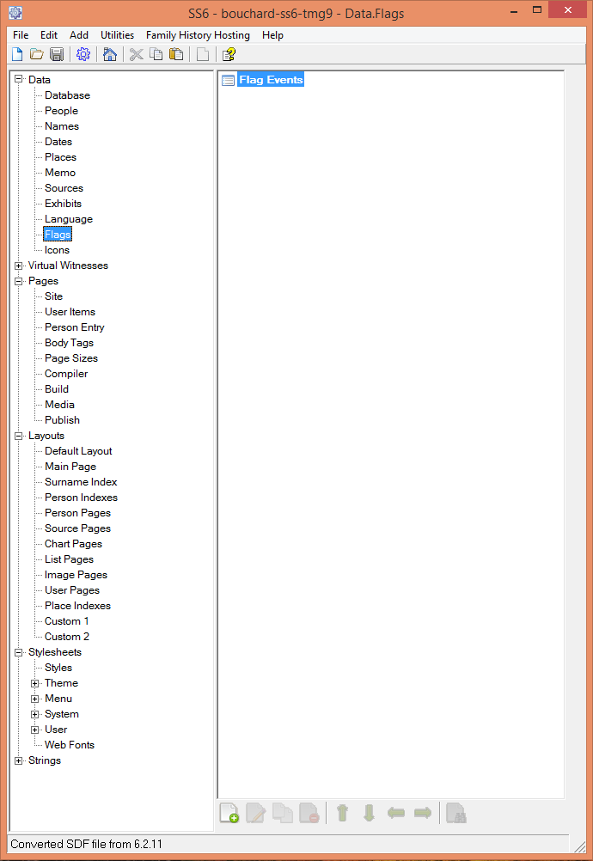
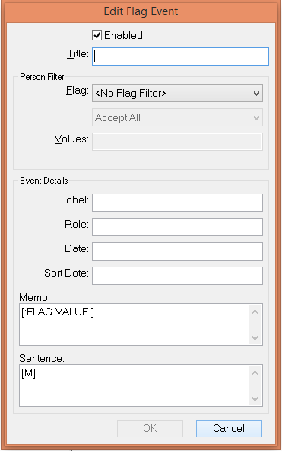
Procedure - Second Site
The first step is to create a Flag Event.
The Edit Flag Event window appears.
Click the ‘+’ icon.

Slide 10
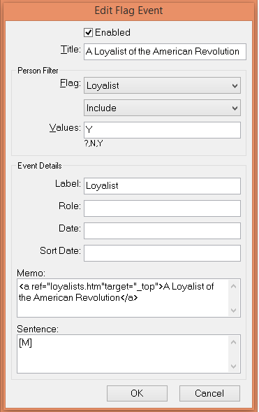
Procedure - Second Site
The ‘Enabled’ option is checked by default
Enter a Title you wish to appear in the Second Site Person Page.
From the drop down list select the Flag to be used
Enter the Event Label. This will appear with the other events.
Enter the text that will appear with other events.
The Sentence will be the above Memo.

Slide 11
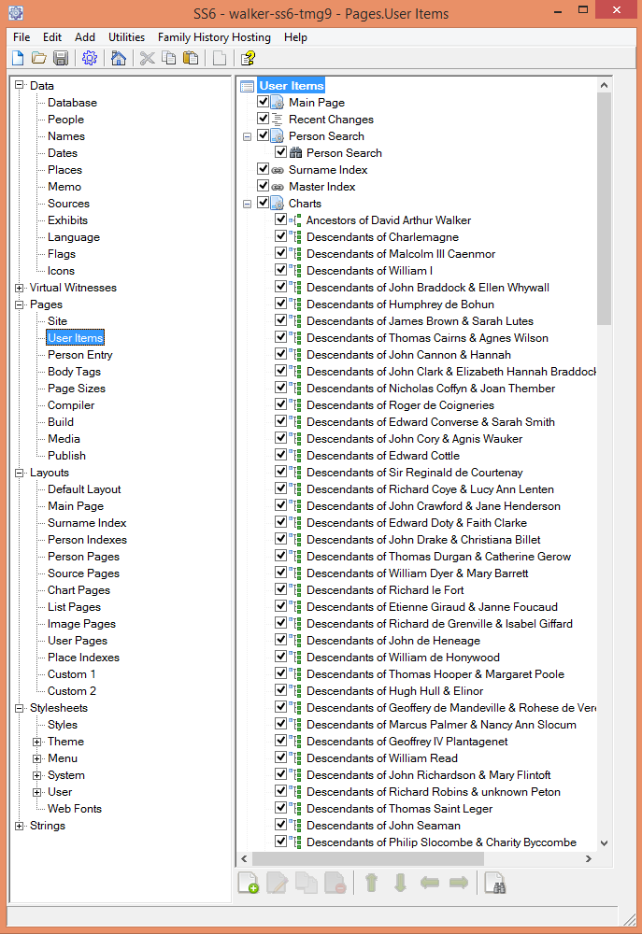
Procedure - Second Site
The next phase consists of creating a custom User item.
Select User Items, then Add

Slide 12
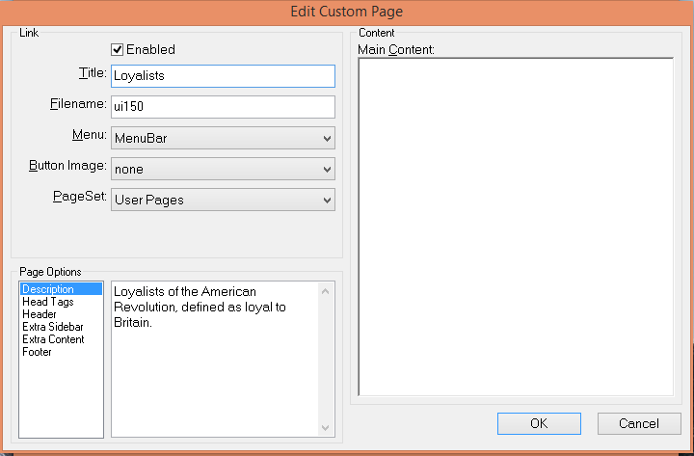
Procedure - Second Site
Text entered in the Title will appear in the button.
Text entered in the Description will appear above the table of Loyalists.

Slide 13
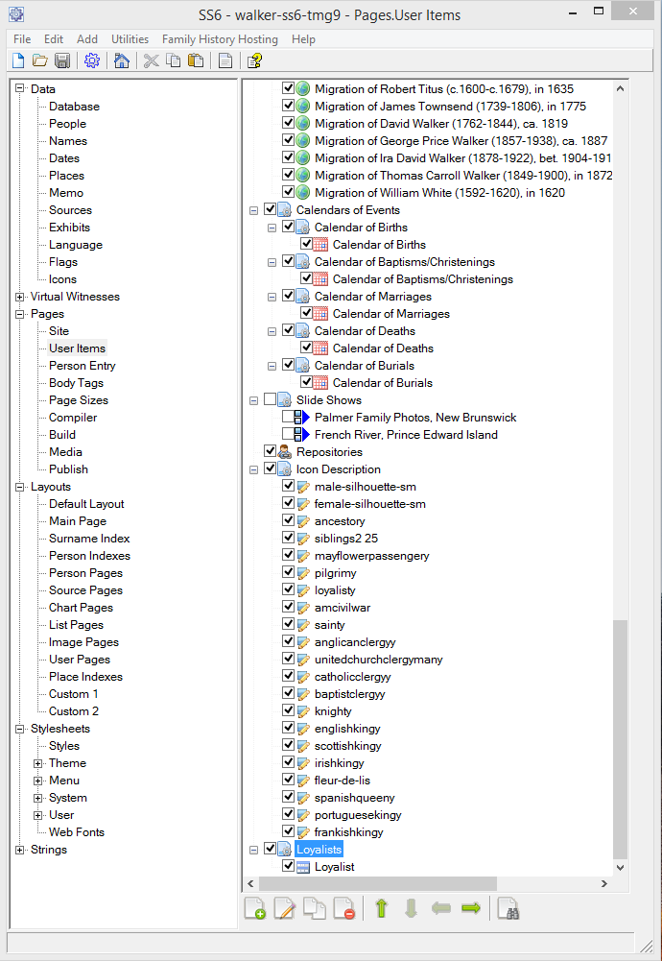
Procedure - Second Site
In the next stage we will create the List of People.
Having created the new User Item, highlight it and click ‘Add’.

Slide 14
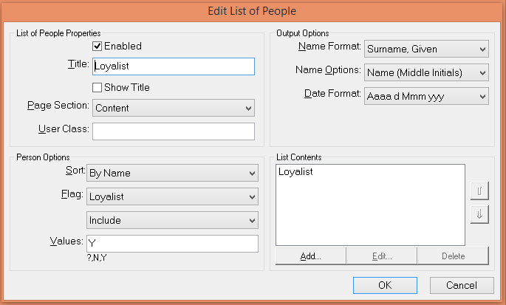
Procedure - Second Site
In the Person Options pane select the Flag to be used, and Value to be Yes

Slide 15
Procedure - Second Site
The final step is to create the site.
Sit back and let Second Site do its job to build your site.

Slide 16
The Final Result
Click on the newly created custom item.

Slide 17
The Final Result
The result of this exercise was to create a table of known United Empire Loyalists in my TMG data, and present them in a table in Second Site. Click on any name to view a Person Page.

Slide 18
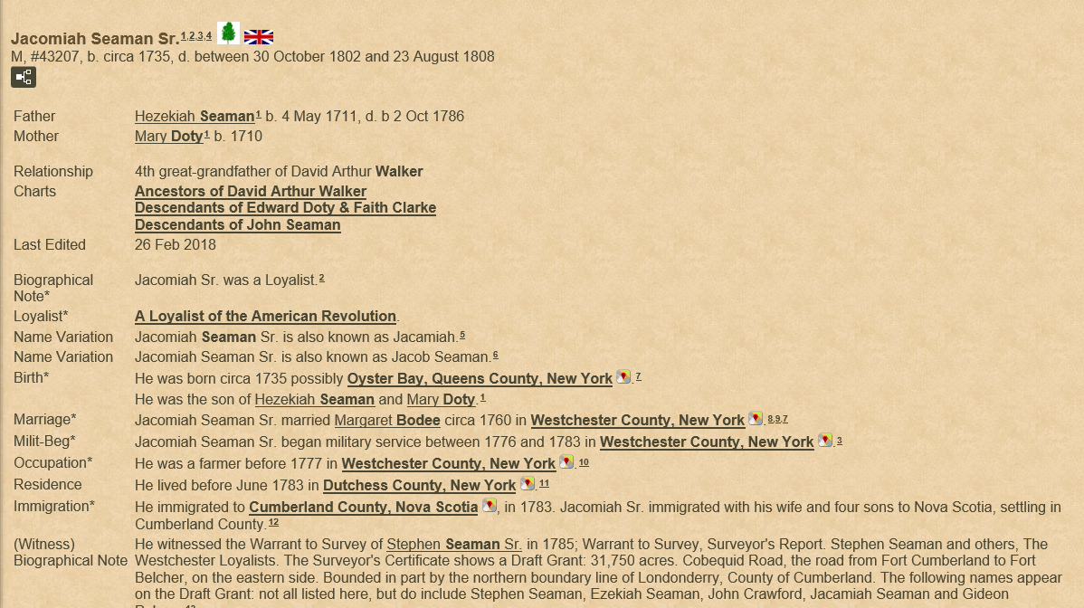
The Final Result

Slide 19
Future Plans
I intend to add additional Flag Events, including various wars, Mayflower passengers and British Isles royalty, using the same procedure as described above.

Slide 20
The End
This presentation may be freely downloaded from our web site ~
http://www.ottawa-tmg-ug.ca
Link to Articles & Presentations

