Slide 1
Creating a Journal Report
from TMG ~ Editorial Issues
Presented by David Walker
To Ottawa TMG Users Group
6 March 2021

Slide 2
Introduction
Generally, TMG Journal Report operations work very well. However, there are many times when what appears in a report is not exactly as what appears in the Preview window.
This is the first in a series of presentations to illustrate many problems that I encountered with creating a Journal Report.

Slide 3
Introduction
Microsoft Word constantly reminds me that are “too many spelling or grammatical errors”.

Slide 4
Example 1
Census Tag
Use of a comma to separate the text for Household creates a problem. The resulting journal text will not be the same.

Slide 5
Example 1
Census Tag
Removal of the comma results in a proper sentence

Slide 6
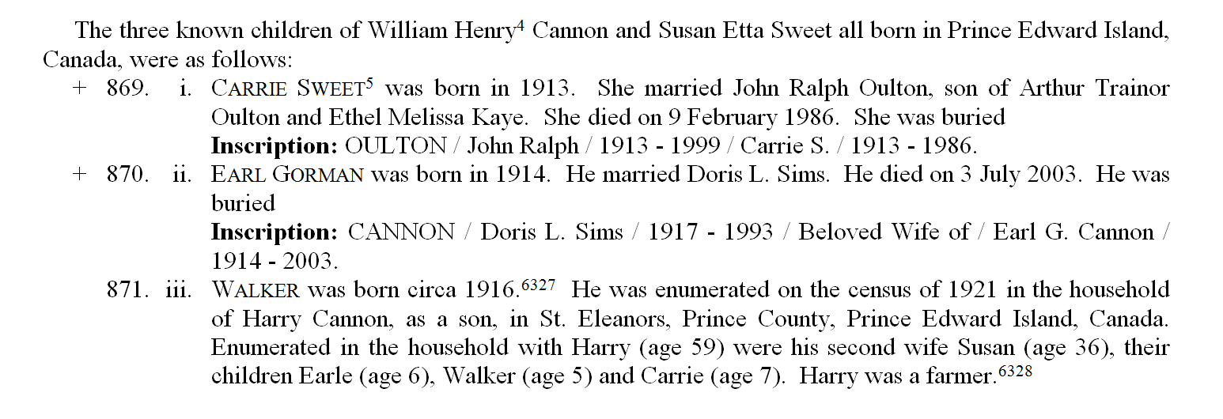
Example 2
Burial Tag
Problem: Incomplete burial sentences.
Clues

Slide 7
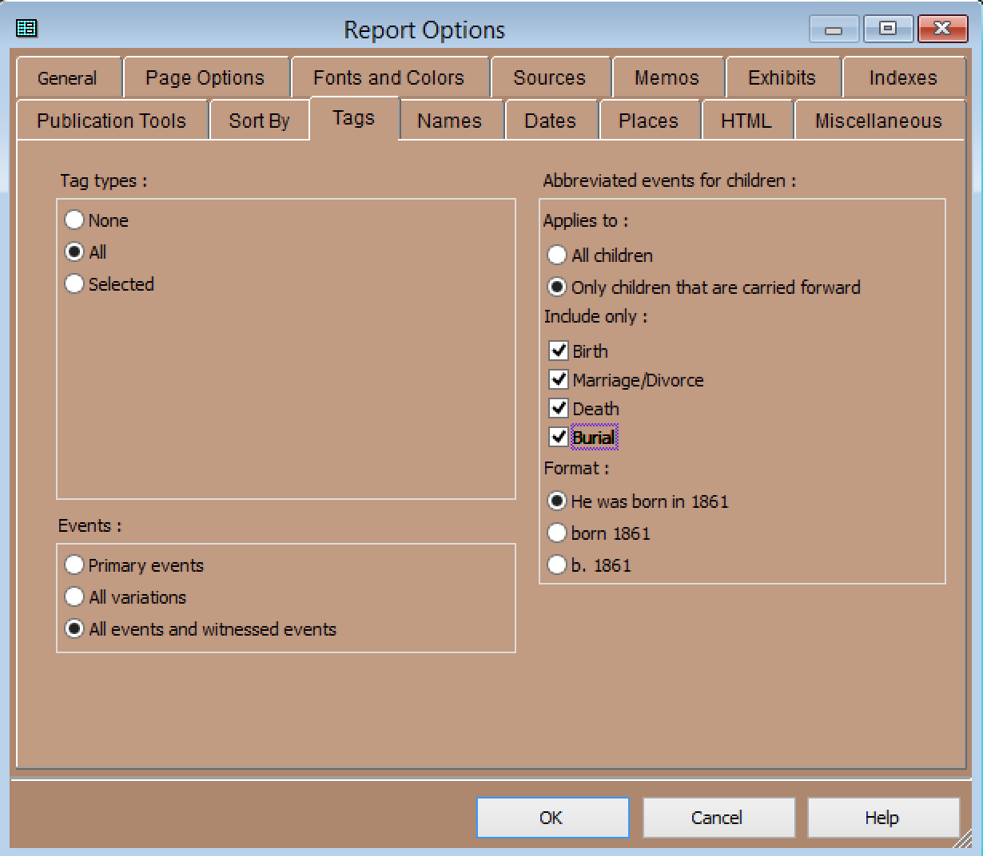
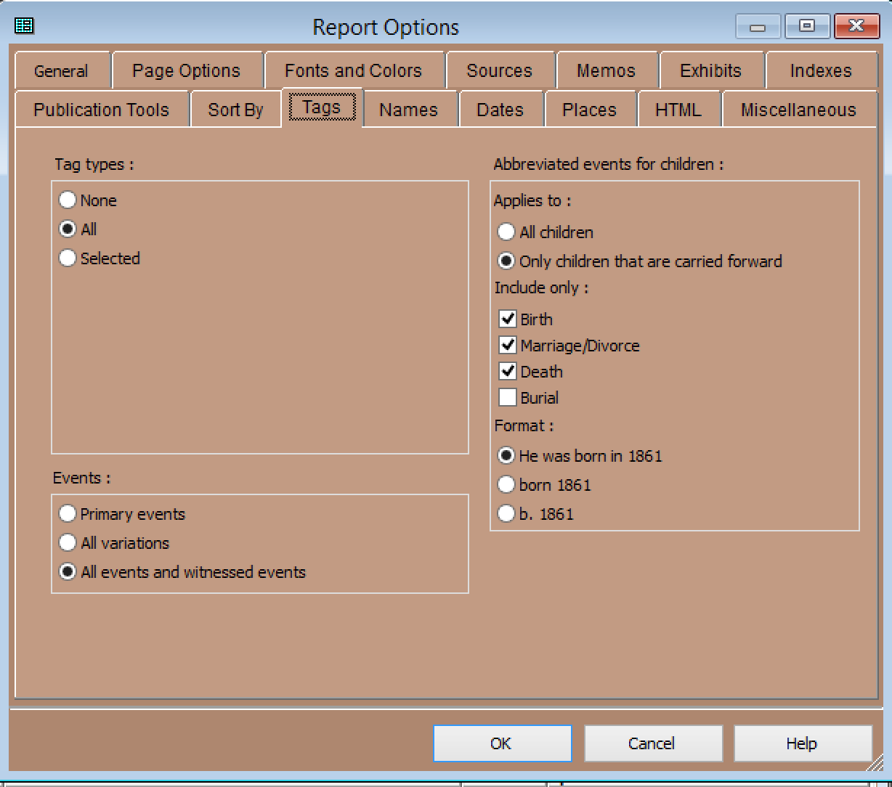
Example 2
Burial Tag
Problem found: Deselect Burial inclusion when opting for “Only children that are carried forward”

Slide 8
Example 2
Burial Tag
Problem solved - no partial sentences.
Complete burial information will appear when viewing their complete entry.

Slide 9
Example 2
Burial Tag
Carrie Cannon’s complete story.

Slide 10
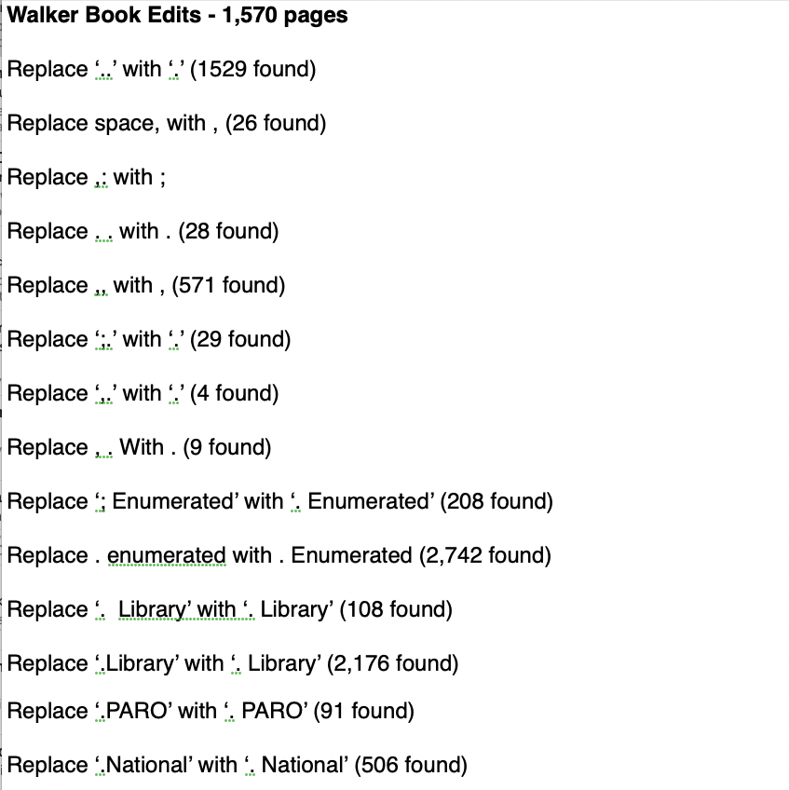
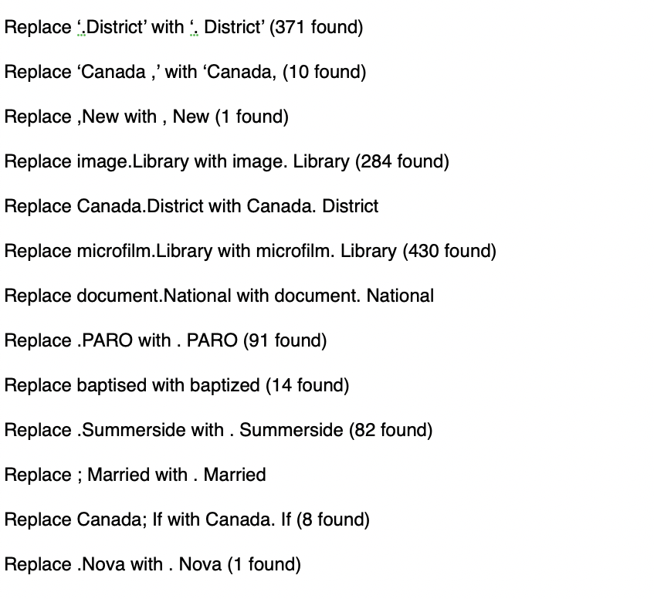
Example 3
Punctuation
Even though the Preview window looks as expected, the Journal Report will often appear different, in both body of text and citations.

Slide 11
Conclusion
Knowing the growing number of pitfalls as I edit my book, you might ask why I am pursuing the task.
I could use Second Site to produce a virtual web site on CD. There are many benefits by selecting this route: much quicker, Second Site doesn’t have the issues seen with TMG Journal Reports.
The reason I have stayed with the route of the TMG Journal Report is that I like to turn pages.
I suggest that you create a Journal Report to learn how to better enter your data.

