Slide 1
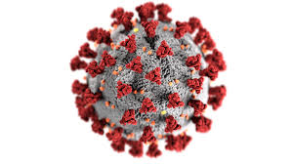
Pseudo People
Ottawa TMGUG
4 Feb 2023

Slide 2
Ottawa Branch of Ontario Ancestors is located on the traditional and unceded territory of the Algonquin people.

Slide 3
Pseudo Link Between Generations
Obituary: …Left to mourn and cherish Stan are his wife Patricia of 47 years, daughters Christine (Gaston) Poulin, Brenda (Thomas) Golas, son Steve Schneider, grandchildren Derrick, Stephan, Michael, Alyssa, Ashley, Meagan, great-grandson Landon…
You know where the children connect but where do the grandchildren and great grandchildren, with no surnames, fit in. Or when there are two or more sons, so multiple grandchildren share a surname?

Slide 4
Family Tree
?
grandchildren Derrick, Stephan, Michael, Alyssa, Ashley, Meagan, great-grandson Landon…

Slide 5
Added Pseudo Child
Added a Pseudo “child” to the family to act as a placeholder to the grandchildren. The Pseudo person has the Family surname and the GivenName of “-link”

Slide 6
Added Pseudo Child

Slide 7
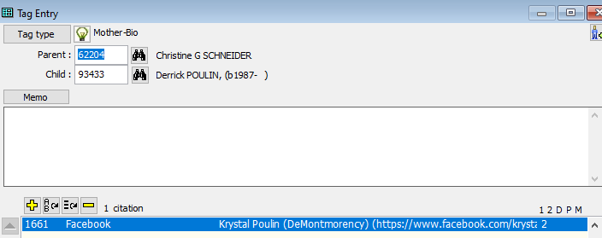
Next steps
When you determine who are the parents of the grandchildren, simply replace the ID number in the relationship tag with that of the real parents. When all grandchildren are linked properly, delete the Pseudo person

Slide 8
Added Pseudo Child

Slide 9
Pseudo Census Person

Slide 10
Pseudo Census Person: Tag

Slide 11
Pseudo Census Person

Slide 12
Pseudo Census Person

Slide 13
Pseudo Census Person: Roles

Slide 14
Pseudo Census Person: Roles

Slide 15
Pseudo Census Person: Roles
Stray: [W] was listed with the household of [R:Head Of Household] in the [P] <for [L]>
Early: [W] was probably the person counted (but not named) in the household of [R:Head Of Household] in the [P] <for [L]>.
FamMem: [W] was listed in the household of [R:Head Of Household] in the [P] <for [L]>
Manual edit:
FamMem: [W] was listed as the nephew of [R:Head Of Household] in the [P] <for [L]>

Slide 16
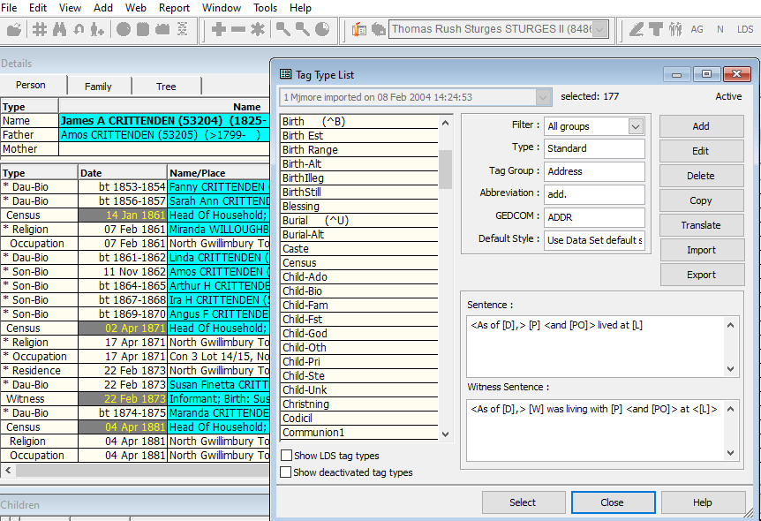

Slide 17
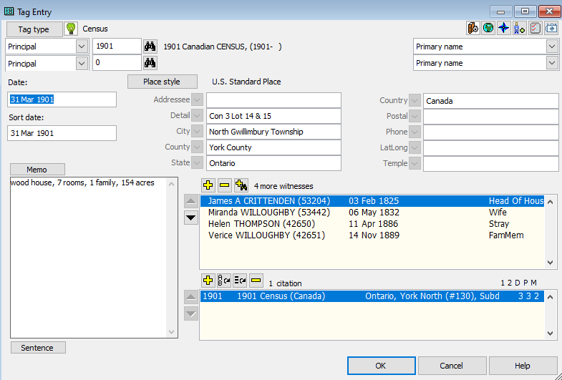

Slide 18
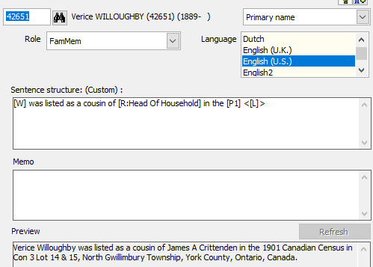
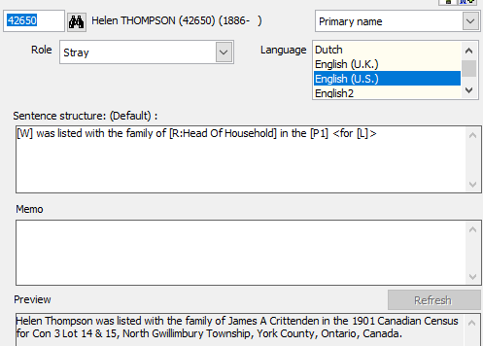

Slide 19
Pseudo Census Person: Sentence
Head: Malcolm W McRae was listed as the Head of the Household in the 1901 Canadian Census for SE Sec 34 Tp 4 R 29 West of the 4th Meridian, Pincher Creek, Alberta, Canada.
Wife: Elizabeth Catherine McClean was listed as the wife of William Arnold McClean in the 1901 Canadian Census for 48 Birch St, Owen Sound, Grey County, Ontario, Canada.
FamMem: Margaret Duncan was listed as the niece of William Arnold McClean in the 1901 Canadian Census in 48 Birch St, Owen Sound, Grey County, Ontario, Canada.
Early: Lewis Billings was probably the person counted (but not named) in the household of Leavett Billings in the 1790 US Federal Census for Sharon, Norfolk County, Massachusetts, USA.
Stray: Sherman Belfry was listed as a lodger with the household of Henry Stiles Belfry in the 1901 Canadian Census in the East part of Ryan Block, Bradford, Simcoe County, Ontario, Canada.

Slide 20
Customizing TMG™ Guide to General Style My Way ©MJH by Michael J. Hannah
mjh-nm.net/STYLE.HTML#PseudoPeople

