Slide 1
Mike’s TMG Tips
Ottawa TMGUG
7 Jan 2017

Slide 2
Social Media Update
TMG-REFUGEES:
(http://lists.rootsweb.ancestry.com/index/other/Miscellaneous/TMG-REFUGEES.html)
Website: https://sites.google.com/site/tmgrefugees
TMG Facebook Page: two posts plus comments in December
(https://www.facebook.com/groups/themastergenealogist/)
TMG Mailing List (http://lists.rootsweb.ancestry.com/index/other/Software/TMG.html)
Oct 2016 41 messages
Nov 2016 69 messages

Slide 3
TMG Download
TMG 9.05 USA Version http://www.whollygenes.com/files/tmg9setup.exe
TMG 9.05 UK Version http://www.whollygenes.com/files/tmg9uksetup.exe
You should select to save the file to a location on your system. Then double-click on the file after the download is finished. This opens the installer and begins the installation. You should tell the installer to install the program in the same place that an earlier v9 version is already installed. This will overwrite the installation with the v9.05 version while leaving your data alone. After v9.05 is installed, you should be able to open (or restore and open) your v9.05 projects. If you happen to restore a project from an earlier version, v9.05 will upgrade it at the time.
Notes:
Norton found a problem with the UK Version when I tried to download it.

Slide 4
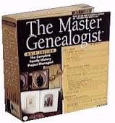
Upgrading to TMG 9
To get TMG 9 you need to buy a license code, which is available only from Harry Goegebeur, the TMG dealer in Holland, and download the installer. Links to both are in Terry Reigel’s article at
http://tmg.reigelridge.com/future.htm#wait

Slide 5
Windows 10
TMG 9.05 runs fine on Windows 10 Preview 10030 - Don Ferguson
For various reasons, Windows will "lose" the unlock information and require you to re-enter it. Follow the instructions given on Terry Reigel's page at <http://tmg.reigelridge.com/new-computer-version.htm#unlock. And use the exact information given you for your license (name, e-mail address, and serial) even if anything has changed.

Slide 6
History Research Environment (HRE)
History Research Environment is a community project to create a free platform-independent application for the serious amateur or professional historical researcher.
For genealogists, HRE will provide an onward path for users of the discontinued program The Master Genealogist (TMG).
HRE will also handle a very wide range of other historical and cultural research needs.
Project website: https://historyresearchenvironment.org Volunteer skills: https://historyresearchenvironment.org/become-a-volunteer/ Donate: https://historyresearchenvironment.org/donate/ Wiki: http://hrewiki.org/index.php?title=Main_Page
Notes:
Nothing new with Rootsweb down.

Slide 7
Word 2013 incompatible w/TMG?
Note: If you are using Microsoft Word 2013, you should choose the Rich Text Format (RTF) file type to save the report rather than the Microsoft Word (DOC) file type. This tabular report is not compatible with the table structure used in Microsoft Word 2013.

Slide 8
Problem backing up files
I get an error notice when I try to back. The notice is "Input file read failure - This error occurs when a read operation is performed on a ZIP file that is locked or restricted by another process."
Where are you "backing up to"? Where is the backup file being created? It sounds like you are backing up to a thumb drive or other external drive. You should make backups to the default TMG Backups folder, and if you want it on the thumb drive then copy the backup file to it. A similar kind of error can occur if you have TMG folders included for backup to a Cloud drive. In this case, exclude the TMG folders from the Cloud and copy the created TMG backup file to a folder that is included in the Cloud use.

Slide 9
Multiple Projects
Lee Hoffman: I do not know your reasons for having two separate projects. I have some projects that I do want separate (mostly small and usually only lasting a few months). But for the majority of my data, I have everything a in a single project and a single data set. I do extensive collaborations with other researchers and find it easy to extract just those of interest to any one researcher for data exchange. Occasionally, I will create a second (or more) data set(s) of small groups for temporary use -- primarily for analysis and report writing. After I have finished with one of these small temporary data sets, I delete it. I never do updates to one of these small data sets and do all updating to the main data set. At the present time, my main project has some 60,000 persons which include my and my wife's extended families and ancestors. In addition, it includes many (very) extended connections. These are often people that are not related at all, but have children or grandchildren that have some kind of connection to a family.

Slide 10
Data Entry: Names
You may create as many name records as needed to record all variations, nicknames, or aliases for an individual. Married name records can be created automatically when you enter a marriage.
Name Types: Name-Baptm, Name-Chg, Name-Marr, Name-Nick, Name-Var (Standard Name)

Slide 11
Custom Name Types
Name-Com:
[P] was commonly known as [N] <[M]
Deszo Aczel was commonly known as Des.
Name-Maybe:
<As of [D], [PF] may have been known as [N] <[M]
As of 1 Jan 1900, Dezso may have been known as John Aczel

Slide 12
Name Variations

Slide 13
Sorting Names
Use the date fields if you would like the name tag to appear in chronological order on the Person View screen and in narrative reports. The Sort Date allows you to order events on the screen, but it does not print. You can enter an estimated date to make the events appear in chronological order on your screen without fear that the estimated date will be passed on to other researchers and mistaken for a real date

Slide 14
Married Names
The Name-Marr tag is used to document a married name for a wife. In general, the original entry for a woman uses her birth or maiden name. A married name record allows women to be searched for or filtered on the Picklist and Project Explorer by either their maiden names or their married names. There is no limit to the number of name records each person can have.
NOTE: Given names need not be part of the Name-Marr tag. The program will include the given name element in the Picklist and Project Explorer, even though it is not included in a Name-Marr tag.

Slide 15
-(Cole)

Slide 16
Data Entry: Dates
Sort Date (Turned off in Beginner Mode)
Sort dates are used to maintain chronological order on the Person View, and in narrative reports, Individual Detail reports and Family Group Sheets. They do not print or export and have no genealogical significance

Slide 17
Date Display Formats
Dates are displayed on the screen in a consistent format based on your Preference setting.
In File Preference Program Options: General, you have a choice of nine different display formats.
Regardless of the screen display Preference selected, dates will be output in reports based on the Report Options for that report. Since the program can spell out the name of the month in reports if requested to do so in the Report Options, there is no need for a display format to spell out the month on screen.

Slide 19
Date: Incomplete or Irregular
A date with one or two digits in the year is considered an incomplete or irregular date, as it cannot be recorded in the correct century. If TMG can interpret the number as intended to be a year it will prompt you for the intended century. To avoid ambiguity, when entering dates be sure to use all four digits for the year. An incomplete date containing an alphabetic month can usually be appropriately interpreted by TMG. If an all-number date is incomplete (entered with less than three parts) TMG must guess what is missing. TMG's interpretations of ambiguous or incomplete dates are stated in Date Format and may be partially based on the date display setting in File Preferences Program Options: General. In all these screen display formats for dates, a missing value in an incomplete date is displayed using underlines.
Any date that does not meet the criteria stated in Date Format is considered an irregular date. There may be times when you want to place text in the date field, e.g., "the 6th day of the 4th month". The date field will accept such text and you may keep the events on your display in chronological order by placing a regular date in the Sort Date field.

Slide 20
Legal Date Entry Formats
30 Aug 1864
30 August 1864
Aug 30, 1864
Aug 30 1864
August 30, 1864
August 30 1864
30/8/1864
30 8 1864
30/08/1864
30 08 1864
8/30/1864
8 30 1864
08/30/1864
08 30 1864
1864.8.30
1864 8 30
1864.08.30
1864 08 30

Slide 21
Best Way to Separate Two Trees
I have a project with two trees in it. They are trees that were built of ancestors and descendants of two men with the same name but in different locations. I have not seen any connection between the trees yet. I would like to work with each tree separately. Right now I want a list of people so I can get death dates, then get obituaries. What is the best way to separate them so I can get these separate lists. I have built a focus group for the more promising family but see any way to get reports by focus group.
Lee Hoffmann: Use the List of People report selecting the Focus Group as the Subject(s) of the report, and select Secondary Output (under [Options] to either Create New Project or Create New Dataset. I suggest the data set option. You can always create a new project later from the new data set if you need it.

Slide 22
Using Square Brackets in Memo
I noticed some odd output. My death tag for an ancestor has a memo of: “He died of Alter[s]schwäche [debility due to age]”
The output is: “He died of AlterGeorge Schubertschwäche [debility due to age]”
Terry Reigel: [S] is the subject variable for full name. If you don't want the square brackets to be read as code you need to add the "escape" character "\" so it reads: “of Alter\[s\]schwäche \[debility due to age\]”
You don't really need those in the second remark since that text is not a variable, but including them will keep Second Site from giving you a warning in the log about a possible misspelled variable.

Slide 23
Using Square Brackets in Memo
I noticed some odd output. My death tag for an ancestor has a memo of: “died of Alter[s]schwäche [debility due to age]”
The output is: “died of AlterGeorge Schubertschwäche [debility due to age]”
Lee Hoffman: This is strictly TMG and not Second Site (except that Second Site follows the TMG rules). But, yes the "[s]" is being interpreted by TMG as the Subject Variable. It has always been noted that the use of square brackets in TMG (other than surrounding Variables, etc. should either be avoided or used with caution. Note the use of square brackets around the English translation works as desired -- because TMG doesn't recognize it as a Variable (and doesn't known what to so, so outputs it as is).
I suggest that you use some other characters, maybe parentheses. If the bracketed 's' indicates that it is sometimes a double 'ss' there. You might try just leaving out the "[s]" and add "(or 'Altersschwäche')".

Slide 24
Printing Reports Using Accent Colors
Is it possible to print reports using the accent colors. I have accented certain people with background colors and have found that I can't print the background colors or don't know how to do that. If I use a different color for the letters of the name (as opposed to background) is there a way for the color to print? I am thinking of a pedigree chart now, but would like to use some other reports with color.
Don Ferguson: Almost all reports have an 'Honor Accent color' option - look under Options -> Fonts and Colors.

Slide 25
Printing Reports Using Accent Colors

Slide 26
Managing TMG Files
A project is comprised of many interrelated files but is identified by a single file with a .PJC file extension. A project contains one or more data sets and may be stored on any accessible drive and folder.
Terry Reigel: Most operations to manage Projects are done with the commands on the File menu. You open existing Projects or create new ones pretty much like you do files in any Windows application. The File menu has the following commands for Projects:
Open Project Close Project
Delete Project Copy Project
Rename Project Merge Project
Notes:
I raise this as I have seen too many instances of folks trying to manage their projects outside of TMG, using Windows Explorer, etc. That will cause major problems. It may seem like your TMG Project is just one file but it is actually made up of about 30 files all connected.

Slide 28
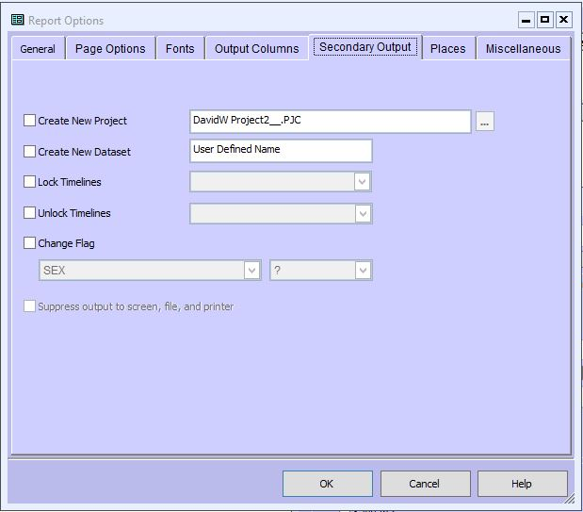
Managing TMG Files
There is another, less obvious, way to manage Projects and Data Sets. The List of People report has a Secondary Output function (click on the Options button on the Report Definition Screen, then click the Secondary Output tab). This function will copy all or a selected part of a Data Set to either a separate Data Set in the current Project, or in a new Project. Some operations may require several steps using these tools to accomplish the desired result. - Terry's TMG Tips

Slide 29
What is the best way to record people named in a will?
I recently found a will that provides a wealth of genealogical information. The author names four siblings and then leaves bequests to eight nieces and nephews, identifying each of the nieces/nephews by which of his siblings they belong to (e.g., "Sarah, the eldest dau of my brother George", "James, the eldest son of my brother Alexander, etc.).
I have recorded all of these names as Witnesses to the will (in addition to the true witnesses and the executors), but this is unsatisfactory in reports since all are then identified as "XXX witnessed the will...".
How do others record such information? Is there a better Role to use for people who are mentioned in a will, but not witnesses?
The reports output "XXX witnessed the will..." because you have not modified the Witness Sentence for that Witness. – Lee H.

Slide 30
What is the best way to record people named in a will?
Do I need to define a new Role for this purpose? If so, are there suggestions on how to do this?
You may wish to create Custom Roles with the appropriate Sentences to be used for the Witnesses. That would be the "global" fix for the situation, but there is nothing wrong with just modifying the "local" Witness Sentences in each such Tag to state the actual situation.
The downside of using local Sentences is that a later change to the Tag, Role or whatever will not automatically change the Sentence(s) to the 'new' Sentence(s). I don't find this a problem and use local Sentences all the time. I just keep aware of the fact that I may need to update the local Sentences if/when I do make a change to the Tag and/or Role assignment.
Should I somehow modify the report language to differently identify them?
That is the general idea of the Tag/Witness Sentences. They should reflect what you want the report to have. Thus you may need the modify the appropriate Tag/Witness Sentence (each Principal and each Witness has their own Sentence that may be modified. As noted above, you may prefer to create Custom Roles and assign certain person(s) to a particular Role rather than modify Sentences locally. Or you can have Custom Roles that cover most situations with an occasional modification of the Custom Role's Sentence locally.

Slide 31
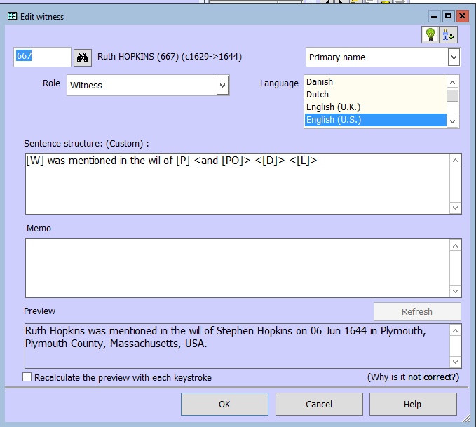
Notes:
This is an instance where I modified the "local" Witness Sentence.

Slide 32
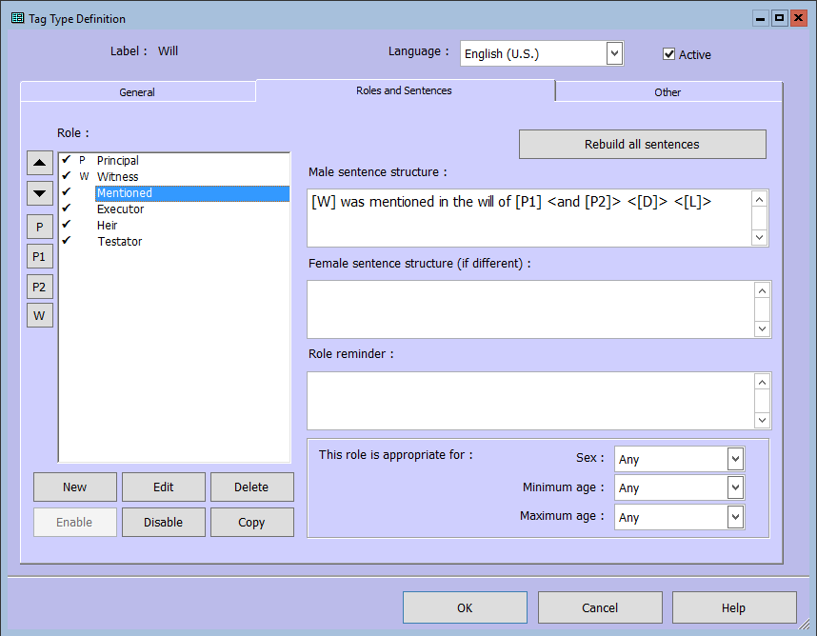
Notes:
It can be a lot of work to modify the sentence locally when you have a lot of instances, so I later added a new Role of Mentioned, with the sentence: “[W] was mentioned in the will of [P1] <and [P2]> <[D]> <[L]>”

Slide 33
Notes:
So now when I enter a Will, I simply click on the role of Mentioned. I can still modify this sentence if needed but remember that a later change to the Tag, Role or whatever will not automatically change the Sentence to the 'new' Sentence

