Slide 1
Mike’s TMG Tips
Ottawa TMGUG
3 Feb 2018

Slide 2
TMG Download
TMG 9.05 USA Version http://www.whollygenes.com/files/tmg9setup.exe
TMG 9.05 UK Version http://www.whollygenes.com/files/tmg9uksetup.exe
You should select to save the file to a location on your system. Then double-click on the file after the download is finished. This opens the installer and begins the installation. You should tell the installer to install the program in the same place that an earlier v9 version is already installed. This will overwrite the installation with the v9.05 version while leaving your data alone. After v9.05 is installed, you should be able to open (or restore and open) your v9.05 projects. If you happen to restore a project from an earlier version, v9.05 will upgrade it at the time.
Notes:
Norton found a problem with the UK Version when I tried to download it.

Slide 3
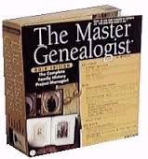
Upgrading to TMG 9
To get TMG 9 you need to buy a license code, which is available only from Harry Goegebeur, the TMG dealer in Holland, and download the installer. Links to both are in Terry Reigel’s article at
http://tmg.reigelridge.com/future.htm#wait
Costs about $60US.

Slide 4
History Research Environment (HRE)
History Research Environment is a community project to create a free platform-independent application for the serious amateur or professional historical researcher.
For genealogists, HRE will provide an onward path for users of the discontinued program The Master Genealogist (TMG).
HRE will also handle a very wide range of other historical and cultural research needs.
Project website: https://historyresearchenvironment.org Volunteer skills: https://historyresearchenvironment.org/become-a-volunteer/ Donate: https://historyresearchenvironment.org/donate/ Wiki: http://hrewiki.org/index.php?title=Main_Page
Notes:
Nothing new with Rootsweb down.

Slide 5
Social Media Update
TMG-REFUGEES:
(http://lists.rootsweb.ancestry.com/index/other/Miscellaneous/TMG-REFUGEES.html)
January 25, 2018: We have taken the RootsWeb Mail system offline for the next few weeks so that we can upgrade the Mailman system.
Website: https://sites.google.com/site/tmgrefugees
TMG Facebook Page: 5 posts plus comments Sep-Dec 2017
(https://www.facebook.com/groups/themastergenealogist/)
TMG Mailing List (http://lists.rootsweb.ancestry.com/index/other/Software/TMG.html)
January 25, 2018: We have taken the RootsWeb Mail system offline for the next few weeks so that we can upgrade the Mailman system.
Notes:
Rootsweb and the Mailing Lists are off line at this time.

Slide 6
Journal Report Options
Notes:
This came up recently and may impact your reports. You can accept one of the Standard styles or you can select a Custom format which allows more options.

Slide 7
Journal Report Options
There are separate options on the right for the listing of children when they appear under their parents. Children who have children of their own, and thus appear in their own sections are treated differently than children who do not have their own sections.
Notes:
The options for children only apply when you have selected Custom Format

Slide 8
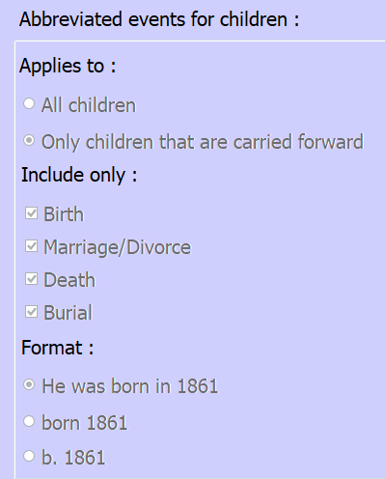
Journal Report Options
The top option "Applies to" controls whether abbreviated listings (more on that next) are used only for children with their own section, or for all children. If you set it to "Only children that are carried forward" only those children will get the abbreviated listing. Children who do not have their own section will get all the Tags specified on the left side of the tab. If you chose "All children" all the children, regardless of whether or not they also appear in their own sections will have only the abbreviated listing.
What Tag Types are included for children who receive the abbreviated listing? That's controlled by the middle section on the right, "Include Only." You can choose any or all, or none, of the Tag Types Birth, Marriage/Divorce, Death, and Burial.
Notes:
The options for children only apply when you have selected Custom Format

Slide 9
Journal Report Options
The third set of options -- "Format" controls how the information in the Tag Types you specified will be displayed. The first, "He was born in 1861,“ uses the Sentences to produce the output - that is they get the same output, but only for these four Tag Types, as will appear in their own section. That's the issue you are having because you put the obit information in the Death Tag.
The second two options -- "born 1861" and "b. 1861" -- do not use Sentences but use abbreviated output from the date and place fields. The Memo will not be included.
If you choose one of these last two options, the obit in the Memo field will not appear with the child in the list of children for his or her parents.
Notes:
This question stemmed from a fellow who included the Obituary in the memo field of the Death tag.
The other option is to make a custom Tag Type for Obituary but this could be used for other issues.

Slide 10
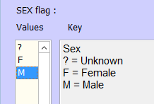
Flag Values
The values should not be changed on any of the standard Flags. They are:
Sex
Living
Birth Order
Multiple Birth
Adopted
Ancestor Interest
Descendant Interest
The reason is you can't actually "change" the values for these flags.
Rather, you are "translating" them. This facility is intended for users of languages other than English, so the values will make sense in the language the person is using. However TMG's understanding of each value is not changed.
You should only change the values of custom flags.

Slide 11
Sureties
Surety: A numerical value assigned to indicate the quality of a source in documenting a given fact recorded in the data set. The surety values are recorded in the citation record. The values are:
3= an original source, close in time to the event
2= a reliable secondary source
1= a less reliable secondary source or an assumption based on other facts in a source
0= a guess
-= the source does not support the information cited or this information has been disproved
Notes:
These are the “official” guidelines from TMG Help.

Slide 12
Sureties
Notes:
When you add a citation, you can also add a surety for the information.

Slide 13
Sureties
Principal 1: What is the surety concerning the identity of the principal (i.e., is this record referring to the same person as the Subject)?
Principal 2: What is the surety concerning the identity of the second principal (in, for example, a marriage event)?
Date: What is the surety concerning the date of the event?
Place: ... the location of the event?
Memo: ... the information stored in the Memo field?
Notes:
When you add a citation, you can also add a surety for the information.

Slide 14
Sureties
Each of these five surety columns can have a number in it, ranging from "0" to "3".
A "3" denotes the most reliable information, usually an original record created at or near the actual time of the event.
A "0" is given to information judged "possible" -- in other words, merely a guess.
If the source provided no information about a particular element, the surety should be blank.
Negative Surety: It sometimes happens that information is almost certainly incorrect. If the error is not noted, it is possible that you or another researcher will stumble across the misinformation again later and accept it as true. The program provides a means to avoid this error by using the Surety Level of “-". There should also be a note in the Memo or Citation Detail explaining why this information is considered to be wrong.
The default surety, entered in the Source Definition screen is shown in the Master Source List when a source is cited.

Slide 15
Default Surety
Notes:
When you add a citation, you can also add a surety for the information.

Slide 16
Max Surety
On a Tag Entry screen, the Maximum Surety is automatically determined, based on the sureties entered for all columns (Principal 1, Principal 2, Date, Place, and Memo) in the source citation(s). The Maximum Surety is the highest number in each column. It is not a total nor an average. The Maximum Surety is displayed on the Person View of Principal 1, Principal 2 (if any), and Witnesses (if any).

Slide 17
Max Surety

Slide 18
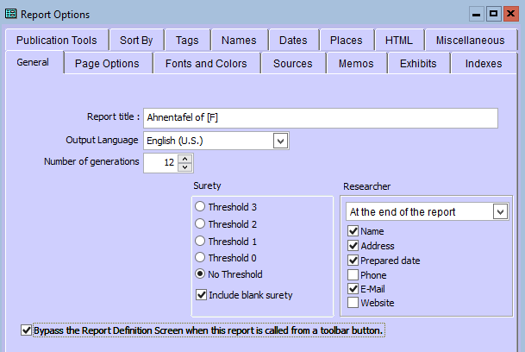
Surety Threshold
A surety level serves as a cutoff in reports. Tags with a surety below the threshold are not printed on the report.
Notes:
In most cases, I select No Threshold in order to have all tags included.

Slide 19
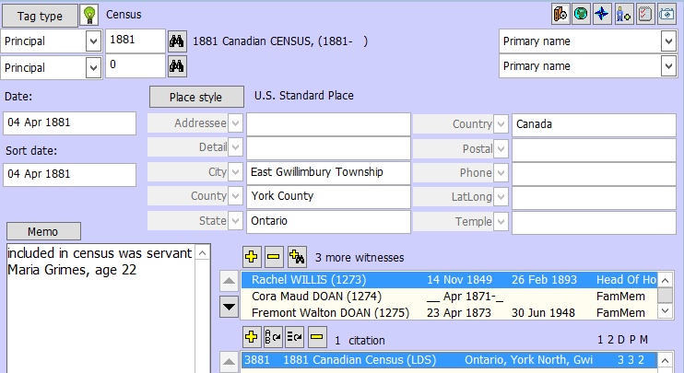
My Examples
Census
Notes:
For a census I use the maximum surety (3) for date and place; I use the official date of the census as that is usually when the information is supposed to be current. In this case, I have added a “stray” enumerated with the family and I give it a 2 as it is probably correct.

Slide 20
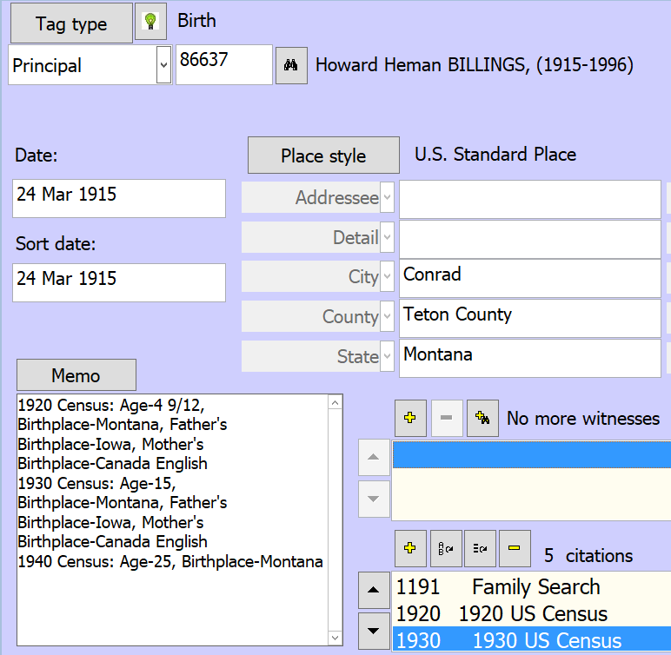
Notes:
I know that this is Howard Heman Billings in the census from the name, other family members, occupation, age, birthplace etc, so I assigned P1 a surety of 3.
In the Tag box, I have the exact date and location from another source (an image of his birth certificate on FamilySearch.
The age in the census as well as the state match with the birth certificate but are not as “accurate”, so I have assigned them lower sureties.
The Memo surety refers to the information that I have typed into the Memo field about the data found on the census; my transcription may have errors or the information may have been recorded incorrectly, for any number of reasons, but I am satisfied that it is reasonably accurate and reliable.

Slide 21
Birth Example
Notes:
For Fremont’s birth, I have found three sources. First is the official birth registration, for which I have assigned 3 for Principal 1 ( can tell it’s him), for the date and the place. I know that sometimes, this is wrong but that’s relatively rare and I doubt if I can find anything more reliable. I also found him in the 1881 census ehre it gives his age and province of birth. These agree with the birth registration but I have given them lower surety which I will get back to. I also found him in a family history written by a reliable gfnealogist but it only reported him as alaive at the time of the book in 1888, so the date is only a 1

Slide 22
Surety Discussion
I was hoping that this would generate some discussion. I admit that I don’t always use Sureties to indicate the reliability of a source but I sometimes mix in the accuracy of the source. For example, for a Census which lists age of an individual and their birth “region” (state, province country, I may assign a 1 to date of birth and a 2 to location of birth
Notes:
As I did in the Birth tag with the census source, I gave date and place a Surety of 1, not because it’s not reliable but more because it’s not specific or accurate enough.

