Slide 1
Mike’s TMG Tips
Ottawa TMGUG
7 Apr 2018

Slide 2
GENE-O-RAMA 2018
presented by Ottawa Branch OGS
April 13-14, 2018
Confederation Education Centre
1645 Woodroffe Avenue, Ottawa
Speakers, Marketplace, Computer Room
Featured Speaker: Ruth Burkholder
Volunteers Needed
Check our website for the latest details
http://ogsottawa.on.ca/gene-o-rama/
Notes:
First a word from our sponsor

Slide 3
Genealogy for Beginners Workshop
In conjunction with Gene-O-Rama, Ottawa Branch will be running a Genealogy for Beginners Workshop on Friday 13 Apr at Confederation Education Centre (1645 Woodroffe Avenue), based on our successful Back-to Basics series.
Cost: $15 pre-registered, $20 at the door
 | TOPIC
9:30 to 10:30 | Getting Started – Mike More
11:00 to 12:00 | Discovering Ancestors through Census Information – Gloria Tubman
Lunch (not provided)
13:30 to 14:30 | Are You a “Trust Me” Genealogist? (Citation of Sources) – Mike More
15:00 to 16:00 | Genetic Genealogy – Richard McGregor

Slide 4
TMG Download
TMG 9.05 USA Version http://www.whollygenes.com/files/tmg9setup.exe
TMG 9.05 UK Version http://www.whollygenes.com/files/tmg9uksetup.exe
You should select to save the file to a location on your system. Then double-click on the file after the download is finished. This opens the installer and begins the installation. You should tell the installer to install the program in the same place that an earlier v9 version is already installed. This will overwrite the installation with the v9.05 version while leaving your data alone. After v9.05 is installed, you should be able to open (or restore and open) your v9.05 projects. If you happen to restore a project from an earlier version, v9.05 will upgrade it at the time.
Notes:
Norton found a problem with the UK Version when I tried to download it.

Slide 5
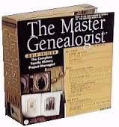
Upgrading to TMG 9
To get TMG 9 you need to buy a license code, which is available only from Harry Goegebeur, the TMG dealer in Holland, and download the installer. Links to both are in Terry Reigel’s article at
http://tmg.reigelridge.com/future.htm#wait
Costs about $60US.

Slide 6
History Research Environment (HRE)
History Research Environment is a community project to create a free platform-independent application for the serious amateur or professional historical researcher.
For genealogists, HRE will provide an onward path for users of the discontinued program The Master Genealogist (TMG).
HRE will also handle a very wide range of other historical and cultural research needs.
Project website: https://historyresearchenvironment.org Volunteer skills: https://historyresearchenvironment.org/become-a-volunteer/ Donate: https://historyresearchenvironment.org/donate/ Wiki: http://hrewiki.org/index.php?title=Main_Page
Notes:
Nothing new with Rootsweb down.

Slide 7
Social Media Update
TMG-REFUGEES:
(home.rootsweb.ancestry.com/listindexes/search/TMG-REFUGEES)
-3 discussions in March
Website: https://sites.google.com/site/tmgrefugees
TMG Facebook Page: 3 posts plus comments in Mar
(https://www.facebook.com/groups/themastergenealogist/)
TMG Mailing List (http://home.rootsweb.ancestry.com/listindexes/search/TMG)
-51 discussions in March
Notes:
Rootsweb and the Mailing Lists came back on-line last month.

Slide 8
Exhibits Review
Exhibits can be attached to people, events, Sources, or Repositories.
TMG will find the Exhibit in the specified folder by the given filename. If you tell TMG to look for Exhibits in the Exhibits folder, and the Exhibit is actually in the Photos subfolder of the Exhibits folder then TMG may not find it unless you have told it to search in subfolders.

Slide 9
Internal vs External Exhibits
Lee recommended that most exhibits be "external" exhibits; some text-only files would be good candidates for being Internal.
Most "experts" recommend you store image files externally, so they remain outside the TMG file system. Only the Exhibit record is stored within the TMG Project. This keeps your backups smaller, and prevents multiple copies being saved should you attach the same image to more than one Person or Event. This does mean that you need to backup your images outside of your TMG backups, and you are likely to have to manage their movement to a new computer.
Check the settings of File=Preferences=>Program Options=>Exhibits.
Set to Ask each time will allows you to determine what you want for that Exhibit.

Slide 10
Location of Exhibits
TMG does NOT require all exhibits to come from a single folder.
Lee Hoffmann suggests that you place all the various folder as sub-folders of a single folder. Then, select that folder as the file path that you enter in Preferences.
Store all by exhibits in folders like C:\genealogy\exhibits that way it isn’t tied to your user name (or where this version of Windows wants to place my user files).

Slide 11
Change Exhibit Location
To change the location of already created exhibits, you use the Validate File Integrity function and give it the new location of where your exhibits are now stored.
VFI allows a list of directories to check, so even that doesn't get in the way.
Best to keep every file having a unique name to help VFI, if something breaks the links, it just takes the first matching name it finds.
If you are moving to a new folder on the same computer, the previous location(s) cannot exist or TMG will not regard the exhibit as "missing." If this is the case temporarily re-name some part of the path to the old location(s) so the exhibits cannot be found there.

Slide 12
Location of Exhibits

Slide 13
Validate File Integrity

Slide 14
Search for Missing External Exhibits
Notes:
Check the box to Search and then click to Specify the Folders to Search

Slide 15
Folders to Search
Notes:
Click on the button to Search in Subfolder and not that a * appears beside the directory to be searched

Slide 16
Validate File Integrity Process
It is recommended that you run
Optimize
VFI
Optimize
Whenever you get VFI errors, you should do an Optimize and then immediately re-run VFI. When VFI "fixes" an error, that fix can then let a subsequent VFI discover and fix other errors which were hidden due to those first errors. Keep doing the Optimize/VFI until VFI finally reports no errors. Then do one last Optimize and Backup.

Slide 17
Exhibits - Additional Comments
Image files are controlled by TMG Preferences to be: Internal, External Link, Ask each time.
This primarily is concerned with image files (JPG, TIF, GIF, PNG, BMP, etc.) as TMG has routines to handle most of these kind of formats. Many other file formats are not handled by TMG and thus will automatically be External.
In a quick test, .TXT, .RTF, and .PDF, all came in as External -- .PNG and .BMP asked how I wanted them, the .PDF warned that TMG can't embed them in reports, and the .TXT and .RTF just quietly came in as externals with no additional prompts.

Slide 18
Journal Report with Spouse's Information
Trying to duplicate a report that had the spouse's information as a separate entry:
In the Journal Report options, Miscellaneous tab, check the box "Include spouse events." This should cause the narrative(s) for the spouse(s) to appear right after the narrative for the subject person.

Slide 19
Journal Report Options
Notes:
In checking, this I discovered a number of interesting things about the Journal Report
There are three styles plus a Custom format. Obvioulsy, if you want to use the official styles, most of the options are fixewd.

Slide 20
Journal Report with Spouse's Information
1. Clara Garnet¹ Lepper was born on 16 Mar 1887 at Birtle, Shoal Lake, Manitoba, Canada. She married Stanley Earl Aglor on 1 Jul 1913 at 40 Church St, St Catharines, Lincoln County, Ontario, Canada. She married Oscar Adolph Lund on 21 Oct 1926 at Niagara Falls, Niagara County, New York, USA. She married (--?--) Bunting. She died on 21 Dec 1959 at age 72.
Stanley Earl Aglor was born on 30 Nov 1889 at Simcoe, Norfolk County, Ontario, Canada, s/o James Aglor and Hannah Eliza Chattington. He died between 1 Dec 1925 and 1 Oct 1926 at age 36. He was the informant for the death of (--?--) Aglor on 22 Oct 1914 at 40 Church St, St Catharines, Lincoln County, Ontario, Canada.
The two known children of Clara Garnet¹ Lepper and Stanley Earl Aglor were as follows:
2 i. (--?--)² Aglor.
3 ii. Marjorie Julia Aglor .
Oscar Adolph Lund was born on 24 Dec 1881 at Norway, s/o Nels Lund and Annie Holston. He died on 14 Nov 1929 at 40 Church St, St Catharines, Lincoln County, Ontario, Canada, at age 47.
There were no known children of Clara Garnet¹ Lepper and Oscar Adolph Lund.
(--?--) Bunting is still living.
There were no known children of Clara Garnet¹ Lepper and (--?--) Bunting.

Slide 21
Journal Report Options
Several options are only available with the Custom format, such as the one that I just showed
Notes:
In checking, this I discovered a number of interesting things about the Journal Report
There are three styles plus a Custom format. Obvioulsy, if you want to use the official styles, most of the options are fixewd.

Slide 22
Oldest Ancestor
My grandson asked who and how old was our oldest ancestor:
Run the Statistical Report: The ID Min and ID Max are IDs of the persons associated with the Min and Max ages. This is one way to find IDs of people who may need to be edited.
A List of People report, filtered for Age at death greater than 100 may turn up a short list of likely candidates. If not, try a lower number than 100. Include Age at death as a report output column to make it easy to screen the list. I tried this and found a clear winner in my database who died at age 236 - so some data cleanup is clearly needed

Slide 23
Statistical Report
Notes:
Note that you can focus the subject of the report

Slide 24
Statistical Report Results

Slide 25
List of People Report
Name-------------------------- ID #- Year Year Age at death
Dolson, Teunis 1264 1664 1766 101
Mueller, Susanna 1101 1699 1809 110

Slide 26
Audit Report
Notes:
Some of these reports showed some anomalies that I went back and fixed. But TMG also has an Audit Report. You can set the parameters for some of the checks.

Slide 27
Audit Report
Dezso Scheibel (12)
Birth after non-birth events.
John More (32)
Death before non-death events.
John More (64)
More than 12 children.
Grace Helen More (93)
Living after age 95 years.
Phineas Snow (3526)
Birth after death.
Susan Bagshaw (394)
Death when LIVING flag is not equal to N.
Christopher Donnelly (410)
Born before mother was 14 years old.
Charity Clapp (1065)
Death after burial.
Abigail Shaw (1247)
Birth after father's death.
Mary Foster (1647)
Death after age 100 years
Notes:
Some of these reports showed some anomalies that I went back and fixed. But TMG also has an Audit Report

Slide 28
Half-Relationships
Actually half-anything is not calculated as the relationship is still sibling, cousin, aunt, uncle, father, mother, etc. Similarly, double-cousins are still just cousins. Yes, half-whatever and double-whatever makes a difference in regard to DNA (double first cousins tend to be closer genetically to siblings than just first cousins), but they're still ….
Example: My wife's grandfather had two wives and had a daughter by each. TMG calculates the daughters as sisters, which they are -- through their father. Both daughters had daughters and TMG calculates the granddaughters as first cousins, which they are -- through their grandfather.

Slide 29
Places: Start and End Dates
You can associate start and end dates with a place.
If you enter a start or end date in a place record, TMG will validate the date of any event entered in that place and tell you if the event falls outside the date range for that place. If you have zeros in both date fields, then no validation is done on the date in relationship to the place.
Remember that all of the place fields must match the place record which contains the start and end dates in order for this to work.

Slide 30
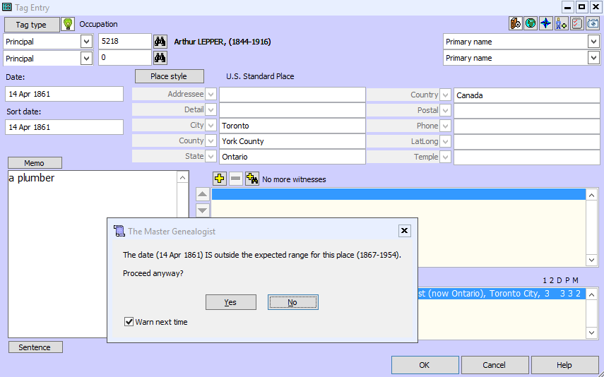
Places: Start and End Dates

Slide 31
Places: Start and End Dates

Slide 32
Places: Start and End Dates

Slide 33
GENE-O-RAMA 2018
Notes:
First a word from our sponsor

