Slide 1
Mike’s TMG Tips
Ottawa TMGUG
5 May 2018

Slide 2
History Research Environment (HRE)
History Research Environment is a community project to create a free platform-independent application for the serious amateur or professional historical researcher.
For genealogists, HRE will provide an onward path for users of the discontinued program The Master Genealogist (TMG).
HRE will also handle a very wide range of other historical and cultural research needs.
Project website: https://historyresearchenvironment.org Volunteer skills: https://historyresearchenvironment.org/become-a-volunteer/ Donate: https://historyresearchenvironment.org/donate/ Wiki: http://hrewiki.org/index.php?title=Main_Page
Notes:
Latest newsletter was December. Anybody subscribe to their Mailing List?

Slide 3
Social Media Update
TMG-REFUGEES:
https://lists.rootsweb.ancestry.com/hyperkitty/list/tmg-refugees@rootsweb.com/
-3 discussions in March, nothing April or May
Website: https://sites.google.com/site/tmgrefugees
TMG Facebook Page: 5 posts plus comments in Mar https://www.facebook.com/groups/themastergenealogist/
TMG Mailing List https://lists.rootsweb.ancestry.com/hyperkitty/list/tmg@rootsweb.com/
-19 discussions in April
Wholly Genes Forum
http://www.whollygenes.com/forums201/index.php -4 discussions in April
Notes:
Rootsweb Mailing Lists came back in early March. I’ve shown numbers above to suggest that the TMG Mailing List is probably your best place to get TMG help.

Slide 4
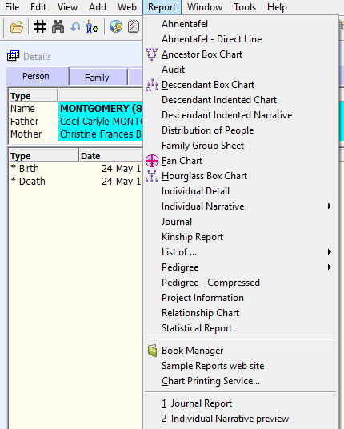
Book Manager
Why are you using Book Manager? You have to create the individual reports anyway. Why not just run them individually? Book Manager just runs the set all at once. The only value of Book Manager is when you have to run a set of reports repeatedly, when it automates the running of the whole set. Terry Reigel

Slide 5
Book Manager

Slide 6
Book Manager
The Book Manager provides a method by which you can bind several Report Definitions together so that they run in a sequence.
You can therefore construct a book consisting of several different reports. For example, the book might contain different narrative reports in various sequences, pedigree charts showing the relationships, and various other reports. While this capability was built into TMG previously, now you can save this structure in a book so that you don't have to re-do the steps each time you print.
Another possible use would be to run a series of List of People or List of Events reports, each changing the value of a certain flag for a different group of people by means of the Secondary Output tab. For instance, if you had a flag with values A, K, R, and W to record family membership, you could periodically run a "book" that would set all these values.

Slide 7
Installing on New Computer
Can someone kind soul give me the instructions for installing TMG on a new computer. I remember that you needed to do it as an Administrator.
Terry Reigel has a good discussion about Moving Data to a New Computer at <https://tmg.reigelridge.com/new-computer-version.htm.
As for running as Administrator, that is only needed once. After TMG is installed, let it open to the SAMPLE project. Do this without entering your registration data. Exit TMG. Now, re-start TMG as Administrator. Enter your registration data. Let TMG open fully (SAMPLE project again) and exit again. Now start TMG normally.
I would suggesting copying the Backup to the new computer TMG Backup folder. Also copy the Exhibits to where you want them in the new computer.
After Restoring your project from the Backup, you should check that File Paths in Preferences are correct…Lee
Notes:
This comes up periodically, so a short reminder.

Slide 8
Merging Similar/Duplicate Tags
In the Master Tag Type List, I have several instances of duplicate, or very similar named tags with exact same sentence. Most of these likely occurred from merging datasets. Is there any way to merge or combine the duplicate type Tags with same sentence?
You can use John Cardinal's TMG Utility to change Tag Type "A" to Tag Type "B". So if you have two Tag Types named Resided and Residence that are both essentially the same, select the one to "keep" and use the Utility program's Events=Change Event Type function to change the Resided Tag Type to the Residence Tag Type (or whatever). You can also change Roles with the same function. if needed.
Be sure to make a backup first. Also use the Log Only feature the first time that you run the function. This way, you can review the log report to see if it is what you want. Then de-select the Log Only option and run the function again "for real“… Lee
Notes:
We had talked about this last month, I believe.

Slide 9
Merging Similar/Duplicate Tags
Notes:
We had talked about this last month, I believe.

Slide 10
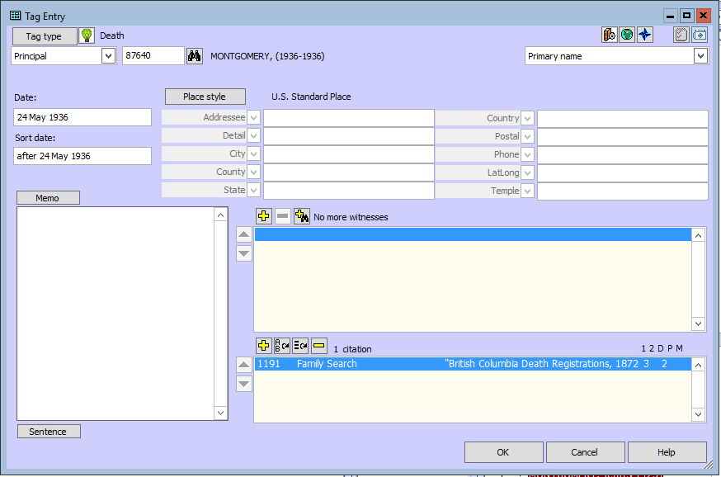
How to add exhibits?
Adding an exhibit to a tag is fairly simple. Open the tag, then press the camera icon in the upper right, and select the file.

Slide 11
How to add exhibits?

Slide 12
Edit Tags
Make sure that you are not in Beginner Mode

Slide 13
Edit Tags
Certain reports -- the Ahnentafel, Descendant Indented Narrative, Journal, and Individual Narrative -- utilize full sentences when listing events in paragraph form. These sentences are constructed according to standard and customizable rules.
By default, a sentence for an event tag is constructed according to the syntax described on the Tag Type Definition Screen for that Tag Type.
Codes are used to represent the variable information in the sentence. For example, the sentence in a marriage tag might look like this:
[P] married [PO] <[D]> <[L]>
and might produce the following sentence:
John Smith married Jane Jones on 4 Jan 1884 in Bath County, Kentucky.

Slide 14
Edit Tags
You may choose how Place labels and Name labels will be displayed on the Tag Entry screen. Your choices are:
Enabled: When you tab through the Tag Entry screen, the cursor will stop on the field label, as well as in the data entry field.
Disabled: When you tab through the Tag Entry screen, the cursor will not stop on the field label, only in the data entry field.
Available only with mouse: When you tab through the Tag Entry screen, the cursor will not stop on the field label, only in the data entry field. However, you may click on the label to access it.

Slide 15
Edit Tags
Select the Tag to be edited and click on the [Edit] button.

Slide 16
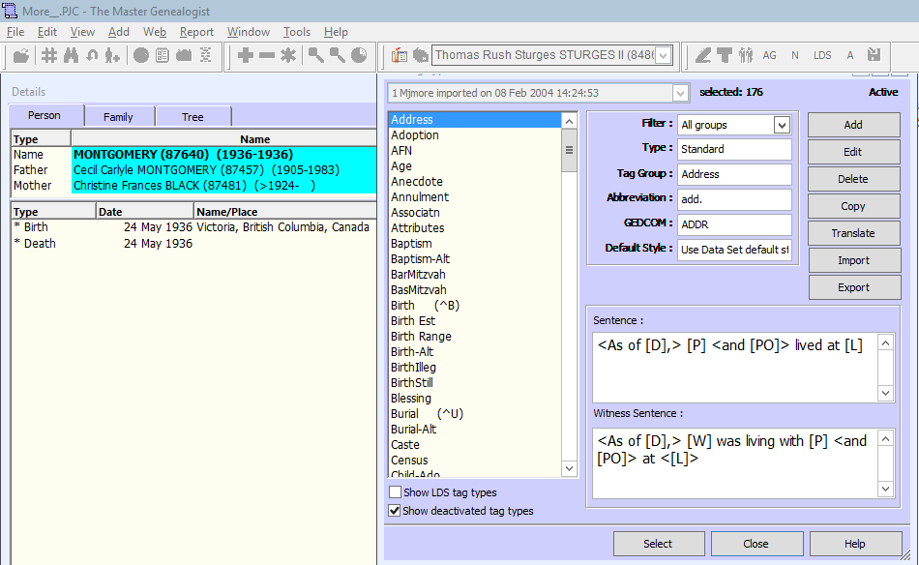
Edit Tags
1
2
3
Select the Tag to be edited and click on the [Edit] button.

Slide 17
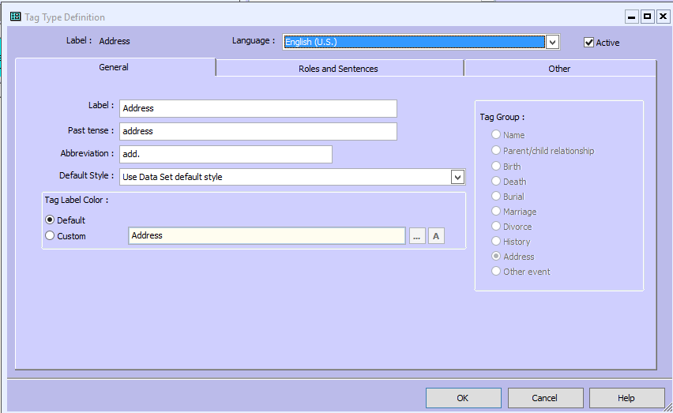
Edit Tags

Slide 18
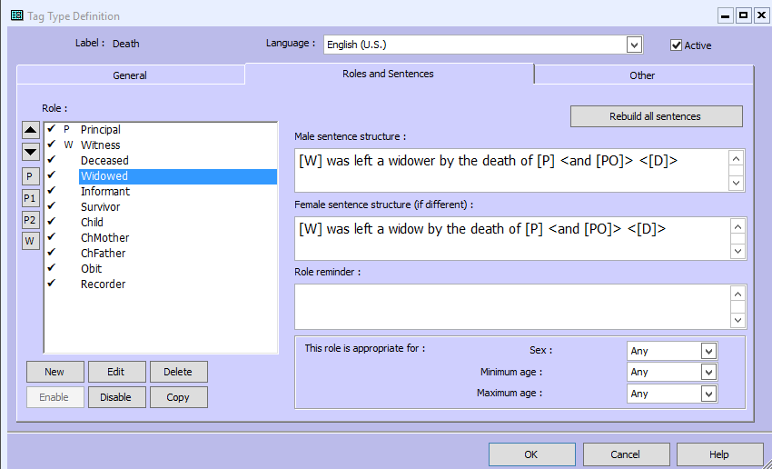
Edit Tags
Notes:
Switch to TMG to demo Roles

Slide 19
Short Place Name
From TMG HELP: A Short Place is an additional way of referring to places. It does not include all of the place fields and is used primarily in charts and other places where the entire set of place fields will not fit.

Slide 20
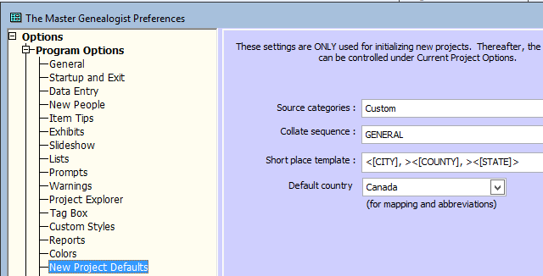
Short Place Name
The default is [CITY], [COUNTY], [STATE].
You can change the fields that will be included in the default Short Place in the Preferences>Program Options>New Project Defaults.

Slide 21
Short Place Name
On the Master Place List you can also assign a Short Place to a specific place record, overriding the default specified.
Example: Instead of Madley, Webtree Hundred, Herefordshire, England, I get Madley, HEF

Slide 22
Short Place Name
Journal Report:
He was a shoemaker on 14 Sep 1854 at Madley, HEF. He was a shoe maker on 23 Jan 1855 at Michaelchurch, Clodock, Herefordshire. He was a cordwainer on 20 Jan 1857 at Madley, HEF. He was the informant for the birth of Alfred Jones on 20 Jan 1857 at Madley, HEF. He and Matilda Huggins lived on 17 Feb 1857 at Madley, HEF.

Slide 23
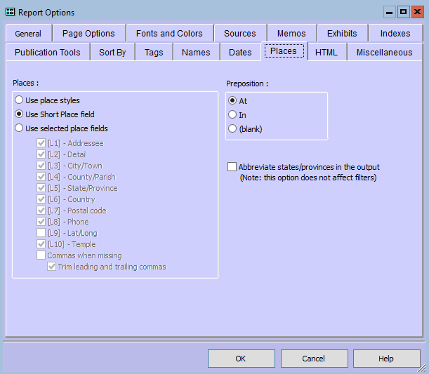
Short Place Name
You can change the fields that will be included in the default Short Place. In addition to charts, many reports have an option to use the Short Place template when printing place fields.

Slide 24
Group Common Birth Places
Short Place Name will not reduce the full place name in circumstances when the same place is used for BMDB.
Group common birth places
(children "all born ________")
1. Arthur James Knowles was born …
Children of Arthur James¹ Knowles and Emily Vincent all born at London, Middlesex County, Ontario, Canada, were as follows:
2. i. Arthur Frederick was born on 10 Jun 1924.
3. ii. Eleanor Ruth born on 21 Dec 1925.
4. iii. Joyce Ethel was born on 24 Jun 1927.

Slide 25
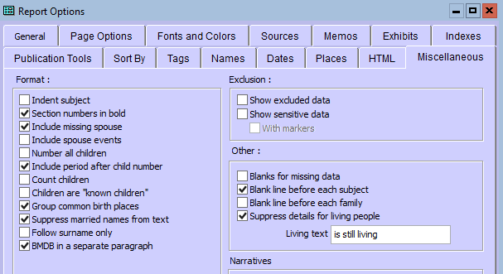
Group Common Birth Places
The option to "Group common birth places" is a separate Miscellaneous option on some reports. But that Place will output using the format chosen for all Places.
Notes:
Note that all the Format options are only enabled when the Style on the General tab is set to Custom

Slide 26
Focus Group
A focus group is a sub-set of individuals in your project that can be used for a variety of tasks, including export (GEDCOM), printing reports, set flags, etc.
You can save Focus Groups for later use.

Slide 27
Use of Focus Groups
Filtering your project: A common problem is selecting the descendants (or ancestors) of an individual, plus all the spouses of this line, along with the parents and other spouses of those who married into the direct line.
Selecting People to be Copied or Exported: using a Focus Group will include all linked people at one time.
Editing a Select Group and removing them from the list as changes are made.

Slide 28
To display the Focus Group window:
Select Window > Focus Group.
or
Click on the Focus Group button on the Layout Toolbar.
Notes:
Swich to TMG and open Focus Group Window. Explain windows

Slide 30
Adding Members to a Focus Group
1. In the Project Explorer, select the persons to be added to the Focus Group. More than one individual can be selected by clicking on the first person, then holding down the <Ctrl> key to click on later selections; or by clicking on the first person, then holding down the <Shift> key and clicking on the last person.
2. Right-click on the Project Explorer and select Add selected names to Focus Group. The selected name or names will be added to the current Focus Group. You can also select Add all names to Focus Group to add all of the names currently in the Project Explorer to the Focus Group.
or
In the Tag Entry Screen, Children window, Siblings window, or Associates window, right-click on a name and select Add this person to the focus group.
or
1. Select Window > Focus Groups
2. Click on [Add Individual] to add the first member to the focus group.
The Add new member to focus group screen will appear.
Notes:
Switch and demonstrate three methods:
Project Explorer
Demo use of a filter in PE (14jandemo.FLP) and load all
Tag entry Screen (principles or witness)
Add button

Slide 31
1. Project Explorer

Slide 32
2. Tag Entry Screen, etc.
Notes:
You can click on the name in most windows.

Slide 33
3. Focus Group Window

Slide 34
To add others to the Focus Group:
Once at least one member has been added, you may also add his or her Ancestors, Descendants, Spouses, and Name Variations by checking the boxes in the Focus groups window. The number of generations of Ancestors and/or Descendants to include can also be specified.
1. Click on an name. Hold <Ctrl> and click if you wish to highlight more than one person. You can select contiguous names by clicking on the first name, holding down <Shift> and clicking on the last name.
2. Once you have made your selections, check the items you want to add:
· Ancestors
· Descendants
· Spouses
· Name variations
3. Click [Add Others].
NOTE: To select all members of the focus group, click [Select All].
CAUTION: Checking Descendants and Spouses will give you the descendants and spouses of the current members of the Focus Group. It will not include the spouses of those descendants. If you want to include their spouses, make a second pass after the descendants have been added and check Spouses on that pass.
Notes:
The main advantage of the Focus Group is the ability to add others.
Switch to TMG and demonstrate (small numbers) ID 83705
Name variation on 83707
Demo use of a filter in PE (14jandemo.FLP) and load all

Slide 35
Add Others

Slide 36
Removing Members from a Focus Group
To delete all members of a focus group:
Click on [Remove All].
To delete one member or several members of a focus group:
Highlight the name of the member(s) and click on [Remove Selected].
Notes:
Switch to TMG and demo

Slide 37
Remove members

Slide 38
Saving and Loading Focus Groups
To save a focus group for later recall:
Click on [Save...].
The Save group window will appear.
To load a saved focus group:
Click on [Load...].
The Load group window will appear.
Notes:
Switch and demo

Slide 39
Load/Save Focus Group

Slide 41
Using Focus Groups
GEDCOM (or export) part of your dataset
Copy selected individuals to another data set.
Delete a group of People
Search the web for a group of people
(To use a focus group to Search the Web, leave that group selected.)
Reports
Track Changes
Notes:
TMG & Demo Export
Demo Select Add > Copy Person.
3. In the Copy Person window click on Copy the people in the current Focus Group.
4. Select the data set that you want the Focus Group to be copied to.
5. Click [OK].
Demo Delete tab
Demo Web > Search the Web
Many reports will use a Focus Group as the subject
Demo: Load MarrNum Review and show how to change and delete
Double click first individual to change to their Details Screen
Make the necessary changes (i.e. marriage number)
Select on Focus Group (should be there)
Click on Remove Selected
At end of session, Save Focus Group>Overwrite
Next session, load smaller Focus Group

Slide 42
GEDCOM

Slide 43
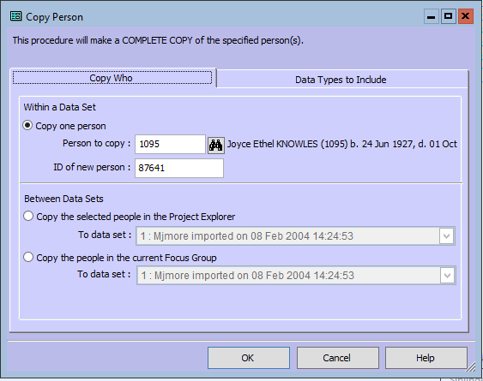
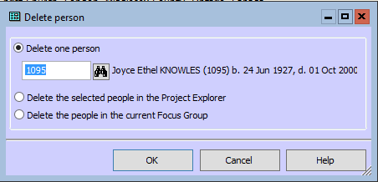
Copy or Delete

Slide 44
Search the Web for a Group

Slide 45
Reports

Slide 46
Ethics in Genealogy
Genealogy and Personal Information
By the very nature of genealogy and family research, you will be dealing with personal information about people from both the past and the present. Researchers should respect peoples right to privacy and as such, should never publish personal records (i.e. posting on a web site, etc.) about living individuals.
Genealogists are always striving for the truth, but be aware other members of your family may be less than enthusiastic. There may be certain family details they do not want revealed to the public. Always be aware of these issues and respond to their concerns accordingly.
Copyright © 2018 The Simcoe County Branch of The Ontario Genealogical Society.
Notes:
There was a large amount of discussion lately about the DNA used to capture the Golden State Killer. Much of it has focused on ethics and DNA but I thought that I would close with tyhis which I found on one of my Branch websites.

