Slide 1

Mike’s TMG Tips
Ottawa TMGUG
3 Nov 2018

Slide 2
History Research Environment (HRE)
History Research Environment is a community project to create a free platform-independent application for the serious amateur or professional historical researcher.
For genealogists, HRE will provide an onward path for users of the discontinued program The Master Genealogist (TMG).
HRE will also handle a very wide range of other historical and cultural research needs.
Project website: https://historyresearchenvironment.org
Volunteer skills: https://historyresearchenvironment.org/become-a-volunteer/
Donate: https://historyresearchenvironment.org/donate/
Wiki: http://hrewiki.org/index.php?title=Main_Page
Notes:
Latest newsletter was July 2018. Anybody subscribe to their Mailing List?

Slide 3
HRE newsletter, July 2018
At the end of April, locked down the design of the HRE database – that is, the design of all the database tables and how they all link together.
The development team have put together the first real screens of ‘HRE v0.1’ and are starting to flesh out the code behind them.

Slide 4
Social Media Update
TMG-REFUGEES:
https://lists.rootsweb.ancestry.com/hyperkitty/list/tmg-refugees@rootsweb.com/
    -5 messages in July, nothing since
Website: https://sites.google.com/site/tmgrefugees
TMG Facebook Page: Three posts in October
https://www.facebook.com/groups/themastergenealogist/
TMG Mailing List https://lists.rootsweb.ancestry.com/hyperkitty/list/tmg@rootsweb.com/
-no stats available but still very active
Wholly Genes Forum
http://www.whollygenes.com/forums201/index.php
-7 discussions in October
Notes:
Rootsweb Mailing Lists came back in early March. I’ve shown numbers above to suggest that the TMG Mailing List is probably your best place to get TMG help.

Slide 5
TMG Expertise
Terry Reigel: http://www.reigelridge.com
Lee Hoffmann: http://www.tmgtips.com/
John Cardinal: https://www.johncardinal.com/
Michael Hannah: https://www.mjh-nm.net/MY_WAY.HTML
Jim Byram
Notes:
These are some of the experts in TMG. The first four have websites with useful information on a wide ranges of aspects of TMG
Jim Byram is a technical expert and he tends to hang out on the TMG forum rather than on the Mailing List.

Slide 6
Maintenance
Last month we had discussion about using the TMG Maintenance Function:
  Reindex
  Optimize
  Validate File Integrity
VFI, Optimize and Reindex work on the WHOLE database, not just one project.
Notes:
After our Sept meeting, there was some discussion on the Mailing List about this.

Slide 7
Maintenance process
Some people run VFI multiple times until it reports no errors. As far as I can tell, there's no value to running Optimize between VFI steps, so this sequence seems ideal:
Optimize
VFI (repeat until no errors)
Optimize
The first Optimize recreates the indexes and removes deleted records. This provides a good base for the VFI(s).
The VFI step repairs data integrity issues. Fixing one issue can expose another, and that's why running it multiple times is useful/required.
The second Optimize rebuilds the indexes and removes deleted records. Any changes as a result of this step are due to VFI activity.
-John Cardinal

Slide 8
Maintenance process
Jim Byram recommends finishing with Reindex but John Cardinal did some testing years ago and determined that Optimize recreated all the indexes from scratch, whereas Reindex recreated the contents of the indexes, but not the index structure definitions. So, a corruption in an index header field would not be corrected by Reindex. “Furthermore, I am not aware of any case where using Reindex solved an issue that Optimize did not solve.”
It was also thought that the intermediate Optimize step would remove deleted data so that the next VFI would not scan that data. Joihn Cardinal: “It's very, very unlikely that the VFI step processes deleted records. Undeleting deleted records and assessing them during the VFI process would introduce issues that are impractical to resolve without AI that we don't have yet.
I suppose the only harm is wasted time.

Slide 9
Unwanted filter
I get a red “filtered” notification in the upper left hand corner of the Details screen for every person in my database, and only primary events show up
Right-click on any visible Tag and about half way down the right-click menu click on "Filtered for." Then click on whichever item in the sub-menu has a check mark in front of it.
If the Filter is part of the layout, save the layout after you clear the filter.

Slide 10
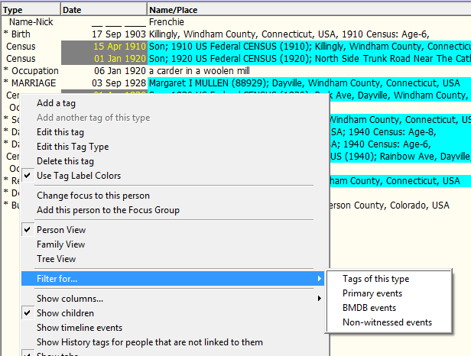
Unwanted filter

Slide 11
Place Data in TMG
The Place data in each tag is NOT separate for each tag.
You do not have to Find/Replace in each tag.
Every unique set of Place data exists only once as a single record in the Master Place List (MPL). All tags which show that Place entry data actually simply have a link to that one place record.
If you simply change the data for a given record in the MPL, then
every tag which is linked to that one place record will now show that new data. That is the whole purpose of the MPL.
However, after you make changes in the MPL, be sure now to do an Optimze to clean up the links to the MPL.

Slide 12
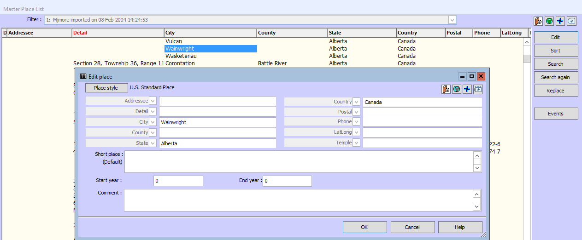
Place Data in TMG
Notes:
If I click on the Edit button on the right, I can then change the place which impact EVERY tag linked to that specific place.

Slide 13
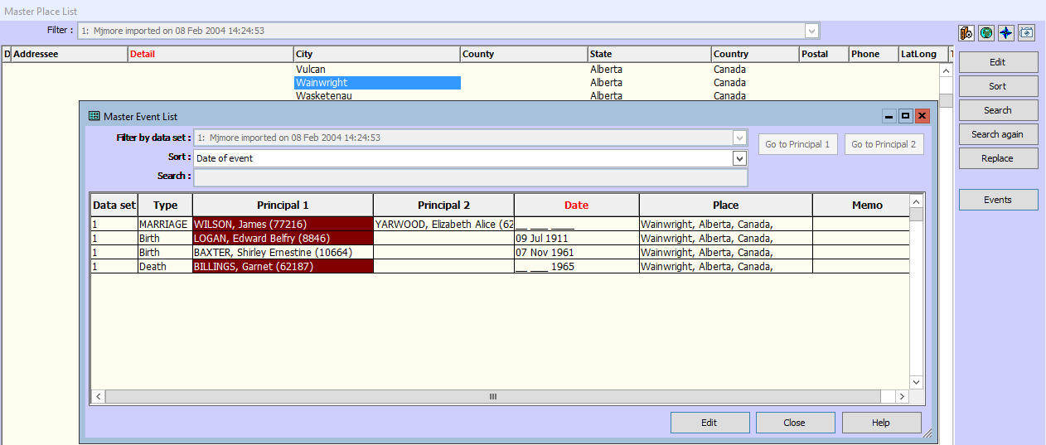
Place Data in TMG
Notes:
If I click on the Events button, it opens a list of events with that place and I can then change them individually

Slide 14
Duplicate Individual in Project Explorer
After spending the day of merging and adding individuals to a Branch I see in the Project Explorer two entries for one of them. All detail including ID Number is repeated. When I click on either entry the screen changes to what was shown prior. The individual is the only one affected.
I have tried doing a merge but of course that does not work as well as a search for duplicate which also does not work.
Remember that the Project Explorer (and the Picklist) are list of Names, not lists of People. So what you are seeing are duplicate Names for the same person. That's why Merge won't work --- you can't merge the same person.
-Terry Reigel

Slide 15
Add a Toolbar
You add any toolbar by using the View > Toolbars menu, or by right-clicking on any existing toolbar, and checking the toolbar you want to add.
Once you have added a toolbar you can place it on the left side of the main TMG window (or any other side) by dragging it where you want it to appear. It assumes a shape to fit the place you put it.
Once you place it you will have to move other windows to make up for the room it takes, or re-size the main TMG window.
After you have done that you need to save the new Layout. If you don't the toolbar will not be there next time you open TMG.
-Terry Reigel

Slide 16
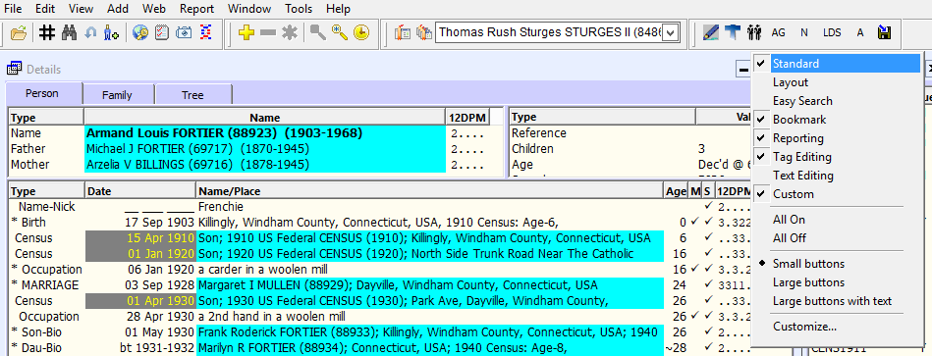
Add a Toolbar

