Slide 1
Mike’s TMG Tips
Ottawa TMGUG
2 Feb 2019

Slide 2
History Research Environment (HRE)
History Research Environment is a community project to create a free platform-independent application for the serious amateur or professional historical researcher.
For genealogists, HRE will provide an onward path for users of the discontinued program The Master Genealogist (TMG).
HRE will also handle a very wide range of other historical and cultural research needs.
Project website: https://historyresearchenvironment.org Volunteer skills: https://historyresearchenvironment.org/become-a-volunteer/ Donate: https://historyresearchenvironment.org/donate/ Wiki: http://hrewiki.org/index.php?title=Main_Page
Notes:
Latest newsletter was July 2018. Anybody subscribe to their Mailing List?

Slide 3
HRE Newsletter, January 2019
Robin Lamacraft’s Europe and USA Trip
Volunteers Wanted ….
PROJECT MANAGERS: The HRE Board is looking for volunteers who have had experience in managing project development in the software industry.
USER INTERFACE DESIGN CRITICS: The HRE Board is looking for several long time TMG Users to become part of a team that reviews these designs.
USER INTERFACE JAVA IMPLEMENTERS: The HRE Board is looking for several long experience and highly skilled Java GUI implementers who explain why a GUI concept is not possible to easily implement.
Meet the Newsletter Team

Slide 4
Social Media Update
TMG-REFUGEES:
https://lists.rootsweb.ancestry.com/hyperkitty/list/tmg-refugees@rootsweb.com/
Website: https://sites.google.com/site/tmgrefugees
-4 recent threads on the future of HRE
TMG Facebook Page: Four posts in January plus several replies
https://www.facebook.com/groups/themastergenealogist/
TMG Mailing List https://lists.rootsweb.ancestry.com/hyperkitty/list/tmg@rootsweb.com/
-38 threads in January and still very active
Wholly Genes Forum
http://www.whollygenes.com/forums201/index.php -4 discussions in January with 26 replies
Notes:
Rootsweb Mailing Lists came back in early March. I’ve shown numbers above to suggest that the TMG Mailing List is probably your best place to get TMG help.

Slide 5
TMG Expertise
Terry Reigel: https://tmg.reigelridge.com/index.htm
Lee Hoffmann: http://www.tmgtips.com/
John Cardinal: https://www.johncardinal.com/
Michael Hannah:
https://www.mjh-nm.net/MY_WAY.HTML
Jim Byram
Notes:
These are some of the experts in TMG. The first four have websites with useful information on a wide ranges of aspects of TMG
Jim Byram is a technical expert and he tends to hang out on the TMG forum rather than on the Mailing List.

Slide 6
Maintenance process
Last month we had discussion about using the TMG Maintenance Functions:
Optimize
VFI (repeat until no errors)
Optimize
Reindex (optional)
Notes:
The standard recommended sequence is as follows:
1) run Optimize to get a clean starting point
2) (optionally run Reindex then) run Validate to identify and fix any problems
If Validate shows any errors, then redo both 1) and 2) until no errors.
If Validate does not show any errors, then:
3) run a final Optimize to get a clean set of files for backup and for further work on the project. Again, as should be clear from the above, that final Optimize *will* always show a difference because of the nature of what Validate does. That difference is not an error or a problem, it is simply a measure of the "clean up" Optimize did.

Slide 7
Maintenance: Optimize
Optimize can also be done on its own. One suggestion is immediately after an import or after use of TMG Utility.
Optimizing projects reduces the size of your files by eliminating records no longer needed. The amount of space saved for data files and Slideshow Manager is shown when the Optimize process is concluded.
Optimize operates on only the current project. If you use several projects, it will be desirable to Optimize each of them separately.
Deleted records, including people, events, sources, repositories; unused media files in Slideshow; as well as duplicate place records, will be eliminated and the space reclaimed. Duplicate place records will be consolidated so that only one entry remains in the Master Place List.
NOTE: For two place records to be considered duplicates, all fields must be the same. This includes the Style, if one was used to create some of the entries. It is possible, for example, for two Master Place records to appear identical, but to have been generated using different Styles. Optimizing will not remove unused place records for which a start year, end year, comment, or short place name have been recorded.

Slide 8
Maintenance: Reindex
Reindex: Data can be sorted (or "indexed") according to various alphabetizing rules. The indexing types reflect international standards for handling accented or diacritic characters.
The current project will be reindexed. Your data will remain intact.
According to Jim Byram: Optimize reindexes the data tables that it cleans up but not all of the data tables.
Notes:
I am not quite sure what Reindex does, so am not really sure what purpose running it alone serves.

Slide 9
Printing Charts
The PDF printer that comes with TMG has not worked since TMG v7 and Windows 7.
Some charts will produce garbage when sent Direct to Word.
However, having TMG generate an RTF file which opens in Word usually produces a usable report, which can then be “printed” in PDF.

Slide 10
Witnesses
I have a census tag set up according to Terry's method. I've entered the husband and wife as Principals . I then entered the children and a grandfather as witnesses. They appear as witnesses. I can make the witnesses appear in what seems to be the proper sentence. The only problem is that the witnesses do not appear on the screen showing the Family View.
Children don't appear in the "Family View”. In TMG 5 and later it shows the subject person, his or her spouse, and the parents of each. To see the children you have to have the Children window open.
In any case, entering children in a Census tag, or any other Event tag, doesn't tell TMG that they were children of the parents. Only Parent/Child Relationship tags to that.
If you want to see who is entered as Witnesses in tags you need to open the Associates window. That does show everyone entered in any Tag.
Notes:
This may be obvious to all but it helps to ensure

Slide 12
Unknown Spouse Message
In a Journal Report I'm getting 'There were no children of John Dunbar and the unknown spouse mentioned above‘. John, his wife and three children display correctly in a journal report as part of Generation Two thus - ' ... Children of John Dunbar and Frances Louisa Ball were as follows:...'
The very last line of Generation Two reads 'There were no children of John Dunbar (25930) and the unknown spouse mentioned above‘.
I can find no 'unknown spouse'
The "unknown spouse" message is caused by a Marriage or Divorce tag that has only one spouse entered. It's typically a Divorce tag in which one has forgotten to enter the second spouse. TMG "knows" that had it been the same spouse as in the marriage (or which whom the subject had children) you would have entered that spouse, so this tag must be for a different, unknown, spouse.
Terry Reigel

Slide 13
Unknown Spouse Message
I have a Widowed custom tag. I deleted this and the "...There were no children ..." no longer appeared.
Not sure of your reason for creating the Custom Tag. But the idea may still be good. The question is how you created the Custom Widowed tag -- in particular, what Tag Group was it in? My guess is that it may have been in a Tag Group such as Marriage or Divorce which normally expect to always have two Principals. The same Custom Tag might still be useful if it were created in the Other Tag Group and not give the adverse text you got with your present Tag.
-Lee Hoffman

Slide 14
More on Witnesses
I added the role of "Widow(er) to the "Death" tag with masculine and feminine sentences. When I open the Death tag, I expect to see two fields, each of which has the options for role of "Deceased," "Widow(er)," "Witness," "Recorder," and "Principal." Instead, there is only one field, which has all of those options for role.
A Death Tag has only one Principal --- the person who died. You can assign any of the available Roles to that person, but there is little point in doing so, because he or she is the one and only Principal of the Tag.
All others who might be linked to or affected by the death are entered as Witnesses. That's where you would enter the spouse, and assign him or her the Role Widow(er). I also create Roles of Father Died and Mother Died, and assign them to minor children when a parent dies.
You may find my Role Tutorial helpful in understanding how to use them.
It's at https://tmg.reigelridge.com/Roles-Tutorial.htm
Terry Reigel

Slide 15
More on Witnesses
I use a Widow(er) ROLE on the death tag. The sentence I use is:
Male: [S] became a widower with the death of his wife, [P] <[D]> <[L]> <[A]>
Female: [S] became a widow with the death of her husband, [P] <[D]> <[L]> <[A]>
(This won't handle a same sex couple, but if you need to do that just replace wife/husband with spouse), or maybe create a special role for that.
-Richard Damon

Slide 16
More on Witnesses

Slide 18
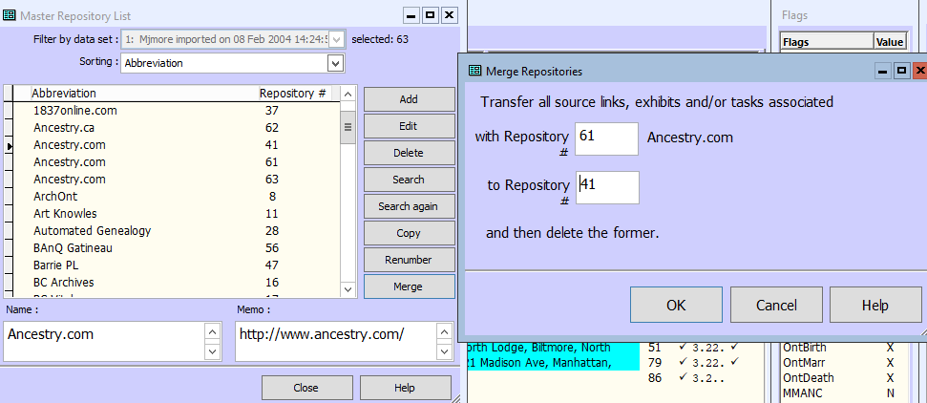
Merging Repositories
If you want to transfer all the Sources to a different repository (or all remaining after you move a group to a new one) you can Merge the two.
Select the one you want to go away, then use the Merge button and enter the number of the one you want to keep.
-Terry Reigel
Notes:
Note that the top Repository listed will be merged and deleted.

Slide 19
Merging Sources
Notes:
Sources can be handled in the same manner

Slide 20
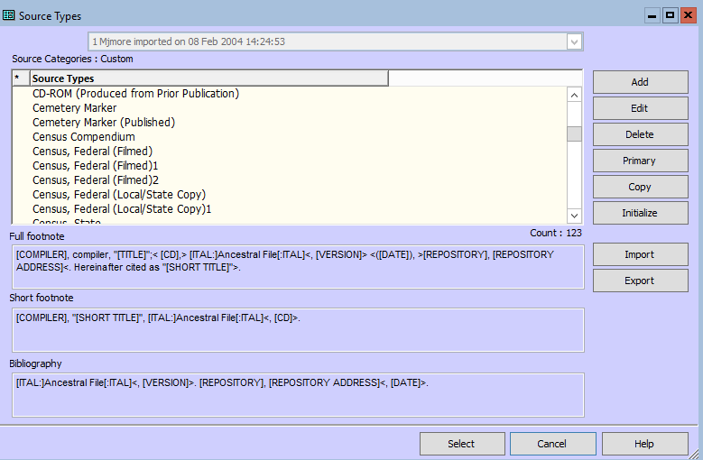
Merging Source Types
Notes:
Merging Source Types is a bit more involved. I find this can happen when you add a Data Set to your Project.
Open the Source Tpe Screen and find a duplicate Source Type. This is usually shown by a number at the end. Here I actually have three Census Federal (Filmed). Notice that there is no button to Merge on the right

Slide 21
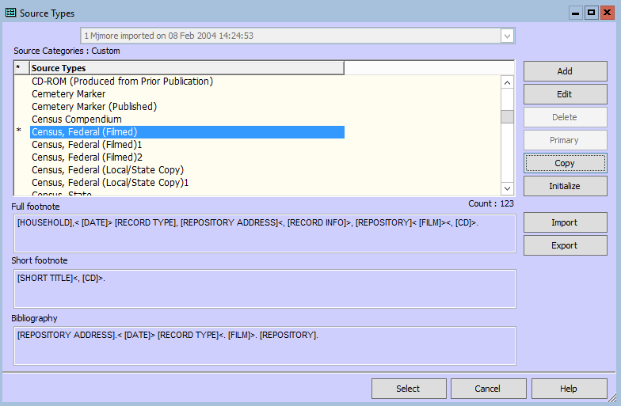
Merging Source Types
Notes:
First, highlight the Source Type that you want to keep and click the Primary button on the right. The Primary * appears beside it

Slide 22
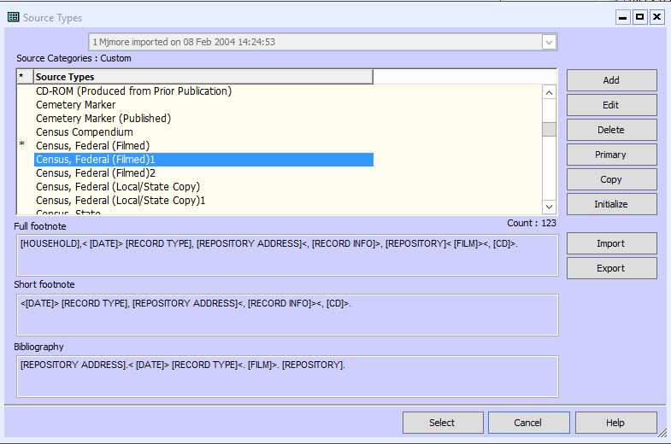
Merging Source Types
Notes:
Then, highlight the Source Type that you want merge or delete and click the Delete button on the right

Slide 23
Merging Source Types
Notes:
Click Ues on the first warning and you get a Second Warning. If you do have Sources assigned to this Source Type, they will be re-assigned to the Primary Sourc3e Type, which was the reason for the first step.

Slide 24
Merging Places
There is no Merge function in the Master Place List
Instead, you would ensure that the two places are identical and use Optimize as we discussed earlier.
Duplicate place records will be consolidated so that only one entry remains in the Master Place List.
NOTE: For two place records to be considered duplicates, all fields must be the same. This includes the Style, if one was used to create some of the entries. It is possible, for example, for two Master Place records to appear identical, but to have been generated using different Styles. Optimizing will not remove unused place records for which a start year, end year, comment, or short place name have been recorded.

Slide 25
Merge Two People
NOTE: You can only merge people who reside in the same data set, although you can compare people from different data sets. If the [Merge] button is grayed out, check to be sure the two people you are trying to merge are in the same data set. If not, you must move or copy one of them first -- or merge the two data sets.

Slide 26
Check for Duplicate People
This feature allows you to check your data set to see if it contains duplicate people. You can specify search criteria for possible Merge candidates, using surnames, given names, birth and death dates (including range of years), and characteristics of parents' names. You can also set the starting point for the duplicates check and decide whether to compare everyone in the project, only people in other data sets; or only people in a selected data set.
In the Check for Duplicate People screen there are eight selections: Configuration, Summary, Surnames, Given, Birth, Death, Parents and Filters. These screens allow you to customize the Check for Duplicate People in order to change how the duplicate-checking process will evaluate the data.

Slide 27
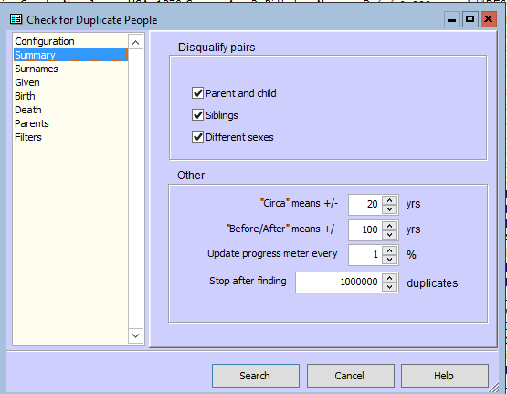
Check for Duplicate People
Notes:
Set up your parameters and save the Configuration.

Slide 28
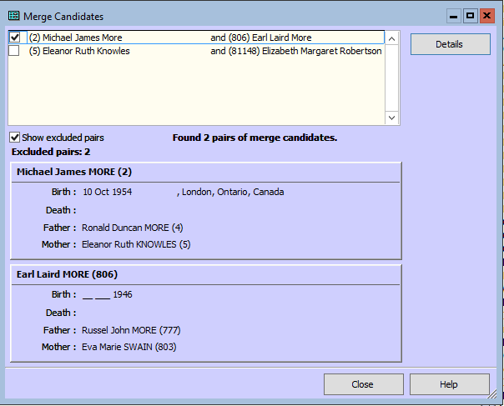
Check for Duplicate People
Notes:
If you determine that a pair of candidates are not the same person, you can exclude them from the list of merge candidates by checking the box in the row containing their names. If you have too many people in your candidates list, you may need to set more strict criteria in the Check for Duplicate People screen.
(Optional) You can eliminate excluded pairs from the list of merge candidates by deselecting Show excluded pairs.
Click [Details].
The Merge Two People - Split Display window will appear. This is the same window that opens when you choose Tools > Merge Two People. When you are finished, click [Close] to return to the Merge Candidates window.

Slide 29
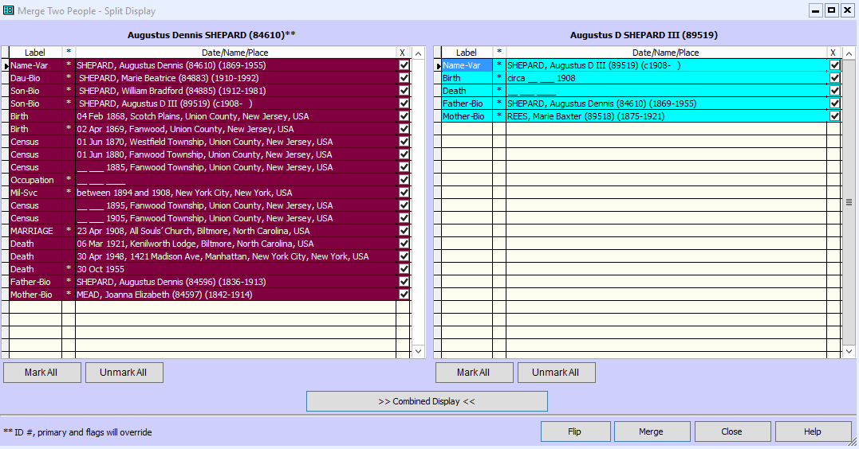
Merge Two People
Notes:
If you determine that a pair of candidates are not the same person, you can exclude them from the list of merge candidates by checking the box in the row containing their names. If you have too many people in your candidates list, you may need to set more strict criteria in the Check for Duplicate People screen.
(Optional) You can eliminate excluded pairs from the list of merge candidates by deselecting Show excluded pairs.

Slide 30
Merge Two People
Select Two Known People for Comparison
1. From the Tools menu, select Merge Two People.
The Merge Two People window will display.
2. Enter the ID Numbers of the two persons who are to be compared. If you don"t know the numbers, press <F2> to select them from the Picklist. Their records will be presented on the Merge Two People - Split (or Combined) Display screen.

Slide 31
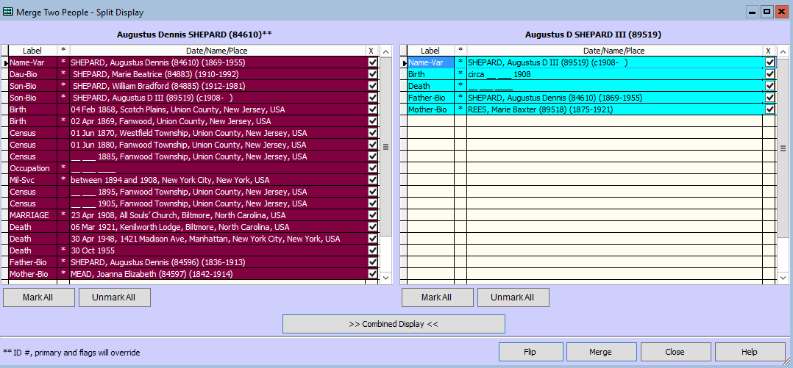
Merge Two People
Notes:
The person on the left is the one whose ID Number will be retained in the event of a merge, and if the same events are retained from both people, the one from the person on the left will be marked primary. If the Reference field for the person on the left is empty, the Reference field from the person on the right will be applied. Flags from the left person will also be kept.

Slide 32
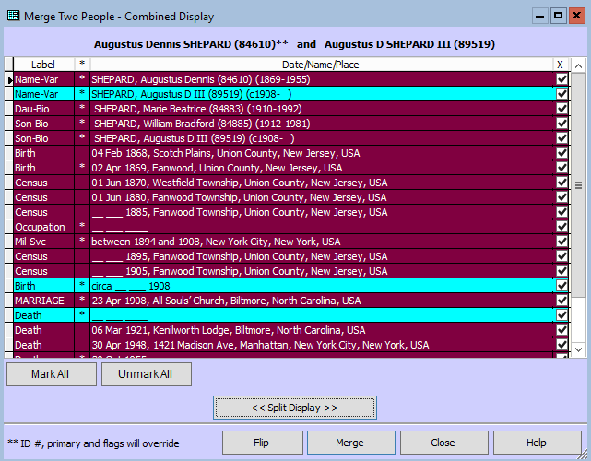
Merge Two People
Notes:
Combined Display screen displays the records of the two people combined in chronological order. The same options are available as on the Split Display screen

Slide 33
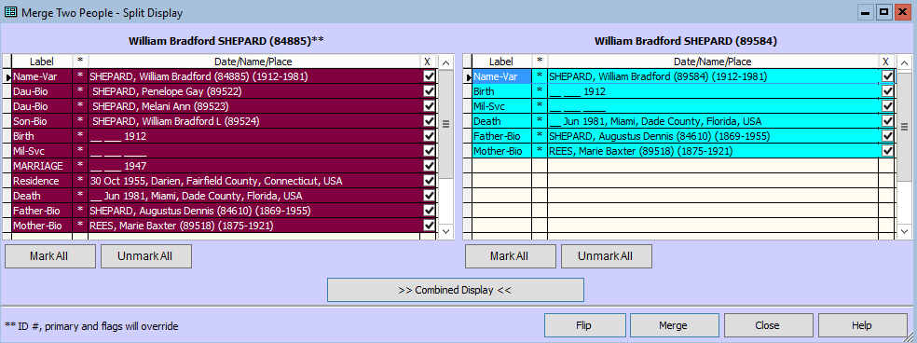
Merge Two People
Notes:
Let’s say that you have imported GEDCOM or entered a new person and realize that they are the same person. You open Merge Two People window and enter the ID Numbers and click OK.
You can also open any of the tags from the screen by double clicking on its label or press <F5>.

Slide 34
Merge Two People
Notes:
You CANNOT edit the tag here.

Slide 35
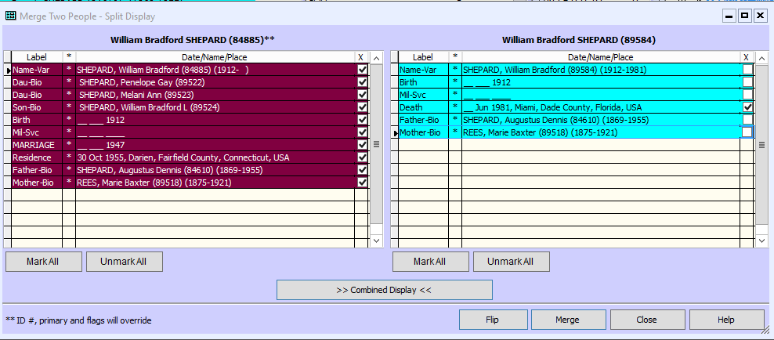
Merge Two People
Notes:
You then select which tags you want to keep from each duplicate.
In this case, I notice that all is identical except that the RIGHT duplicate includes a date of death; I unmark all except the Death tag. If you include too many, you can always delete them back in the PERSON view.
Press MERGE

Slide 36
Merge Two People
Notes:
Bingo: One Merged Individual.

Slide 37
Merging Tags/Citations
There is NO function to merge tags or citations in either TMG or TMGU.
So if you need to combine two tags, i.e. two birth tags from two merged duplicates, it has to be done manually. Don’t forget the F3: Repeat previous entry in this field (in data entry fields)

Slide 38
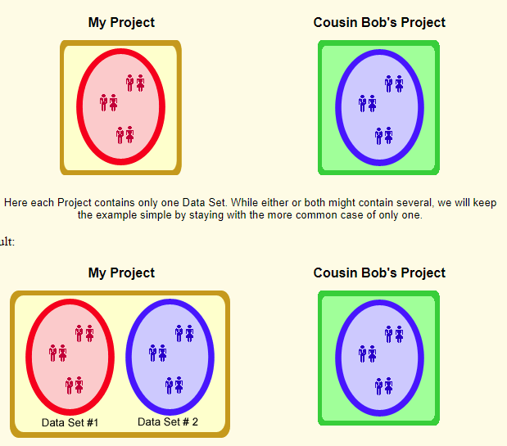
Merge Projects
Notes:
Terry Reigel has a great picture of what happens when you Merge two projects. You end up with two Data Sets in the Merged Project.
Now let’s see how we do this.

Slide 39
Merge Projects
Under the File tab, select Merge Projects.
Warning: You cannot merge two projects if both are not the current structural version. Any older project must be updated to the current version of TMG before you merge the projects.

Slide 40
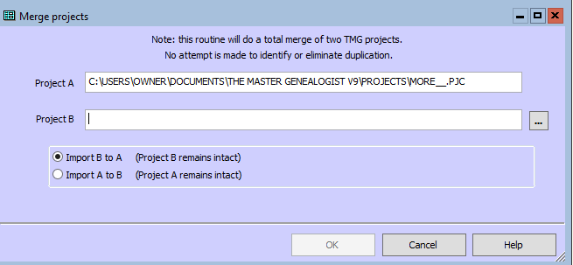
Merge Projects
NOTE: If you import B to A, A will contain both projects and B will remain the same as it was before the merge. The data set numbers for individuals in A will stay the same and the data sets in B will be appended to the end of A, their numbers changing accordingly. For example, if A has two data sets, individual 1:1 in B will become 3:1 in the newly merged A.
Notes:
The name of the current project will appear as Project A. Enter the path and name for Project B. It is usually best to use the select button to locate the project.
Lookup: Files and Folders. Click on the radio button next to Import B to A or Import A to B.
If you import A to B, B will contain all the data and A will remain the same, etc.

Slide 41
Merge Projects
It is important to check the contents of Project A before deleting Project B to be certain everything is to your satisfaction. If it is not, you can delete the newly imported data sets in A and try again.
Notes:
I wanted to draw your attention to the Note at the top of the Merge Projects box.
TMG Help also suggests:

Slide 42
Merge Data Sets
Under the File tab, select Data Set Manager

Slide 43
Merge Data Sets
From the Data Set Manager, click on [Merge].

Slide 44
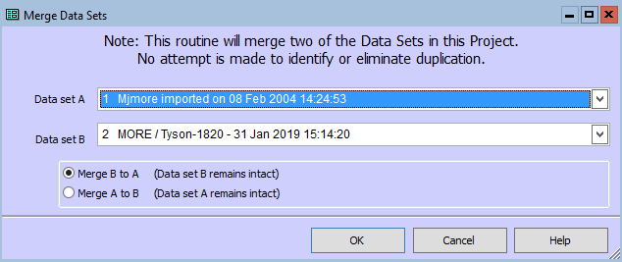
Merge Data Sets
Click on the down arrow next to Data Set A and select the first data set to merge if the pre-selected one is incorrect. Then do the same thing for Data Set B.
Click on the radio button next to Merge B to A or Merge A to B. Click [OK].
NOTE: If you merge B to A, A will contain both data sets and B will remain the same as it was before the merge. The ID Numbers for individuals in A will stay the same and the individuals in B will be appended to the end of A. If you merge A to B, B will contain all the data and A will remain the same, etc.

Slide 45
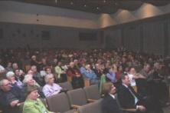
Genealogy: Back To Basics
A basic level genealogy lecture followed by a Q&A session.
Next: 23 Feb: Getting Started by Mike More
There is no charge for the sessions and all are invited to return at 1:00pm for the monthly presentation.
Coffee and tea will be available.
Following session: 23 Mar: OPL Resources by Romaine Honey
For more topics, check our website at http://ogsottawa.on.ca/.

Slide 46
Genealogy Drop-In
Drop in to get some help on your family tree, share research strategies, & discover what resources are available for your research. Experienced researchers from Ottawa Branch will be here to answer questions & help you get the most from several resources. Bring your laptop, or tablet! Sessions are free and open to all.
Ottawa Public Library Genealogy Drop-In:
- Tuesday 05 Feb at 2:00pm, Nepean Centrepointe
- Tuesday 19 Feb at 2:00pm, Nepean Centrepointe
- Tuesday 05 Mar at 2:00pm, Nepean Centrepointe
- Tuesday 19 Mar at 2:00pm, Nepean Centrepointe
Ottawa Public Library Genealogy Research Lab:
- Thursday 28 Feb at 7:00pm, Nepean Centrepointe

Slide 47
GENE-O-RAMA 2019
presented by Ottawa Branch OGS
April 5-6, 2019
Confederation Education Centre
1645 Woodroffe Avenue, Ottawa
Speakers, Marketplace, Research Room
Featured Speaker: Glenn Wright
Leanna Cooper, Ron Dale, Sadie De Finney, Shirley-Ann Pyefinch, Lisa Tremblay-Goodyer, Mary Munk, Megan Butcher, Ken McKinlay
Volunteers Needed
Details and registration when available:
https://ottawa.ogs.on.ca/geneorama/

