Slide 1
Mike’s TMG Tips
Ottawa TMGUG
2 Mar 2019

Slide 2
History Research Environment (HRE)
History Research Environment is a community project to create a free platform-independent application for the serious amateur or professional historical researcher.
For genealogists, HRE will provide an onward path for users of the discontinued program The Master Genealogist (TMG).
HRE will also handle a very wide range of other historical and cultural research needs.
Project website: https://historyresearchenvironment.org Volunteer skills: https://historyresearchenvironment.org/become-a-volunteer/ Donate: https://historyresearchenvironment.org/donate/ Wiki: http://hrewiki.org/index.php?title=Main_Page
Notes:
Latest newsletter was July 2018. Anybody subscribe to their Mailing List?

Slide 3
TMG Expertise
Terry Reigel: https://tmg.reigelridge.com/index.htm
Lee Hoffmann: http://www.tmgtips.com/
John Cardinal: https://www.johncardinal.com/
Michael Hannah:
https://www.mjh-nm.net/MY_WAY.HTML
Jim Byram
Notes:
These are some of the experts in TMG. The first four have websites with useful information on a wide ranges of aspects of TMG
Jim Byram is a technical expert and he tends to hang out on the TMG forum rather than on the Mailing List.

Slide 4
Storing Database in the Cloud
The problem with using any Cloud service as the main storage for TMG is that TMG has some 80 files that need to be updated at various times. While it may seem that the 80 files are updated all at once, in reality, it is one at a time and this takes time.
Cloud services are fairly safe most of the time because they are constantly being backed up by the owning service. Then, if there is a problem, the service will restore the latest backup (often without the user knowing it. If that backup happened at a time in the middle of the 80 files being updated, then corruption will occur.
As for backing up on-line, do the backups to the hard drive TMG folder and copy the SQZ file to OneDrive. This is very safe operation in that you have the copy on One Drive for safety and the copy on the hard drive (with the convenience of not having to download it from One Drive to do a Restore).
Lee Hoffman

Slide 5
Accessing Database from Multiple Computers
If the two computers are on the same network, you can place the database in a shared directory (not ‘cloud’, but a basic network shared directory) on one computer, then you can access it from a different computer connecting to that shared directory. This is fully supported, TMG fully expects that there might be a second database program accessing the file, possibly over a network, using the database specific locking procedures.
Notes:
Windows only??

Slide 6
Accessing Database from Multiple Computers
Two people can even be working on the same project at the same time. If you try to open the same tag for the same person, then a notice will appear stating that the record is in use elsewhere.
However, you an simultaneously work on different tags for the same person without difficulty.
Similarly, one could work in the Master Source List on one Source while the second person could work on a different Source. If either of us tried to open the Source Definition that the other had open, we would get the "locked" notice.
The same applies to any other record in the project.

Slide 7
Accessing Database from Multiple Computers
There are programs to allow you to sign in to your home computer from anywhere in the world. A similar kind of program is used by technicians to allow them to work your computer from their office while you are sitting in front of your computer watching the screen and seeing what they are doing. In both these case, the programs are not really networking, but remote access.
Lee Hoffman

Slide 8
Journal Report Index
Some word processors receive the index codes from TMG, but do not structure the index in a visible form. If you have chosen to include an index in your report, but it doesn't appear to be there, you may have to generate the index in your word processor or select a different screen mode which shows the completed document.
TMG only places the Word Processor's index codes in the document. It doesn't actually build the index. You have to do that in the Word Processor after you open the report. In Word 2007 go to the References ribbon, in the Index block. Position the cursor where you want the index to be and choose "insert index" on the ribbon.
Terry Reigel
Notes:
If you do any editing to the report after the index is generated, the index itself will not change the page references until you tell it to. When all the edits are completed, go back to the Word ribbon, references, and select Update Index.

Slide 9
TMG Flags
Most of the information about your individuals will appear in Tags but some is contained in Flags, for example the Sex of the subject. Flags are generally not useful for basic information about a subject but are used in the analysis of your data.
A flag is a single-character field that may be used to codify information about a person or to classify individuals in the data set. Flags can be used in conjunction with the accent feature and to filter information for display or in reports.

Slide 10
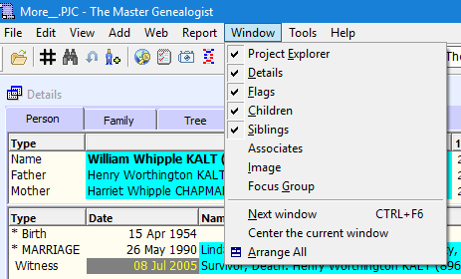
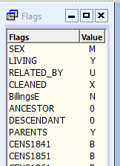
Flag Window
Notes:
To display the Flags window:
Select Window from the Main Menu and check Flags or click on the Flags window toolbar button in the Layout Toolbar

Slide 11
Flag Window
The Flags window displays all of the seven standard flags in a project, as well as those custom flags that are specific to a particular data set.
Where imported formats support something similar to these seven, they are mapped automatically to one of these seven formats.
All other customized flags are specific to the data set. The program supports up to 250 unique flags in each data set. There is no limit to the number of flags in a project.

Slide 12
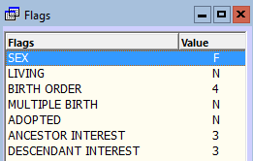
Flags
There are two types of flags: Standard and Custom
Standard
SEX
LIVING
BIRTHORDER
MULTIPLE BIRTH
ADOPTED
ANCESTOR INTEREST
DESCENDANT INTEREST

Slide 13
Standard Flags
SEX: used to compile reports, generate statistics, set accents, audit for discrepancies, etc. Therefore, it is important that the flag be set correctly. The choices for setting this flag are: M, F, and ?. When you add sons, daughters, brothers, sisters, mothers, or fathers, this flag is set automatically. It is automatically set to ? if you add a child or sibling.
LIVING: defaults to ?. The program automatically sets it to N when a death or burial tag is entered, or when a birth group tag indicates that the person would be more than 110 years old. You can change the LIVING flag to Y to use it with filters.
BIRTHORDER: used to keep children in the correct order on reports like the Family Group Sheet when the birth dates are not known. On the Family Group Sheet the numbers will be printed on the report if they have been entered.
ADOPTED: set in conjunction with relationship tags such as Moth-Ado, Fath-Ado, Son-Ado, or Dau-Ado. A Y indicates that the person shares an adoptive relationship in this family.
MULTIPLE BIRTH: designates a person who is part of a multiple birth -- 2 for twins, 3 for triplets, etc.
ANCESTOR AND DESCENDANT INTEREST: can be used to indicate your level of interest in a particular ancestor or descendant. i.e. 3 might be used for a direct ancestor or descendant.

Slide 14
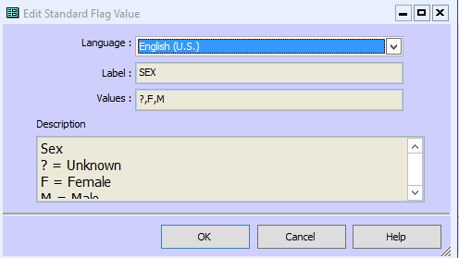
Editing Flags
The standard flags cannot be edited. Their Edit screen will be view-only.
SEX
LIVING
BIRTH
MULTIPLE
ADOPTED
ANCESTOR
DESCENDANT)

Slide 15
Editing Standard Flags
However, you can edit the Description when you set the Flag to some other language, even English (U.K. You may wish to "translate" that description. You also will be able to edit the Flag Name and Values, but again only to "translate" its character values.
TMG will let you edit the values field, but will ignore your changes when you save if they contain some error, like the wrong number of values or values with more than one character. However, the position of each (translated) value in the sequence of assignment values for any flag is defined to have the same meaning in all languages. Which means the second value in the list is treated by TMG as having the same meaning in every language, even if the "letter" used for that position is different in different languages.

Slide 16
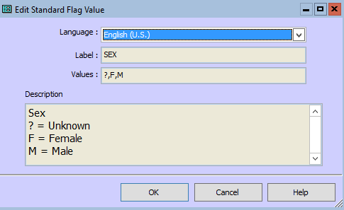
Editing Standard Flags
For example, regardless of what you call them or the language, the first value in the Sex flag means Unknown, the second means Female and the third Male.

Slide 17
Custom Flags
You can also create your own customized flags.
When importing data from other genealogy programs, any custom flags will be imported with the same name they had there.
If more than one data set in a project uses the same custom flag name, then in the Flag Manager, the data set number will appear after the flag name, e.g., CLERGY#1 and CLERGY#2.

Slide 18
Common Uses of Flags
Accents and Reports make use of the Flag feature.
Track the progress of research or clean up. For each task you define a Custom Flag . This can be a simple Yes/No or more detailed.
Divide a single TMG data set into logically distinct groups such as ancestor branches.
Record a particular characteristic that is present in multiple people but is not associated with a particular place and time, i.e. an inherited health condition or Military service.
It is often useful to create one or two custom flags for temporary use in building complex search statements when writing reports.
Flags are also used by some of John Cardinal’s companion programs.
Notes:
Show some examples from my database

Slide 19
Flag Manager
To use the Flag Manager:
Select File > Flag Manager.
The Flag Manager window will appear.
or right-click on any flag in the Flags window and select Customize Flags from the menu.

Slide 20
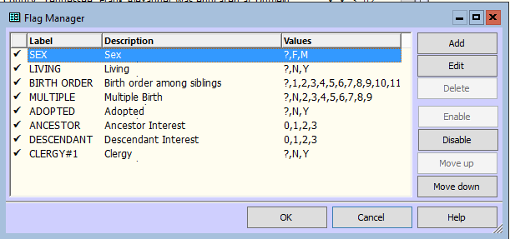
Flag Manager
All flags are enabled by default.
You can disable these flags so that they do not appear in the Flags window.

Slide 21
Flag Manager
To disable a flag: Highlight the flag name and click [Disable].
To enable a flag: Highlight the flag name and click [Enable].

Slide 22
Flag Manager
To delete a flag: In the Flag Manager, highlight the flag and click on [Delete] or press <F6> or <Delete>.
Answer [Yes] to confirm the deletion.
You cannot delete any of the Standard Flags

Slide 23
Flag Manager
To rearrange the order of the flags:
Highlight a flag name and click [Move up] or [Move down].

Slide 24
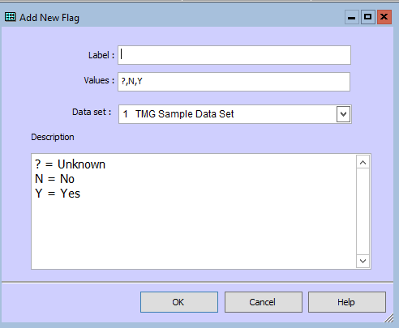
Add a Flag
In the Flag Manager window, select [Add] or press <F4>.
The Add New Flag window will appear.

Slide 25
Add a Flag
In the Label field, enter a label for the flag, then press <Tab> or click in the Values field.
NOTE: Flag names (up to 50 characters) and values (one character) can be entered using upper or lower case letters, numbers, and any characters except comma. A pound sign (#) can be used in the values section, but not in the name. Spaces can be used in the name, but not as a value.

Slide 26
Add a Flag
In the Values field, list all possible values. Only one character may be used for each value. The first value in the list is the default value. This value will automatically be set by the program and remain until you change it. It is often best to use a "?" for the default value.

Slide 27
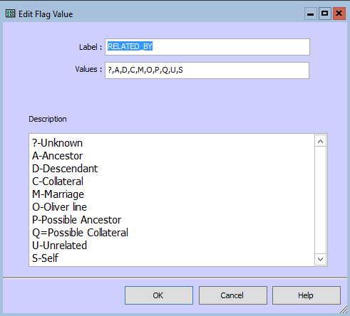
Add a Flag
Example: You want to indicate your relationship to the people in your data set. Call the flag "Related by." Enter Related by in the Label field.
Then you must determine all possible values. In this case, you may want a question mark and the first letters of the following words as the possible values:
? = Unknown
A = Ancestor
D = Descendant
C = Collateral
M = Marriage
U = Unrelated
S = Self
Your list of possible values would be ?,A,D,C,M,U,S. While you can use lowercase letters here, you should be aware that the search is not case sensitive, e.g., "A" and "a" are the same.

Slide 28
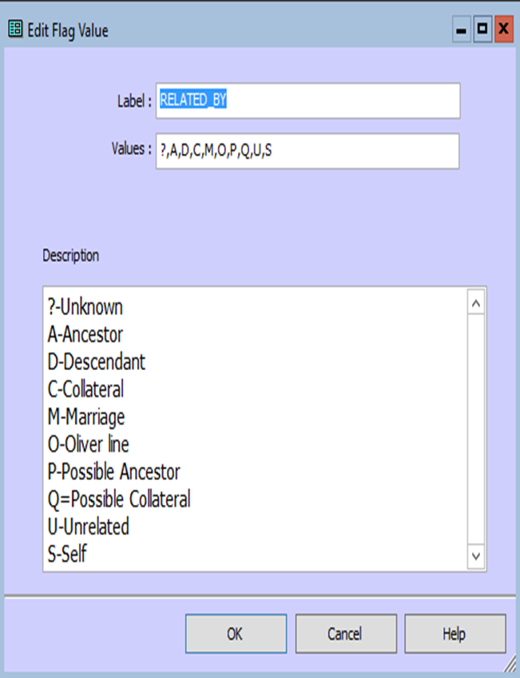
Add a Flag
In the Data Set field, if more than one data set is unlocked, you can select the data set in which this flag will be used.
Type a description in the Description field identifying the meaning of the custom flag and its various values. In the example above, you might have something like:
This field contains the relationship of the
subject to the owner of the data set.
? = Unknown
A = Ancestor
D = Descendant
C = Collateral
M = Marriage
U = Unrelated
S = Self
Select [OK].
Notes:
Note that in this example, there is only one Data Set, so no option to select.

Slide 29
Add a Flag
NOTE: You should experiment and be sure you are satisfied before setting the flag value for many individuals. You cannot delete flag values which are currently being used in flags.
A flag can be set only to a value you have included in the list.
It is perfectly safe to create new flags as this does not affect any other flag in the data set.
NOTE: In any field in which you can type, there is a right-click menu with cut, copy, paste, and spell checker. The Label, Values, and Description fields support the use of hot keys:
<F3> = Repeat previous entry
<Ctrl>+<F3> = List previous 15 entries
Lookup: Repeat Keys

Slide 30
Edit Flag Values
In the Flag Manager window, select [Edit] or press <F5>.
The Edit Flag Value window will appear.
You may make changes in any field. You should experiment and be sure you are satisfied before setting the flag value for many individuals.
You cannot delete flag values which are currently being used in flags.
Select [OK].
NOTE: In any field in which you can type, there is a right-click menu with cut, copy, paste, and spell checker. The Label, Values, and Description fields support the use of hot keys:
<F3> = Repeat previous entry
<Ctrl>+<F3> = List previous 15 entries
Lookup: Repeat Keys

Slide 31
Suppressing names in TMG
It’s a simple matter with Second Site to exclude everything for living people. However, in a TMG journal report it appears that you can only suppress details, not names. I’ve checked Terry’s site and the TMG Forum, but couldn’t find any reference to suppressing names of living people.

Slide 32
Suppressing names in TMG
3. Annie Eliza ALEXANDER (Frank¹) was born on 10 Jan 1869. She was born on 10 Jan 1870 at Marion, Smyth County, Virginia. She married John Keys Fugate on 8 Dec 1896 at Dickensonville, Virginia. She died on 11 Apr 1936 at Kingsport, Sullivan County, Tennessee, at age 66. She was buried at Bristol, Tennessee.
Children of Annie Eliza Alexander and John Keys Fugate are as follows:
i. Joseph Alexander is still living.
ii. Mary Virginia is still living.
5. iii. Elizabeth Keys is still living.
Generation Three
5. Elizabeth Keys FUGATE (Annie² Alexander, Frank¹) is still living.
Children of Elizabeth Keys³ Fugate and Thomas L. Williams are as follows:
i. Donald James is still living.
ii. Donna Joanna is still living.
Notes:
This shows a report with a check by Suppress details for living people

Slide 33
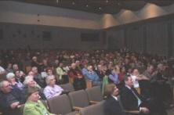
Genealogy: Back To Basics
A basic level genealogy lecture followed by a Q&A session.
Next: 23 Mar: OPL Resources by Romaine Honey
There is no charge for the sessions and all are invited to return at 1:00pm for the monthly presentation.
Coffee and tea will be available.
Following session: 27 Apr: Evaluating Evidence
For more topics, check our website at http://ogsottawa.on.ca/.

Slide 34
Ottawa Public Library Programs & Events (Check the website for the latest details) https://biblioottawalibrary.ca/en/program
Log in and register
Genealogy Drop-In:
- Tuesday 05 Mar at 2:00pm, Nepean Centrepointe
- Tuesday 19 Mar at 10:30am, Greenboro Computer training room
- Tuesday 19 Mar at 2:00pm, Nepean Centrepointe
- Tuesday 02 Apr at 2:00pm, Nepean Centrepointe
Genealogy for the Whole Family
- Friday 15 Mar at 2:00pm Nepean Centrepointe
Library Resources for Genealogy
- Tuesday 9 Apr at 7:00pm, Stittsville
Discover Your Roots: Genealogy and Local History Fair
- Saturday 27 Apr at 10:00am, Nepean Centrepointe

Slide 35
GENE-O-RAMA 2019
presented by Ottawa Branch OGS
April 5-6, 2019
Confederation Education Centre
1645 Woodroffe Avenue, Ottawa
Speakers, Marketplace, Research Room
Featured Speaker: Glenn Wright
Leanna Cooper, Ron Dale, Sadie De Finney, Shirley-Ann Pyefinch, Lisa Tremblay-Goodyer, Mary Munk, Megan Butcher, Ken McKinlay
Volunteers Needed
Details and registration when available:
https://ottawa.ogs.on.ca/geneorama/

