Slide 1
Mike’s TMG Tips
Ottawa TMGUG
7 Sep 2019

Slide 2
History Research Environment (HRE)
History Research Environment is an open source project to create a free platform-independent application for the serious amateur or professional historical researcher.
For genealogists, HRE will provide an onward path for users of the discontinued program The Master Genealogist (TMG).
HRE will also handle a very wide range of other historical and cultural research needs.
Project website: https://historyresearchenvironment.org Volunteer skills: https://historyresearchenvironment.org/become-a-volunteer/ Donate: https://historyresearchenvironment.org/donate/
Notes:
Latest newsletter was Posted on 15 August 2019 . Anybody subscribe to their Mailing List?

Slide 3
HRE newsletter, 15 August 2019
Progress
Progressing, but at a slower pace than we would like
Recently we have refined a number of the database design aspects as we work on the implementation of HRE features.
Java code is being built to manage the operations on the database through a well defined set of Java classes (API) such that the database engine is independent of the Java code.
HRE Board Changes
Next Objectives
LOAD the settings for Name Styles and create the ability to enter Person and Location Names
IMPORT Person and Location Names from a TMG project and be able to display/edit those names.
Volunteers
It is very difficult to find and keep suitably skilled volunteers. PLEASE RESPOND if you have Java programming skills and time to help.

Slide 4
Social Media Update
TMG-REFUGEES:
https://lists.rootsweb.ancestry.com/hyperkitty/list/tmg-refugees@rootsweb.com/
Website: https://sites.google.com/site/tmgrefugees
-Nothing since April
TMG Facebook Page: Five posts in August plus several replies
https://www.facebook.com/groups/themastergenealogist/
TMG Mailing List https://lists.rootsweb.ancestry.com/hyperkitty/list/tmg@rootsweb.com/
-Still very active
Wholly Genes Forum
http://www.whollygenes.com/forums201/index.php -Still active
Notes:
Rootsweb Mailing Lists came back in early March. I’ve shown numbers above to suggest that the TMG Mailing List is probably your best place to get TMG help.

Slide 5
TMG Expertise
Terry Reigel: http://www.reigelridge.com
Lee Hoffmann: http://www.tmgtips.com/
John Cardinal: https://www.johncardinal.com/
Michael Hannah:
https://www.mjh-nm.net/MY_WAY.HTML
Jim Byram: use the TMG Forum
Notes:
These are some of the experts in TMG. The first four have websites with useful information on a wide ranges of aspects of TMG
Jim Byram is a technical expert and he tends to hang out on the TMG forum rather than on the Mailing List.

Slide 6
Second Site v7.05 Is Available
There was a bug in SS v7.04 where the Family History Hosting Publish command did not work and caused a crash. The Publish command works as expected in v7.05.
Users with a Second Site 7 license can download the installer here:
https://www.secondsite7.com/downloads.htm?v=7.05
This is a free upgrade for registered users of Second Site 7.
If you are using Second Site 6 or a previous version, you must purchase a license to use Second Site 7:
https://www.secondsite7.com/purchases.htm?v=7.05

Slide 7
TMG Forum Registration
There is an issue with the Forum that prevents people from registering.
It requires the user to respond to a CAPTCHA, but the CAPTCHA that is specified is no longer supported by Google, who hosts it. Bob hasn't yet fixed that.
If you write to Terry Reigel, he may be able to register you.

Slide 8
Split Memos and Citations-Terry Reigel
All the memo fields in TMG, which include the Tag Memo, Citation Detail, Citation Memo, Source Comments, and Repository Memo, can be "split.“ This is done by dividing the text for each segment with two vertical bars, like this:
this is some text||this is different text||this is still different text
The various segments can be placed into the output with the appropriate Sentence Variables or Source Elements: [M1], [M2], [M3], etc., or [CD1], [CD2], [CD3], etc.
Notes:
I spoke about this a couple of years ago and I wanted to refresh you before going into David’s discovery earlier this summer.

Slide 9
Split Memos and Citations-Terry Reigel
Splitting the Memo is useful in several cases:
separating parts of the memo text with other Variables or text in the Sentence, for example in this Sentence for a Land Buy Tag:
[P] <purchased|and [PO] purchased> <[M1]><[L]><[D]><, [M2]>
Here the first segment would describe the property - "100 acres on the river" - while the second would tell more about the transaction - "from John Doe for $150.“
can also be used to provide different memo text for different persons in the Tag. For example you can have different text for each of the two Principals - "with his wife||with her husband" - or different text for Principals and Witnesses.

Slide 10
Split Memos and Citations-Terry Reigel
Memo: Regtl. No 3379/201165 Pte Knowles, Arthur James 1/4th Batt. Hants Regt. || transferred to Reserve. ||Enlisted on the 5th November 1914 for Hants Regt, also served 36th L.T.M.B. Medals and Decorations awarded during present engagement: Chevrons. Has served Overseas on Active Service. ||
Place of Rejoining in case of emergency: Winchester
Medical Category: A1
Specialist Military qualifications: Trench Mortar
||The 1/4 Hampshire Regiment served for most of the war in Mesopotamia
Sentence: [P joined the British Army <[D]> <[L]>: [M1] [M3] [M5]
Notes:
This is from my databse and I have colour coded the various portions. Note that there is no need to use all of the portions of the split memo.

Slide 11
Split Memos and Citations-Terry Reigel
He joined the British Army on 5 Nov 1914: Regtl. No 3379/201165 Pte Knowles, Arthur James 1/4th Batt. Hants Regt. Enlisted on the 5th November 1914 for Hants Regt, also served 36th L.T.M.B. Medals and Decorations awarded during present engagement: Chevrons. Has served Overseas on Active Service. The 1/4 Hampshire Regiment served for most of the war in Mesopotamia.
Notes:
This is there result.

Slide 12
David’s Discovery
A single vertical bar ‘|’ inside conditional variable brackets defines which part of the conditional text is output if there is one or both Principals known. This <one text|two text> construct outputs only the first part when there is one Principal and only the second when there are two, as in “[P] <was|and [PO] were>”

Slide 13
David’s Discovery
WARNING: TMG will recognize any set of conditional variable brackets containing a memo or memo part variable in a sentence template where that memo text contains a single vertical bar as having a “two principals” separator.
Depending upon the number of known Principals the resulting output will either be only the resulting expanded text before the vertical bar, or only the expanded text after the vertical bar. Thus either the text before or the text after the separator bar will not output in TMG narrative reports.
Second Site only recognizes this special meaning of this character in sentence templates, not in memos.

Slide 14
David’s Discovery
I use this vertical bar symbol to separate tombstone inscriptions where the husband is shown in several lines on the left and the wife in several lines on the right.
For example:
Inscription: EADE | WALKER / In Loving Memory of / Harriett E West / 1887 - 1963 / Beloved Wife of / Alfred W. Eade / 1885 - 1970 | Tom K. Walker / 1911 - 1996 / Beloved Husband of / Daisy E. Walker / 1913 - 2005 // At Rest
A journal report in TMG with a sentence including <[M]> produces only: “Inscription: EADE “.
[M] produces the full sentence.
Second Site displays the entire memo.

Slide 15
Appending Records To Existing Dataset
When you import data, either from a Gedcom or from another TMG Project, it is imported to a separate Data Set. There is no way to avoid that. If you want it put in the same Data Set as your existing data you then need to merge the data sets. Doing so is not as obvious as it sounds. Please see article at https://tmg.reigelridge.com/merging.htm#datasets for details.
Note: you should not be transferring people from one TMG Project to another via Gedcom. Much data can be lost this way.
Instead, use the Secondary Output of the List of People report to create a new Project from the original TMG Project. Then Merge that new Project into your Second Project, and finally Merge the resulting Data Set into your working Data Set. The article above covers merging Projects too.
-Terry Reigel

Slide 16
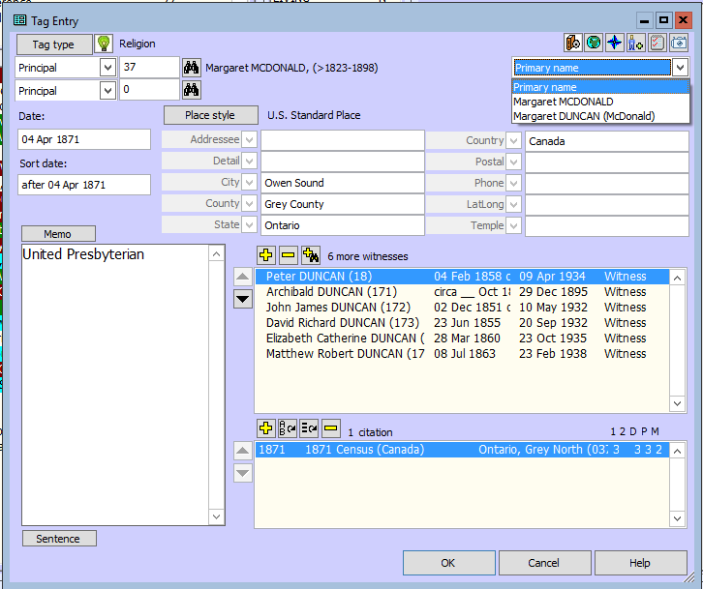
Alternate Names
TMG will not decide on its own to use a non-primary name in an event based on other events. However, you can alter which name is used by editing the event. On the right-hand side of the Tag Entry window you will see a pull-down menu where you choose "Primary name" or another name. The default is "Primary name". -John Cardinal

Slide 17
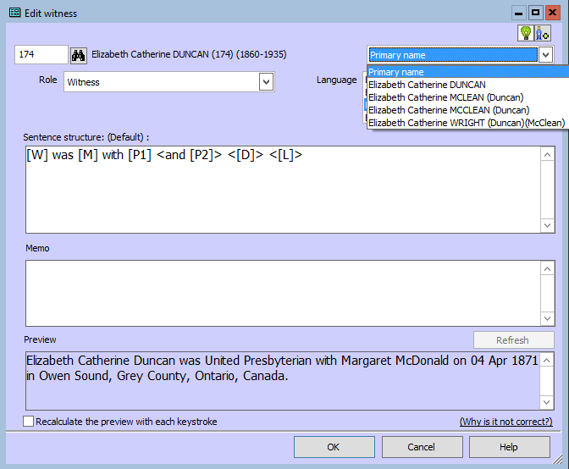
Alternate Names
There is a similar control for the Add Witness / Edit Witness window.

Slide 18
Alternate Names
I typically use the primary name for all events. That's what I've seen the most, and it avoids the confusion that might result when reading a narrative and the person's name changes mid-stream. I don't treat my narratives as transcriptions of the source documents, but rather, they are my interpretation/understanding of what the sources indicate.
-John Cardinal

Slide 19
Prepositions
Dates: If the day (1-31) is known, then the date is preceded by "on." Otherwise, the date is preceded by "in." If a date is unknown and included inside of conditional brackets, the phrase "on an unknown date" will be generated.
Places: The place is preceded with "at," "in," or nothing, according to the setting in the Places tab of the Report Options Screen for the report being generated.
Memos: No preposition is automatically inserted. Any necessary preposition should be given within the sentence construction rules or within the memo itself.
Notes:
TMG handles prepositions on both a global and local level.

Slide 20
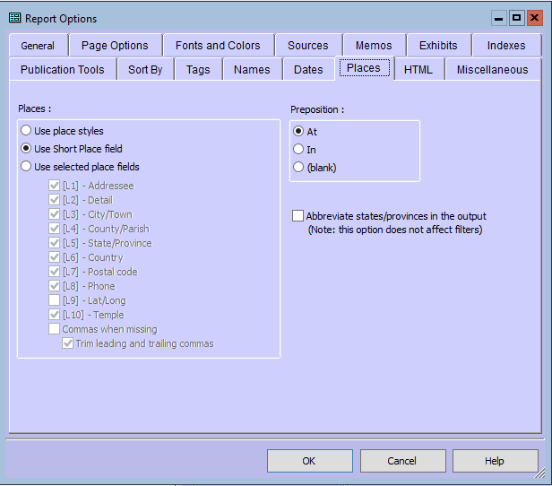
Prepositions
Notes:
Globally, the Report Options can be used to set the prepositions for Places

Slide 21
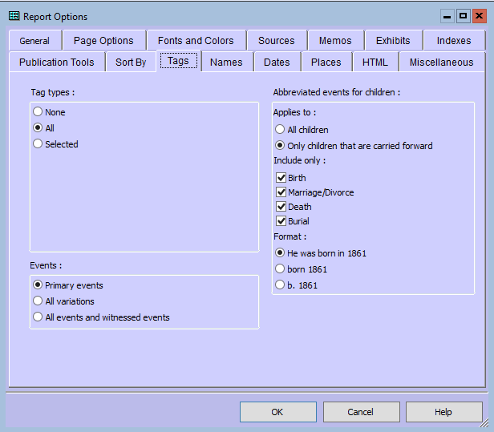
Prepositions
Notes:
And for Dates

Slide 22
How to get rid of "in" in a sentence?
Locally change the sentence template for that one tag to prevent the automatic preposition being generated for the location variable.
Within the conditional brackets insert some leading text (e.g. a space) which will prevent the preposition, like:
Anita graduated <[D]> from < [L1]><[M]>
You will then get:
'Anita graduated in 1959 from Memorial High School'
Notes:
You can also change them locally witth either a space (to leave it blank) or another preposition

Slide 23
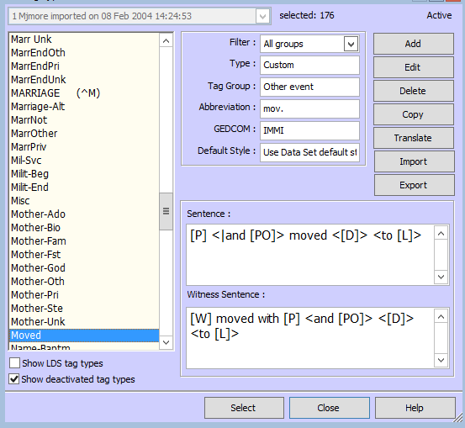
Prepositions
Notes:
In my Custom Moved Tag, I’ve entered the preposition TO for all locations but I could still edit this locally.

Slide 24
PDF Printing with TMG 9.05 in Windows 10
Constance Chappell Horne: I would suggest that if you truly want PDFs, that you install CutePDF.
It installs as a printer. I have it as my default printer and print everything that way usually. It is free and works great. I highly recommend it
Notes:
I can’t vouch for this but it came up recently

Slide 25
Unknown Custom Place Style
Found 5 same place(s) with different styles:
"Baldwin County Georgia( U.S. StandardPlace )" and "Baldwin County Georgia( Addressee, Detail, City, County, State, Country, Postal, >Phone, LatLong, Temple )"
I have never intentionally created a custom place style. How do I change these places back so they are all (U.S StandardPlace) ?
In all likelihood, you inadvertently created the Custom Place Style. There are a couple of places where, if you aren't looking, TMG will create a Custom Place Style. In almost all cases, the Custom Style is the same as the Standard Place Style (or a Custom Style that you had created and were using).
To correct it, open the Master Place list, find and highlight the problem place that shows the Custom Place Style in use and press [F5] to open the Edit Place screen. Click on the [Edit style] button to open the Master Style List. Hightlight the name of the Style that you want (probably the U.S. Standard) and click on the [Select] button. Click on the [OK] button to close the Edit Place screen. When finished, [Close] the Master Place List.

Slide 26
Unknown Custom Place Style
Notes:
On the Master Place List, you can find the Style way over to the right. Mine are all US Standard, so ignore that aspect but look for those that you want to change.

Slide 27
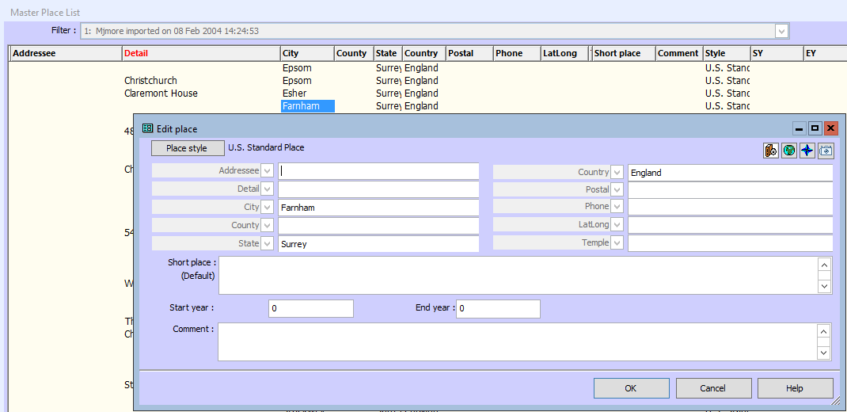
Unknown Custom Place Style
Notes:
open the Edit Place screen. Click on the [Edit style] button to open the Master Style List.

Slide 28
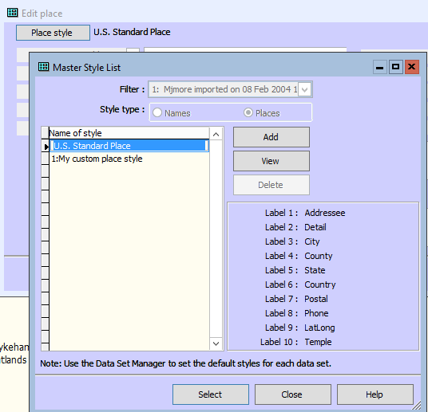
Unknown Custom Place Style
Notes:
Hightlight the name of the Style that you want (probably the U.S. Standard) and click on the [Select] button. Click on the [OK] button to close the Edit Place screen. When finished, [Close] the Master Place List.

Slide 29
List of Persons showing only their PRIMARY SURNAME
I want to create a list of all the persons in the dataset of a certain Surname but only when it is their PRIMARY surname, not to include married, nick names, aliases, etc.
Rather than just selecting the option "Surname" in the Field slot of the filter screen, scroll down the Field options list to Name Group..., select it and choose "Surname" in the Subfield. This allows use of the "*" option at the left. Click on the * box and finish the filter as desired. I would normally use the following:
* NAME GROUP... Surname = Equals ------- END

Slide 30
List of Persons showing only their PRIMARY SURNAME

Slide 31
List of Persons showing only their PRIMARY SURNAME
Notes:
If you enter a value of [?], this allows youto run the same report for a different surname each time as the "[?]" tells TMG to ask for the search Value when the report is generated.

Slide 32
List of Persons showing only their PRIMARY SURNAME
Notes:
If you enter a value of [?], this allows youto run the same report for a different surname each time as the "[?]" tells TMG to ask for the search Value when the report is generated.

Slide 33
Filters
Lee Hoffman: As a follow-up to my earlier post about the filter options, I was looking at how many there were of each type and estimate there are over 1500 different filter options. They range from 11 options for Tag Types to about 300 for Tasks. I have not counted those for people although I suspect that would also be about 300. As I noted earlier, some filter options are the same regardless of the type report (e.g., Surname, Sex, etc.). Also, while some may have the same option name, the meaning is different. For example, Abbreviation is used for Sources, Tag Types, and Repositories, and while the same idea, they each are different.

Slide 34
List of Persons showing only their PRIMARY SURNAME
I want to create a list of all the persons in the dataset of a certain Surname but only when it is their PRIMARY surname, not to include married, nick names, aliases, etc.
Rather than just selecting the option "Surname" in the Field slot of the filter screen, scroll down the Field options list to Name Group..., select it and choose "Surname" in the Subfield. This allows use of the "*" option at the left. Click on the * box and finish the filter as desired. I would normally use the following:
* NAME GROUP... Surname = Equals [?] END
This allows me to run the same report for a different surname each time as the "[?]" tells TMG to ask for the search Value when the report is generated.

Slide 35
Ottawa Branch Upcoming Presentations
Saturday 14 Sep
Quebec Notarial Records – An Underused Resource
Gloria Tubman & Brian Glenn
1:00pm at City of Ottawa Archives
Saturday 26 Oct
Ancestors Intersecting History
Gloria Tubman
1:00pm at City of Ottawa Archives

Slide 36
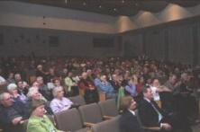
Genealogy Lunch Bunch
You are invited to bring a “brown bag” lunch to eat while we hold a presentation or a research workshop. Coffee and tea will be available throughout the sessions.
Next: 14 Sep: Heather Oakley will talk about some of the FREE ways to upgrade your knowledge about genealogy and the various aspects of research.
If you are new to family history research or need a refresher, come out and join us! Sessions are free and open to all. Our normal monthly presentation social time will start at 1:00pm with the regular cookies.
Following session: 26 Oct: Ottawa Branch Library Update
For more topics, check our website at http://ogsottawa.on.ca/.

Slide 37
Genealogy Drop-In
Drop in to get some help on your family tree, share research strategies, & discover what resources are available for your research. Experienced researchers from Ottawa Branch will be here to answer questions & help you get the most from several resources. Bring your laptop, or tablet! Sessions are free and open to all.
Ottawa Public Library Genealogy Drop-In:
- Tuesday 17 Sep at 2:00pm, Nepean Centrepointe
- Tuesday 01 Oct at 2:00pm, Nepean Centrepointe
- Tuesday 15 Oct at 2:00pm, Nepean Centrepointe
- Tuesday 29 Oct at 2:00pm, Nepean Centrepointe

Slide 38
GENE-O-RAMA 2020 presented by Ottawa Branch OGS April 3-4, 2020 Confederation Education Centre 1645 Woodroffe Avenue, Ottawa
Volunteers Needed

