Slide 1
Mike’s TMG Tips
Ottawa TMGUG
2 Nov 2019

Slide 2
We acknowledge that we meet here today on unceded Algonquin territory

Slide 3
History Research Environment (HRE)
History Research Environment is an open source project to create a free platform-independent application for the serious amateur or professional historical researcher.
For genealogists, HRE will provide an onward path for users of the discontinued program The Master Genealogist (TMG).
HRE will also handle a very wide range of other historical and cultural research needs.
Project website: https://historyresearchenvironment.org Volunteer skills: https://historyresearchenvironment.org/become-a-volunteer/ Donate: https://historyresearchenvironment.org/donate/
Notes:
Latest newsletter was Posted on 15 August 2019 . Anybody subscribe to their Mailing List?

Slide 4
HRE Newsletter 15 August 2019
Progress
Progressing, but at a slower pace than we would like
Recently we have refined a number of the database design aspects as we work on the implementation of HRE features.
Java code is being built to manage the operations on the database through a well defined set of Java classes (API) such that the database engine is independent of the Java code.
HRE Board Changes
Next Objectives
LOAD the settings for Name Styles and create the ability to enter Person and Location Names
IMPORT Person and Location Names from a TMG project and be able to display/edit those names.
Volunteers
It is very difficult to find and keep suitably skilled volunteers. PLEASE RESPOND if you have Java programming skills and time to help.

Slide 5
Social Media Update
TMG-REFUGEES:
https://lists.rootsweb.ancestry.com/hyperkitty/list/tmg-refugees@rootsweb.com/
Website: https://sites.google.com/site/tmgrefugees
-Nothing since April
TMG Facebook Page: Four posts in October plus several replies
https://www.facebook.com/groups/themastergenealogist/
TMG Mailing List https://lists.rootsweb.ancestry.com/hyperkitty/list/tmg@rootsweb.com/
-Still very active
Wholly Genes Forum
http://www.whollygenes.com/forums201/index.php -Still active
Notes:
Rootsweb Mailing Lists came back in early March. I’ve shown numbers above to suggest that the TMG Mailing List is probably your best place to get TMG help.

Slide 6
TMG Expertise
Terry Reigel: http://www.reigelridge.com
Lee Hoffmann: http://www.tmgtips.com/
John Cardinal: https://www.johncardinal.com/
Michael Hannah:
https://www.mjh-nm.net/MY_WAY.HTML
Jim Byram: use the TMG Forum
Notes:
These are some of the experts in TMG. The first four have websites with useful information on a wide ranges of aspects of TMG
Jim Byram is a technical expert and he tends to hang out on the TMG forum rather than on the Mailing List.

Slide 7
Second Site v7.05 Is Available
There was a bug in SS v7.04 where the Family History Hosting Publish command did not work and caused a crash. The Publish command works as expected in v7.05.
Users with a Second Site 7 license can download the installer here:
https://www.secondsite7.com/downloads.htm?v=7.05
This is a free upgrade for registered users of Second Site 7.
If you are using Second Site 6 or a previous version, you must purchase a license to use Second Site 7:
https://www.secondsite7.com/purchases.htm?v=7.05

Slide 8
Spouse Events in Journal Report
The option to include spouse events is on the Miscellaneous tab of Report Options.
That choice is disabled when one of the Styles (NEHGR, NGSQ or TAG) is selected on the General tab.
Choosing the Custom Style enables this and the other options. When you use the Custom Style and include Spouse Events you will get all qualifying spouse events, not just BMDB.

Slide 9
Including children without progeny in reports
There are two methods to do this:
1. In report Options, Tags tab, on the right side about Abbreviated events for children, choose the second option "Only for children that are carried forward." This setting controls how much detail is shown in the children list after the parents. Choosing this setting puts all the details of children not carried forward where they appear under their children.
2. Add a "fake child" to those who have not children. Then, when your run the report send it to a word processor and edit out the fake children. This creates a separate section for these people where all the details can appear, just like those who have children.
Terry Reigel

Slide 10
TMG lock up when using LoP to change flag
I suspect that there is a dialog box, maybe just an OK acknowledgement, that is being placed behind the main TMG screen so you can't see it.
Some things you might try:
Press the Enter key when it locks up to see if you can "click" the OK button.
Use the Window > Center the Current Window menu command to see if that will bring the hidden window to the front.
Resize the main TMG window only to partial screen and position it to the side so the middle of your monitor is clear before taking the action that locks it up, so the OK dialog will not be hidden.
Terry Reigel

Slide 11
Two Instances of TMG Open at Same Time
If you are interested in multiple users on a single project via a network, you might find this article of interest:
http://www.tmgtips.com/tmg5_network.htm
Note that the project must be located on a network drive (e.g., it appeares to be the same address to both users) and Cloud drives do not work.
The article was written for TMG v5, but still applies to all later versions of TMG. Many of the hardware/software details will be different, but the basic premise remains the same.
Lee Hoffman

Slide 12
TMG and OneDrive
Johns Cordes: I began experimenting with OneDrive a few months ago. I have certainly encountered problems, and am still not sure I'm going to keep using it. However, I have had no problems with TMG due to OneDrive. This is probably because my TMG is installed to C:\TMG and does not use any folders which are being watched by OneDrive.
John Cardinal: For the first week or so after switching to Win10, I had OneDrive running. I have since uninstalled it. It was not interfering with TMG, bit it was annoying for other reasons and so I got rid of it. I've read online that it may re-appear after a Windows Update. If so, I'll kill it again, and keep killing it, until Windows Update gives up and accepts my decision about what software I want on my PC.

Slide 13
GPS coordinates in TMG
Terry Reigel : I add LatLong info in these cases:
Private cemeteries which Google Maps will not successfully locate.
Residences or businesses when house numbering or street names have changed, or when I don't know the exact address but am able to place the location by other means.
Rural properties that I locate by section and range or otherwise, when a street address is not available.
Unfortunately, the LatLong entry is output in TMG reports using the standard place style. I seldom use TMG reports, but I suppose if I have occasion to I'll either edit them out in a word processor or create a custom place style that will omit them.

Slide 14
Standardized Historical and Current Place Names - Randy Seaver
"Why don't you use historical place names in your Family Tree?" “The simple answer is Convenience! I want to be able to use the mapping features in my RootsMagic 7 desktop software program and also add place content to FamilySearch Family Tree. That doesn't mean my view is correct, or that everyone should agree with me. The FamilySearch Family Tree wants standardized place names that are based on current place names and jurisdictions. RootsMagic provides the FamilySearch standardized place names in their place list, and inserts them into the FamilySearch Family Tree when requested. However, many genealogy professionals assert that we should always use historical place names existing at the time of the event because those names will lead us to the correct jurisdictions.”
https://www.geneamusings.com/2016/01/standardized-historical-and-current_28.html

Slide 15
Standardized Historical and Current Place Names
The quandary that many researchers have that use genealogy software or online family trees who want to include historical place names in their family trees.
TMG does allow you to include a Start Year and an End Year, where appropriate, for each place in the Master Place List. When including a place name that wasn't in use on the event's date, TMG will warn the user before saving the event. As always, one can override the warning - or turn it off in preferences. A "List of Places" report that includes start and end year columns provides a quick reference list, if desired.

Slide 16
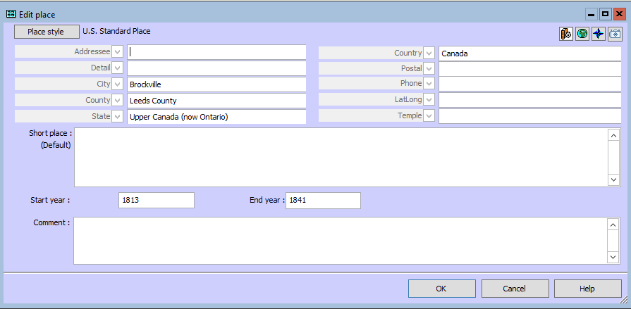
Notes:
Top shows the Master Place List while the bottom is the individual place record. Note that the end year for Brockville, Upper Canada is 1841 when it became Brockville, Canada West.

Slide 17
Eliminating/suppressing punctuation at end of Memo sentence
I can't figure out how to eliminate/suppress the period at the end of a sentence that simply is <[M]>
TMG automatically adds a period at the end of the output of each event tag. If you want to leave the output just the way you wrote it, add the "No change to Punctuation" code to the end of the Sentence, either from the right-click menu, or by typing in: [:NP:]

Slide 19
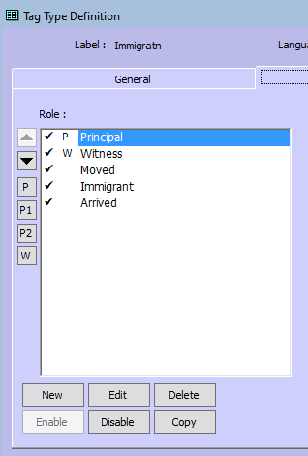
Default Role
In the Tag Type Definition screen for the Tag Type, the default Role may be selected by highlighting it and clicking on the [P], [P1], [P2], or [W] button at the left. Using the arrow buttons on the left only change the way the list of Roles is presented.
Lee Hoffman

Slide 20
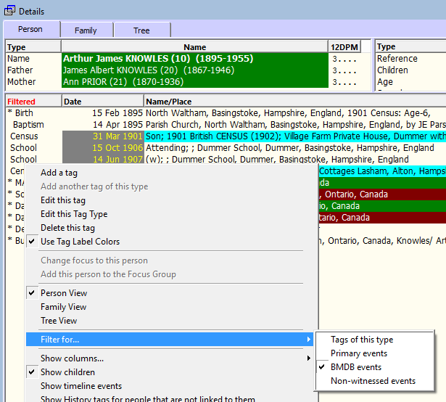
Problems with Tags Not Appearing
You may have the details view filtered.
Right-click on any tag there, and about half way down choose "Filter for..." -- ten click on whichever item has a check mark.
Terry Reigel

Slide 21
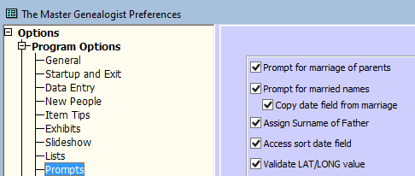
Married Name Not Created
I cannot get a married name for this woman. Preferences is set to create married names with a prompt.
The reason I generally see for this is that the husband's surname is not entered in the Surname field, but after his given name in the Given Name field. - Terry Reigel

Slide 22
Notes:
As Terry mentioned, if the husband’s surname filed is blank, you do not get the prompt, Nor do you get one if the husband and wife have the same surname.

Slide 24
Michael Hannah’s Bug List
New descriptions and workarounds to my on-line list of outstanding bugs in the final TMG version. The full list is at:
https://www.mjh-nm.net/BUGS.HTML
Recent additions are:
[Added 7 Jul 2019] Some irregular forms of date input are interpreted as regular “between” dates: https://www.mjh-nm.net/BUGS.HTML#B105
[Added 30 Jul 2019] A single vertical bar character in conditional memo text is treated as the Two Principals separator: https://www.mjh-nm.net/BUGS.HTML#B106
[Added 30 Aug 2019] A Negative Latitude entered in the LatLong Place field requires a leading Escape character: https://www.mjh-nm.net/BUGS.HTML#B107
[Added 31 Aug 2019] “Name-Variation // Surname” filter does not work with some operators: https://www.mjh-nm.net/BUGS.HTML#B108
[Added 31 Aug 2019] LIND codes around a Memo variable can produce FONTM errors depending upon periods: https://www.mjh-nm.net/BUGS.HTML#B109
I hope these descriptions and workarounds help those users unfortunate enough to encounter these bugs. - Michael

Slide 25
Upcoming Presentations
Saturday 23 Nov
Did you use all of the information?
Alan Campbell (remote)
1:00pm at City of Ottawa Archives
Saturday 14 Dec
Preserving Family Archives: Updates and Refresher
Kyla Ubbink
1:00pm at City of Ottawa Archives

Slide 26
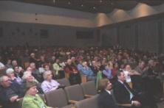
Genealogy Lunch Bunch
Next: 23 Nov: Ancestry DNA
There is no charge for the sessions. Bring a “brown bag” lunch to eat while we hold a presentation or a Research Workshop. Coffee and tea will be available throughout the sessions. Our normal monthly presentation social time will start at 1:00pm along with the regular cookies.
Following session: 14 Dec: Ottawa SIGs
For more topics, check our website at http://ogsottawa.on.ca/.

Slide 27
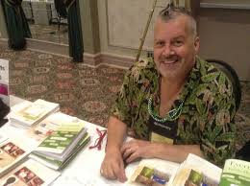
GENE-O-RAMA 2020
presented by Ottawa Branch OGS
April 3-4, 2020
Confederation Education Centre
1645 Woodroffe Avenue, Ottawa
Speakers, Marketplace
Featured Speaker: Thomas MacEntee

Slide 28
GENE-O-RAMA 2020 3-4 Apr 2020
Volunteers Needed

Slide 30
Sunday, November 2, 2:00 AM
Notes:
That’s tonight

