Slide 1
Mike’s TMG Tips
Ottawa TMGUG
7 Mar 2020

Slide 2
We acknowledge that we meet here today on unceded Algonquin territory

Slide 3
History Research Environment (HRE)
History Research Environment is an open source project to create a free platform-independent application for the serious amateur or professional historical researcher.
For genealogists, HRE will provide an onward path for users of the discontinued program The Master Genealogist (TMG).
HRE will also handle a very wide range of other historical and cultural research needs.
Project website: https://historyresearchenvironment.org Volunteer skills: https://historyresearchenvironment.org/become-a-volunteer/ Donate: https://historyresearchenvironment.org/donate/
Mailing List: https://groups.io/g/HistoryResearchEnvironment
Notes:
Latest newsletter was Posted on 15 August 2019 . Anybody subscribe to their Mailing List?

Slide 4
HRE Newsletter 15 August 2019
Progress
Progressing, but at a slower pace than we would like
Recently we have refined a number of the database design aspects as we work on the implementation of HRE features.
Java code is being built to manage the operations on the database through a well defined set of Java classes (API) such that the database engine is independent of the Java code.
HRE Board Changes
Next Objectives
LOAD the settings for Name Styles and create the ability to enter Person and Location Names
IMPORT Person and Location Names from a TMG project and be able to display/edit those names.
Volunteers
It is very difficult to find and keep suitably skilled volunteers. PLEASE RESPOND if you have Java programming skills and time to help.

Slide 5
Social Media Update
Ancestry announced a few weeks ago that they found be shutting down Rootsweb on March 2nd.
The TMG List (TMG-L) has moved to `Groups.io’, a free, easy-to-use email group service.
You can visit your group, start reading messages and posting them here: https://groups.io/g/TMG-L
The email address for this group is: TMG-L@groups.io.
To see and modify all of your groups, go to https://groups.io
Notes:
Most other Mailing Lists have now moved to Groups.Io or other services

Slide 6
Social Media Update
TMG-REFUGEES: https://groups.io/g/TMG-Refugees :
381 members, 12 Topics, Last Post: Jan 26
Website: https://sites.google.com/site/tmgrefugees
TMG Facebook Page: Five posts in February plus several replies
https://www.facebook.com/groups/themastergenealogist/
TMG Mailing List https://groups.io/g/TMG-L
604 Members, 73 Topics, Last Post: Mar 4
Wholly Genes Forum
http://www.whollygenes.com/forums201/index.php -Still active
Notes:
To be fair, al lot of the TMG messages had to do with the move to the new mailing list.

Slide 7
TMG Expertise
Terry Reigel: tmg.reigelridge.com/
Lee Hoffmann: www.tmgtips.com/
John Cardinal: www.johncardinal.com/
Michael Hannah: www.mjh-nm.net/MY_WAY.HTML
Jim Byram: use the TMG Forum
Notes:
These are some of the experts in TMG. The first four have websites with useful information on a wide ranges of aspects of TMG
Jim Byram is a technical expert and he tends to hang out on the TMG forum rather than on the Mailing List.

Slide 8
Second Site Version 8.00 is available
It includes a major new feature, the Interactive Pedigree Chart. The new chart is described in the newsletter here:
https://www.secondsite8.com/ssn088.htm
You can download the installer here:
https://www.secondsite8.com/downloads.htm?v=8.00
The upgrade price for Second Site 7 customers is $15.00 USD. New customers and customers whose most-recent license is for Second Site 6 or previous must purchase the full-price license for Second Site 8 for $35.00 USD.
Notes:
Announced 23 Jan

Slide 9
Marriage Name Date Out of Order
I have Marriage Name dates for females that comes after the sort marriage dates. When I print a journal report, the married name comes before the marriage date.
Use TMGU to delete all the Name-Marr tags and then use TMGU to add Married Names By default, TMGU will put the tags in the right order.

Slide 10
Marriage Name Date Out of Order

Slide 11
Marriage Name Date Out of Order
Notes:
The style, as definied in the lower section, reflects my preference for adding the maiden name to the suffix files with brackets and the exclusion marker as I’ll show in the next slide.

Slide 12
Married Name Tag
Notes:
I’ve mentioned this before but I think it’s a good one if you have a large database.

Slide 13
Married Name Tag
Notes:
The Married Name tag has the same Sort Date as the Marriage but it sorts after the married tag.

Slide 14
P1 = male, P2 = female
TMG does not require P1 to be male or P2 to be female, and there are only a few situations where it might matter. Some reports are easier to configure/filter if you arrange a couple with the genders in predictable principal slots.
TMG Utility (TMGU) has a "Make P1 Male" feature that will swap the principals if P1 is female and P2 is male. You can choose a single event type to change (Marriage?), or change all two-person events. In the latter case, it will only swap people if P1 is female and P2 is male.
If you run the feature with Log Only set, it will do a dry run and produce a log, but no changes will be made. That's effectively a report.

Slide 15
P1 = male, P2 = female
John Cardinal: Events with sentence templates that use [P1] and [P2]. It's possible that swapping the principals is not a good idea in that case because the template might have been written for the current arrangement, i.e., "[P1] sent a letter to [P2]…". So, by default, TMGU will *not* swap principals if the sentence template uses [P1] and/or [P2]. Many two-principal sentences can (and do) use [P] and [PO] rather than [P1] and [P2]. If your default sentence template for Marriage (for example) uses [P1] and [P2], you might consider changing it to use [P] and [PO] instead before you use the Make P1 Male feature in TMGU. Alternatively, you can uncheck the "Filter by sentence" checkbox and TMGU will swap principals even if [P1] and [P2] are used in the sentence template.

Slide 16
P1 = male, P2 = female
Drop Down Menu

Slide 17
Variations on a Name
Name-Variation Tag for a different surname spelling (for improved searching). I added the new tag and created a sentence which read: The surname is sometimes spelled as <[N]>. Just be sure to create the tag in the proper Group and name it something obvious.
Census record name variations: [:CR:][:TAB:]In the Federal Census of [Y], [PS] name was recorded as [N]<. [M]>. I use the same date as the census information for the Date and that date minus 2 days for the Sort Date (which makes sense as an output in Second Site based on other sort dates which control may census information output).

Slide 18
Variations on a Name
Name-Rec Tag (name recorded) based on Name-Var to handle the different ways that names are given in different records other than marriage, birth, and baptism.
Sentence reads [:CR:][:TAB:]<On [D],> [P] was recorded as [N]< [M]>.
Put the date of the record in the Date box and use the appropriate date as the Sort Date; i.e., if the record reflects a maiden name, use the birth date, or for a married name from a Draft Registration, use the date of the registration as the date and the marriage date (if known) as the sort date.
Put a note in the Memo field, i.e. "on his/her marriage record' or "on her husband's Draft Registration."
This tag can be used in all sorts of situations and puts the various names together based on the sort date.

Slide 19
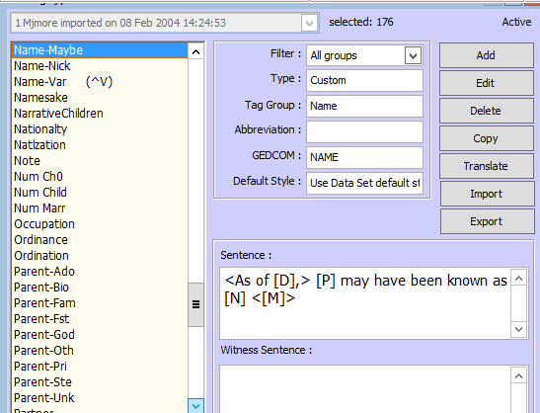
Variations on a Name: Name-Maybe

Slide 20
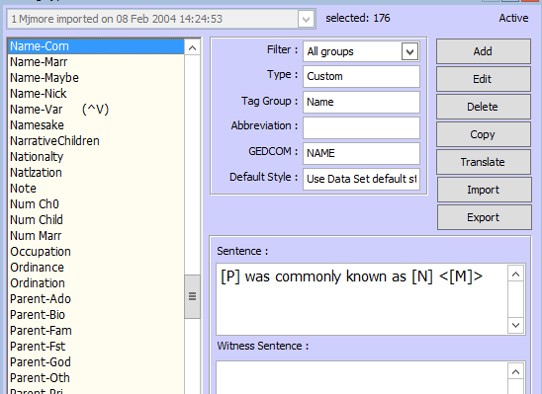
Variations on a Name: Name-Com

Slide 21
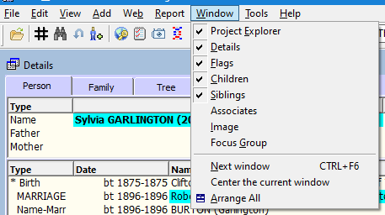
Focus Group for "Related To"
Start by opening the FG - click the Focus Group icon on the toolbar (the one with two heads in it) or use the Windows > Focus Group menu command.

Slide 22
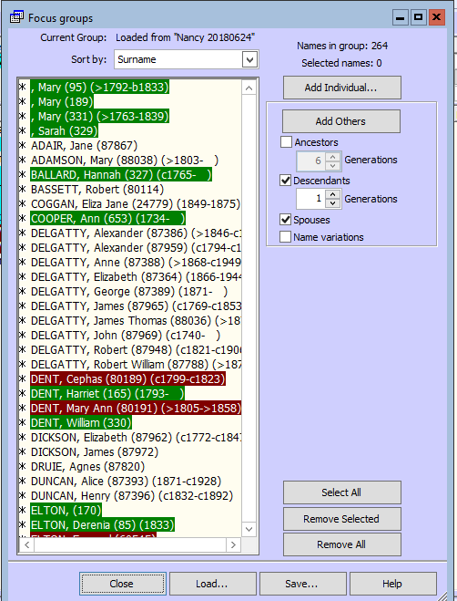
Focus Group for "Related To"
Make sure it's empty, as it should be if you've never used it. If it has someone in it, click the Remove All button to empty it.

Slide 23
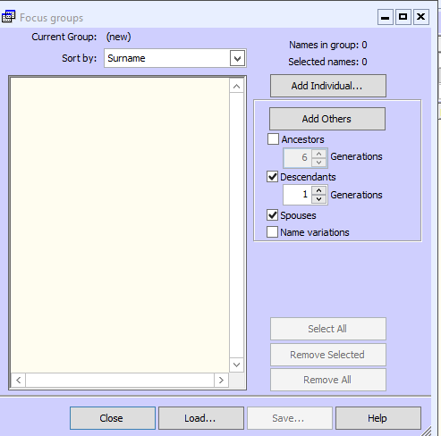
Focus Group for "Related To"
Add the first person. Either right-click on that person's name in one of the other screens and choose "Add this person to the Focus Group," or in the FG window click the "Add Individual..." button and enter the ID#.

Slide 24
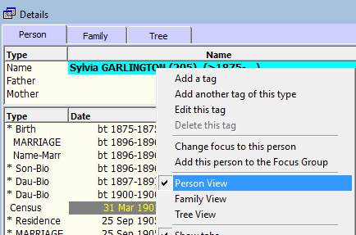
Focus Group for "Related To"
Add the first person. Either right-click on that person's name in one of the other screens and choose "Add this person to the Focus Group," or in the FG window click the "Add Individual..." button and enter the ID#.

Slide 25
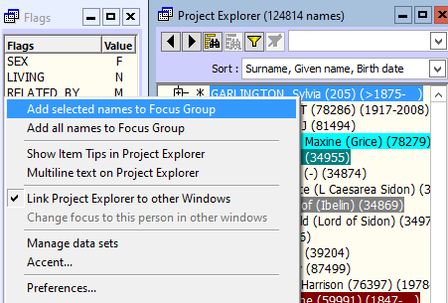
Focus Group for "Related To"
Add the first person. Either right-click on that person's name in one of the other screens and choose "Add this person to the Focus Group," or in the FG window click the "Add Individual..." button and enter the ID#.

Slide 26
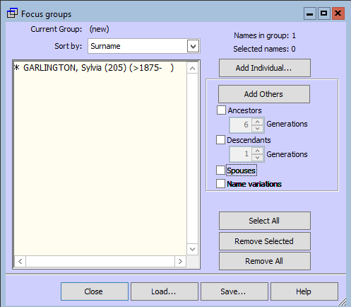
Focus Group for "Related To"
Now you are ready to add others. In the box on the right you check the boxes for the type of people you want to add. They are added to the people already in the FG who are selected.

Slide 27
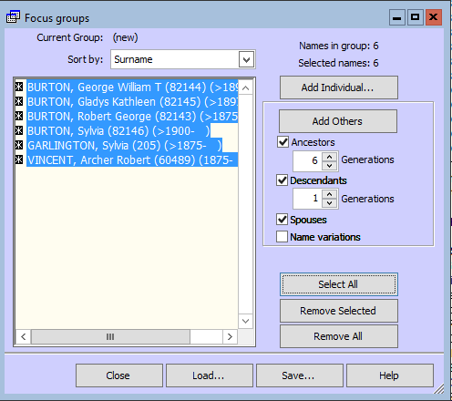
Focus Group for "Related To"
Click the "Select All" button, then “Add Others”
At the top right is the number of people in the FG. So watch that each time you click the two buttons and when it stops increasing you are done.
2
1

Slide 28
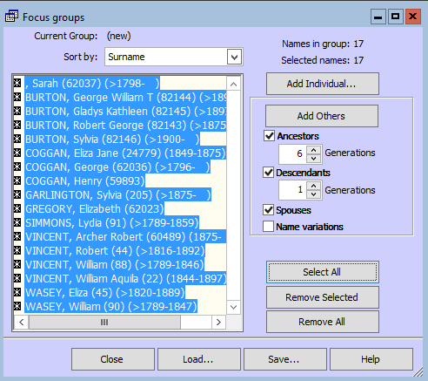
Focus Group for "Related To"
Click the "Select All" button, then “Add Others”
At the top right is the number of people in the FG. So watch that each time you click the two buttons and when it stops increasing you are done.
Notes:
Now up to 17

Slide 29
TMG Backup Error - Insufficient Stack Space
I now back up the entire project by copying the entire TMG folder tree and the exhibits files by a semi-automated method (using LapLink software which just copies files that have changed). I imagine that this is adequate. Is there a particular advantage to using the TMG Backup routine?
Lee Hoffman: First, I would strongly advise not backing up by copying just the files that appear to have changed (e.g., the change in the date/time for a file and/or file size) as that does not always include files that have minor changes. Using the TMG backup function always ensures all files in a project are included in a backup. Trying to open a project that was backed up using a Windows (or other backup program) backup process often finds that the project will not open as certain files are of a different "version" of the project.
Notes:
Charles may have more to say on this.

Slide 30
TMG Backup Error - Insufficient Stack Space
Lee Hoffman: Are you directing the backup file to a hard drive on your computer? Do not backup to an external drive of any kind -- including a thumbdrive or the like. Instead backup to your hard drive and then copy it to your external drive.
Are you using Dropbox (or other Cloud) service? If you are, be sure that the TMG folders are not part of the Dropbox backups. This would include the folder in which the backup file is created. Again backup to a TMG folder that is not part of Dropbox. Then copy the backup file to a Dropbox folder.

Slide 31
Upcoming Presentations
Saturday 28 Mar
General Society of Mayflower Descendants: History, Resources and Applications
Becket Soule
1:00pm at City of Ottawa Archives
Saturday 25 Apr-no meeting
Saturday 23 May
Genealogical Librarian
Krista Woltman
1:00pm at City of Ottawa Archives

Slide 32
Genealogy Lunch Bunch
Next: 28 Mar: Getting Started– Mike More
There is no charge for the sessions. Bring a “brown bag” lunch to eat while we hold a presentation or a Research Workshop. Coffee and tea will be available throughout the sessions. Our normal monthly presentation social time will start at 1:00pm along with the regular cookies.
Following : 23 May: tbd
For more topics, check our website at ottawa.ogs.on.ca/events/

Slide 33
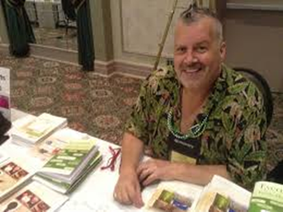
GENE-O-RAMA 2020
presented by Ottawa Branch OGS
April 3-4, 2020
Confederation Education Centre
1645 Woodroffe Avenue, Ottawa
Speakers, Marketplace
Featured Speaker: Thomas MacEntee
Also: John Reid, Ken McKinlay, Glenn Wright, Bruce Elliott and Shirley Ann Pyefinch
Registration: ottawa.ogs.on.ca/geneorama/
Early Bird registration close midnight Sunday 8 March.

Slide 34
GENE-O-RAMA 2020 3-4 Apr 2020
Volunteers Needed

