Slide 1

Mike’s TMG Tips
Ottawa TMGUG
19 Sep 2020

Slide 2
Ottawa TMG Users Group
(Ottawa, Ontario, Canada)
We are a group of enthusiastic users of The Master Genealogist, the genealogy software product "that does it all".
We meet at the City of Ottawa Archives to discuss various issues, give formal presentations and assist other users in developing their TMG and third party software skills.
Our monthly meetings are webcast and available to anyone in the world!
https://meet.google.com/nvz-kftj-dax

Slide 3
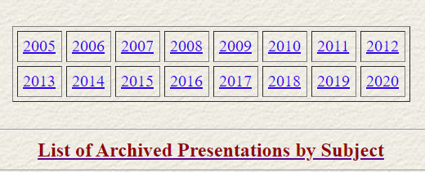
Ottawa TMG Users Group
(Ottawa, Ontario, Canada) http://ottawa-tmg-ug.ca/articlesandpresentations.htm
Articles and Presentations
The following is our library of articles and presentations by this group's members.

Slide 4
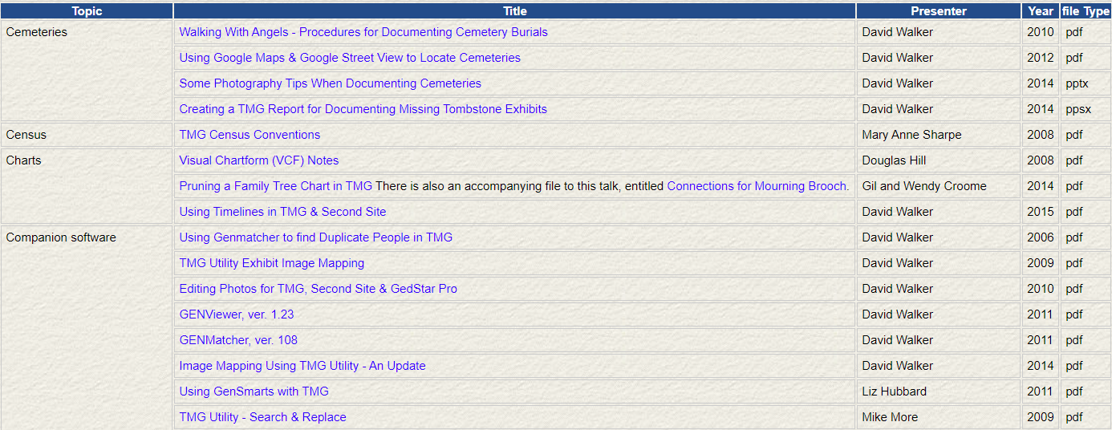
Ottawa TMG Users Group
(Ottawa, Ontario, Canada)

Slide 5
History Research Environment (HRE)
History Research Environment is an open source project to create a free platform-independent application for the serious amateur or professional historical researcher.
For genealogists, HRE will provide an onward path for users of the discontinued program The Master Genealogist (TMG).
HRE will also handle a very wide range of other historical and cultural research needs.
Project website: https://historyresearchenvironment.org
Volunteer skills: https://historyresearchenvironment.org/become-a-volunteer/
Donate: https://historyresearchenvironment.org/donate/
Mailing List: https://groups.io/g/HistoryResearchEnvironment
Notes:
Latest newsletter was Posted on 15 August 2019 . Anybody subscribe to their Mailing List?

Slide 6
HRE Newsletter
20 May 2020
Progress
  Importing TMG data – testing that the developing importing code can work on larger TMG projects. A project with 160,000 individuals has “stress tested” our import process and ensured that the process maintains accuracy.
  Researching issues (like historical dates) where the TMG DATE model doesn’t deal with known calendar issues.
Next Objectives
  Complete the HRE date storage re-design
  Implement this in code
  Rework the import from TMG of dates and names
  Move on to Event imports..
Volunteers
  https://historyresearchenvironment.org/become-a-volunteer/

Slide 7
Social Media Update
The TMG List (TMG-L) has moved to `Groups.io’, a free, easy-to-use email group service.
You can visit your group, start reading messages and posting them here: https://groups.io/g/TMG-L
The email address for this group is: TMG-L@groups.io.
To see and modify all of your groups, go to https://groups.io
Notes:
Most other Mailing Lists have now moved to Groups.Io or other services

Slide 8
Social Media Update
TMG-REFUGEES: https://groups.io/g/TMG-Refugees :
405 members, 22 Topics, Last Post: 21 Aug
Website: https://sites.google.com/site/tmgrefugees
TMG Facebook Page: 570 members; 13 posts in Aug plus replies
  https://www.facebook.com/groups/themastergenealogist/
TMG Mailing List https://groups.io/g/TMG-L
  676 Members, 370Topics, Last Post: daily
Wholly Genes Forum
http://www.whollygenes.com/forums201/index.php
-Still active (3 users on-line Tue PM)
Notes:
To be fair, al lot of the TMG messages had to do with the move to the new mailing list.

Slide 9
TMG Expertise
Terry Reigel: tmg.reigelridge.com/
Lee Hoffmann: www.tmgtips.com/
John Cardinal: www.johncardinal.com/
Michael Hannah: www.mjh-nm.net/MY_WAY.HTML
Jim Byram: use the TMG Forum
Notes:
These are some of the experts in TMG. The first four have websites with useful information on a wide ranges of aspects of TMG
Jim Byram is a technical expert and he tends to hang out on the TMG forum rather than on the Mailing List.

Slide 10
Second Site Version 8.01 is available
This is a maintenance release with minor enhancements, changes and fixes. All Second Site users should update to this release.
https://www.secondsite8.com/ssn089.htm#ss
You can download the installer here:
  https://www.secondsite8.com/downloads.htm?v=8.01
  The upgrade price for Second Site 7 customers is $15.00 USD. New customers and customers whose most-recent license is for Second Site 6 or previous must purchase the full-price license for Second Site 8 for $35.00 USD.
Notes:
Announced 23 Jan

Slide 11
Attaching Source Documents as Exhibits
I never include books or similar.
For images found online, I attach a jpg copy, re-sized to around 220 - 300 dpi. I don't print the source images, but it is there anyways.
In Second Site, I include a downsized copy in an alternate Exhibit folder, named the same and downsized to approx. 95 dpi and to a page size suitable that is related to the original image type. The downsized version reads very nicely in the SS website on a screen.
-Tom Momeyer

Slide 12
Recording Adoptions
There is a very wide range of how complex one can get in recording issues like this. At the simplest end of the spectrum one could just create a single Anecdote tag for the 'cousin-in-law' and link all the appropriate people as Witnesses to that one tag. The main memo could be written to describe the situation for the cousin's narrative, and the Witness memos constructed for the Witness' narratives. Done.
On the other hand, one could do more complex actions, depending upon how complete you want to be. In my on-line book about customizing TMG I have a full chapter about recording a "non-Primary" (which in TMG's case means "not biological") child, what your cousin is to her adopted parents. In that chapter I have a detailed discussion about several ways to record Adoptions, which is only one way to be "non-Primary":
https://www.mjh-nm.net/NON_PRIM.HTML#AdoptionApproaches
-Michael Hannah

Slide 13
Recording Adoptions
TMG provides ways to deal with adoptions, birth parents, and adoptive parents. However, TMG can only work with one set of parents -- the Primary parents although the user can see other (non-Primary) parents in the child's Details window. Sometimes, the user wants to show the birth family while, at other times, the adoptive family is desired. As installed, one must make changes to the data depending on the desired family. This works OK, but is an inconvenience and often does not give the whole story.
-Lee Hoffman

Slide 14
Married Name Not Created
  The Name-Marr tag is used to document a married name for a wife.
  Prompt for married name: If this is checked, when a marriage is entered for a female, you will be asked if a married name tag should be created for her. If you create this tag, she will be listed under both names in the Picklist and Project Explorer.
cannot get a married name for this woman
The reason I generally see for this is that the husband's surname is not entered in the Surname field, but after his given name in the Given Name field.
  Copy date field from marriage: If this is checked, you will be asked if you want to copy the marriage date from the marriage tag to the married name tag.

Slide 15
How to handle change in spelling of name
How do I handle this? Some sources spelled the ancestor's name Maddon. Some later sources, different newspapers for example, spelled the name Madden. It appears to me that either the family initiated or accepted this change. Is there anyway both spellings could be accessible in my journals, GEDCOM, etc. to later researchers?
In my view, for the most part, spelling variations belong in the Citation Detail. That way they are readily available to those who come later if they read the footnotes. However, if I believe a person actually began to use a different spelling I will enter that in a Name-Change tag with an explanation in the memo of how that change came about.
-Terry Reigel

Slide 16
How to handle change in spelling of name
I try to decide how the person tended to spell the name, and enter that as the Primary name tag. If there are alternates that they might have used significantly, or is likely for someone else to use to try and find them, I will enter an alternate name of some type and may or may not have it print in the report (but let it generate an index entry).
Minor variations are just listed in the details of the citation to the source with the variation.
It really isn't that long ago that spelling for names was really fixed, as others have commented, it isn't uncommon for a person to write their name differently even in the same document.
-- Richard Damon

Slide 17
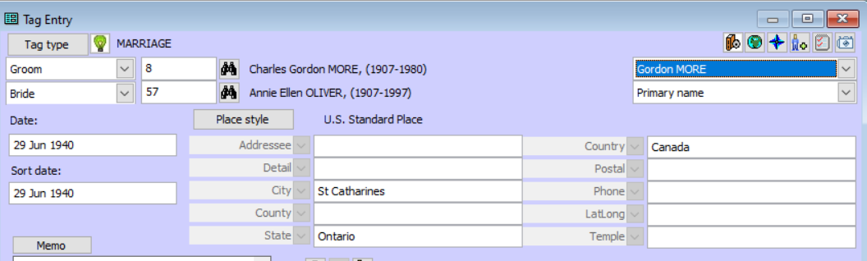
How to handle change in spelling of name
You can specify an alternate name in most Tag Entry boxes.

Slide 18
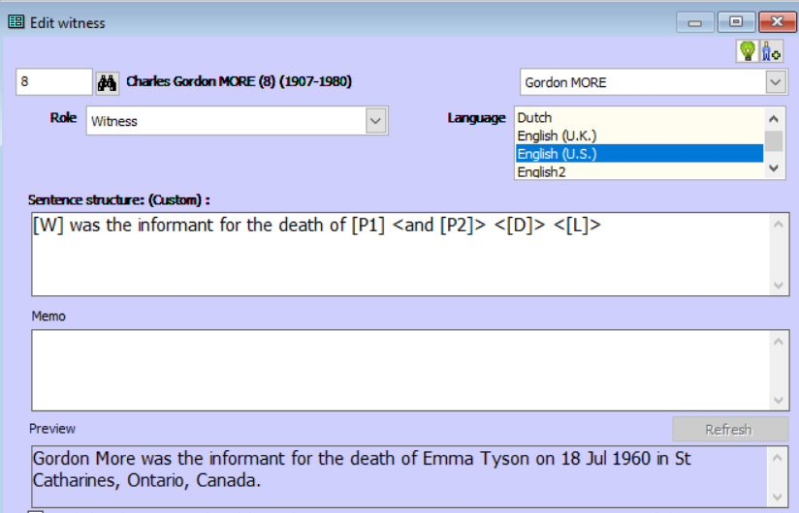
How to handle change in spelling of name
Likewise for witnesses. Note the sentence at the bottom.

Slide 19
Tags
The basic medium for recording information about a person in your TMG data set is the tag. A tag is a collection of certain fields in which information is stored about a name, an event, or a relationship.

Slide 20
Event Tags
An Event tag is used for all events (birth, death, marriage, etc.).
Tags used for miscellaneous information, such as occupation, education, notes, etc., use the same format as events and are loosely grouped with them here for the purpose of discussion.
Event tags may be shared by many individuals, depending on the Tag Type. There can be a maximum of two principal participants, but any number of people can be attached using the Witness feature.
All Event tags have fields for date, place, and an unlimited memo; any number of source citations may be attached for documentation of the facts in the tag.

Slide 21
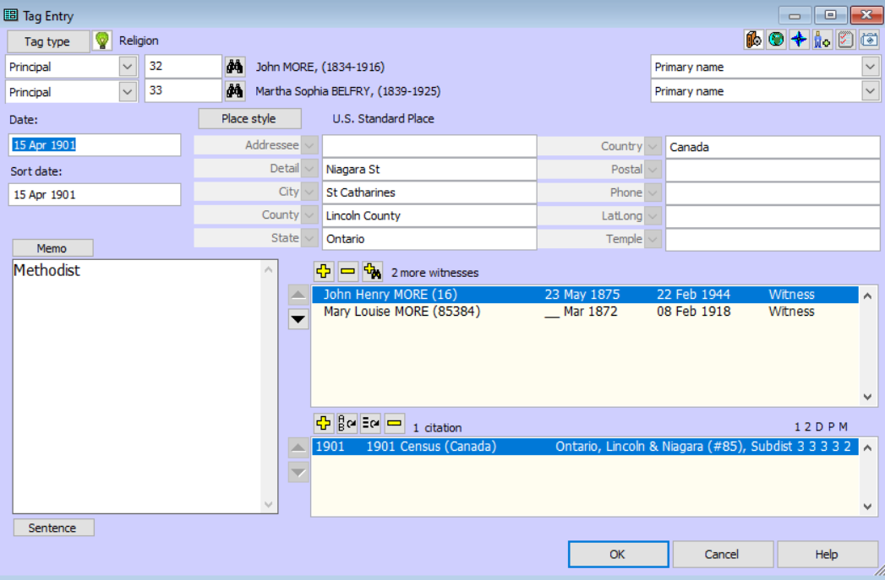
Event Tags

Slide 22
Event Tags
When a Standard Tag does not meet your need:
Customize the Standard Tag by modifying the sentence.
  Certain reports -- the Ahnentafel, Descendant Indented Narrative, Journal, and Individual Narrative -- utilize full sentences when listing events in paragraph form. These sentences are constructed according to standard and customizable rules.
  By default, a sentence for an event tag is constructed according to the syntax described on the Tag Type Definition Screen for that Tag Type. Codes are used to represent the variable information in the sentence.
Add a Custom Tag.
  The Tag Type Definition Screen allows you to add a new Tag Type or edit the properties of an existing one.
Notes:
Milit Beg – added Enlisted role
Mil Svc, new tag

Slide 23
Upcoming Presentations
Saturday 24 Oct
Ottawa Public Library Genealogy Services
Krista Woltman
1:30pm online via Ontario Ancestors
Saturday 28 Nov
Canadiana.ca
Émilie Lavallée-Funston & Francesca Brzezicki
1:00pm online via Ontario Ancestors

Slide 24
SIG Meetings
DNA Tools Workshop: Cancelled until further notice
Irish Research Group: Cancelled until further notice
Ottawa TMG Users Group (webcast on Google Hangouts)
  10 Oct 2:00PM, online - https://meet.google.com/nvz-kftj-dax
British Colonial America SIG
  23 Sep 7:00PM - online (contact treasurer@bifhsgo.ca)
DNA Interest Group:
  3 Oct 9:30 to 11:30AM online (see https://bifhsgo.ca/cpage.php?pt=21)
Scottish Genealogy Group
  24 Oct 10:00AM, online via Zoom (details tba)

Slide 25
Virtual Genealogy Drop-In – Tuesday 2pm-3pm
In partnership with the Ottawa Public Library
Drop in to share research strategies, & discover what resources are available for your research. Volunteers from The Ontario Genealogical Society will be here to answer questions & help you get the most from on-line resources.
Join the meeting with this link: https://meet.google.com/nvz-kftj-dax
You do NOT need a Google account but will be asked for a name. To listen only, you do not need a microphone or a camera. In fact, you are encouraged to turn your camera off, and also leave your microphone muted until you are called upon. Google Meet has been successfully tested with Firefox, Chrome and the newest Edge browsers in Windows 10. There are also apps for Android, iPad and iPhone. If you need help joining, send an e-mail to ottawawebmaster@ogs.on.ca.

Slide 26
Ontario Ancestors’ Virtual Events
    Many other branches of Ontario Ancestors are offering online presentations as we battle through the pandemic.
    Most are open to everyone, so please encourage friends who may be interested to register too!
    Check out the calendar at https://ogs.on.ca/events-calendar/

Slide 27
Ottawa Branch of Ontario Ancestors
Ottawa Branch includes the former counties of Carleton, Lanark, Renfrew, Prescott & Russell.
Our Branch collection of 7500 publications is housed in the Reference Room of the City of Ottawa Archives and is available to the public from Tuesday to Saturday with volunteers on hand to assist you.
We hold monthly meetings (except during July, August, tornadoes and pandemics) at the City of Ottawa Archives.
Our Special Interest Groups include Irish Research, The Master Genealogist and DNA Tools.
Our annual mini conference, Gene-O-Rama is usually held in the spring of each year featuring local and international experts.

