Slide 1
TMG Tips
Ottawa TMGUG
6 Mar 2021

Slide 2
Ottawa TMG Users Group (Ottawa, Ontario, Canada)
We are a group of enthusiastic users of The Master Genealogist, the genealogy software product "that does it all". We meet at the City of Ottawa Archives to discuss various issues, give formal presentations and assist other users in developing their TMG and third party software skills. Our monthly meetings are webcast and available to anyone in the world!
https://meet.google.com/nvz-kftj-dax

Slide 3
Ottawa TMG Users Group (Ottawa, Ontario, Canada) http://ottawa-tmg-ug.ca/articlesandpresentations.htm
Articles and Presentations
The following is our library of articles and presentations by this group's members.

Slide 4
Windows Characters Map
From TMG's Main Menu, select Tools=>External Utilities=>Windows Characters Map.
Scroll down to find the desired character and click on it to highlight it.
Click [Select] and [Copy]. Go back to where you want the character, and press [Control]+V.

Slide 5
Windows Characters Map

Slide 6
One Individual Crashes Relationship Report
Check if the individual is related to themself.
This sets up a loop whereby the individual is recorded as a descendant or ancestor of themselves.

Slide 7
Name Variation Sentences
How do you collect name variations and have them output into a narrative in a single sentence, where all of the names were recorded in TMG as name variations with dates recording the date the name was used. ?
For example: John Joseph Smith was also known as Joe Smith, Joseph Smith, John Smith, and J.J. Smith.

Slide 8
Name Variation Sentences
You need to concatenate the Sentences from the non-Primary Name Tags.
See the "Concatenating Sentences" topic in TMG Help.
Note that these Tags need to be together date-wise (or at least Sort Date-wise) as having a name used across the individual's lifetime can cause other events to keep the sentences spread apart.

Slide 9
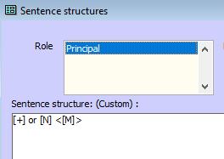
Name Variation Sentences

Slide 10
Name Variation Sentences
Individual Narrative of Anna Elisabeth Billings (66993)
Anna Elisabeth Billings (66993) was also known as Annie E (66993) or Anne (66993).

Slide 11
Duplicate people…not
If you find a completely duplicated person but one of them has the * In the Picklist and the other one doesn’t, and they can't be "merged" because they are the same, how would you delete one?
You don't have duplicate people, but duplicate names for the same person. Go to the Details View for that person and look for the additional name among the event tags in Tag Box. If you don't want it, just delete it, after transferring any citations to the primary name tag.
Terry Reigel

Slide 12
Duplicate people…not
If you want to avoid seeing the duplicate names, most search screens, such as the Picklist, can set a Filter to only show the Primary names.

Slide 13
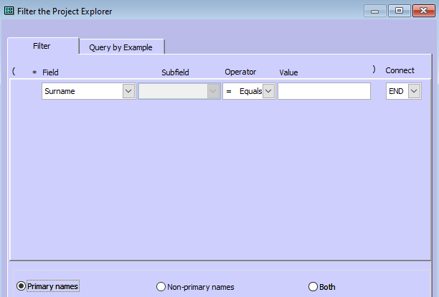
Duplicate people…not
If you want to avoid seeing the duplicate names, most search screens, such as the Picklist, can set a Filter to only show the Primary names.

Slide 14
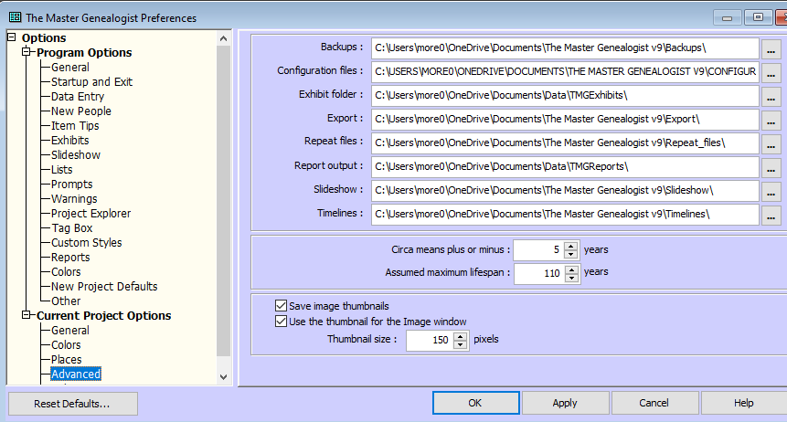
Missing Exhibits
The last VFI log showed 18 exhibits not found.
Checking the file path settings in Preferences> Current Project Options>Advanced. Make sure that all paths are correct. Most will refer to the folder \The Master Genealogist v9\ --- make sure it says v9 not v7 or something else.

Slide 15
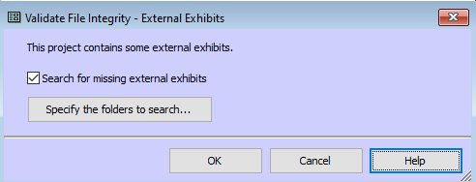
Missing exhibits
When you run the Validate File Integrity (VFI) function, click on the [Specify the folders to search...] button and select the correct folder(s) to search? VFI will find/correct the file paths for any "missing" Exhibits if they are in the specifies folders. It is often the case that Exhibits are assigned with the right file path, but one that is not the default Exhibit folder. TMG will find them, but Slideshow might not

Slide 16
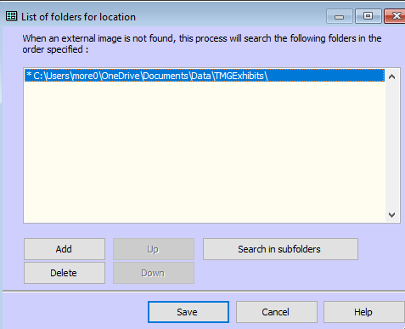
Missing exhibits
When you run the Validate File Integrity (VFI) function, click on the [Specify the folders to search...] button and select the correct folder(s) to search? VFI will find/correct the file paths for any "missing" Exhibits if they are in the specifies folders. It is often the case that Exhibits are assigned with the right file path, but one that is not the default Exhibit folder. TMG will find them, but Slideshow might not

Slide 17
Missing exhibits
TMG Utility also has Verify Exhibit Paths that verifies the filename and filepath of external exhibit files.
When an external exhibit file is not found, Verify Exhibit Paths writes an entry to the log file that indicates there was an error. If you see one of those messages, you should investigate to determine what is wrong. In most cases, the external exhibit file was moved or renamed after it was added as an external exhibit.
You can not use the existence of a thumbnail image in the TMG Exhibit Log as an indication that the path to the file is correct. TMG loads the thumbnail image when you add the exhibit or when you enable the thumbnail option in Preferences. If the path is correct at that time, the thumbnail will be created properly. If the file is later moved or renamed, the thumbnail image is not removed. So, a thumbnail image can appear in the TMG Exhibit Log even though the external exhibit file path is incorrect.

Slide 18
Missing exhibits - TMGU
TMG Utility v7.4.0
Function=Verify Exhibit Paths
Project=More_ (C:\Users\more0\OneDrive\Documents\The Master Genealogist v9\Projects\More_)
Dataset=Mjmore imported on 08 Feb 2004 14:24:53
Started at 15:19:16
Options:
Missing Only: Checked
Create Folders Report: Checked
TMG Exhibit Folder: C:\Users\more0\OneDrive\Documents\Data\TMGExhibits\
Finished at 15:19:16
Exhibits=430
External Exhibits=421
External Exhibits Found=421
External Exhibits Missing=0

Slide 19
Upcoming Presentations
Saturday 24 Apr
Royal Heraldry Society of Canada
Vicken Koundakjian
1:00pm online via Ontario Ancestors
Saturday 22 May
Arnprior McNab Braeside Archives Update
Irene Robillard
1:00pm online via Ontario Ancestors

Slide 20
SIG Meetings
DNA Tools Workshop: contact Jason Porteous at yakapoww@yahoo.com
Irish Research Group: Cancelled until further notice
London SIG
Wednesday, March 10, 2:00pm – (contact queries@bifhsgo.ca)
British Colonial America SIG
Wednesday 24 Mar, 7:00pm - (contact treasurer@bifhsgo.ca)
Scottish Genealogy Group
Saturday 27 Mar, 14:30am online via Zoom (contact queries@bifhsgo.ca)
DNA Interest Group:
Saturday 3 Apr, 9:30 to 11:30am (see https://bifhsgo.ca/cpage.php?pt=21)
Ottawa TMG Users Group (webcast on Google Hangouts)
Saturday 10 Apr, 2:00pm online
https://meet.google.com/nvz-kftj-dax

Slide 22
Virtual Genealogy Drop-In – Tuesday 2pm-3pm In partnership with the Ottawa Public Library
Drop in to share research strategies, & discover what resources are available for your research. Volunteers from The Ontario Genealogical Society will be here to answer questions & help you get the most from on-line resources.
Join the meeting with this link: https://meet.google.com/nvz-kftj-dax
You do NOT need a Google account but will be asked for a name. To listen only, you do not need a microphone or a camera. In fact, you are encouraged to turn your camera off, and also leave your microphone muted until you are called upon. Google Meet has been successfully tested with Firefox, Chrome and the newest Edge browsers in Windows 10. There are also apps for Android, iPad and iPhone. If you need help joining, send an e-mail to ottawawebmaster@ogs.on.ca.

Slide 23
Ontario Ancestors’ Virtual Events
Many other branches of Ontario Ancestors are offering online presentations as we battle through the pandemic.
Most are open to everyone, so please encourage friends who may be interested to register too!
Check out the calendar at https://ogs.on.ca/events-calendar/

Slide 24
Ottawa Branch of Ontario Ancestors
Ottawa Branch includes the former counties of Carleton, Lanark, Renfrew, Prescott & Russell.
Our Branch collection of 9000 publications is housed in the Reference Room of the City of Ottawa Archives and is available to the public from Tuesday to Saturday with volunteers on hand to assist you.
We hold monthly meetings (except during July, August, tornadoes and pandemics) at the City of Ottawa Archives.
Our Special Interest Groups include Irish Research, The Master Genealogist and DNA Tools.
Our annual mini conference, Gene-O-Rama is usually held in the spring of each year featuring local and international experts.

