Slide 1
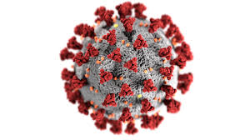
TMG Tips
Ottawa TMGUG
6 Nov 2021

Slide 2
Ottawa Branch of Ontario Ancestors is located on the traditional and unceded territory of the Algonquin Anishinaabeg.

Slide 3
Ottawa TMG Users Group (Ottawa, Ontario, Canada)
We are a group of enthusiastic users of The Master Genealogist, the genealogy software product "that does it all". We meet at the City of Ottawa Archives to discuss various issues, give formal presentations and assist other users in developing their TMG and third party software skills. Our monthly meetings are webcast and available to anyone in the world!
https://meet.google.com/nvz-kftj-dax

Slide 4
Golden Rules of TMG

Slide 5
Golden Rules of TMG
1. Keep Cloud services and Auto backup away from TMG Data files
2. Never backup directly to removable disks or cloud service
3. Keep copy of your registration details handy
4. Unlock as Admin (if needed)
5. Where to get help
6. Archived Presentations
7. Companion Software

Slide 6
Keep Cloud Services and Auto Backup away from TMG Data files
Some 80 files are kept open when TMG is running. When you open a Tag, Source, or other record in TMG and then save it (click on [OK]), TMG writes that information to the appropriate open files. If the Cloud happens to do a backup of the open files at the time TMG is writing to the files, then the update to the file may not actually be made. Thus data can be lost.
Double-check to see if any Cloud Service or Auto backup is running on your system and if so, what folder are included in it. Normally, they work on the User Documents folder and all its sub-folders. If you installed TMG normally then the TMG folders are located in that folder.

Slide 7
Never backup directly to removable disks or cloud service
One cause of TMG backup problems is that the backup destination is a thumb drive or other external media.
Always, set the backup destination to the TMG Backup folder as configured during installation. Then, if you want to have the backup on the thumbdrive, use Windows to copy the SQZ file there from the TMG backup folder.

Slide 8
Keep copy of your registration details handy
When you purchased TMG, you received an e-mail that included:
Please enter the following information within the program to unlock it and
complete the registration process. We strongly advise you to copy (control-C)
and paste (control-V) in order to prevent typographical errors.
First Name: Michael
Last Name: More
Email: mikemore@rogers.com
Serial Number: XXXXXXXXXXXXXXXXXXXXXXXXXXXXXXXXXX

Slide 9
Open your project in TMG: Help Technical Support Trouble Report - open in word processor and save for future reference

Slide 10
Open in word processor and save for future reference Just the top part needs to be saved, since there no longer is Technical Support at Wholly Genes
Notes:
Remember that TMG expects the name and e-mail address that you used when you purchased it. That may NOT be your current e-mail.

Slide 11
Unlock as Admin (if needed)
Sometimes, TMG ask you to re-enter the Unlock information.
The recommended fix is to open it as administrator to enter the information. Only run TMG once as Administrator to enter licensing information. Immediately after the licensing info is entered, exit and run TMG as normal.
(Run as administrator by right clicking the TMG icon, select option “Run as Administrator).
The problem with always running as an administrator is that you have then disabled several safety checks that make sure you don’t damage your system (or at least make it much harder), and it allows you to put your data in places that other tools, like Second-Site, can’t properly get to them.

Slide 12
Where to get Help
TMG Help tab
Terry Reigel: tmg.reigelridge.com/
Lee Hoffmann: www.tmgtips.com/
John Cardinal: www.johncardinal.com/
Michael Hannah: www.mjh-nm.net/MY_WAY.HTML
Jim Byram: use the TMG Forum
Notes:
These are some of the experts in TMG. The first four have websites with useful information on a wide ranges of aspects of TMG
Jim Byram is a technical expert and he tends to hang out on the TMG forum rather than on the Mailing List.

Slide 13
Archived Presentations http://ottawa-tmg-ug.ca/articlesandpresentations.htm
Articles and Presentations
The following is our library of articles and presentations by this group's members.

Slide 14
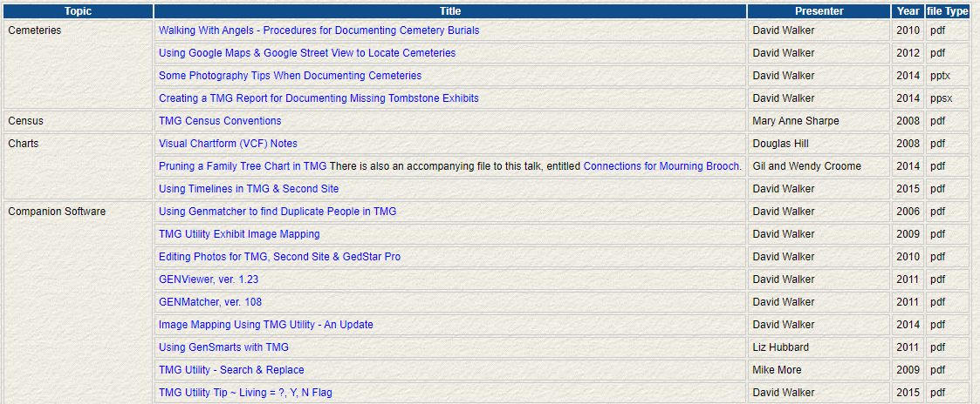
Archived Presentations http://ottawa-tmg-ug.ca/articlesandpresentations.htm
Notes:
Most of the Tips presentations are not indexed by specific topic.

Slide 15
Companion Software
There are several useful programs for TMG Users for a small fee:
TMG Utility: a powerful database modification tool for TMG projects. https://www.johncardinal.com/tmgutil/
Current Version: 7.4 donorware
Second Site: creates web pages from TMG.
Current Version: 8.01 $35USD
https://www.secondsite8.com/
Online Repository Assistant: automated assistant for use with online repositories including Ancestry, FamilySearch, and others. Sold as a subscription service, $24 USD per year. https://www.ora-extension.com/en/index.htm#/
TMG to GEDCOM: fast, useful GEDCOM exports for TMG
Current Version: 1.06 $35USD
Notes:
Others may have more ideas.

Slide 16
Event Tags
When a Standard Tag does not meet your need:
Customize the Standard Tag by modifying the sentence.
Certain reports -- the Ahnentafel, Descendant Indented Narrative, Journal, and Individual Narrative -- utilize full sentences when listing events in paragraph form. These sentences are constructed according to standard and customizable rules.
By default, a sentence for an event tag is constructed according to the syntax described on the Tag Type Definition Screen for that Tag Type. Codes are used to represent the variable information in the sentence.
Add a Custom Tag.
The Tag Type Definition Screen allows you to add a new Tag Type or edit the properties of an existing one.
Notes:
Milit Beg – added Enlisted role
Mil Svc, new tag

Slide 17
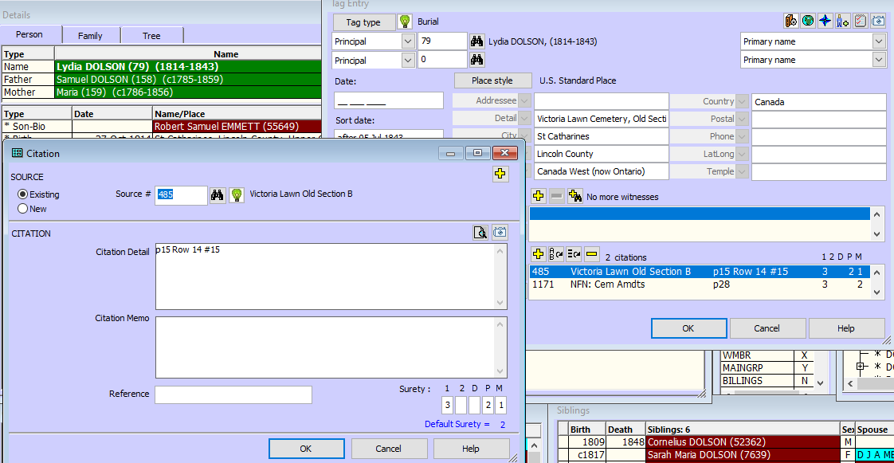
Cite Your Sources
“Genealogy Without Proof is Mythology”
Notes:
I want to emphasize how important it is to CITE YOUR SOURCES. If you plan to pass your work on to somebody, they may want to check your data. But, probably more importantly, you will need to return to a source. You will be surprised at how often you will want to re-check something a year or two later. You will receive a piece of information that conflicts with what you have or somebody else asks where you found that bit of information. I don’t know how many times I have heard somebody say that they wished that they had cited their sources from the very beginning.
Genealogical Evidence identifies individuals or the relationships between them. This is done by linking the ancestor with an exact location and time period and applying this to the key events in their life: Birth-Marriage-Death.
Proof is defined as a conclusion supported by three things:
thorough research and documentation;
Reliable evidence correctly interpreted; and
Well-reasoned analysis.
The Genealogical Proof Standard has three elements:
Direct or Indirect Evidence
Original or Derivative Source
Primary or Secondary Information
Direct Evidence stands on its own i.e. a birth registration with name, date and parents. It would be Indirect if the name was omitted and she was recorded as female child; a census record could be used to link the person with the birth, thus making it Indirect Evidence.
An Original Source is one that is not derived from an earlier record. A Derivative Source is one that is copied, transcribed, abstracted or summarized from the Original Source. Even microfilm, photos, scans and photocopies are Derivative Sources but they are generally given more weight that other Derivative Sources.
Primary Information was recorded at or near the time of the event by somebody who hand firsthand knowledge. OR was made later in writing by an office charged to make an accurate account; i.e. the court or parish clerk.
If all your records are primary information and direct evidence from original sources, with no conflicts, you are off to the races. Often you need to examine what you have and determine who provided it and why it was created. It is a bit of an art with no magic formula. Avoid making any assumptions and ensure that you have looked at as many records as possible.
Somebody always brings up the example of the birth that was recorded in error or some similar. There is nothing to say that primary information, original sources and direct evidence cannot be wrong. That adds an extra level to your proof.
Citation of Sources is essential to evaluation of evidence. It needs enough information to identify the sources and where to locate it. And consistency in citing your sources is usually expected. If you want to join an organization such as the United Empire Loyalists, the Mayflower Society or one of the OGS’ Heritage Societies, they will not simply take your word that your application is correct and may check your sources; if they cannot find them, they will likely reject your application.

Slide 18
Cite Your Sources
Surety: 12DPM
A source citation can include judgments as to the reliability of that source with respect to the information derived from it:
Principal 1: What is the surety concerning the identity of the principal (i.e., is this record referring to the same person as the Subject)?
Principal 2: What is the surety concerning the identity of the second principal (in, for example, a marriage event)?
Date: What is the surety concerning the date of the event?
Place: ... the location of the event?
Memo: ... the information stored in the Memo field?

Slide 19
Cite Your Sources
Surety
A numerical value assigned to indicate the quality of a source in documenting a given fact recorded in the data set. The surety values are recorded in the citation record. The values are:
3= an original source, close in time to the event
2= a reliable secondary source
1= a less reliable secondary source or an assumption based on other facts in a source
0= a guess
-= the source does not support the information cited or this information has been disproved

Slide 20
Upcoming Presentations
Saturday 27 Nov
Capital Chronicles: Abigail Wright-First-Lady of the Capital Area
Rick Henderson
1:00pm online via Ontario Ancestors
Saturday 11 Dec
"They Came on Ships“
David Walker
1:00pm online via Ontario Ancestors

Slide 21
Ottawa Area SIG Meetings
DNA Tools Workshop: contact Jason Porteous at yakapoww@yahoo.com
Irish Research Group: Cancelled until further notice
British Colonial America SIG
Wednesday 1 Dec, 7:00pm - online (contact bca_sig@bifhsgo.ca)
DNA Interest Group:
Saturday 5 Feb, 9:30 to 11:30am (contact dna_sig@bifhsgo.ca)
Ottawa TMG Users Group (webcast on Google Hangouts)
Saturday 4 Dec, 2:00pm online - https://meet.google.com/nvz-kftj-dax
London Special Interest Group <new>
Wednesday 10 Nov, 2:00pm online via Zoom (contact london_sig@bifhsgo.ca)
Scottish Genealogy Group
tbd (contact scottish_sig@bifhsgo.ca)

Slide 22
Virtual Genealogy Drop-In – Tuesday 2pm-3pm In partnership with the Ottawa Public Library
Drop in to share research strategies, & discover what resources are available for your research. Volunteers from The Ontario Genealogical Society will be here to answer questions & help you get the most from on-line resources.
Join the meeting with this link: https://meet.google.com/nvz-kftj-dax
You do NOT need a Google account but will be asked for a name. To listen only, you do not need a microphone or a camera. In fact, you are encouraged to turn your camera off, and also leave your microphone muted until you are called upon. Google Meet has been successfully tested with Firefox, Chrome and the newest Edge browsers in Windows 10. There are also apps for Android, iPad and iPhone. If you need help joining, send an e-mail to ottawawebmaster@ogs.on.ca.

Slide 23
Ontario Ancestors’ Virtual Events
Many other branches of Ontario Ancestors are offering online presentations as we battle through the pandemic.
Most are open to everyone, so please encourage friends who may be interested to register too!
Check out the calendar at https://ogs.on.ca/events-calendar/

Slide 24
Ottawa Branch of Ontario Ancestors
Ottawa Branch includes the former counties of Carleton, Lanark, Renfrew, Prescott & Russell.
Our Branch collection of 9300 titles is housed in the Reference Room of the City of Ottawa Archives and is available to the public from Tuesday to Saturday with volunteers on hand to assist you.
We hold monthly meetings (except during July, August, tornadoes and pandemics) at the City of Ottawa Archives.
Our Special Interest Groups include Irish Research, The Master Genealogist and DNA Tools.
Our annual mini conference, Gene-O-Rama is usually held in the spring of each year featuring local and international experts.

