Slide 1
TMG Tips
Ottawa TMGUG
4 Dec 2021

Slide 2
Ottawa Branch of Ontario Ancestors is located on the traditional and unceded territory of the Algonquin Anishinaabeg.

Slide 3
Ottawa TMG Users Group (Ottawa, Ontario, Canada)
We are a group of enthusiastic users of The Master Genealogist, the genealogy software product "that does it all". We meet at the City of Ottawa Archives to discuss various issues, give formal presentations and assist other users in developing their TMG and third party software skills. Our monthly meetings are webcast and available to anyone in the world!
https://meet.google.com/nvz-kftj-dax

Slide 4
Picklist Filter
It is normal to lose the Picklist filter after re-starting TMG. There is no provision in TMG Preferences to keep a filter. However, when you create the filter, you have the choice to [Save As...] the filter. Then on re-starting TMG, the saved filter can be re-used by selecting [Load] on the filter screen and selecting that filter. Depending on the complexity of your filter, this save and re-load can save a lot of work. I tend not to save a filter often as I don't expect to use it for long. Still, there have been times when I found this save/load feature useful (or would have <g>) - Lee Hoffman

Slide 5
Picklist Filter

Slide 6
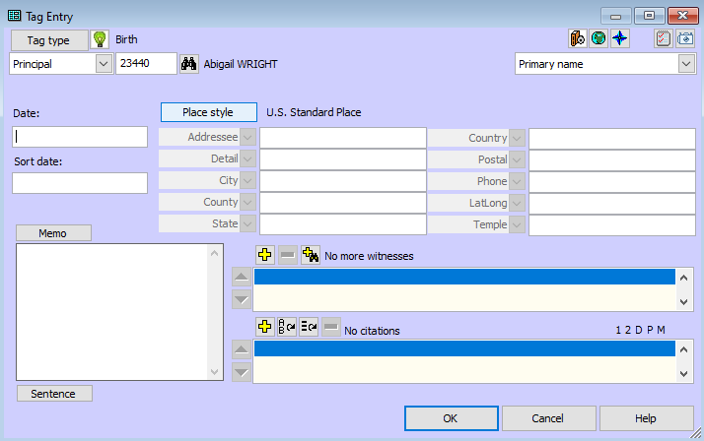
Data Entry: Dates
Sort Date (Turned off in Beginner Mode)
Sort dates are used to maintain chronological order on the Person View, and in narrative reports, Individual Detail reports and Family Group Sheets.
They do not print or export and have no genealogical significance

Slide 7
Date: Incomplete or Irregular
A date with one or two digits in the year is considered an incomplete or irregular date, as it cannot be recorded in the correct century. If TMG can interpret the number as intended to be a year it will prompt you for the intended century. To avoid ambiguity, when entering dates be sure to use all four digits for the year.
An incomplete date containing an alphabetic month can usually be appropriately interpreted by TMG. If an all-number date is incomplete (entered with less than three parts) TMG must guess what is missing. TMG's interpretations of ambiguous or incomplete dates are stated in Date Format and may be partially based on the date display setting in File > Preferences > Program Options: General. In all these screen display formats for dates, a missing value in an incomplete date is displayed using underlines.

Slide 8
Date: Incomplete or Irregular
Any date that does not meet the criteria stated in Date Format is considered an irregular date. There may be times when you want to place text in the date field, e.g., "the 6th day of the 4th month". The date field will accept such text and you may keep the events on your display in chronological order by placing a regular date in the Sort Date field.
While irregular dates can only have a maximum of 29 characters, TMG will export such dates exactly as entered to a GEDCOM without any problem. However, what some other program will do with these irregular dates when they import the GEDCOM file may be an issue.

Slide 9
Date: Irregular
I recently found in the images of the British 1939 Registry the date of birth of a relative as 29 Feb 1875, so I entered it. TMG, much quicker on the uptake than I, immediately declared my entry to be an Irregular Date. While clearly an entry error, that seems to be the best date I have, and from what I would think a reputable source. How would you handle this odd situation within TMG?
The first thing I would do is look at the registry again. If the image is that is a hand-written register then check if what you see is actually a "29". Could it be something else? Maybe a "27"? A "24"? Or maybe it isn't a "2", but a "1" -- making it "19".
If it is clearly a "29", leave the Irregular date, and change the Sort Date to a "28" for sorting purposes. Then include in the Citation Detail of the Source Citation the details of the entry indicating that you recognize that the entry must be wrong, but it is what it is.
-Lee

Slide 10
Marriage Date Tool
How could I add a sort date to my Marriage tags for couples that currently have no date recorded for the marriage? This would allow narratives to read a bit better if the marriage was not listed before the other events (like birth!) I have about four thousand couples without marriage dates.
Set Sort Dates is the only automated way to do what you want.
See: https://www.johncardinal.com/tmgutil/sortdates.htm
You should read that help page slowly and completely before you use the feature. It's one of the more complicated features in TMGU.
Don't worry that the sort dates are not logical, i.e., you might end up with sort dates that are impossible, like marriage one day after birth. Sort dates don't display anywhere. The key thing is, what is the effect of the sort dates on the event sequence?

Slide 11
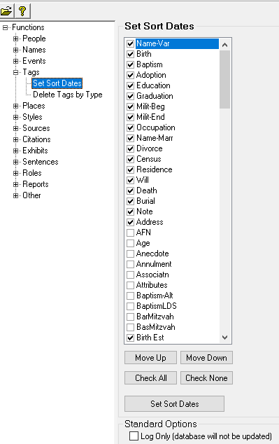
Marriage Dates
Move event types up or down in TMG Utility to control how Set Sort Dates assigns sort dates to events that don't have them.

Slide 12
Married Names
The Name-Marr tag is used to document a married name for a wife. In general, the original entry for a woman uses her birth or maiden name. A married name record allows women to be searched for or filtered on the Picklist and Project Explorer by either their maiden names or their married names. There is no limit to the number of name records each person can have.
NOTE: Given names need not be part of the Name-Marr tag. The program will include the given name element in the Picklist and Project Explorer, even though it is not included in a Name-Marr tag.

Slide 13
Pseudo People (https://www.mjh-nm.net/STYLE.HTML#PseudoPeople)
Means of recording certain non-typical information within TMG and linking that information to other standard information in the dataset.
A TMG “person” entry can be thought of more generically as a “thing” entry with a name/label, tags that describe possibly dated “stuff” or events about this “thing”, the ability to link (relate) this “thing” directly or via events to other “things” and people, and the ability to generate reports about these “things”.
The possible uses of TMG “person” entries, tags, and links is limited only by your own imagination.

Slide 14
Pseudo People (https://www.mjh-nm.net/STYLE.HTML#PseudoPeople)
As the “names” of these people are likely contrived, a special naming scheme usually needs to be defined.
Useful in defining this “person’s” Primary name and their entry in an index, an important reason for creating these Pseudo People is to include their name in the narrative sentence for a “real” person as a link to that pseudo person’s narrative.
Ideas:
Cemetery Pseudo People
Census Pseudo People
Ship Pseudo People
Notes:
Cemetery Person
A location pseudo person could be used to define a crematorium or burial site that could link multiple people with cremations or graves of interest at that site, and have other tags such as describing the process to obtain records from the site.
Ship Person
Some have discussed recording information about ships using a pseudo person, with separate tags for the voyages they made, their officers, owners, etc.

Slide 15
Pseudo People (https://www.mjh-nm.net/STYLE.HTML#PseudoPeople)
Notes:
Cemetery Person
A location pseudo person could be used to define a crematorium or burial site that could link multiple people with cremations or graves of interest at that site, and have other tags such as describing the process to obtain records from the site.
Ship Person
Some have discussed recording information about ships using a pseudo person, with separate tags for the voyages they made, their officers, owners, etc.

Slide 16
Pseudo People (https://www.mjh-nm.net/STYLE.HTML#PseudoPeople)
Notes:
Cemetery Person
A location pseudo person could be used to define a crematorium or burial site that could link multiple people with cremations or graves of interest at that site, and have other tags such as describing the process to obtain records from the site.
Ship Person
Some have discussed recording information about ships using a pseudo person, with separate tags for the voyages they made, their officers, owners, etc.

Slide 17
Notes:
Cemetery Person
A location pseudo person could be used to define a crematorium or burial site that could link multiple people with cremations or graves of interest at that site, and have other tags such as describing the process to obtain records from the site.
Ship Person
Some have discussed recording information about ships using a pseudo person, with separate tags for the voyages they made, their officers, owners, etc.

Slide 18
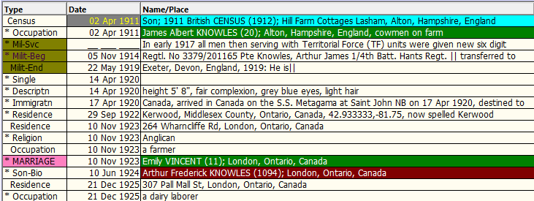
How to make tags different colors
There is a way to make tags in the details box have a color overlaid on them

Slide 19
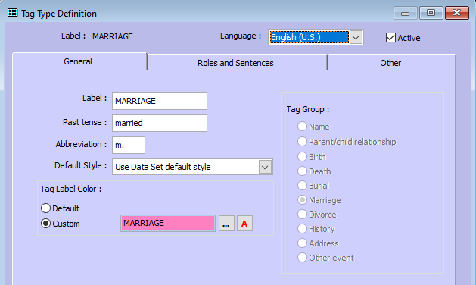
How to make tags different colors

Slide 20
Where to get Help
TMG Help tab
Terry Reigel: tmg.reigelridge.com/
Lee Hoffmann: www.tmgtips.com/
John Cardinal: www.johncardinal.com/
Michael Hannah: www.mjh-nm.net/MY_WAY.HTML
Jim Byram: use the TMG Forum
Notes:
These are some of the experts in TMG. The first four have websites with useful information on a wide ranges of aspects of TMG
Jim Byram is a technical expert and he tends to hang out on the TMG forum rather than on the Mailing List.

Slide 21
Archived Presentations http://ottawa-tmg-ug.ca/articlesandpresentations.htm
Articles and Presentations
The following is our library of articles and presentations by this group's members.

Slide 22
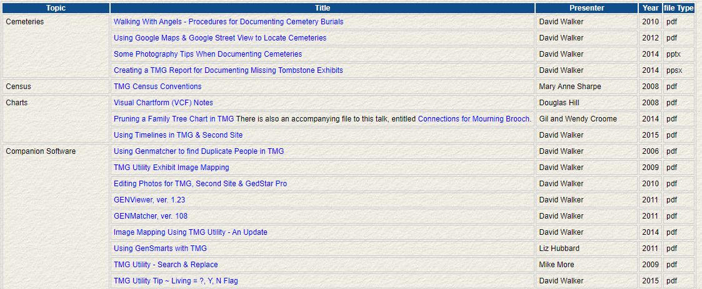
Archived Presentations http://ottawa-tmg-ug.ca/articlesandpresentations.htm
Notes:
Most of the Tips presentations are not indexed by specific topic.

Slide 23
Upcoming Presentations
Saturday 11 Dec
They Came on Ships ~ Plotting a Course to Publishing Genealogical Research
David Walker
1:00pm online via Ontario Ancestors
Saturday 22 Jan
Building on Local History
Michelle Landriault
1:00pm online via Ontario Ancestors

Slide 24
Ottawa Area SIG Meetings
DNA Tools Workshop: contact Jason Porteous at yakapoww@yahoo.com
Irish Research Group: Cancelled until further notice
Scottish Genealogy Group: Cancelled until further notice
London Special Interest Group
Wed 8 Dec, 2:00pm online (contact london_sig@bifhsgo.ca )
Ottawa TMG Users Group (webcast on Google Hangouts)
Sat 8 Jan, 2:00pm online (https://meet.google.com/nvz-kftj-dax)
British Colonial America SIG
Wed 12 Jan, 7:00pm online (contact bca_sig@bifhsgo.ca)
DNA Interest Group:
Sat 5 Feb, 9:30 to 11:30am online (contact dna_sig@bifhsgo.ca)

Slide 25
Virtual Genealogy Drop-In – Tuesday 2pm-3pm In partnership with the Ottawa Public Library
Drop in to share research strategies, & discover what resources are available for your research. Volunteers from The Ontario Genealogical Society will be here to answer questions & help you get the most from on-line resources.
Join the meeting with this link: https://meet.google.com/nvz-kftj-dax
You do NOT need a Google account but will be asked for a name. To listen only, you do not need a microphone or a camera. In fact, you are encouraged to turn your camera off, and also leave your microphone muted until you are called upon. Google Meet has been successfully tested with Firefox, Chrome and the newest Edge browsers in Windows 10. There are also apps for Android, iPad and iPhone. If you need help joining, send an e-mail to ottawawebmaster@ogs.on.ca.

Slide 26
Ontario Ancestors’ Virtual Events
Many other branches of Ontario Ancestors are offering online presentations as we battle through the pandemic.
Most are open to everyone, so please encourage friends who may be interested to register too!
Check out the calendar at https://ogs.on.ca/events-calendar/

Slide 27
Ottawa Branch of Ontario Ancestors
Ottawa Branch includes the former counties of Carleton, Lanark, Renfrew, Prescott & Russell.
Our Branch collection of 9300 titles is housed in the Reference Room of the City of Ottawa Archives and is available to the public from Tuesday to Saturday with volunteers on hand to assist you.
We hold monthly meetings (except during July, August, tornadoes and pandemics) at the City of Ottawa Archives.
Our Special Interest Groups include Irish Research, The Master Genealogist and DNA Tools.
Our annual mini conference, Gene-O-Rama is usually held in the spring of each year featuring local and international experts.

Slide 28
Merry Christmas and Happy New Year

