Slide 1
TMG Tips
Ottawa TMGUG
8 Jan 2022

Slide 2
Ottawa Branch of Ontario Ancestors is located on the traditional and unceded territory of the Algonquin people.

Slide 3
Ottawa TMG Users Group (Ottawa, Ontario, Canada)
We are a group of enthusiastic users of The Master Genealogist, the genealogy software product "that does it all". We meet at the City of Ottawa Archives to discuss various issues, give formal presentations and assist other users in developing their TMG and third party software skills. Our monthly meetings are webcast and available to anyone in the world!
https://meet.google.com/nvz-kftj-dax

Slide 4
How to Cite Sources Recording Where Your Find Information
https://www.genealogy.com/articles/research/19_wylie.html
Experienced genealogists agree that accurately recording the full citation data from a source the first time is essential.
Family group sheets, GEDCOM files and any other form used to share genealogical information should be as fully documented as formal manuscripts. Even those who have no intention of submitting their work to a journal or of publishing a book will swap information with "genealogy cousins." Thus, it is essential that the software you use to record your work handles source citations well.

Slide 5
How to Cite Sources Recording Where Your Find Information
A citation must cite the source you used, not the one that someone told you existed in their citation. Another person's research, even cited, is hearsay you until you see the source for yourself. For example, if a cousin tells you that she extracted your grandfather's birth information from his birth certificate, then your cousin is your source for the information, unless she provided you a photocopy, a scanned copy, or you actually saw her copy of the certificate. This is perhaps one of the most difficult concepts of genealogical research for many to accept.

Slide 6
How to Cite Sources Recording Where Your Find Information
A citation is a reference to a source. Each Tag Entry screen has a special place for citations which reference the source or sources of the data within that tag. The citation window will hold an unlimited number of sources. In order to build the preponderance of evidence required by modern genealogy, it is often necessary to quote more than one source for a particular event. For example, if the date of an event came from one source, the place from another, and an anecdote regarding the event from still another, separate citations for all three sources are needed. (Advanced mode only) Values in the Surety level columns show which information came from which source. – TMG Help

Slide 7
How to Cite Sources Recording Where Your Find Information

Slide 8
How to Cite Sources Recording Where Your Find Information
Published Sources
Unpublished Sources
Official Records
Online Sources
https://www.genealogy.com/articles/research/19_wylie.html

Slide 9
Searching For a Word in a Memo
I frequently mistype "two" as "tow" so tried to search for all my past memo typos with the List of Events report, using the filter "memo contains tow." The result was thousands of hits for all the memos with the words town, township, surnames like Estow, Stow,Towle, etc.

Slide 10
Searching For a Word in a Memo
Assuming you want to find "tow" as a separate word, which may begin, end, or be in the middle of a memo, you need the following compound filter:
The first condition finds where "tow" is somewhere in a memo but surrounded by spaces. But it will not find where it begins or ends the memo. Unfortunately, I know of no special characters to use in the TMG LIKE operator to indicate beginning or end, so finding those two special cases is more difficult.
The second and third conditions are not as obvious. The second will find "tow" followed by a space anywhere in the memo with anything or nothing in front of it and at least one character after the trailing space. So while it will find it at the beginning of the memo, it will also match cases such as "Kowtow something".
The third will find "tow" anywhere in the memo with a space in front of it and at least one character in front of that space with anything or nothing following it. So it will find " tow" at the end of the memo, as well as " tow," and "tow.", but will also match " township".

Slide 11
Searching For a Word in a Memo
If you would prefer to explicitly find only the cases where " tow" is immediately followed by punctuation (e.g. " tow,") that could also be done by looking separately for each punctuation case, e.g.
Memo // Is Like // "* tow," // OR
Memo // Is Like // "* tow." // OR

Slide 12
Filtering with Date Modifiers
Dates with Modifiers: The Operators for the Date and Year filters can produce very different results when the date includes a modifier.
There is a significant difference between the condition "Year > is greater than 1880" and the condition "Date > Comes after 1880". The "Year >" condition turns up dates such as “after 1750,” whereas the "Date >" search results do NOT include dates which are input as "after YYYY" when YYYY is 1880 or earlier.
If you only use the year with a date search, it considers the date to be I Jan.
Technically "after 1528" just means it was "NOT BEFORE 1528". It could be /any date/ after including next year <G>. It will display sorted before "after 1840", but that is the limit of meaning.
From the help system: The "after" modifier is interpreted as inclusive of the specified time. Thus, "after June 1930" is interpreted as "June 1930 or later."

Slide 13
Filtering with Date Modifiers

Slide 14
Filtering with Date Modifiers

Slide 15
Filtering with Date Modifiers All dates which are not irregular are sorted chronologically, according to rules illustrated by the following sorted example:
after 1974
between 1974 and 1975
before 1975
say 1975
circa 1975
1975
after 1975
between 1975 and 1976
bef June 1975
circa June 1975
June 1975
after June 1975
between June and July 1975
From June 1975 to July 1975
June 1975 or July 1975
before 30 June 1975
30 June 1975
after 30 June 1975
July 1975
before 1 July 1975
From TMG Help - Chronological Sort

Slide 16
Census
1921 UK census released this week
1950 census records will be released in April 2022
Last month, my Pseudo-person census process: http://ottawa-tmg-ug.ca/Docs/TMG%20Tips%202021-12.pptx
Terry's TMG Tips: http://tmg.reigelridge.com/Census.htm
http://tvtmg.bridgenealogue.com/census.htm
Census Source Data Entry My Way ©MJH
https://www.mjh-nm.net/CENSUS.HTML#Top

Slide 17
TMG Releases
Version | Release date | Time between releases
TMG v0.9x | 1991
TMG v1.0 | Jun 1993 | 24 mths
TMG v2.0 | Oct 1996 | 40 mths
TMG v3.0 | May 1997 | 8 mths
TMG v4.0 | May 1999 | 24 mths
TMG v5.0 | 22 May 2002 | 36 mths
TMG v6.0 | 21 Dec 2004 | 31 mths
TMG v7.0 | 28 Dec 2007 | 36 mths
TMG v8.0 | 21 Dec 2011 | 48 mths
TMG v9.0 | 7 Feb 2014 | 26 mths

Slide 18
Where to get Help
TMG Help tab
Terry Reigel: tmg.reigelridge.com/
Lee Hoffmann: www.tmgtips.com/
John Cardinal: www.johncardinal.com/
Michael Hannah: www.mjh-nm.net/MY_WAY.HTML
Jim Byram: use the TMG Forum
Notes:
These are some of the experts in TMG. The first four have websites with useful information on a wide ranges of aspects of TMG
Jim Byram is a technical expert and he tends to hang out on the TMG forum rather than on the Mailing List.

Slide 19
Archived Presentations http://ottawa-tmg-ug.ca/articlesandpresentations.htm
Articles and Presentations
The following is our library of articles and presentations by this group's members.

Slide 20
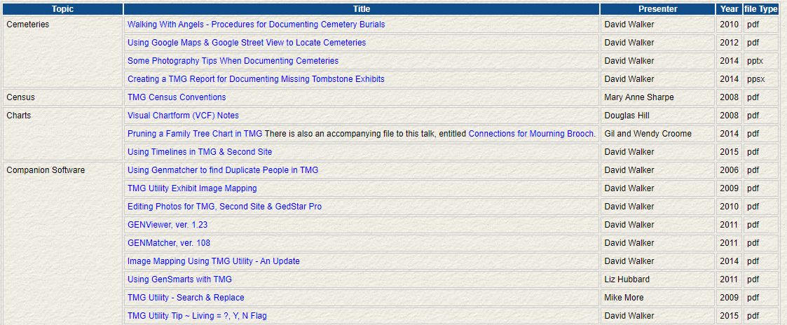
Archived Presentations http://ottawa-tmg-ug.ca/articlesandpresentations.htm
Notes:
Most of the Tips presentations are not indexed by specific topic.

Slide 21
Upcoming Presentations
Saturday 22 Jan
Building on Local History
Michelle Landriault
1:00pm online via Ontario Ancestors
Saturday 26 Feb
London Archives: How to Research From a Distance
Penny Allen
1:00pm online via Ontario Ancestors

Slide 22
Ottawa Area SIG Meetings
DNA Tools Workshop: contact Jason Porteous at yakapoww@yahoo.com
Irish Research Group: Cancelled until further notice
Ottawa TMG Users Group (webcast on Google Hangouts)
Sat 8 Jan, 2:00pm online (https://meet.google.com/nvz-kftj-dax)

Slide 23
Virtual Genealogy Drop-In – Tuesday 2pm-3pm In partnership with the Ottawa Public Library
Drop in to share research strategies, & discover what resources are available for your research. Volunteers from The Ontario Genealogical Society will be here to answer questions & help you get the most from on-line resources.
Join the meeting with this link: https://meet.google.com/nvz-kftj-dax
You do NOT need a Google account but will be asked for a name. To listen only, you do not need a microphone or a camera. In fact, you are encouraged to turn your camera off, and also leave your microphone muted until you are called upon. Google Meet has been successfully tested with Firefox, Chrome and the newest Edge browsers in Windows 10. There are also apps for Android, iPad and iPhone. If you need help joining, send an e-mail to ottawawebmaster@ogs.on.ca.

Slide 24
Ontario Ancestors’ Virtual Events
Many other branches of Ontario Ancestors are offering online presentations as we battle through the pandemic.
Most are open to everyone, so please encourage friends who may be interested to register too!
Check out the calendar at https://ogs.on.ca/events-calendar/

Slide 25
Ottawa Branch of Ontario Ancestors
Ottawa Branch includes the former counties of Carleton, Lanark, Renfrew, Prescott & Russell.
Our Branch collection of 9300 titles is housed in the Reference Room of the City of Ottawa Archives and is available to the public from Tuesday to Saturday with volunteers on hand to assist you.
We hold monthly meetings (except during July, August, tornadoes and pandemics) at the City of Ottawa Archives.
Our Special Interest Groups include Irish Research, The Master Genealogist and DNA Tools.
Our annual mini conference, Gene-O-Rama is usually held in the spring of each year featuring local and international experts.

