Slide 1
Using and Modifying Tag Sentence - Updated
Ottawa TMGUG
8 Sep 2018
Notes:
Periodically, the TMG Mailing List will have a question from someday along the lines of: “ I can’t find a Tag for “fill in the blank”. How do I enter this information? So I thought I’d put together something on Tags and Sentences, most of which comes from Terry Reigel’s website.

Slide 2
Some TMG Basics
A Person is an ID Number
Everything Else is Added With Tags
Notes:
In TMG, a person is only an ID number, nothing more.
Everything you enter about a person is done by adding Tags. Everything! His or her name, birth and death information, parents, children, everything! (Well, not quite, but flags are another subject.) TMG allows any number of Tags for each person.

Slide 3
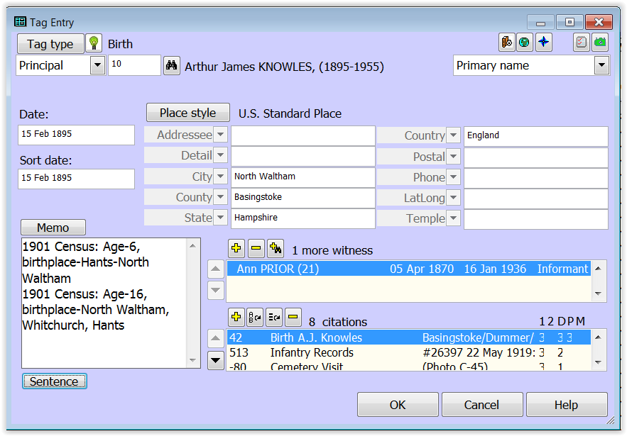
Notes:
A typical Tag:
Tag Type
The person that it related to (Principal)
Date
Place
Memo
Witnesses to the Tag contents
Citations
And you can see at the bottom left is a Sentence button., If the tag retains the default sentence for that tag, there is nothing below the button

Slide 4
Tags and Sentences
Tags in TMG have one or two people entered as Principals, and any number may be entered as Witnesses.
Each of those people has an associated Sentence Structure, which controls how information from the Tag appears when a narrative report is created for that person. That person can be said to be the "subject" of that Sentence.
The Sentence may direct that information from the Date, Place, and/or Memo fields of the Tag be included in the narrative. It may also output the name or other information about the subject.
When there are other people entered in the Tag their names or other information may also be output.

Slide 5
Sentence Structures
Sentence Structures are templates that control how the data in the various fields in tags – names, dates, place information, or the text of memos – will be assembled into finished text when narrative reports are generated.
Each Tag Type (Birth, Anecdote, Census, Marriage, College, and so forth) has its own Sentence Structure to generate text appropriate for the event being recorded.
Sentence Structures are only used by narrative reports: the Individual Narrative, Ahnentafel, Descendant Indented Narrative, and Journal reports. All other reports and charts use different methods to assemble the data into the report format.
Notes:
Before we get into the process, let me briefly explain Sentence Structure

Slide 6
Why Change Sentence Structure?
The text created by the existing Sentence Structures are not satisfactory for some reason, i.e. you simply want to be able to include the Memo field in the output of a standard Tag Type that doesn't include it by default.
You prefer that the description of a certain kind of event flow in a different way; the narrative for a particular person could be improved by rearranging the text.
You have come across a type of event that is not a good fit in any existing Tag Type.
Notes:
Why would you want to change the existing Sentence Structure?

Slide 7
How to Change Sentence Structure
Create a Custom (i.e. new) Tag Type
Change an existing Tag Globally
Change an existing Tag Locally
Notes:
Standard tags covers a great many types of events:, birth marriage death, etc.
But if you do not find a Tag Sentence that says what you want, you need to change it somehow. There are three ways to do this and I will go over them.

Slide 8
Reasons to Change (1)
To add a Variable to a standard Tag Type (i.e. add the Memo to the standard birth Tag Type so you can include details about the birth event), change the Sentence Structure of that Tag Type globally.
To change the way a specific type of event is described (i.e. change the wording for all Census tags), change the Sentence Structure of that Tag Type globally.
If you have records of a type of event that doesn't fit well in an existing Tag Type:
If the type of event is found rarely, the best solution is generally to use an existing Tag Type (perhaps a very general tag type, like Note or Anecdote, and record the details in the memo; or use a Tag Type designed for similar events and change the Sentence Structure of that Tag Type locally to better reflect your event.
if there are a number of events of this type, it may be better to create a custom Tag Type.

Slide 9
Reasons to Change (2)
If you find that the narrative for a particular person in your Project could be improved by rearranging the output of some Tags, the best choice is often to locally change the Sentence Structure of some of the Sentences of that person's Tags. While improvement can sometimes be make by changing the global Sentences for the Tag Types, often improving the narrative for one person with global changes makes it worse for others.
If you find that you make the same type of local changes for several, but not all cases for a particular Tag Type, you may want to consider creating "Roles" for the Tag Type. This allows you to have several different Sentence Structures available, and you can easily select the appropriate one for the person. This is especially useful when events recorded in a single Tag include people with distinctly different roles in the event, each best described with as different Sentence Structure.
Notes:
I’m not going to get into Roles today; that’s probably a presentation in itself, which you will find that I did back in Oct 2008: Custom Tags, Roles and Sentences

Slide 10
Warnings from Terry
It is easy to get carried way with the excitement of creating new Tag Types or adding Roles to existing ones. I see little point in having dozens of Tag Types, or Roles, each of which is used only a time or two. Better, I think, to locally modify Sentences until you are sure you see a need for custom Tag Types or Roles.
Experimenting with global changes to Sentences is relatively safe, at least until you start "polishing" the narratives of selected people, because you can simply change them again. Doing so is a good way to learn about how Sentence Structures work.
It is probably wise to keep the impulse to change Sentences locally under some control until one gets a sense of the type of output you prefer, and you become familiar with how Sentence Structures work. Otherwise it is possible to end up with lots of local Sentences that one later wants to change, and those changes have to be made one-by-one.

Slide 11
Add a Custom Tag Type
Reasons
None of the default Tag Types does what you want (i.e. the Tag sentence must be changed).
Use a unique Tag Type Name to make it easier to find (i.e. Land Grant or LivedTogether).
You anticipate having a number of these events.
Type will be shown as Custom for those that you have added.
Notes:
Why would you want to Add a New Tag?

Slide 12
Custom Tag Type
Lee Hoffmann: “The most common reason to add a Custom Tag Type is to make a tag uniquely address a specific set of circumstances that occurs frequently in your data. You can write a sentence that is appropriate – write it once and forget it – and you can assign a label that distinguishes the event from other similar events.”
Notes:
Lee Hoffman’s take is similar.

Slide 13
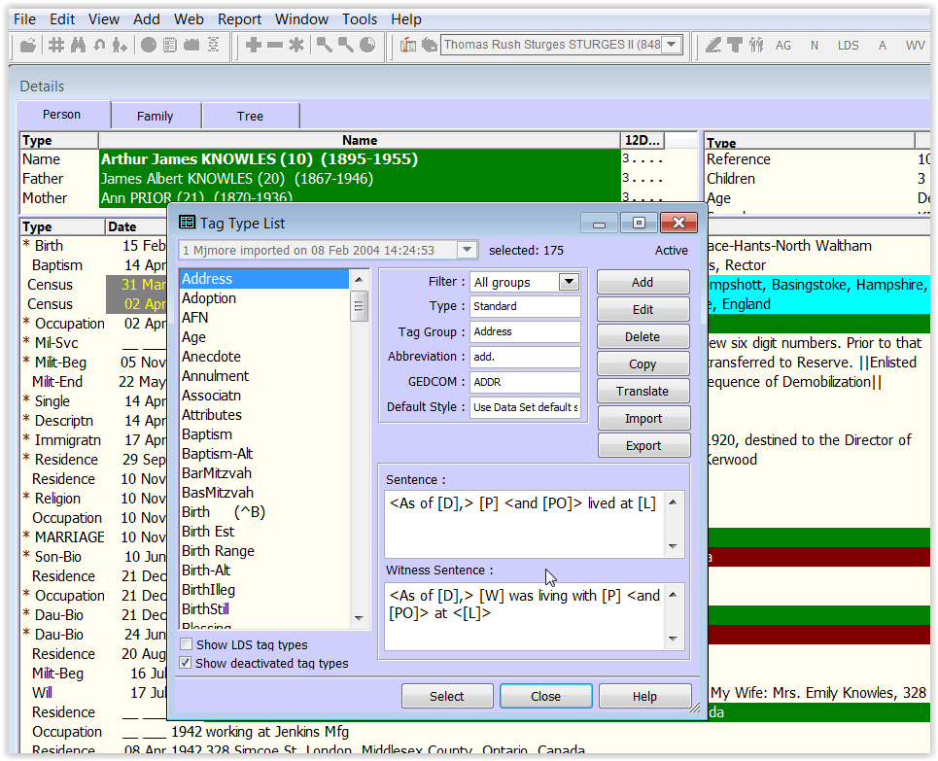
Add a Custom Tag Type
F4, + sign or Add Menu
Notes:
Open the Tag Type List and click the Add butt n at top left. I won’t go into details as it is well covered in the TMG Help as well as my Oct 2008 talk: Custom Tags, Roles and Sentences which is on our website. The simplest method is add a Custom Tag Type may be start with an similar Tag Type, then and copy and edit the new Tag Type to reflect what you want the Sentence to say.

Slide 14
Modify a Sentence Structure
Globally – When you modify the Sentence Structure of a Tag Type, you are modifying the Sentence Structure for every individual Tag of that type. Any existing tags of that type take the new Sentence Structure, as do all new Tags you may later create of that same type.
Locally – Alternatively, you can modify the Sentence Structure for one individual Tag. When you do that, you only change the Sentence Structure for that one Tag.
NOTE: Once you make a change to the local Sentence Structure of an individual Tag, any Global changes made later to the Tag Type will Not have any impact on that individual Tag.
Notes:
What I want to focus on today is modifying the Sentence Structure.

Slide 15
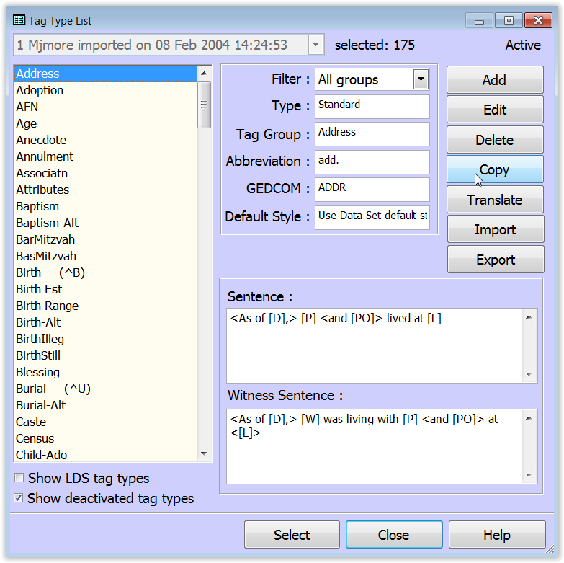
Modify a Sentence Structure
Open the Tag Type Definition screen.
Select the Tag
Click the Edit button
Notes:
To modify the Sentence Structure of a Tag Type globally, you open the Tag Type Definition screen.
Select the Tag that you want and click the Edit button

Slide 16
Notes:
Click on the Roles and Sentences tab, and select the Role you wish to modify in the Roles list on the left side of the of screen. By default, all Principals will be assigned the Role of "Principal" and all Witnesses will receive the Role of "Witness," as indicated by the "P" and "W" in front of those Roles. Unless you want to explore additional Roles, these two are the only ones you need to deal with. See Terry’s article on Roles for more information on using other Roles
You modify the Sentence Structure in the field to the right. For most Tag Types only the "Male sentence structure" is used; it is applied to everyone unless there is an entry in the "Female sentence structure (if different)" field. That field is used in those cases were different wording is required for female subjects. A primer on editing the Sentence Structures themselves is found below in the section "Writing Sentence Structures."

Slide 17
Adding Memos
Most standard Tag Types do not include the [M] variable n the Sentence. The Memo text will only appear in narrative reports if you choose one of the choices other than "None" on the Memos tab of report Options. The memo text will appear for those tag types in footnotes, endnotes, or embedded in the body, depending on which choice you make.
However, you have no control of where the text appears relative to the output of the other Sentence Variables.
Better to edit the Sentences of all the Tag Types you use to add the [M] variable, located in the position in the Sentence you want the memo to appear.
Always put it in conditional brackets in case some tags do not have anything in the Memo - <[M]> - or with a comma - <, [M]> which works especially well if you put it at the end of the Sentence.
Notes:
Some recent words from Terry Reigel:
For most of the standard Tag Types, the [M] variable is not included in the Sentence. For those few Tag Types that include that variable, like Occupation, the text of the Memo will automatically appear. However, for most of the others the Memo text will only appear in narrative reports if you choose one of the choices other than "None" on the Memos tab of report Options.
If you do choose one of those options, the memo text will appear for those tag types in footnotes, endnotes, or embedded in the body, depending on which choice you make.
However, I think including memo text that way is the wrong way to do it
- you have no control of where the text appears relative to the output of the other Sentence Variables. A far better method in my view is to edit the Sentences of all the Tag Types you use to add the [M] variable, located in the position in the Sentence you want the memo to appear.
Always put it in conditional brackets in case some tags do not have anything in the Memo - <[M]> - or with a comma - <, [M]> which works especially well if you put it at the end of the Sentence.

Slide 18
Memo Options
Notes:
In my case, the Memos that are not included in sentences are almost always simply notes and I don’t want them included in reports.

Slide 19
Modify a Sentence Locally
Notes:
You modify the Sentence Structure locally for an individual Tag in the Tag Entry Screen. You access that screen for an existing Tag by double clicking on the tag name.
To modify the Sentence Structures for the Principal(s) at the top of the screen, click the Sentence button in the lower left to open the Sentence Structures screen

Slide 20
Modify a Sentence Locally
Notes:
Select the Role you want to modify, and edit the Sentence Structure in the large field below. If the Tag has two Principals, the Roles of each will be listed, and you can select either to modify that Principal's Sentence.
In this screenshot, the word "(Default)" appears above the Sentence Structure field, indicating that we have not yet edited the Sentence in this Tag, so the Sentence displayed is the Global Sentence Structure from the Tag Type. Once the we make changes in this screen, the "(Default)" label will disappear.
A preview of the output of the Tag is displayed in the lower part of the screen. See Terry’s article on Sentence Previews for more on this feature.

Slide 21
Modify a Witness Sentence Locally
Notes:
To modify the Sentence Structures for Witnesses, open the Add Witness screen. by clicking on the + icon for a new witness or double-clicking on an existing witness entry (on the Other Witnesses tab if you are using the tabbed version of the Tag Entry screen).
Edit the Sentence Structure in the "Sentence" field. Note that when you are editing Sentences for Witnesses locally, each Witness in a Tag has his or her own Sentence, so you can customize the Sentences specifically for each Witness if you like. A preview of the output appears at the bottom of the screen, as with the Sentence Structures screen.

Slide 22
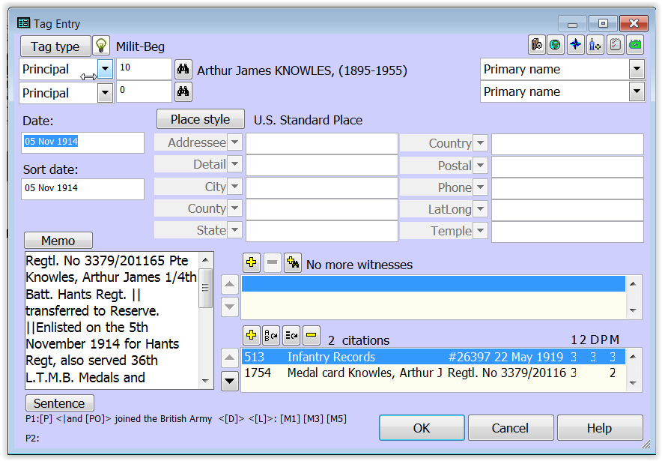
Notes:
If the sentence has been changed, it will show below the Sentence button on the Tag screen. In this case, there are two sentences, one for each Principal but only the first has been changed.

Slide 23
Combining Output Sentence
Generally, a Tag in TMG creates one or more complete sentences of text in narrative reports.
A special "Join to Previous Tag" code permits the output of two or more Tags to be combined into a single sentence of narrative output.
The "Join" code, [+], is placed at the very beginning of the Sentence of the second or following Tag. When this code is present, the following "rules" are used to create a combined output sentence:
The final punctuation for the first Tag is suppressed.
Automatic capitalization at the beginning of the second Tag is suppressed; only words capitalized by the user will appear with an initial capital letter.
Any spaces that immediately follow the [+] code will be retained.
The code can be typed into the Sentence field, or added by selecting "Join to Previous Tag" from the right-click menu.

Slide 24
Example
 | Default Tags | Joined Tags
Death Tag Sentence: | [P] died <[D]> <[L]> <[A]> | [P] died <[D]> <[L]> <[A]>
Burial Tag Sentence: | [P] was buried <[D]> <[L]> | [+] and was buried <[D]> <[L]>
Sample output: | He died 3 Mar 1852 in Memphis, Tennessee at age 51. He was buried 5 Mar 1852 in Elmwood Cemetery. | He died 3 Mar 1852 in Memphis, Tennessee at age 51 and was buried 5 Mar 1852 in Elmwood Cemetery.
Notes:
Suppose we wanted to join the output of the Death and Burial Tags so that they produce only a single sentence in narrative reports.
No change is required in the first Tag of the joined pair. In the Sentence of the second Tag, the Join [+] code is added, followed usually by a space and the text wanted. The [P] variable is removed since repeating the pronoun "He" is inappropriate.

Slide 25
The Fine Print
Since the final punctuation of the first tag is suppressed, any needed punctuation, such as a comma or semicolon, must be placed as the first character after the [+] code in the Sentence of the second tag.
If no connecting punctuation is used, generally a space is desired between the two sentence fragments. To obtain such a space, place it immediately after the [+] code in the Sentence of the second tag.
Many Sentences start with the variable [P], to produce the subject's name or the pronoun He or She. Generally that would not be appropriate in a combined output sentence, so some editing of the Sentence of the second tag is likely required.
Unexpected results will occur if the intended first tag is not followed by intended second tag when the report is generated. This could happen if another tag is inadvertently assigned a Sort Date between the two tags. Or it can happen if the first tag is omitted from the report by settings on the Tags Tab of report Options, or the tags are reordered by use of the "BMDB in a separate paragraph" option in the Miscellaneous tab of Journal Options.
Notes:
It is certainly possible to create unintended results with it, for example by failing to construct the sentences appropriately, by adding or editing other tags, or choice of report Options.

Slide 26
Modifying Tag Sentence Structures
http://tmg.reigelridge.com/Sentences.htm
Notes:
That’s the end of this presentation but if you want to learn more about Sentences and modifying them, go to Terry’s website.
I’ll finish with an update on TMG alternatives.

Slide 27
Default Sentences
Once a new Tag Sentence has been saved, you cannot return to it and Click the Rebuild All Sentence button to return it to the original default (as delivered “out of the box”). However, for Standard Tags, you could cut and paste from the Sample Project Tag Type Definition box, which presumably has not been modified. For Custom Tags, you could also restore a backup to another location and copy from there.

Slide 28
Merging Tags
Jim Slade wrote: There is no merge function for Tag Types. But, you can use John Cardinal's TMG Utility to change Tag Type "A" to Tag Type "B".
If you have two Tag Types named Resided and Residence that are both essentially the same, select the one to "keep" and use the Utility program's Events=>Change Event Type function to change the Resided Tag Type to the Residence Tag Type (or whatever).
You can also change Roles with the same function. if needed.
Be sure to make a backup first.
Also use the Log Only feature the first time that you run the function. This way, you can review the log report to see if it is what you want. Then de-select the Log Only option and run the function again "for real".

Slide 29
Memo Variables
You can use the entire memo field by using [M] in your sentence, or the memo field can be divided into parts that can be used separately in sentences.
[M1] through [M9] Elements of a memo field that contains the delimiters "||" (two vertical lines).
Whether or not the memo field contains delimiters, [M1] = [M].

Slide 30
Memo Variable [M0]
[M0] ([Mzero]) triggers the output of memo segment number zero, which is empty by definition. The effect is that the memo will not print in the sentence in question (e.g., witness sentence), but it will also not be subject to the Publication Tools option that outputs unprinted memos to endnotes, embedded, etc. Because the [M0] Variable defines an empty segment, the variable needs the Conditional Markers to prevent the "(an unknown value)" text from printing where the Memo field data would normally print (if it had data) and should be entered as <[M0]>.

