Slide 1
Text Macros in TMG 9
Presented by ~ David Walker
To ~ Ottawa TMG Users Group
6 May, 2017

Slide 2
Introduction
There are many instances when one uses repeated text entries in TMG.
The F3 key is a useful tool as an alternative to retyping text, such as place names.
However, using the F3 key is useful only for the last 15 entries.
An alternative is to create a text file, key in your desired text strings, then cut & paste as needed.
A suggested alternative is to use TMG Text Macros.

Slide 3
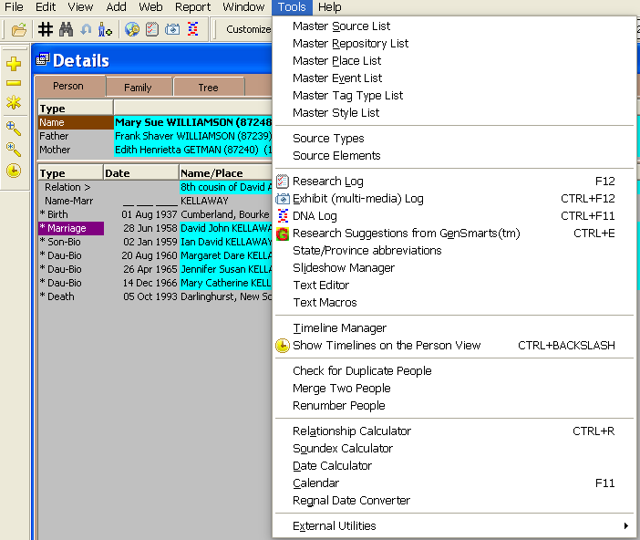
TMG Text Macros
From the Tools drop down list, select Text Macros

Slide 4
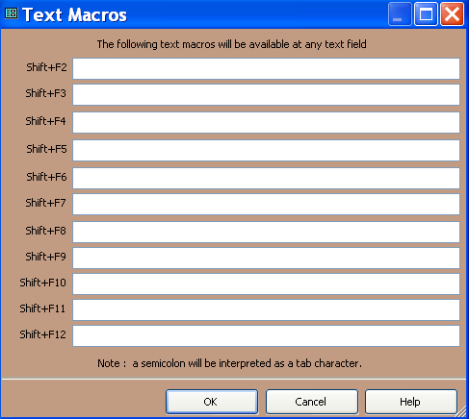
A maximum of eleven macros can be saved, and used for any text field.

Slide 5
I have over 10,300 exhibits in my main project, most of which are tombstones. I need a convenient way to handle repeated key entries in various text fields.
The example below illustrates my preferred format when recording tombstone inscriptions.

Slide 6
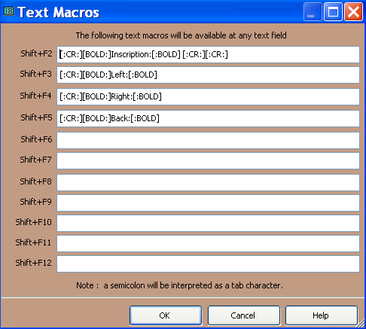
Creating the Text Macros
Codes include Bold and Carriage Return

Slide 7
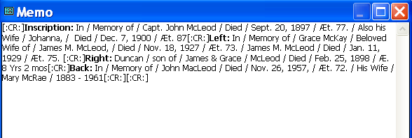
Formatted text in TMG Memo Field of Burial Tag

Slide 8
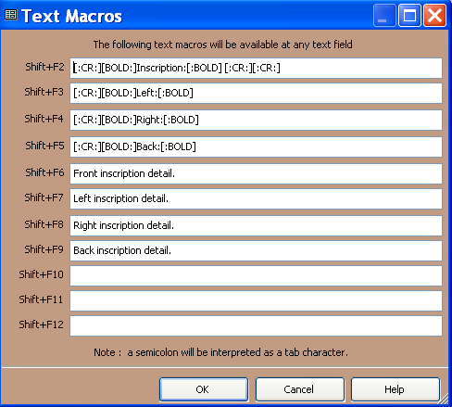
Text macros can be used when entering captions for exhibits.

Slide 9
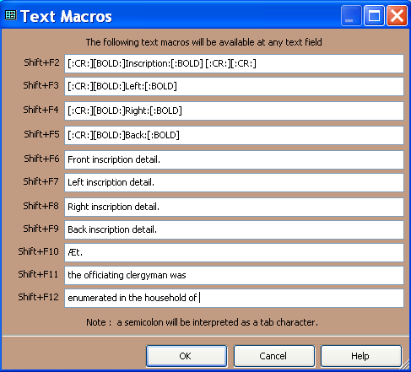
The three remaining text macro fields are used for other frequently keyed text.
Often seen on older tombstones.
Abbreviation for Aetatis (Latin) = aged
Used in the Baptism Memo Field
Used in the Census Memo Field
Each macro is invoked by pressing Shift+F-key
Click OK to save & exit

Slide 10
Memo field of Burial Tag
Use Shift+F10 instead of having to extract the code from the Windows Character Map

Slide 11
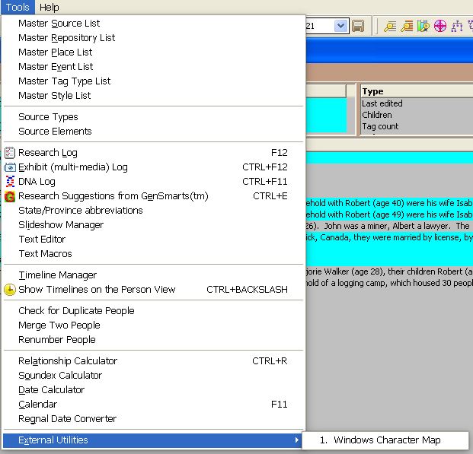
The slower alternative

Slide 12
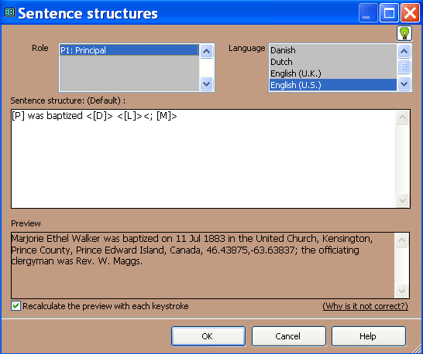
Baptism Tag
Text macro is invoked with Shift+F11
Sentence Preview

Slide 13
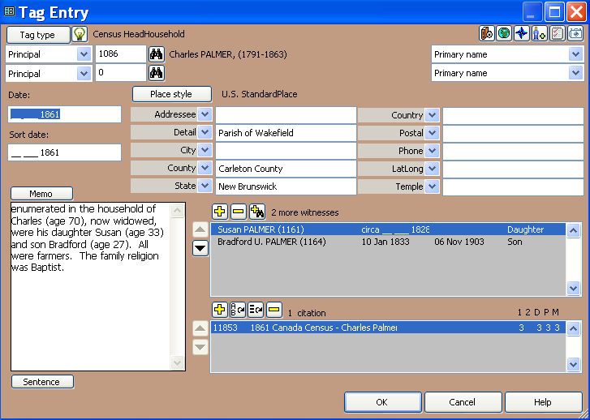
Census Tag
Text macro is invoked with Shift+F12

Slide 14
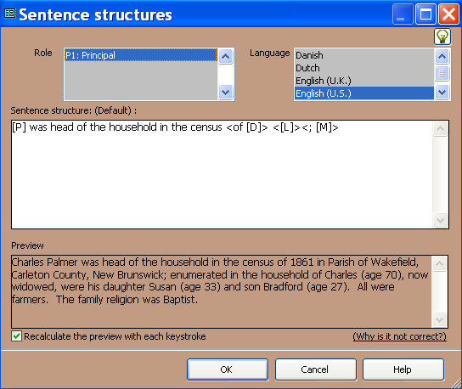
Census Tag
Sentence Preview

Slide 15
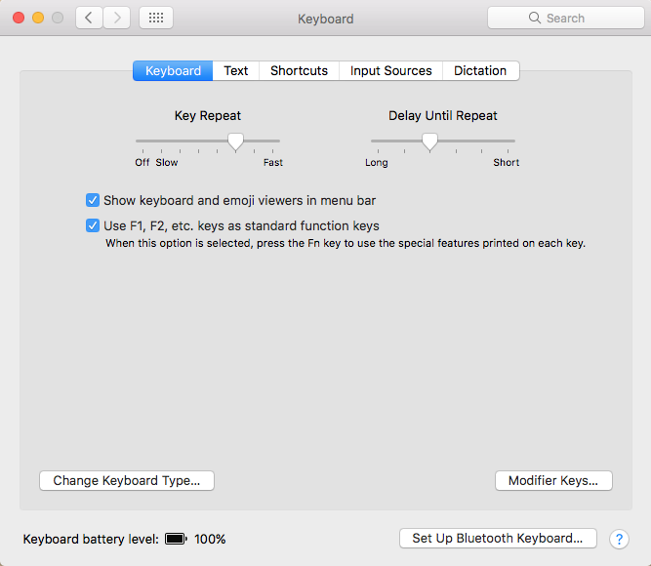
Running TMG on a Mac
On a Mac the F-keys are used by default to control various aspects of the computer, such as sound, display brightness.
Check this box to allow using Shift+F-keys with Text Macros. Use Fn+F-keys to control Mac functions.

Slide 16
The End
This presentation may be freely downloaded from our web site ~
http://www.ottawa-tmg-ug.ca
Link to Articles & Presentations

