Slide 1
TMG v.9.05
Updating the Living Flag
Presented by David Walker
Ottawa TMG Users Group
6 November 2021

Slide 2
Introduction
A Flag is a tool “for storing very simple bits of information about a person”. http://tmg.reigelridge.com/basics-flags.htm
By default, the Flags window does not open in TMG. To view this window, use the Window > Flags menu option
If you wish to have the Flags window appear with each subsequent opening of TMG, save the Layout , or overwrite an existing layout

Slide 3
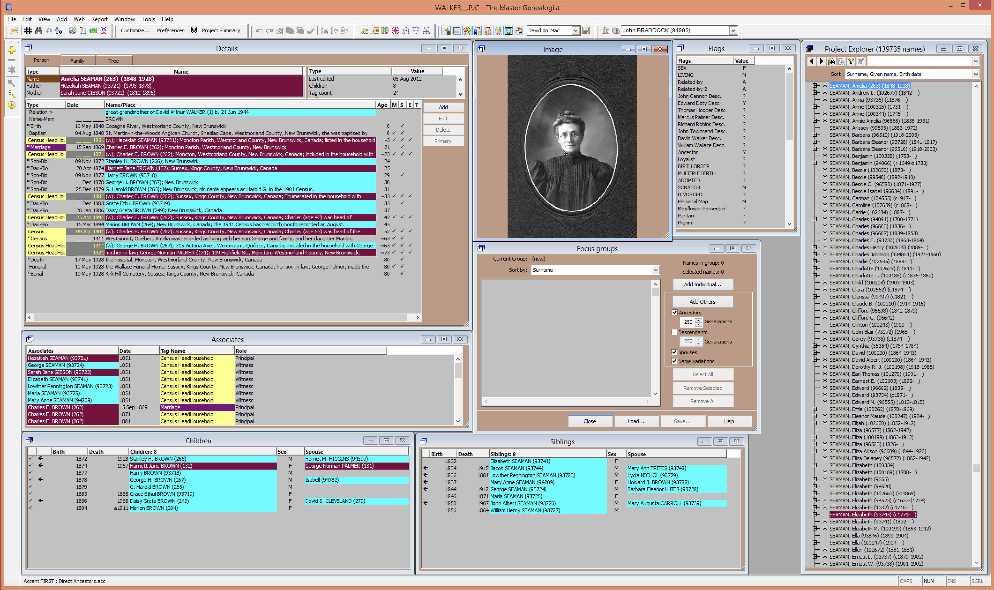
Flag window appears with each TMG startup.

Slide 4
This presentation will describe a procedure for using the Living Flag
For the uninitiated, most of the flags in this window are so-called custom flags, which can be explained in a future presentation.

Slide 5
The Living Flag options are ?, N, Y. The first option is used when the person’s living status is not known, i.e. no known birth, death or burial year
The Living Flag is used to control output to reports from TMG, and exports if “Suppress details for living people” option is selected
Second Site uses the Living Flag if one chooses to have only non-living people on a web site

Slide 6
After 30+ years of conducting family research, I realized that many people in my TMG datafile should have their Living Flag = N.
TMG automatically adjusts the Living Flag value when entering a new person, or adding a birth, death or burial date to an existing person, according to the lifespan defined in File > Preferences > Current Project Options > Advanced.
Sometimes, I have entered a new person, with a known birth and/or death date, and the parents. I have forgotten to adjust the Living flag for the parents
TMG does not automatically update the Living Flag over time.
TMG Project Explorer is not flexible enough to filter those people requiring attention.

Slide 7
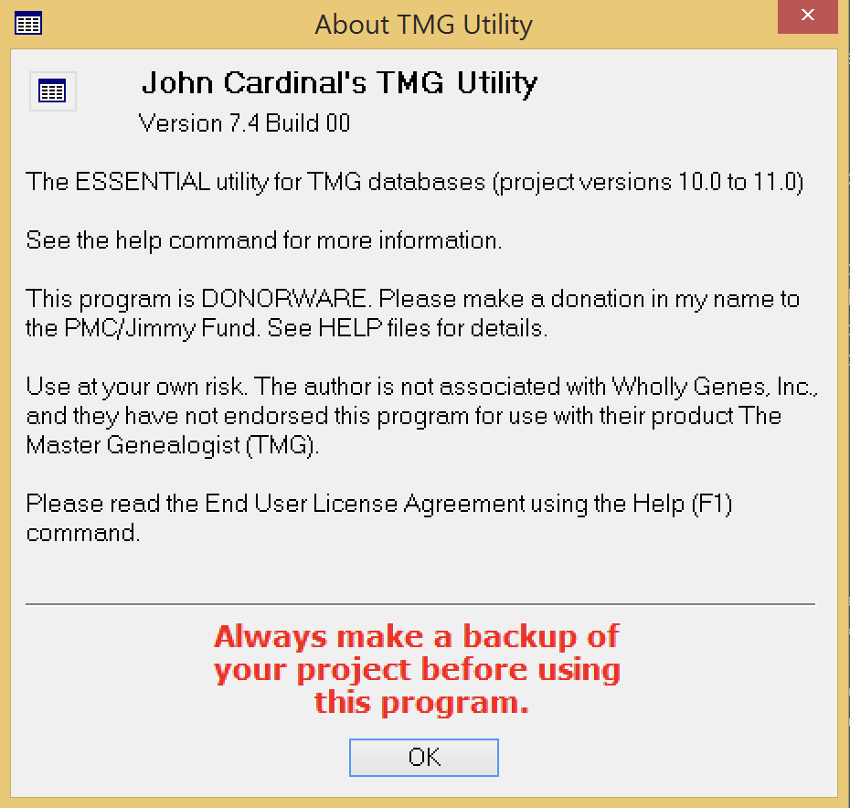
Use of TMG Utility is a better alternative. This application is one of John Cardinal’s creations, and is free. johncardinal.com
The current version of TMG Utility is 7.4
Heed the warning to backup your TMG data file before instructing TMG Utility to make changes, as they will be permanent.
Close TMG Project before proceeding.

Slide 8
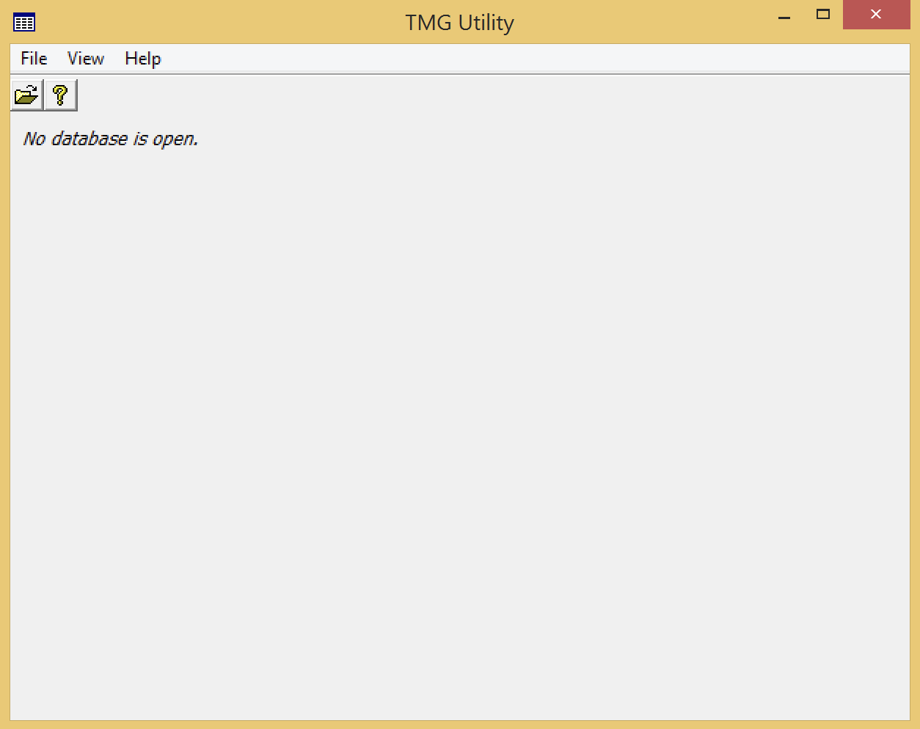
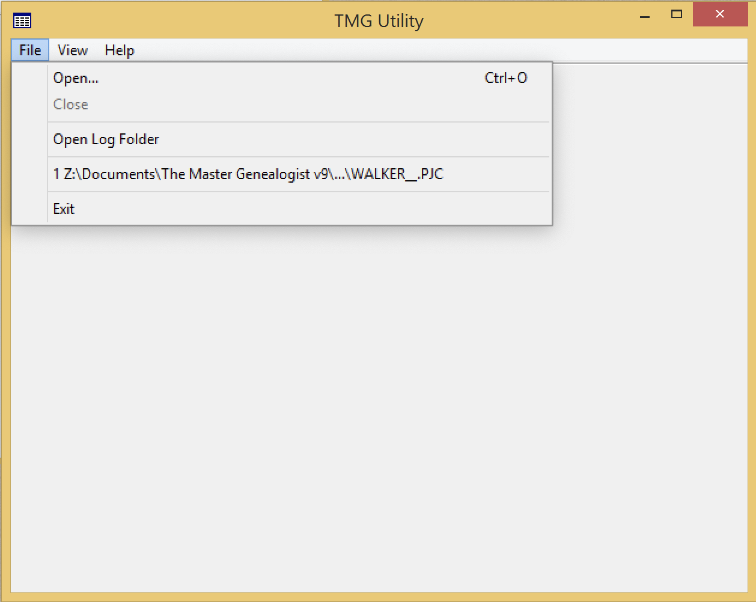
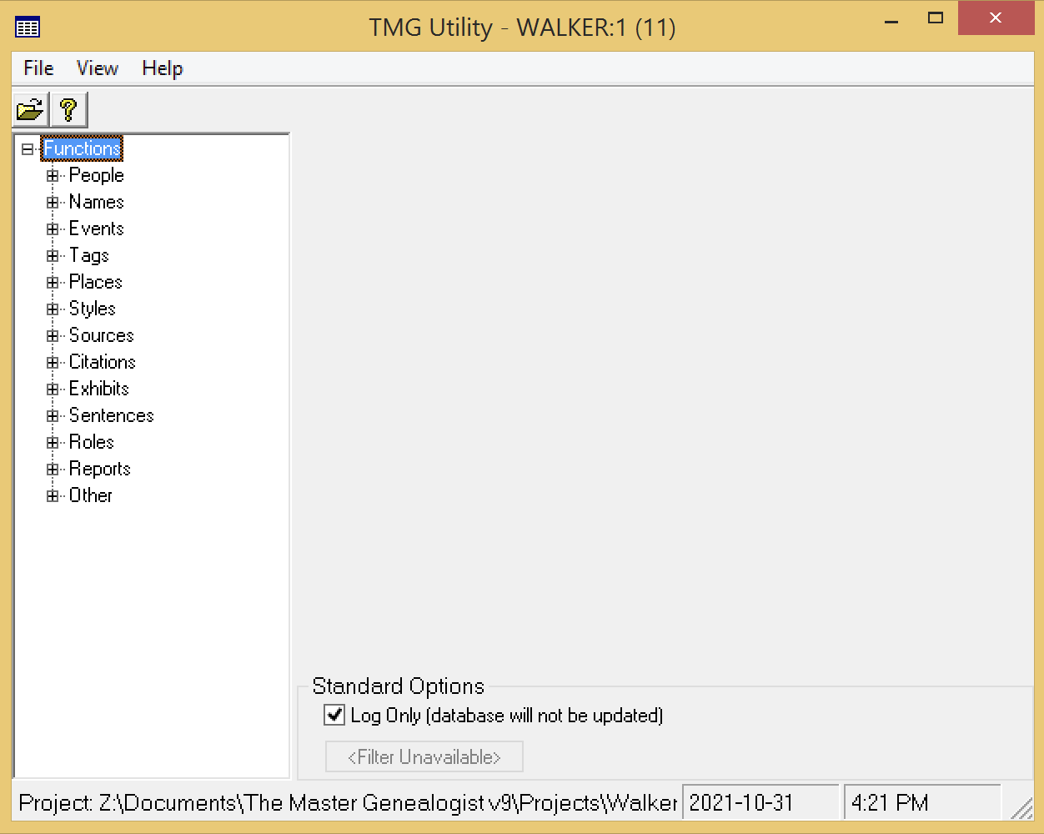
Opening screen of TMG Utility.
Select a TMG .pjc file to open.
From the list of options, select People

Slide 9
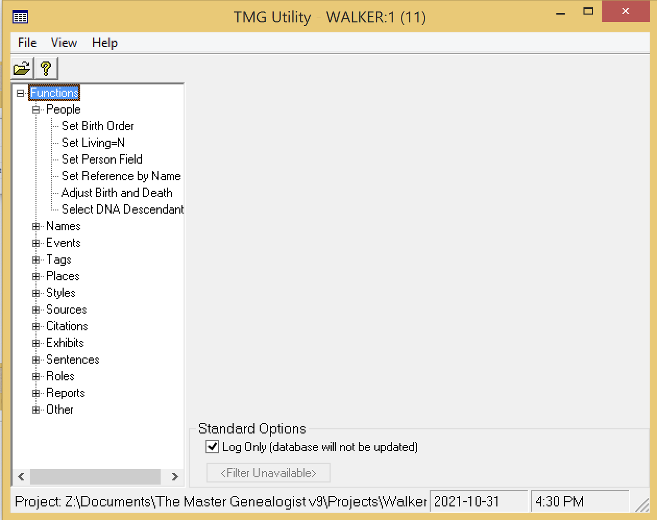
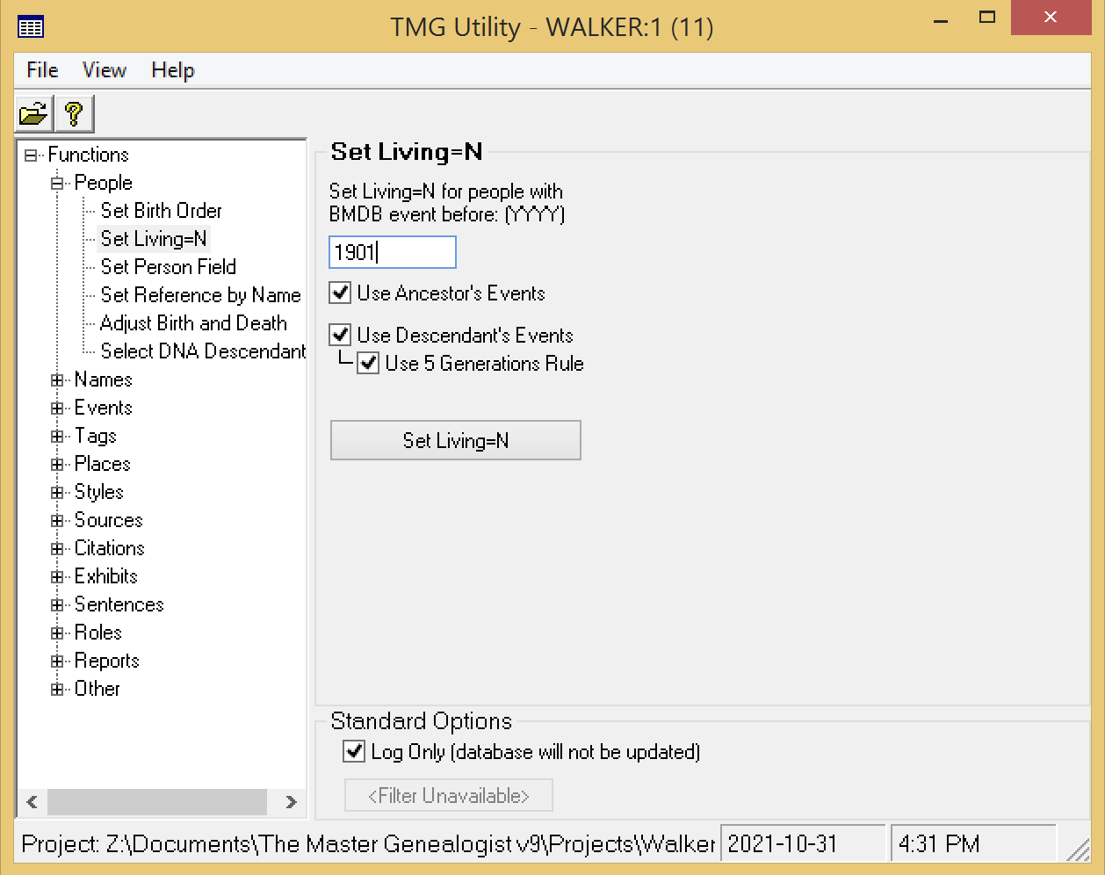
From these options select Set Living=N
Enter a year to represent the maximum expected life span. John Cardinal suggests the current year minus 120.
If Use Ancestor’s Events is checked, the program will set Living=N if any ancestors of a person have a BMDB event prior to the date entered above.
If Use Descendant’s Events is checked, the program will set Living=N if any descendants of a person have a BMDB event prior to the date entered above.
If Use 5 Generations Rule is checked, the program will set Living=N if any people have 5 or more generations of descendants.

Slide 10
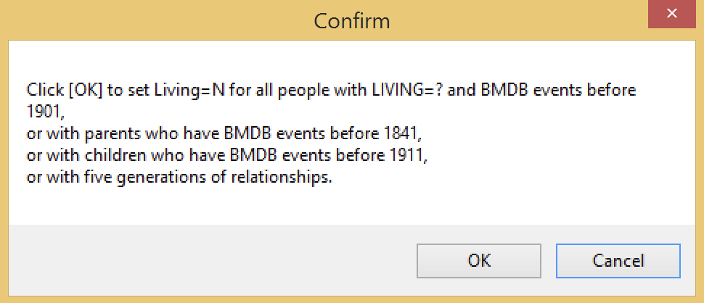
Click on this box to begin the analysis.
Check the Log Only box if you wish only to create a log file. TMG Utility will not overwrite your TMG data.
Click OK to confirm and proceed.

Slide 11
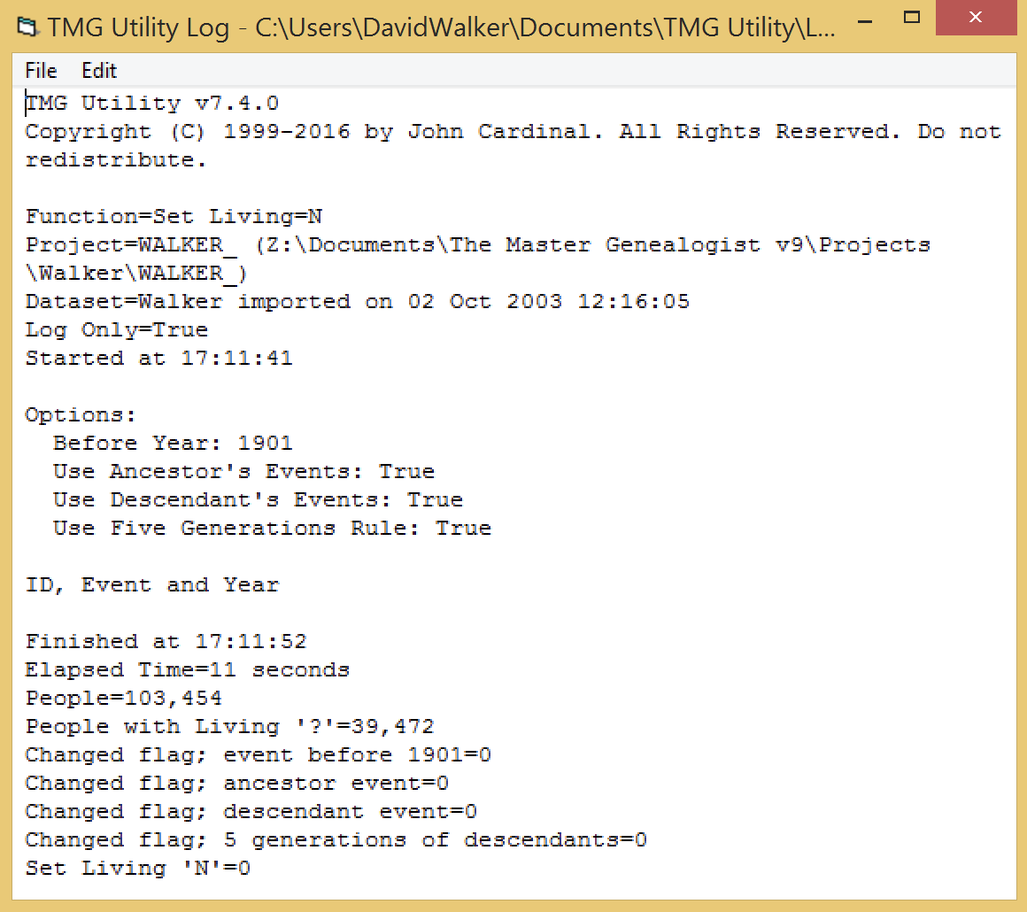
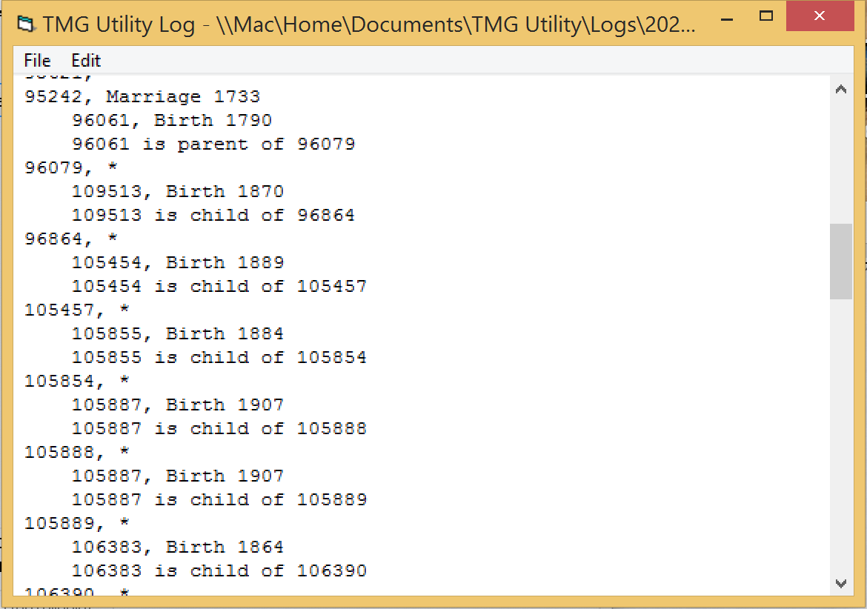
It took TMG Utility 6 seconds to analyze 103,454 people.
No changes are shown here because I had already run TMG Utility, instructing it to make the changes to the Living Flag. The result was that the Living Flag for 1,706 people was changed from Living=? to Living=N.
This is a partial view of the log from when I previously instructed TMG Utility to make permanent changes by unchecking the Log Only box.
In this example a birth event triggered a change in the Living flag for #105855, who is a child of #105854, who previously had their Living flag=?, and was changed to N. Detailed descriptions of the log can be found in the Help file.

