Slide 1
Improving Workflow in TMG
v.9.05 Using Witnesses & Roles
Presented by ~ David Walker
To ~ Ottawa TMG Users Group
8 April, 2017

Slide 2
Introduction
Improving workflow in anything we do is always a time saving goal
TMG is no exception
This presentation will describe the use of Witnesses and Roles when recording burials, with or without tombstone exhibits, and Censuses for TMG v.9.05

Slide 3
Introduction
There was a time when I was less than efficient when entering burial data in TMG
Worst case scenarios included family plots with three generations of inscriptions
Until I explored the use of Witnesses & Roles I wasted considerable time entering burial data, including the inscription in the memo field, all place names and the exhibits with captions, for each and every person

Slide 4
Introduction
There was also a time when I was less than efficient when entering census data in TMG
Worst case scenarios included families several children and perhaps grandparents
Until I explored the use of Witnesses & Roles I wasted considerable time entering census data for each person separately

Slide 5
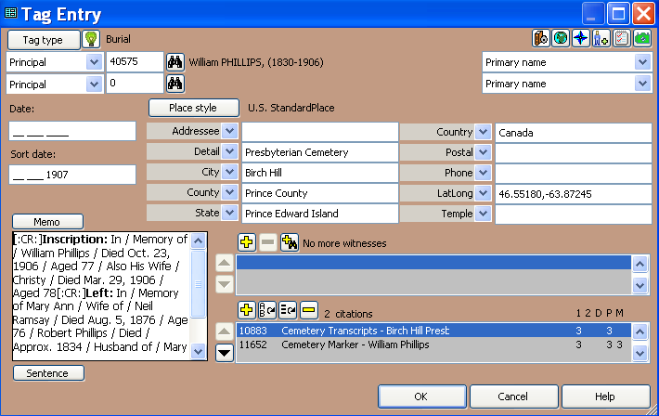
A Case Study: Burials
Burial Tag Entry Screen

Slide 6
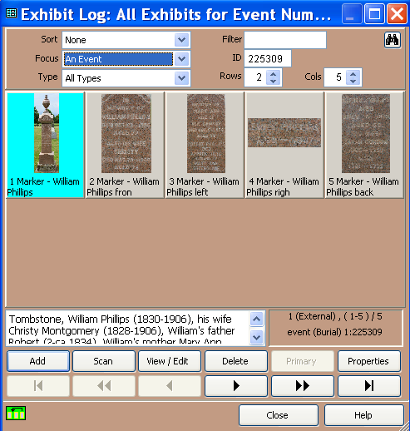
A Case Study: Burials
Exhibit Log: five images for overall view of the tombstone, and detailed
views of the front, left, right and back. There are seven people buried here.

Slide 7
A Case Study: Burials
Rather than entering the memo text, place names, citation(s), exhibits with captions for each person buried in a given plot, the following is my current workflow.
Beginning with the father (for a family plot) or the husband (for a simple husband & wife burial), enter all data. Inscription in the memo field, all place names, citation(s) and
exhibit(s) with caption(s)

Slide 8
A Case Study: Burials
By default, the man’s wife is not entered in the burial tag

Slide 9
A Case Study: Burials
In the Details window, the burial tag entry applies to [P1], in this case William Phillips

Slide 10
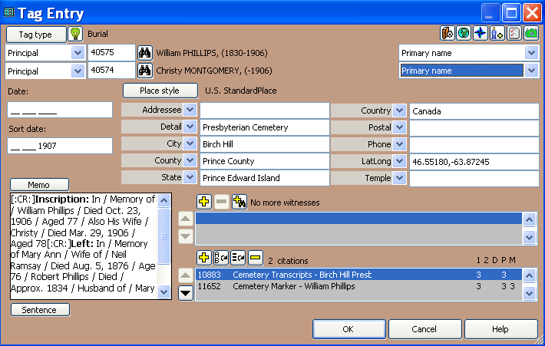
A Case Study: Burials
2. Enter her ID value

Slide 11
A Case Study: Burials
In the Details window, the burial tag entry includes his wife, Christy Montgomery

Slide 12
A Case Study: Burials
In the Details window for his wife, the burial tag entry shows William Phillips

Slide 13
A Case Study: Burials
3. The next step is to add other family members as witnesses.

Slide 14
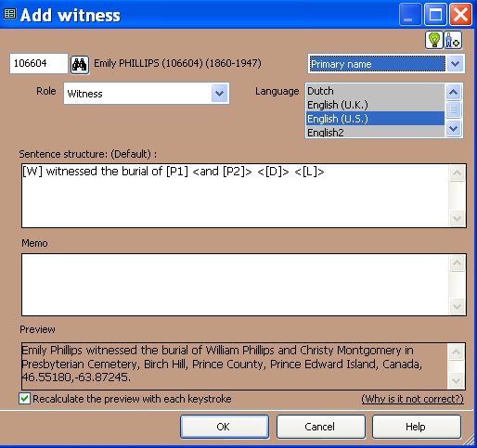
A Case Study: Burials
3. Having added a daughter as a witness we soon realize that her role
must reflect the fact that she is buried here as well.

Slide 15
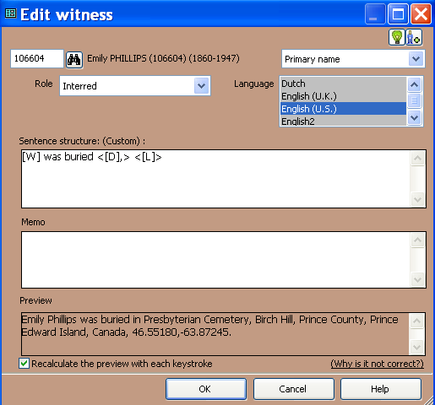
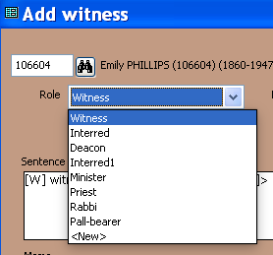
A Case Study: Burials
4. Open the drop down menu for Roles and select ‘Interred’.
Edit the default variable from [P] to [W]. The sentence structure changes accordingly.
The Preview reads correctly.

Slide 16
A Case Study: Burials
5. Continue adding other family members
TIP: Compare the death dates for everyone, then use the latest date + 1 year in the Sort Date of the primary person. Otherwise, a child buried after a parent will have the Witness tag in the wrong place.

Slide 17
A Case Study: Burials
TIP: Compare the death dates for everyone, then use the latest date + 1 year in the Sort Date of the primary person. Otherwise, a child buried after a parent will have the Witness tag in the wrong place.
Incorrect timeline
Correct timeline

Slide 18
A Case Study: Burials
TMG Reports
Father
Mother
Daughter
TIP: Concatenation was used for each person to produce a smoother looking transition from death to burial.

Slide 19
A Case Study: Burials
Second Site Reports
Father
Mother
Daughter
Note: For [P1] and [P2] the tombstone exhibits are displayed on each Person Page. For those listed as Witnesses, there are links (camera icon) to the exhibits.

Slide 20
A Case Study: Census
Another Use of Witnesses & Roles ~ Census tags
In this example I will describe my workflow for recording members of a family as witnesses to the Head of Household.

Slide 21
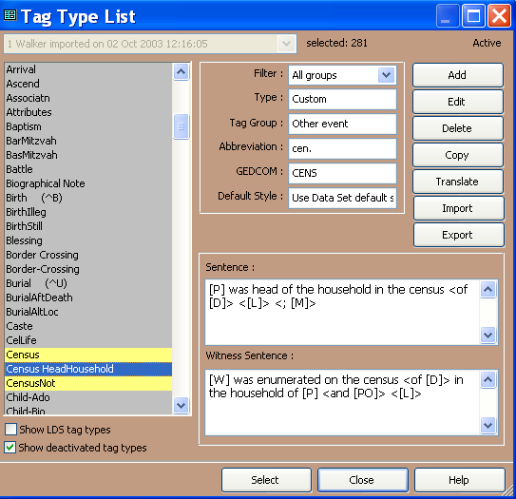
A Case Study: Census
Sentence
Witness Sentence
From the Tag Type list select Census HeadHousehold
Select

Slide 22
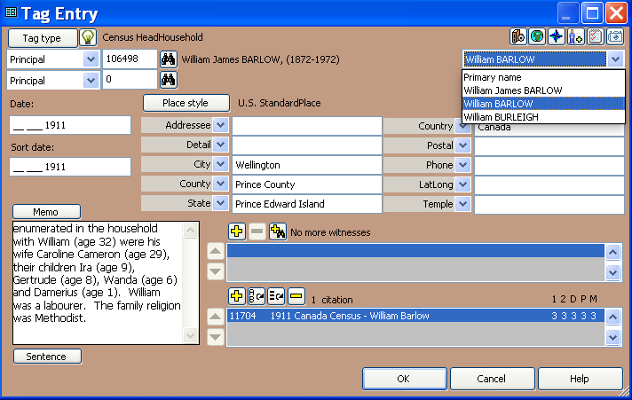
A Case Study: Census
Select name variation as it appears in the census
Having keyed in data for the memo, place names and citation, the next step is to add witnesses

Slide 23
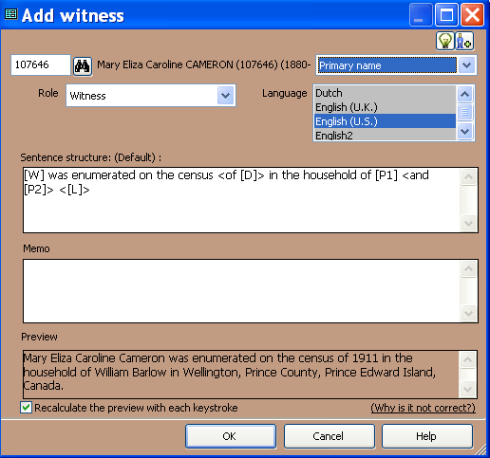
A Case Study: Census
Assuming the Head of Household is still married, start with her
Default sentence structure before changes
Preview before changes

Slide 24
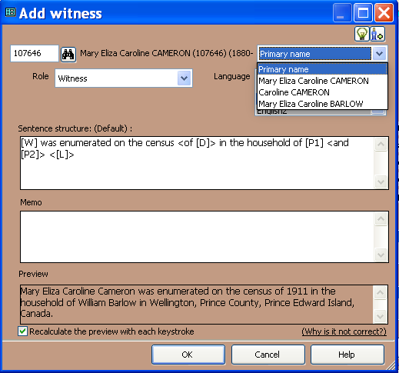
A Case Study: Census
Select name variation as it appears in the census

Slide 25
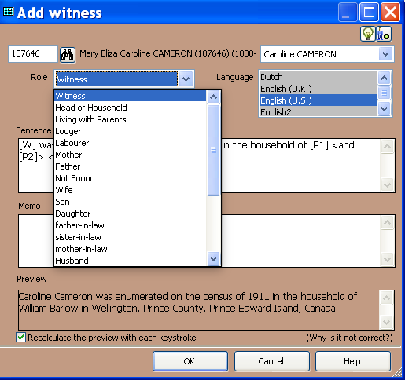
A Case Study: Census
Select ‘Wife’ from the list of Roles

Slide 26
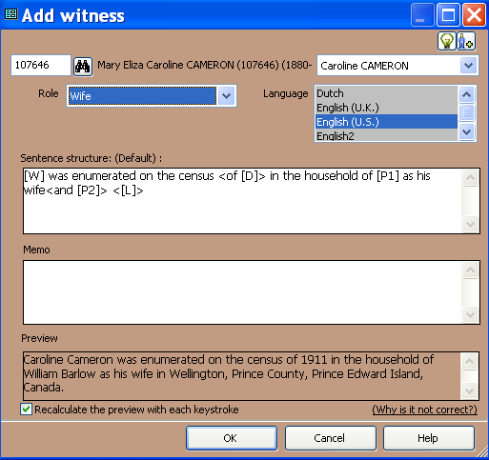
A Case Study: Census
Sentence changes with selected Role
Preview updates with selected Role

Slide 27
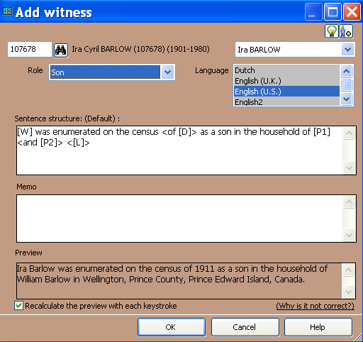
A Case Study: Census
Continue with addition of children
Sentence changes with selected Role
Preview updates with selected Role

Slide 28
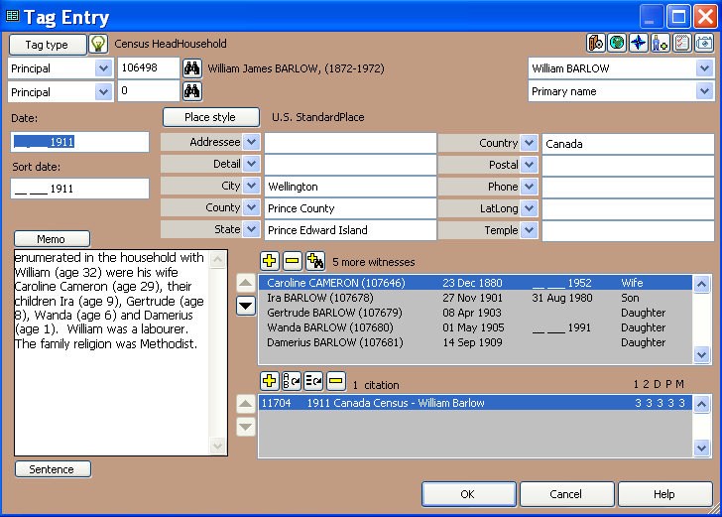
A Case Study: Census
Data entry is complete, with all witnesses & their roles

Slide 29
A Case Study: Census
1911 Census added for each person enumerated
Father, William Barlow
Son, Ira Barlow

Slide 30
A Case Study: Census
TMG Journal Report
Father, William Barlow
Son, Ira Barlow

Slide 31
A Case Study: Census
Second Site Report
Father, William Barlow
Son, Ira Barlow

Slide 32
The End
This presentation may be freely downloaded from our web site ~
http://www.ottawa-tmg-ug.ca
Link to Articles & Presentations

