Slide 1
Tools for Notetaking
How to quickly remember URLs and images while surfing

Slide 2
Note Keepers
Introduction
Sample page https://canadianheadstones.ca/wp/headstone-vendor/?wpda_search_column_idperson=25314
Pocket Google Keep OneNote Evernote

Slide 3
Pocket
Works on most platforms
Very simplistic, but quick
https://getpocket.com/en/

Slide 4
Google Keep
Allows better note keeping
Works in Chrome and Edge on Windows, Android Don’t know about Apple devices
Get it here https://keep.google.com/#home
Demo

Slide 5
OneNote, EverNote etc.
Not much experience
Comparison between Keep and OneNote https://www.mksguide.com/google-keep-vs-onenote/
Using Lens with Chrome

Slide 6
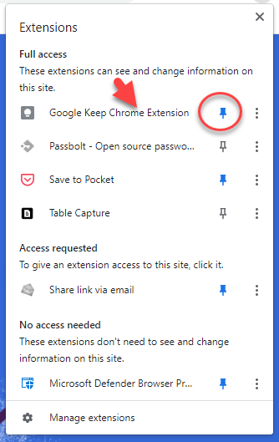
Installation and setup

